Slide 1
Curriculum, Events and Excursions
Term 4, 2021

Slide 2
Reading Curriculum
We will be exploring a fantasy novel in Grades 5 and 6. Through the novel, each class will focus on:
Grade 5: Students will be looking at the different viewpoints of a text and exploring how the viewpoint impacts on their own interpretations and responses. They will focus closely on how characters and settings are depicted.
Grade 6: Students will identify the degrees of possibility. They will examine the ways that authors use humour and will also identify the purposes of images.
In both Grade 5 and 6, students will continue to develop their reading comprehension through the use of SRA and Accelerated Reader. They will expand their vocabulary through lessons on prefixes, suffixes and word origins.

Slide 3
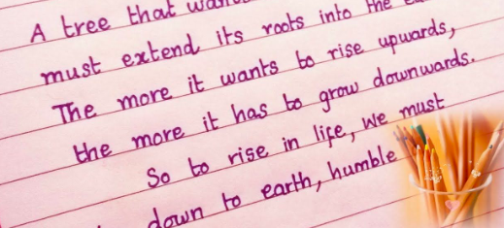
Writing Curriculum
In Term 4, students will explore the structure and language of news reports. They will practise writing their own news reports and will publish these for others to read.
Students will learn thorough editing skills through using a checklist. They will learn how to explain their writing choices, referring to their audience, language choices and clarity.
Students will also develop their handwriting style to ensure their handwriting becomes fluent, legible and adapted for different purposes, e.g. note-taking.
After reading our class novel, students will practise writing their own fantasy fiction stories. They will learn how to develop characters, settings and plots using rich descriptive language.

Slide 4
Grade 5 Mathematics Curriculum
In Term 4, Grade 5 students will be exploring 2D shapes. Students will be taught how to describe translations, reflections and rotations of the shapes.
Measurements of different units will be a focus too. Students will be identifying and choosing suitable units of measurement in length, area, mass and capacity.
In addition to this, students will be solving problems using mental, written and digital technologies strategies.
Later in the term, we will be recapping and revising different aspects of the Mathematics curriculum. This will include topics such as place value beyond hundredths, fractions, decimals, angles and time.

Slide 5
Grade 6 Mathematics Curriculum
In Term 4, students will learn how to interpret and use timetables. They will use this knowledge to solve problems by measuring and comparing time.
Students will build upon their learning of coordinates from Grade 5, by locating Cartesian Coordinates (using a four-quadrant grid).
Students will also learn about angles of shapes and how to find measurements of missing angles.
In Statistics and Probability, students will explore probabilities and conduct chance experiments. They will also learn to construct 3D shapes such as prisms and pyramids.

Slide 6
Inquiry Curriculum
Throughout Term 4, our inquiry will focus on topics related to transition.
Our Grade 5 students will be learning about leadership, including what makes an effective leader, how to write a leadership application and how to deliver a persuasive speech.
Our Grade 6 students will be learning about their upcoming transition to high school. They will explore what is the same and what is different between primary school and high school, learn about high school life and explore how high schools operate (timetables, different teachers, etc.).

Slide 7
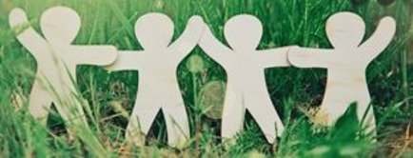
Prosocial Education
In Term 4, students will be learning how to be persistent and adaptable in order to use these skills in challenging situations. We will also investigate and practise how to agree and disagree with others in a respectful way.
We will have a focus on self-talk whereby we explore the ways in which we speak to ourselves. What are our thoughts saying? Are we being kind to ourselves?
In addition to this, students will be learning about confidence and why confidence is important in new situations. For our Grade 6 students, this will be an important skill when transitioning to high school.
Finally, students will be asked to think about their own personal strengths help them to become more successful. This could be at home, in school or in the community. For our Grade 5 students, this will be an important skills as they apply for leadership for the upcoming academic year.

Slide 8
Whole School Events
Event | Week | Date
Numeracy Week | 4 | All Week
Remembrance Day | 6 | Thursday 11th November
Athletics Day | 6 | Friday 12th November
Step Up Day | 11 | Tuesday 14th December

Slide 9
Grade 5 and 6 Special Events
Event | Week | Date(s)
Grade 6 Southport District Basketball Gala | 1 | Wednesday 6th October
Grade 5 & 6: Camp Rumbug | 2 | Wednesday 13th October – Friday 15th October
Grade 5 & 6: South Melbourne Market Trip | 5 | Monday 1st November
Grade 5 & 6: Cinema Trip | 9 | Friday 3rd December
Grade 5 & 6: Swimming | 10 | Monday 6th December – Friday 10th December
Grade 6: Orientation Day for Grade 7 | 10 | Tuesday 7th December
Grade 5: Student Leadership speeches | 10 | Thursday 9th December
Grade 6: Gravity Zone | 11 | Monday 13th December
Grade 6 Graduation | 11 | Thursday 16th December

Slide 10
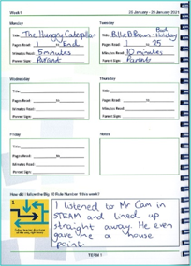
Other Notes and Reminders
Homework When Onsite Learning Resumes:
Students are expected to read for 30 minutes a night 4 x a week. The Homework Diary must be signed by a parent or carer to evidence this.
200 points of Mathletics activities should be completed this week.
Spelling tasks should be completed using the spelling sheet Monday-Thursday for 10 minutes.
Uniform:
All summer or all winter is required
All additional items should be navy e.g. socks and hair ties
All jackets, hats and jumpers should be SMPS branded
Shoes must be black and polishable
Please see the uniform policy on the SMPS website for more information
Communication
Please continue to check the School Newsletter for Grade Level information and the Compass NewsFeed for immediate, high level information sharing.

