Slide 1
Moja Nana
By Tahlia Vosnakis

Slide 2
This is my grandmother, Ljubica Šango (but we all call her ‘nana’).
After leaving Croatia and coming to Australia, an untreated medical issue led to her developing chronic lung problems. Thus, with COVID-19, we’ve had to keep away from her for her safety.

Slide 3
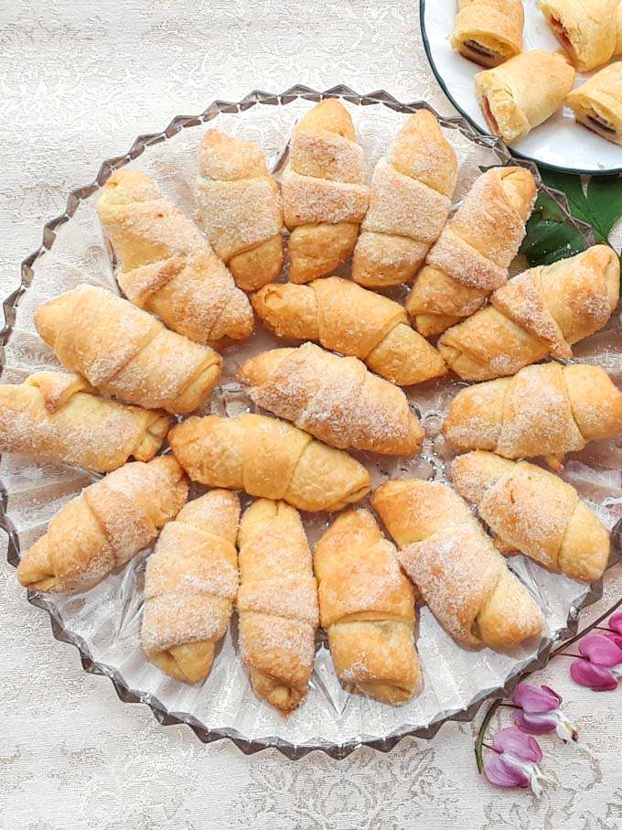
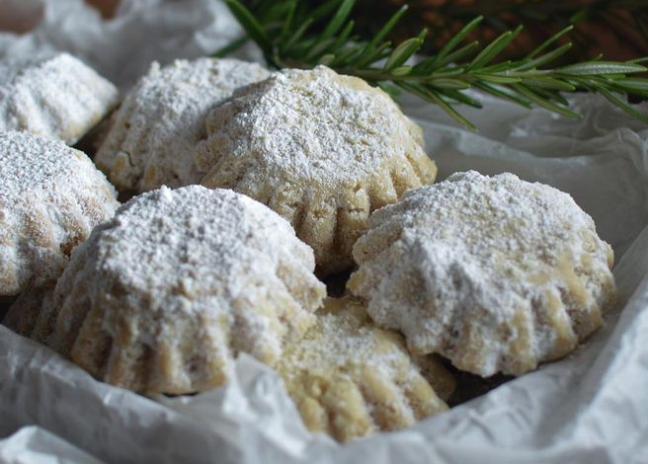
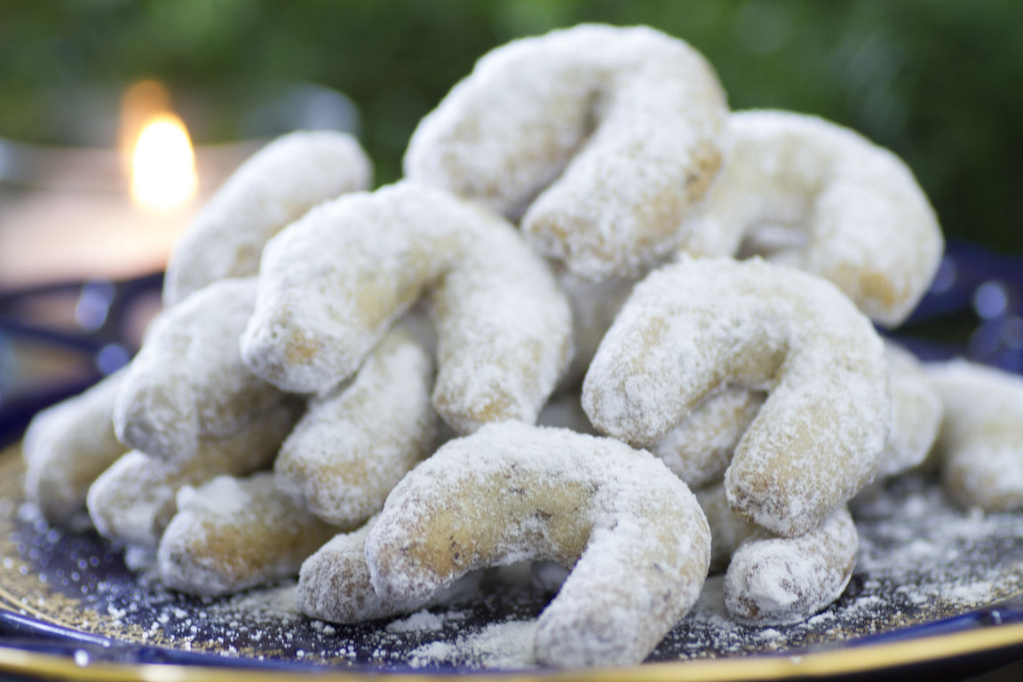
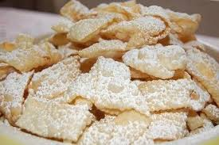
Being a proficient baker, we love her desserts. Croatians culturally are similar to Italians- so food is a big deal. Every time she makes a new batch of banana cake or kiflice, it doesn’t last much longer than a day or two. At shops we will never see the things she bakes, and often when I bring her funny-shaped Croatian biscuits to school, people ask me what it is. It makes us feel like we have our own unique little delights- all to ourselves.

Slide 4
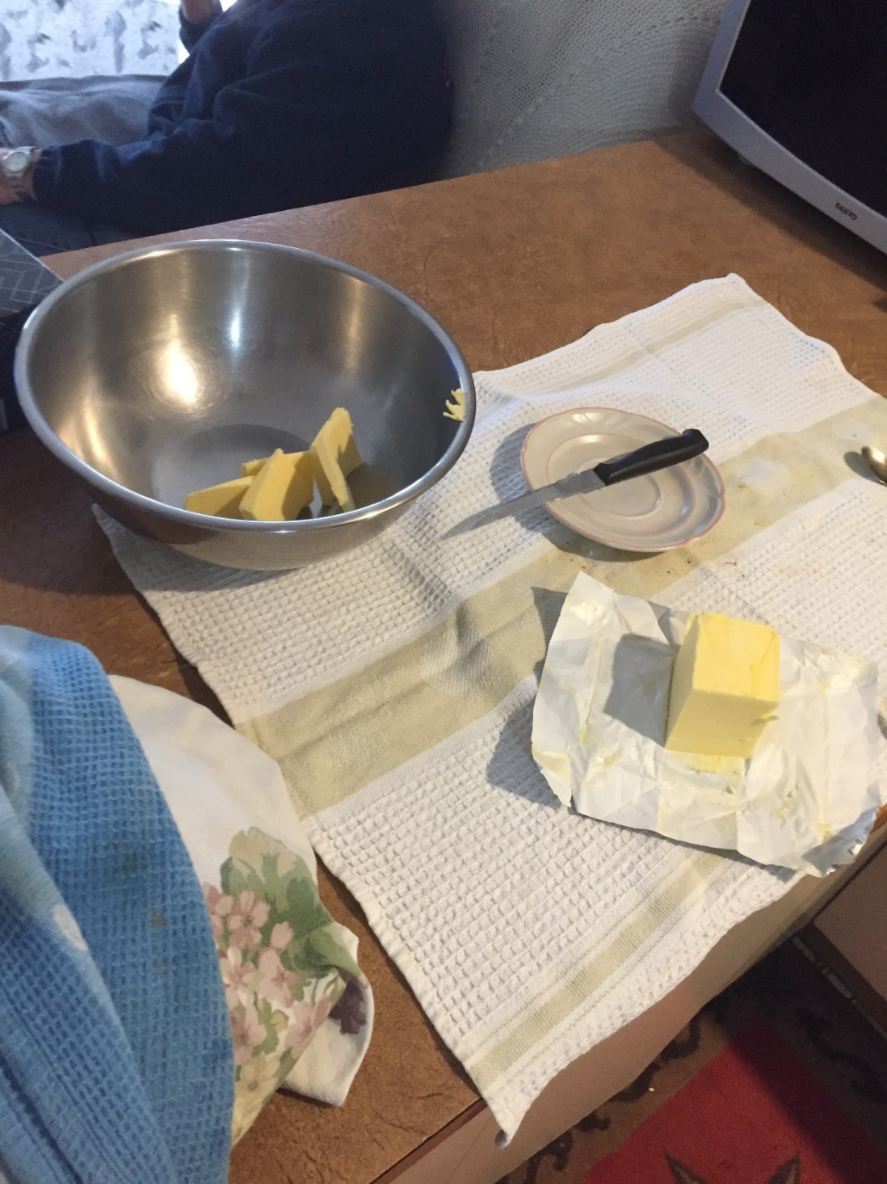
When the coronavirus started to become a large problem and people were visiting her less and less, I started wondering how she must have felt at a time like this. A few days later, our whole family received a fresh batch of some of her well-loved biscuits, and I was struck with an idea.
About a month ago, when we could still visit, I went to my Nana’s and she taught me how to make her delicious jam kiflice or ‘rolls’. She seemed very excited to see me.

Slide 5
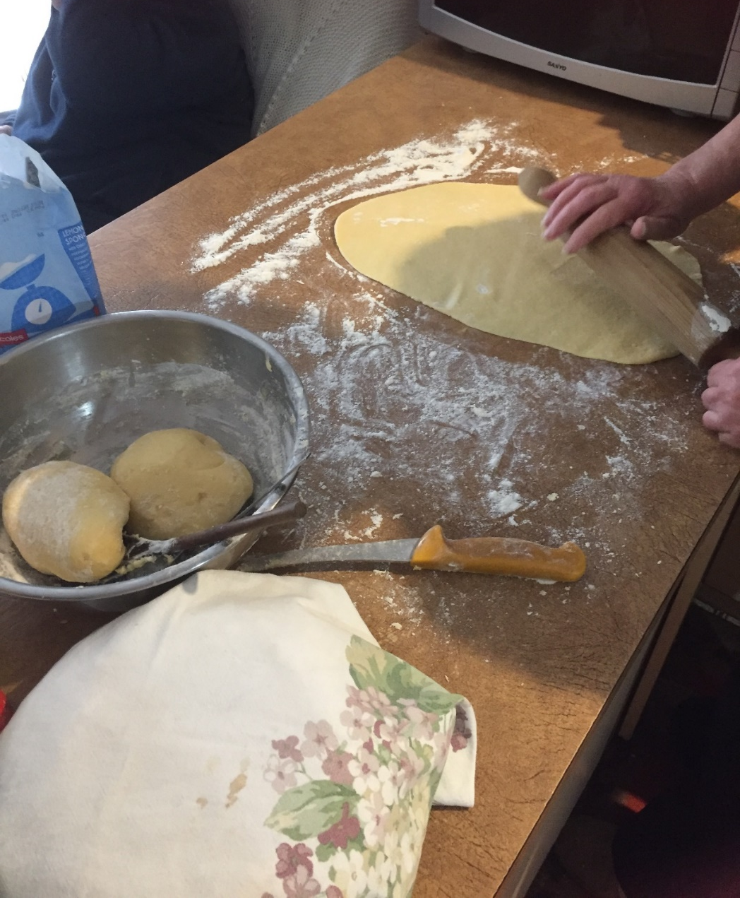
As we worked, we told each other jokes- sometimes slowly because of the language barrier- and I took photos along the way so I didn’t forget how to do it. I was determined to be able to make them on my own some time.
Overall, the experience was much more than just spending time with her- it was about passing down tradition (since it wasn’t passed to the generation above mine), learning new things, and remembering that we are family and will be there for each other, even through pandemics.

Slide 6
Our shared culture enabled us to find a common ground and entertain each other during an unlikely time. We became closer during those two days of baking than ever before, and at the same time, a much-loved Croatian tradition was passed down the generations so that we can continue to embrace our diversity….
Though the word ‘diversity’ itself refers to variations or divergence, in this case, our diversity brought us together.

Slide 7
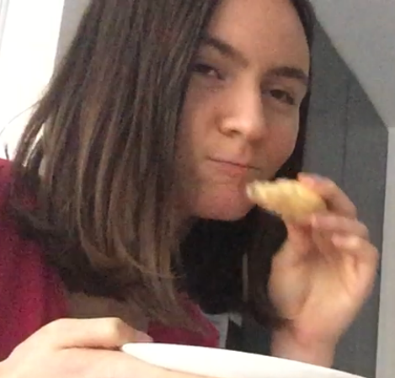
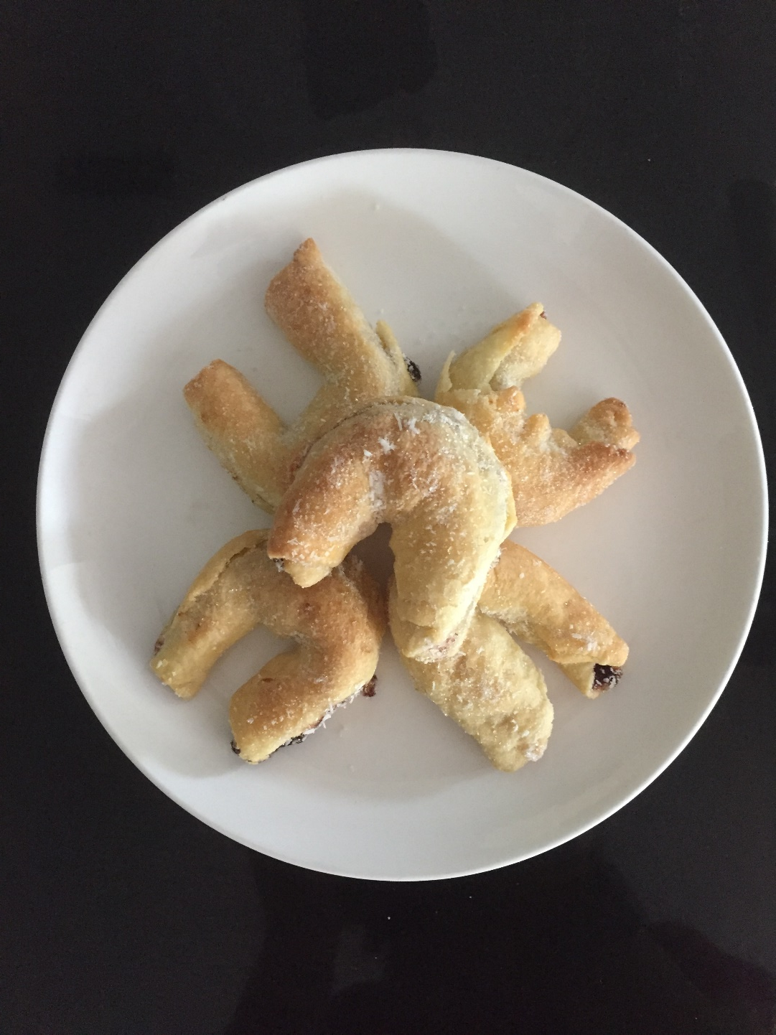
Caught in the act...

Slide 8
