Slide 1
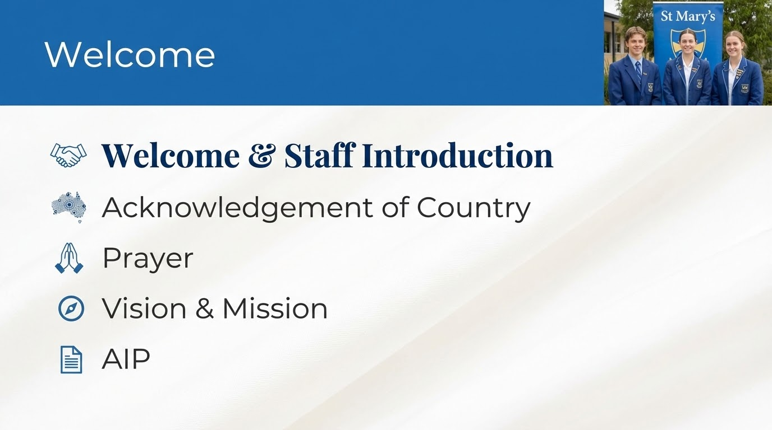


Slide 3


Slide 4

Prayer
Notes:
Sarah

Slide 5


Slide 6
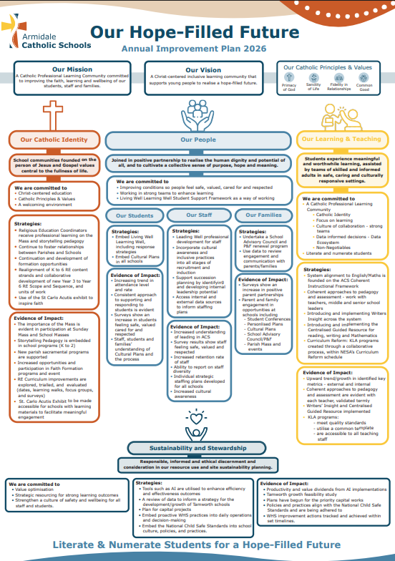

AIP - ACSO / SMA 2026
Notes:
SMA is a System of schools under the Armidale Catholic Schools. We take our direction from the ACS AIP to develop our own AIP for 2026.

Slide 7
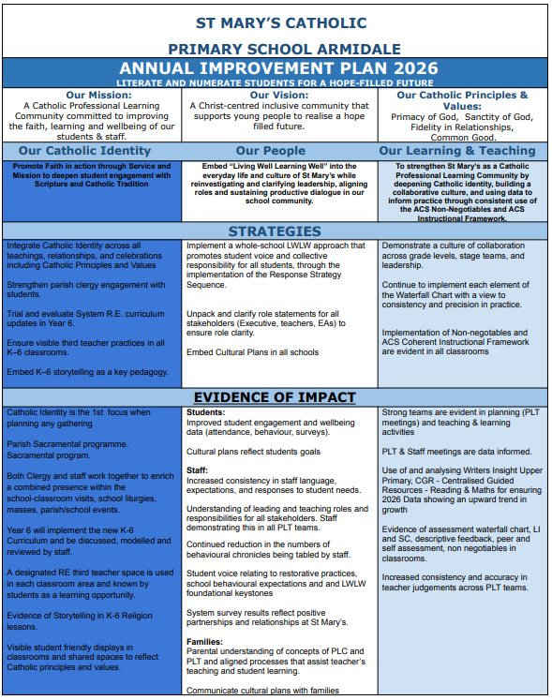
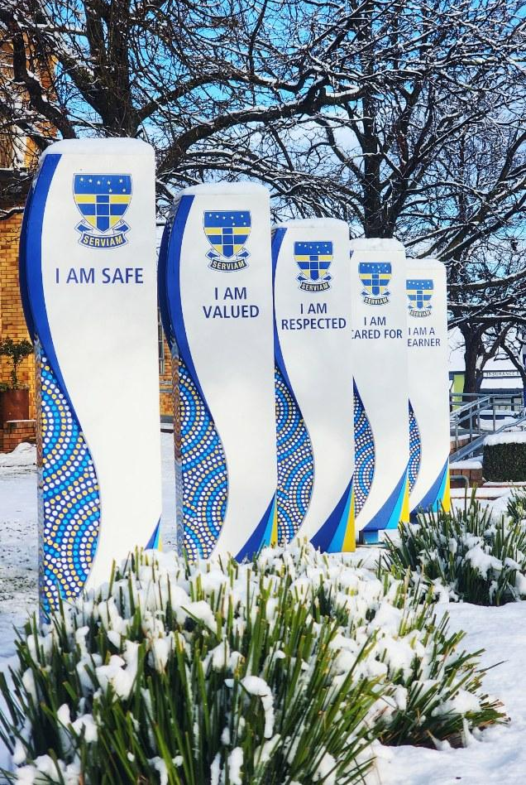
AIP - ACSO / SMA 2026
Notes:
Our AIP reflects the ACS Direction. It shapes our work in addition to what you already do, and have achieved.

Slide 8
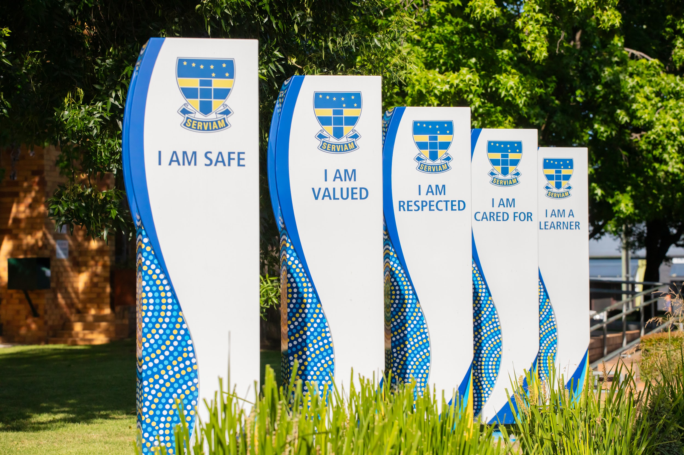

Slide 9

Notes:
Catherine

Slide 10

Notes:
Leadership - Whole school Assembly Wednesday.

Slide 11

Notes:
Darren

