Slide 1


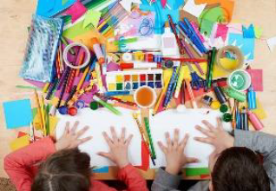

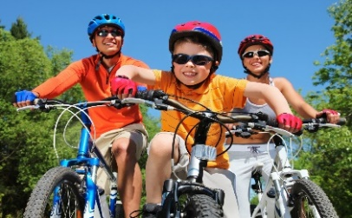


22 September – 6 October
Monday 22 Sept
Tuesday 23 Sept
Wednesday 24 Sept
Thursday 25 Sept
Friday 26 Sept
Pancake Art Party
Art Attack
Zumba Party
Wheels Day & Super Hero Dress up Day
Movie Day at Cenima
Today is going to be lots of fun as we get to channel our inner Picasso while turning everyday items into a beautiful masterpiece of Art initiated by your artistic and creative mind
Dance less in motion and more in spirit; awaken the dreamer within. Music does not need language of words for it has movements of dance to do its
translation. Bring your dancing shoes and join us for a ZUMBA dance party
Pancake Art Party, where every child will have the opportunity to enjoy their favorite design transformed into a delicious, edible pancake..
(A special Person is invited to make Pancakes)
Bring your wheels and cruise around our inhouse bike track.
Wear you best cape and superhero outfit and be prepared to conquer the world
Sit back, relax and enjoy a movie at the Alice springs Cenima.
Popcorn and drinks provided.
Movie- The Bad Guy 2
$95
GREEN
$85
GREEN
$80
GREEN
$85
GREEN
$100
Amber

Slide 2


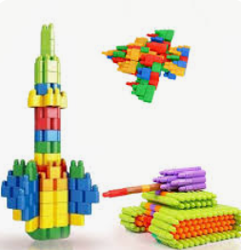
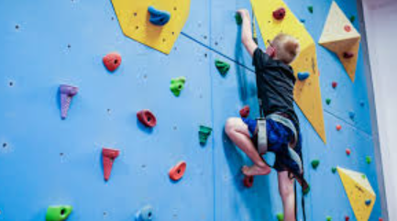
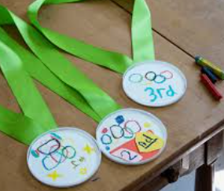
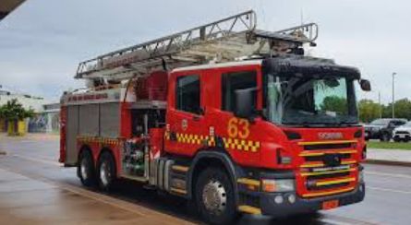
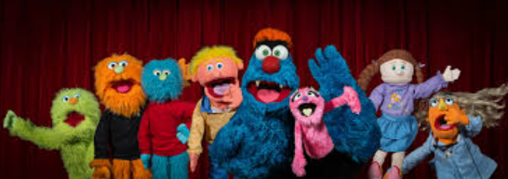
22 September – 6 October
Monday 29 Sept
Tuesday 30 Sept
Wednesday 1 Oct
Thursday 2 Oct
Friday 3 Oct
Monday 6 Oct
Make your Favorite chilled Milkshake
Task Master Day
Rock Climbing at The Y
Olympic Games at the oval
End of Program Party
Who will be able to Master the task we have planned for today???
Who can build the Highest tower in 3 Mins? Who Can make the best Airplane? Who can draw a picture of themselves using their Feet?
Firefighters Visit
Reach new heights at the Y! Our rock climbing wall offers a fun, exciting challenge for all ages.
Also,many more other activities at the stadium
Get ready for the Olympic Games with our Olympic Games activities and Games like,
Three-legged race, sack race, egg and spoon race and many more at Braitling Oval
Firefighter visit can be both exciting and educational. A fantastic Opportunity for the Children to see the Alice springs Fire Rescue team they will have opportunity to see the fire truck.
Come and celebrate at the end of Program Party!
Food, Disco, games and Prizes!
Rich, creamy and indulgent – the milkshake is perhaps one of the world’s most perfect dessert foods.
Children with Allergy will have choices
$90
GREEN
$80
GREEN
$100
GREEN
$90
GREEN
$80
GREEN
$80
GREEN

Slide 3


