Slide 1
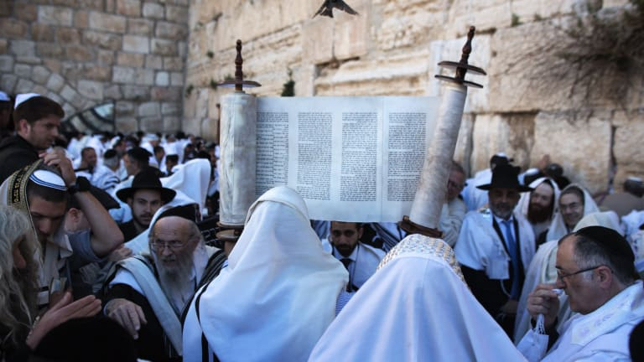
Judaism

Slide 2
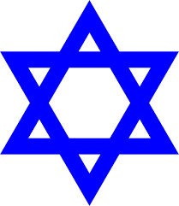
Time, Place and Origins
Judaism originated in Israel, dating back to around 4000 years ago. It is the world's oldest monetheistic religion (which is the belief in one God only)
Most of the beliefs and stories taught and read from Judaism, is the Torah
The Torah consists of the books Genesis, Exodus, Leviticus, Numbers, and Deuteronomy, which are also the first five books of the Christian Bible
For centuries, the traditional understanding has been that Judaism came before Christianity and that Christianity separated from Judaism some time after Jesus had died

Slide 3
Founder of Judaism
There was no exact founder of Judaism, however, it was said that Abraham was the founder
Abraham was perhaps the most important individual in the history of the world according to Judaism
Around 4,000 years ago, in Israel, Abraham’s family and all the people around him worshipped the stars, the sun and the moon, as well as idols of stone, metal and wood.
They worshipped images of their king and treated him as a god. Young Abraham also worshipped along with them.
Abraham grew skeptical of all these deities. He saw that the wind, the rain, the sun and the moon worked together in wondrous harmony. There seemed to be order among the stars in the night sky, as there was among the plants and animals on earth.
Observing the world around him and the events of his lifetime, Abraham came to realise that there is really only one God, a single force behind all that occurs, a single reality behind all that exists.

Slide 4
Spread of Judaism
Abraham passed the torch on to his son Isaac, who passed it on to his son Jacob. Jacob taught his 12 sons. But Jacob and his sons descended to Egypt, and their children became enslaved there
Moses was then born, who was said to redeem the people from Egypt.
After Moses had passed away, the beliefs continued to be passed down and followed, which eventually spread across the Earth.
The total population of Jews worldwide today is 14.6–17.8 million

Slide 5
Founder of Judaism
Abraham realized that it was the worship of idols that was concealing the truth. With no single God to answer to, people had fallen to the depths of immorality, sacrificing their own children, justifying thievery, rape and murder.
So Abraham smashed the idols in his father’s house. He began to preach to people that they should worship only the one God of heaven and earth who is found everywhere and is accessible to all.
He taught that this one God has compassion for all His creatures and demands honesty and justice from all. Abraham’s teachings spread rapidly, until much of the world was convinced.
Once Abraham had discovered these truths on his own, God revealed Himself to him and assigned him the mission of spreading this knowledge.
God promised Abraham that he would be the father of many peoples.

Slide 6
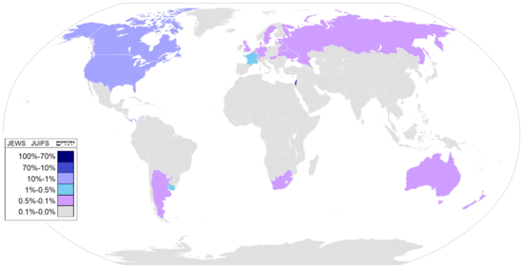
Population of Jews around the Globe

Slide 7
Fundamental Beliefs
God exists
There is only one God
There are no other gods
God can't be subdivided into different people (unlike the Christian view of God)
Jews should worship only the one God
God is Transcendent: God is above and beyond all earthly things.
God doesn't have a body: Which means that God is neither female nor male.
God created the universe without help
God is omnipresent: God is everywhere, all the time.
God is omnipotent: God can do anything at all.
God is beyond time: God has always existed and God will always exist.
God is just, but God is also merciful: God punishes the bad, God rewards the good and God is forgiving towards those who mess things up.
God is personal and accessible: God is interested in each individual, God listens to each individual, God sometimes speaks to individuals, but in unexpected ways.

Slide 8
Types of Judaism
Orthodox Judaism: They are typically known for their strict behaviour of traditional Jewish law and rituals. For example, most believe the Shabbat (which is a rest day every saturday) shouldn’t involve working, driving or handling money.
Reform Judaism: They are considered a liberal category of Judaism that values social traditions over strict observance of Jewish laws. Most of the Jews living in the United States follow Reform Judaic traditions
Conservative Judaism: Many people consider this form of Judaism somewhere in between Orthodox and Reform Judaism. Typically, conservative Jews honour the traditions of Judaism while allowing for some modernisation
Reconstructionist Judaism: This dates back to 1922 when Mordecai Kaplan founded the Society for the Advancement of Judaism. This sect believes that Judaism is a religious civilization that’s constantly evolving.
Humanistic Judaism: Rabbi Sherwin Wine founded this denomination of Judaism in 1963. Humanistic Jews celebrate Jewish history and culture without an emphasis on God.

Slide 9
Jewish Holidays
Passover: This holiday lasts seven or eight days and celebrates Jewish freedom from slavery in Egypt. Specifically, Passover refers to the biblical story of when the Hebrew God “passed over” houses of Jewish families and saved their children during a plague that was said to have killed all other first-born babies in Egypt.
Rosh Hashanah: Jews celebrate the birth of the universe and humanity during this holiday, which is also known as the Jewish New Year.
Yom Kippur: This “Day of Atonement” is considered the holiest day of the year for Jews who typically spend it fasting and praying.
High Holy Days: The 10 days starting with Rosh Hashanah and ending with Yom Kippur are also known as the High Holidays, the Days of Awe or Yamim Noraim. The High Holy Days are considered a time of repentance for Jewish people.
Hanukkah: This Jewish celebration, also known as the “Festival of Lights,” lasts eight days. Hanukkah commemorates the rededication of the Jewish Temple in Jerusalem after the Maccabees defeated the Syrian-Greeks over 2,000 years ago.
Purim:This is a joyous holiday that celebrates a time when the Jewish people in Persia were saved from extermination

Slide 10
Significant dates
1800 BCE: Abraham (Founder) and Sarah (his wife) begin the Journey to Judaism
1250 BCE: Moses ( Hebrew prophet) leads Hebrews out of Egyptian bondage (the state of being a slave)
1000 BCE: King David ( founded the Judaean dynasty) unites the people and grows the Kingdom.
950 BCE: King Solomon ( David’s son & Last King) builds First Temple in Jerusalem

Slide 11
722 BCE: Assyrians (From present day northern Iraq) destroy Northern Israelite Kingdom, disperse ten tribes
586 BCE: Babylonians ( From present day Iraq) overthrow Southern Kingdom, destroy first Temple
428 BCE: Second Temple dedicated by Ezra and Nehemiah (religious leaders of the Jews)
164 BCE: Hasmonean revolt against Greek rule (celebrated by Chanukkah)

Slide 12
70: Second Temple destroyed by Romans
135: Bar Kochba (Jewish leader who led a bitter but unsuccessful revolt) rebellion
200: Mishnah(repetition) codified(arrange laws or rules into a systematic code.)
500: Babylonian Talmud(central text of Rabbinic Judaism) codified
1492: Jews expelled from Spain

Slide 13
1880: Mass migrations to America begin
1938: Kristallnacht (civilians throughout Nazi Germany) begins Holocaust
1948: State of Israel declared
1972:First American woman rabbi (a Jewish scholar or teacher, especially one who studies or teaches Jewish law.) ordained

Slide 14
How and why was judaism formed
The origins of Jewish faith are explained throughout the Torah. According to the text, God first revealed himself to a Hebrew (Holy book) man named Abraham, who became known as the founder of Judaism. Abraham’s son Isaac, and his grandson Jacob, also became central figures in ancient Jewish history. Jacob took the name Israel, and his children and future generations became known as Israelites.
Jews believe that God made a special covenant with Abraham and that he and his descendants were chosen people who would create a great nations

Slide 15
Two major events in Judaism
Around 1000 B.C., King David ruled the Jewish people. His son Solomon built the first holy Temple in Jerusalem, which became the central place of worship for Jews.
He kingdom fell apart around 931 B.C., and the Jewish people split into two groups: Israel in the North and Judah in the South.

Slide 16
Reason 2:
When Solomon's successor, Rehoboam, dealt tactlessly (lacking skill and sensitivity) with economic complaints of the northern tribes, in about 930 BCE (there are differences of opinion as to the actual year) the Kingdom of Israel and Judah split into two kingdoms: the northern Kingdom of Israel, which included the cities of Shechem and Samaria, and the southern Kingdom of Judah, which contained Jerusalem. Most of the non-Israelite provinces became independent.

Slide 17
Bibliography
https://www.history.com › topics › religion › judaism
https://www.dummies.com › religion › judaism › a-brie…
https://en.wikipedia.org › wiki › Kingdom_of_Israel_(uni...

Slide 18
Bibliography
https://www.bbc.co.uk/religion/religions/judaism/beliefs/beliefs_1.shtml
https://en.wikipedia.org/wiki/Jews
https://en.wikipedia.org/wiki/List_of_religious_populations#Judaism
https://www.britannica.com/topic/Jew-people

