Slide 1
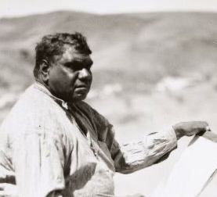
Albert Namatjira
By
Ava north

Slide 2
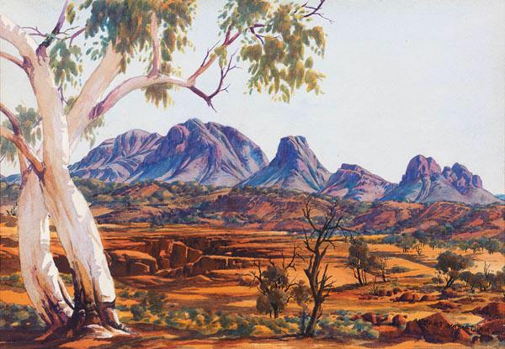
Personal information
Albert Namatjira was an Aboriginal artist. He was raised on the Hermannsburg Mission near Alice Springs in the Northern Territory. He was separated from his parents and had a western style upbringing.
He sketched what he could see around him from when he was a kid.
When he was 13 he returned to the bush to learn about his culture and go through initiation. He became a member of the Arrernte community. This inspired his artworks.

Slide 3
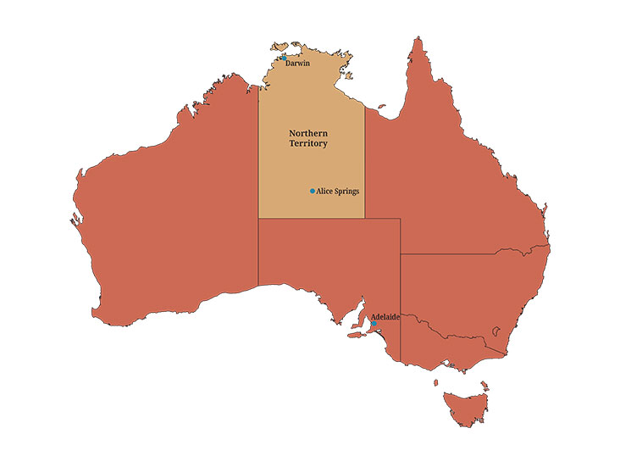
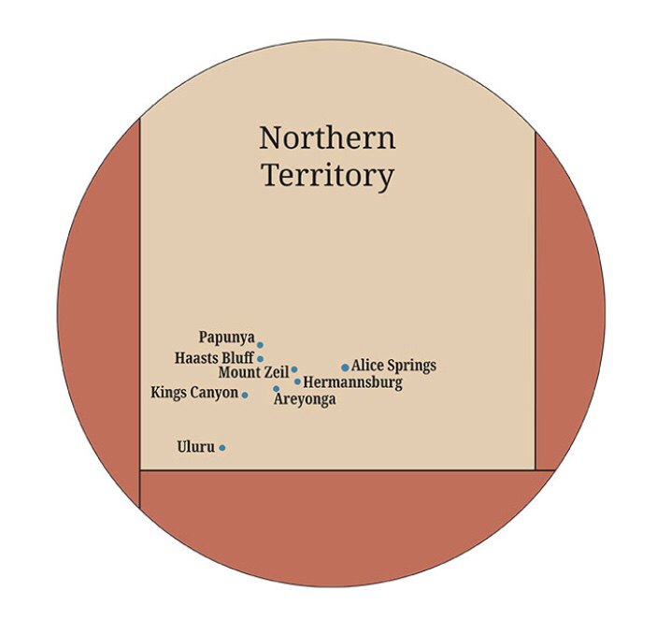
Place of birth/aboriginal country
Albert Namatjira was born at Herrmannsburg near Alice springs Northern territory. He was a member of the Western Arrernte people.

Slide 4
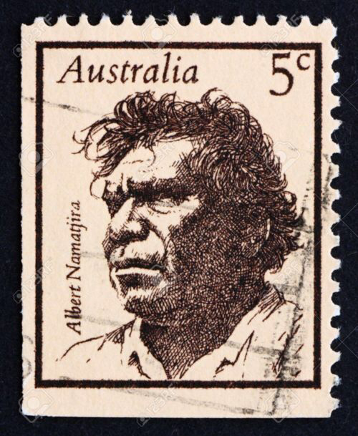
Achievements
Albert Namatjira was a water colour artist but he didn’t do the traditional aboriginal art instead he painted landscapes of what he saw in front of him. He was the pioneer of modern Aboriginal art.
Albert was the most famous indigenous Australian of his generation.
He even inspired the Hermansburg school of painting.
In 1953 Albert was awarded the Queen’s coronation medal.
He also was honoured with an Australian postage stamp in 1968.

Slide 5
Interesting facts
Albert painted more than 2000 paintings by the time he died.
Albert Namatjira’s name was first Elea but was changed to Albert .
He married some one from a different tribe and couldn’t live in the tribe he lived in anymore for some time. It went against the tribes beliefs.
Even though Albert became very wealthy from his paintings, at the end of his life he ended up living in poverty beside a creek bed. This was because he was expected to share all of his money with his tribe.

Slide 6
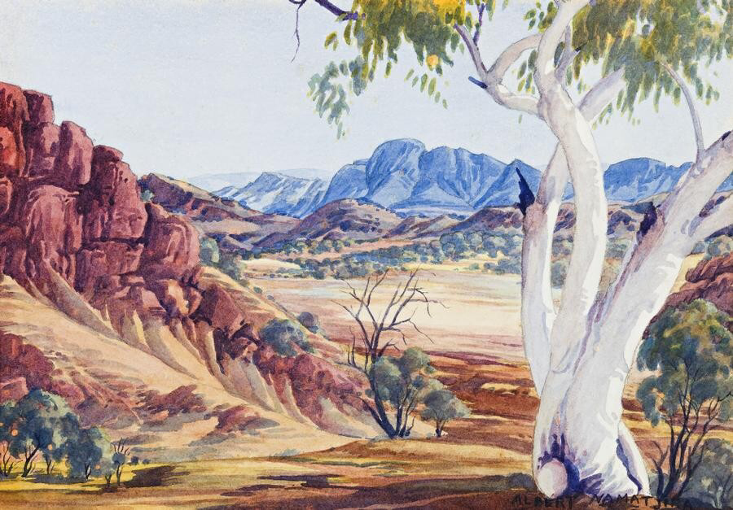
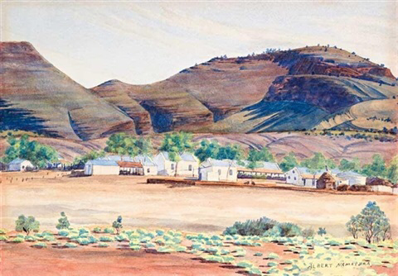
Palm Valley and Mt Hermannsburg Paintings

Slide 7
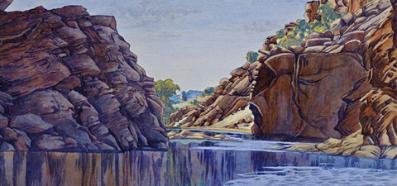
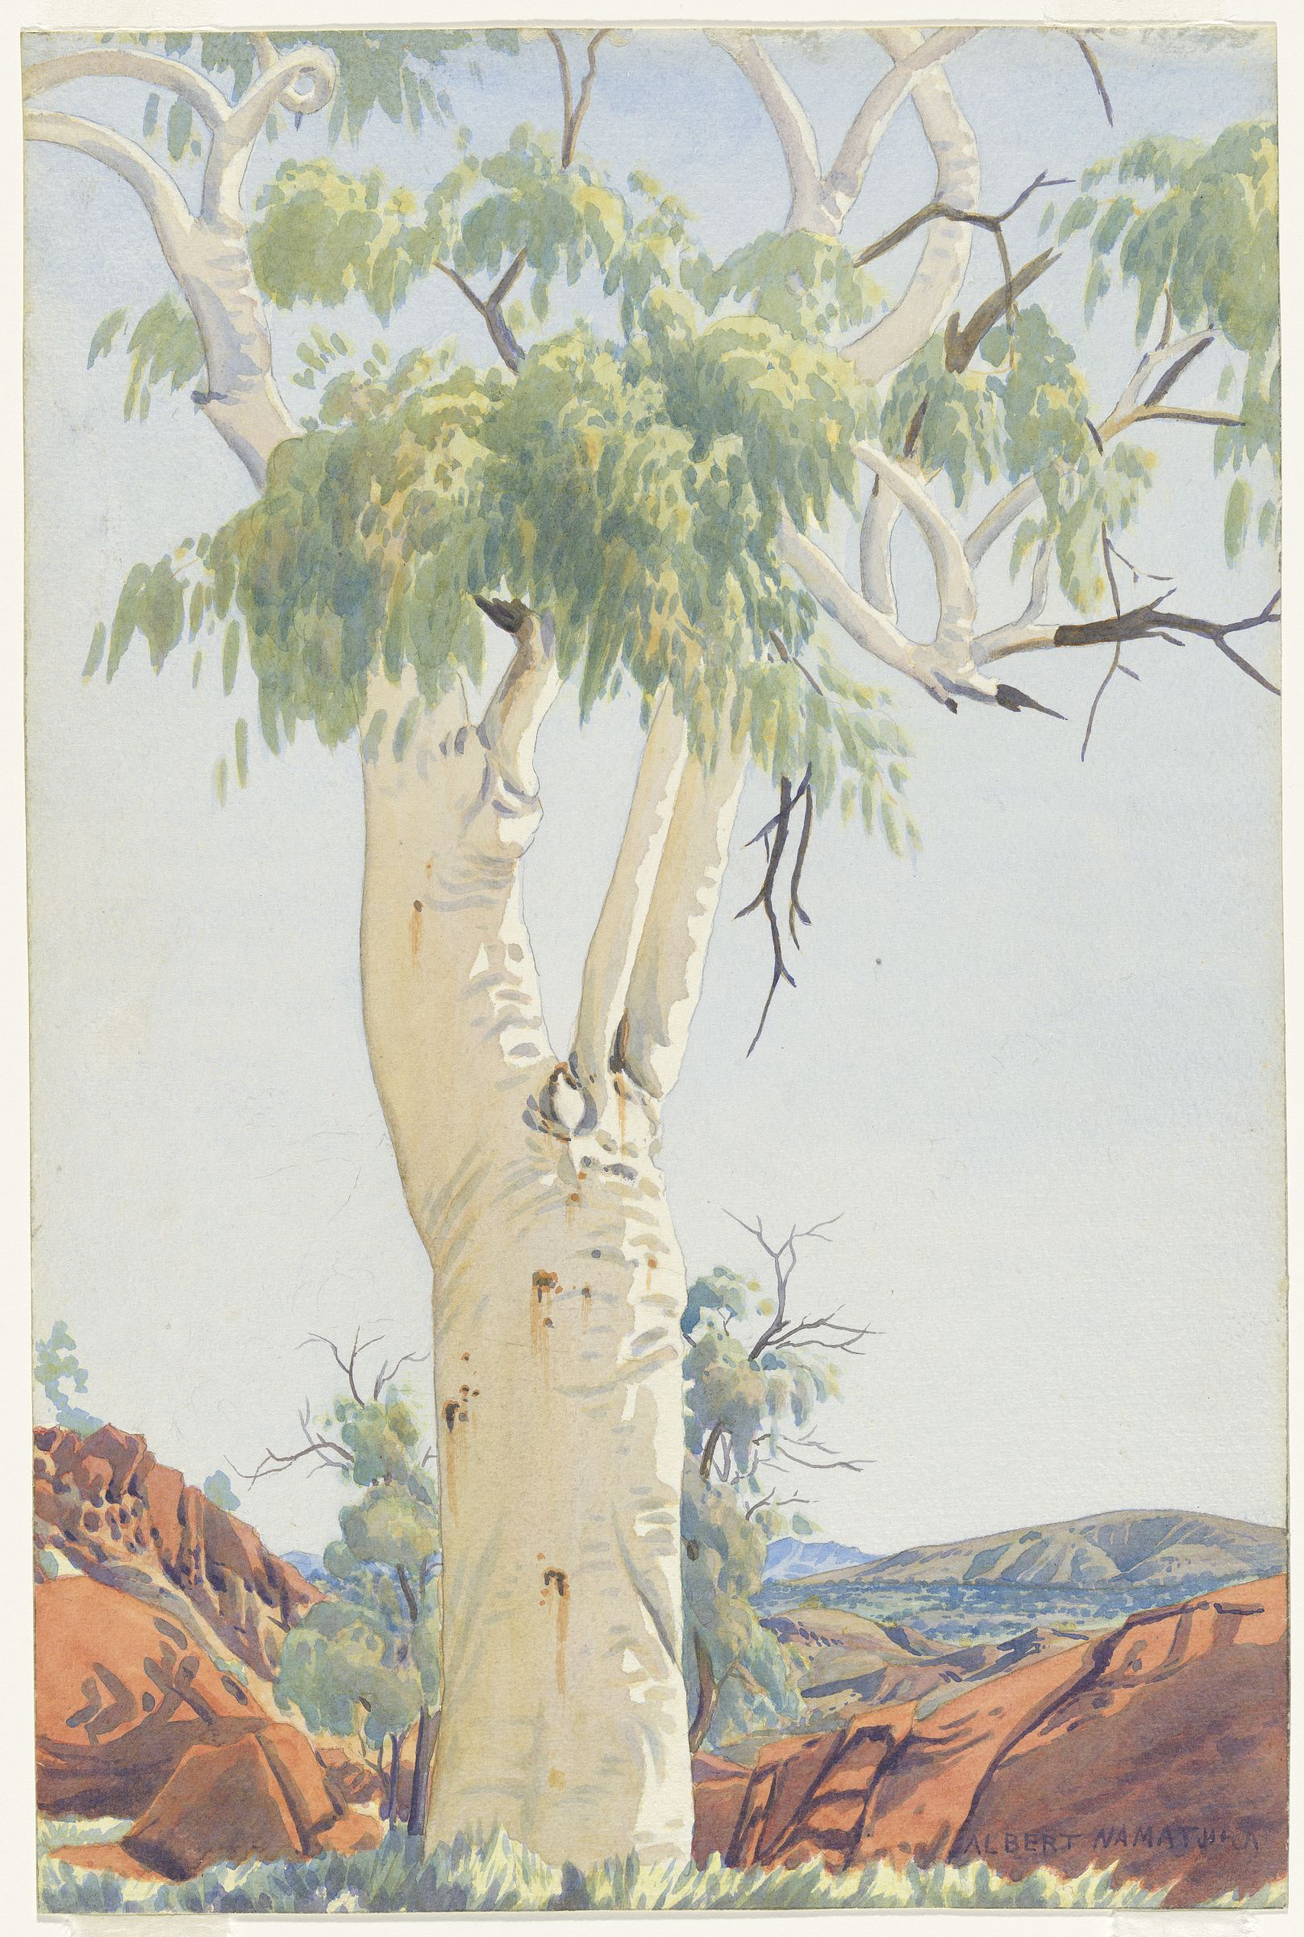
Central Australian Gorge and Ghost Gum paintings

Slide 8
How he inspires people
Albert Namatjira inspired a change in Aboriginal artworks.
He was very inspirational as he was the first Northern Territory Aboriginal person to be freed from restrictions that made him be a ward of the State. Meaning he was now able to manage his own life.
He was the first Northern Territory Aboriginal person to be allowed to vote.
Albert Namatjira is very inspiring as his artworks show great connections to his country.

Slide 9
References
https://kids.kiddle.co/Albert_Namatjira
https://en.wikipedia.org/wiki/Albert_Namatjira
https://manyhandsart.com.au/about/albert-namatjira/

