Slide 1
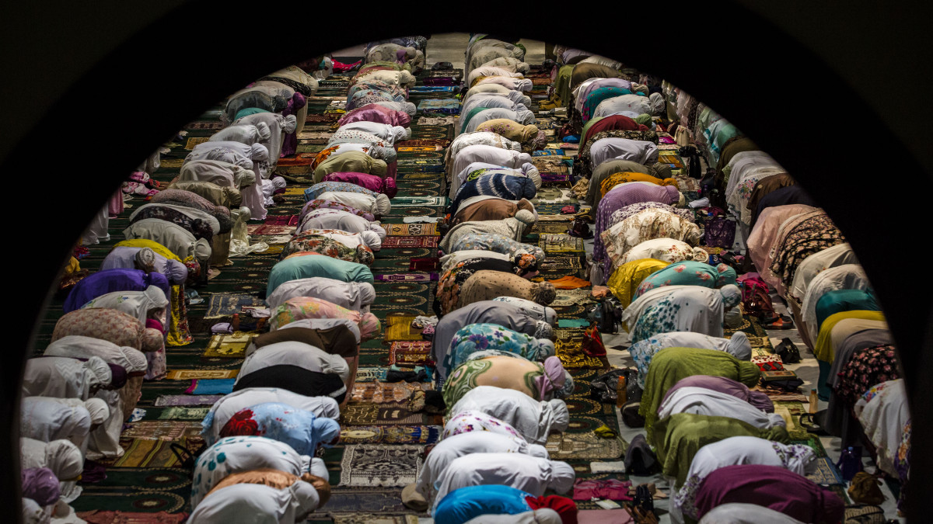
Islam
Kenneth

Slide 2
Fundamental Beliefs

Slide 3
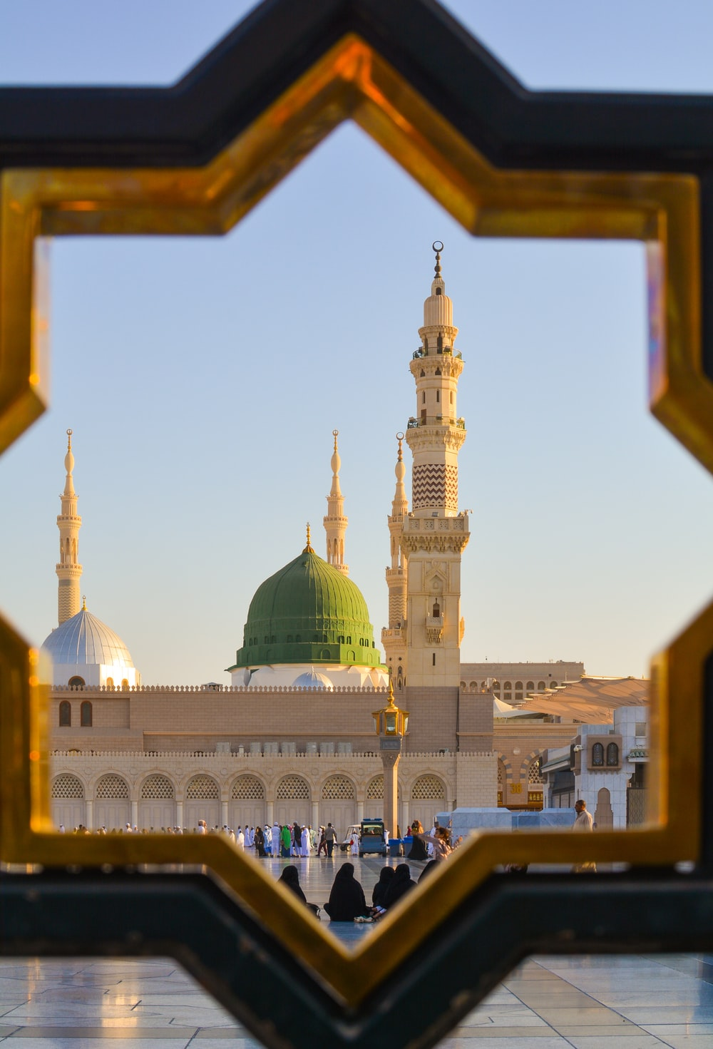
The principal message of Islam is monotheism (doctrine or belief that there is only one God).
Monotheism is the foundation. Of the Islamic expect that everyone of the prophets sent by god to humankind had a similar message and that was the message of Monotheism
Muslims accept that God is the maker, all things considered, and that God is almighty and all-knowing. God has no posterity, (all future generations of people.) no race, no sexual orientation, no body, and is unaffected by the qualities of human existence.

Slide 4
Time , Place

Slide 5
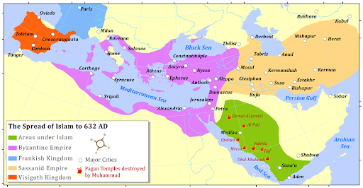
Although its underlying foundations return further, researchers normally date the production of Islam to the seventh century, making it the most youthful of the significant world religions. Islam began in Mecca, in current Saudi Arabia, during the hour of the prophet Muhammad's life. Today, the confidence is spreading quickly all through the world.

Slide 7
Why and How the religion was formed

Slide 8
Most history specialists acknowledge that Islam began in Mecca and Medina toward the beginning of the seventh century CE. Muslims see Islam as a re-visitation of the first confidence of the prophets, like Jesus, Solomon, David, Moses, Abraham, Noah and Adam, with the accommodation (Islam) to the desire of God.

Slide 9
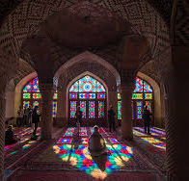
Facts about Islam?
The word “Islam” means “submission to the will of God.”
Followers of Islam are called Muslims.
Muslims are monotheistic and worship one, all-knowing God, who in Arabic is known as Allah.
Followers of Islam aim to live a life of complete submission to Allah.

Slide 10
Basic Beliefs of ISLAM The basis for Islamic doctrine is found ...
https://www.northampton.edu ›
https://www.history.com/topics/religion/islam#:~:text=Although%20its%20roots%20go%20back,spreading%20rapidly%20throughout%20the%20world.

