Slide 1
CAT 2: Digital Art Exploration Folio
By Davinder Singh Y10

Slide 2
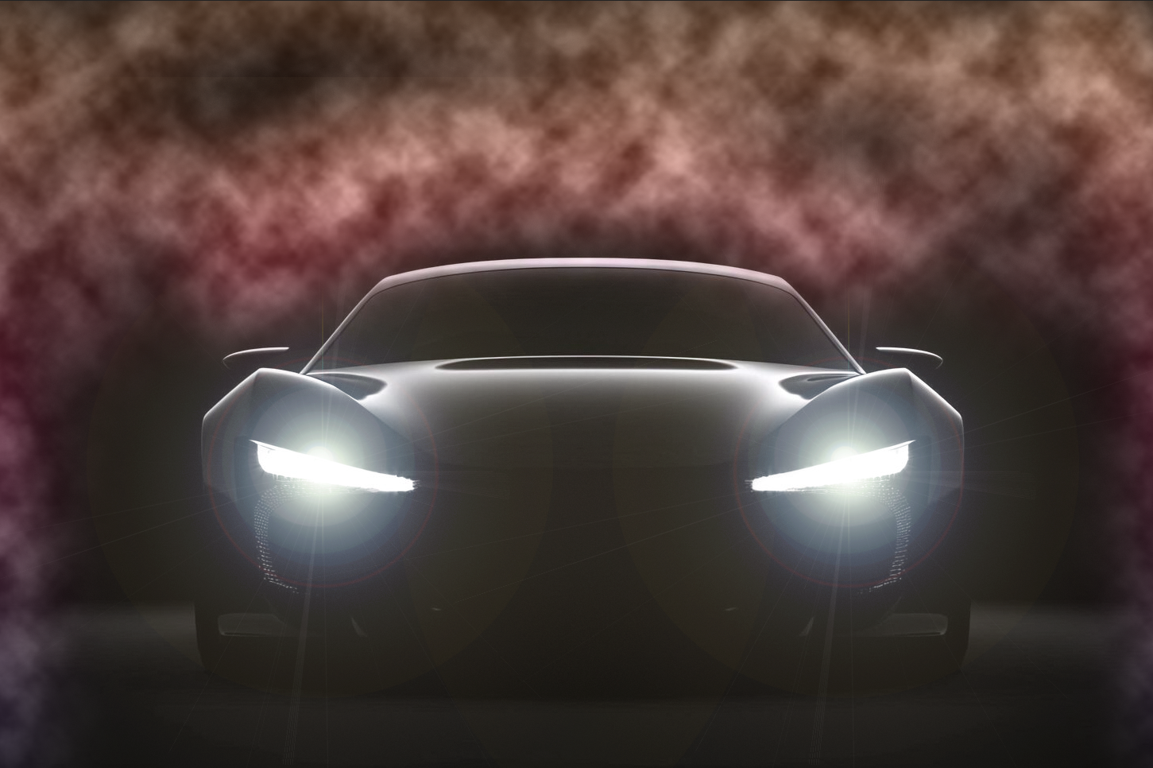
Final Photo for context

Slide 3
Core Concepts
Speed and Power
The car symbolises human innovation, technology, and the relentless drive for speed and power. It represents society's ambition to push boundaries and accelerate progress, both literally and metaphorically. The sleekness and motion of the car suggest energy and momentum, reflecting humanity’s quest for greater efficiency and control over the environment.

Slide 4
Core Concepts
Duality of Progress
The artwork explores the contrast between progress and its consequences. The lens flare represents the optimism and bright future that technological advancements promise, symbolising hope and enlightenment. However, the presence of smoke adds complexity, highlighting the challenges and consequences that come with progress, such as environmental damage or ethical dilemmas. This duality makes the viewer reflect on how power and progress come with risks and responsibilities.

Slide 5
Core Concepts
The artwork evokes feelings of excitement and tension from the audience. The dynamic car and bright lens flare inspire feelings of exhilaration and awe, highlighting the thrill of progress and the power of human innovation. At the same time, the dark, swirling smoke introduces a sense of unease, prompting viewers to question the sustainability of such rapid advancement. This contrast creates a sense of conflict between optimism and caution, encouraging the audience to reflect on the emotional complexity of chasing power and progress.

Slide 6
Inspiration
This piece reflects my inspiration from the power of technological innovation, symbolised by the car and its lens flare. The flare conveys energy and ambition, while the smoke represents the hidden challenges of rapid advancement, like pollution and uncertainty. Together, these elements evoke excitement and caution, inviting viewers to reflect on the dual impact of progress.
I also like the look of dynamic art pieces, this is why I chose to do a car with the lens flare and smoke.

Slide 7
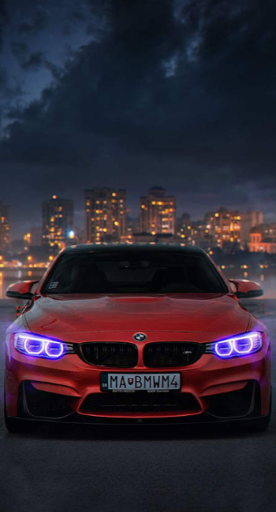
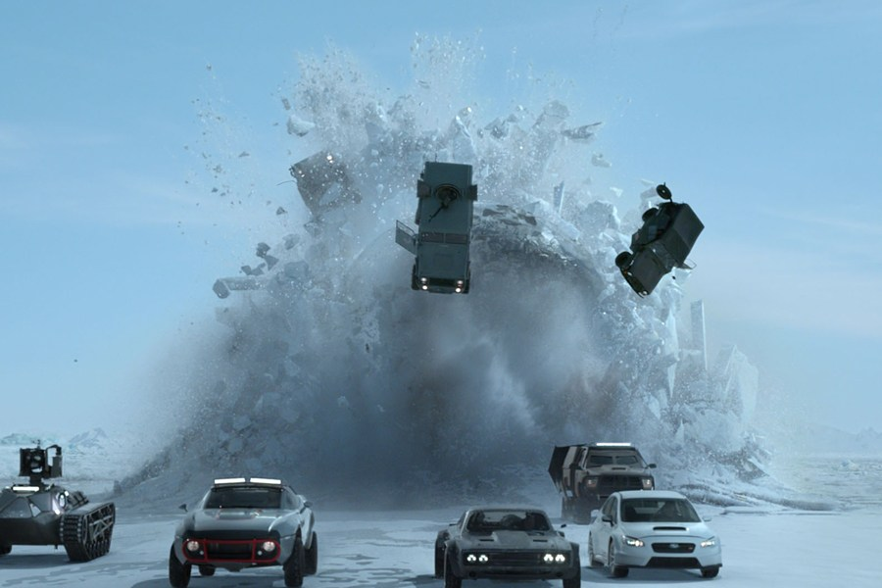
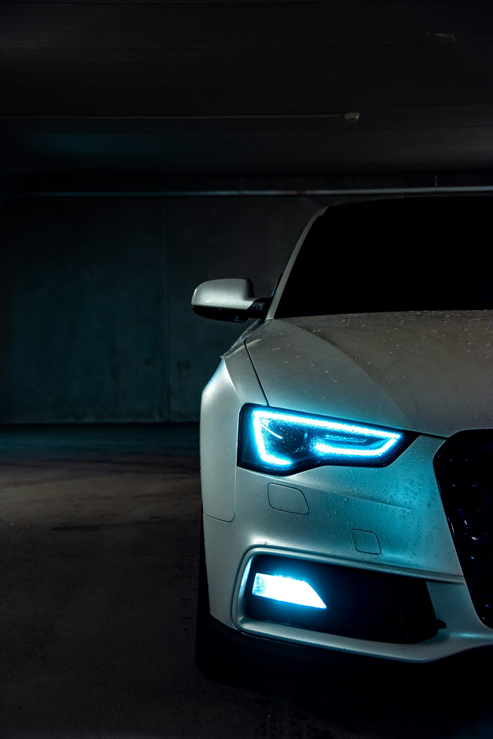
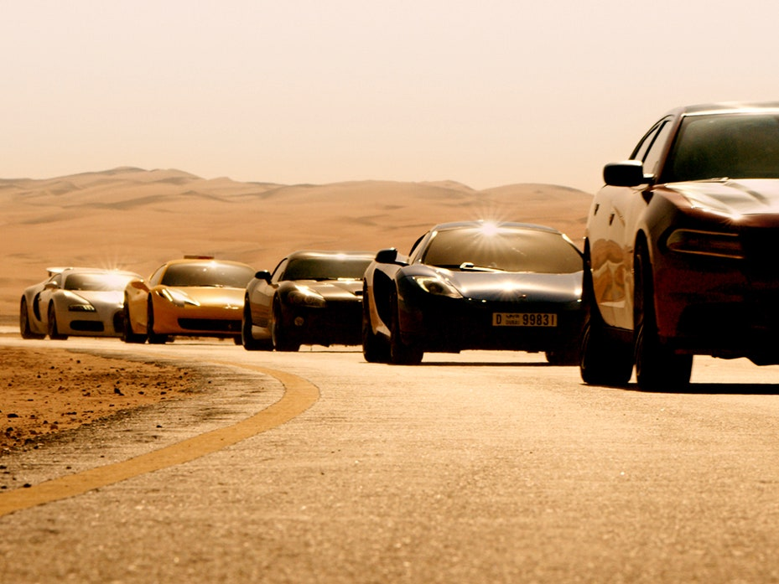
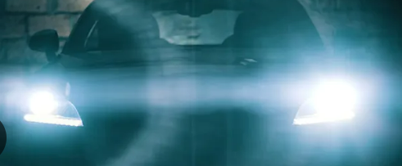
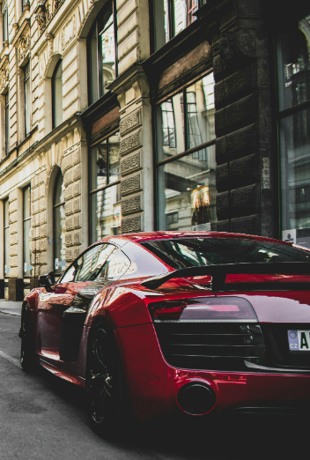
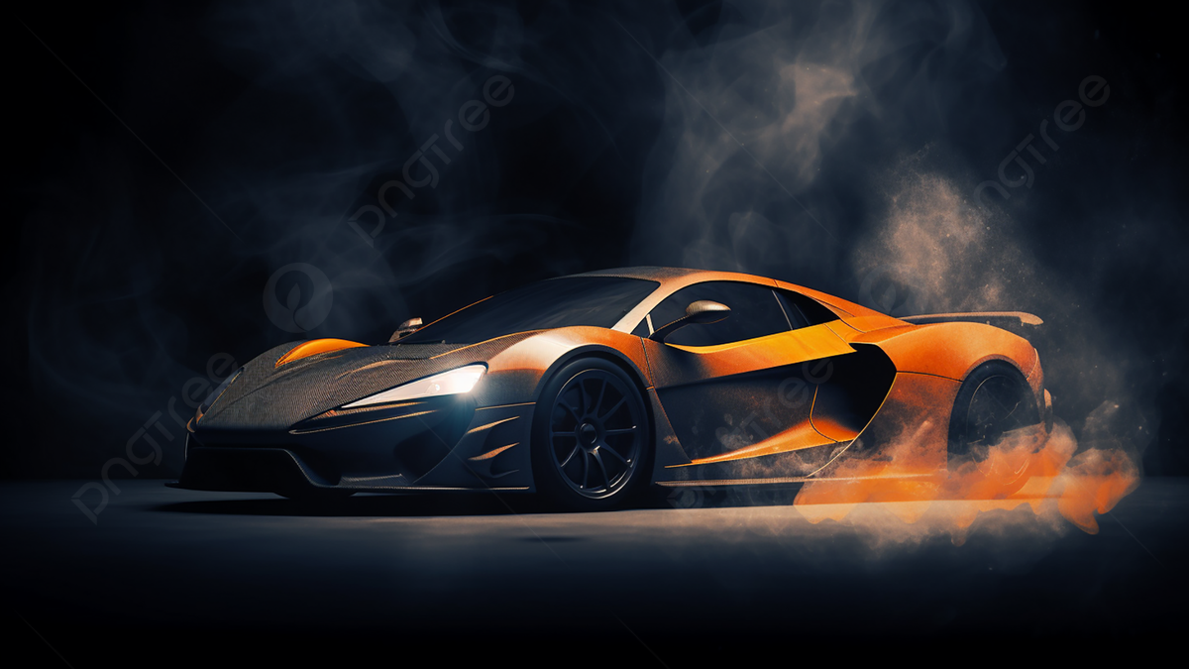
Inspiration

Slide 8
Subject Matter
Focus on a Car as a Symbol: The central subject of the artwork is a car, representing speed, power, and human ambition. It serves as a metaphor for technological progress and the drive for innovation.
Elements of Lens Flare and Smoke: Lens flare highlights the optimism and forward momentum associated with innovation, while smoke introduces a sense of ambiguity, symbolising the unseen challenges or costs of advancement.
Dynamic and Cinematic Style: The use of movement, light, and shadow brings a dynamic, almost cinematic quality to the piece, drawing viewers into the energy and tension of the scene.
Exploration of Progress: Through the car and surrounding elements, the subject matter reflects the dual nature of progress—its inspiring potential and the complexities that often follow in its path.

Slide 9
Aesthetic Qualities
Dynamic Composition: The piece captures a sense of motion and intensity, using the car’s forward movement to create an engaging, powerful visual impact.
Contrasting Light and Dark: Lens flare and shadow are used to balance brightness with depth. The bright flare suggests energy and optimism, while the darker smoke adds a layer of tension, creating a compelling contrast.
Cinematic Elements: Inspired by film visuals, the use of dramatic lighting, lens flare, and realistic smoke adds a cinematic feel, enhancing the artwork's visual appeal and storytelling quality.
Realism Meets Abstraction: Blending realistic details in the car and smoke with abstract lighting effects, the piece merges reality with creative interpretation, making it both visually engaging and thought-provoking.

Slide 10
Main Techniques
Layering and Blending: Multiple layers were used to build depth and realism, particularly with the lens flare and smoke. Blending modes like Screen helped integrate these effects seamlessly into the scene.
Lens Flare Application: To create a realistic light effect, a lens flare was added on a separate layer. Positioning and adjusting brightness and opacity created a focal point that adds a cinematic, high-energy effect to the artwork.
Smoke Texture and Masking: Smoke was added using high-quality textures and custom brushes. Layer masks and opacity adjustments were used to control the smoke’s placement and blend it naturally around the car, adding depth and movement.

Slide 11
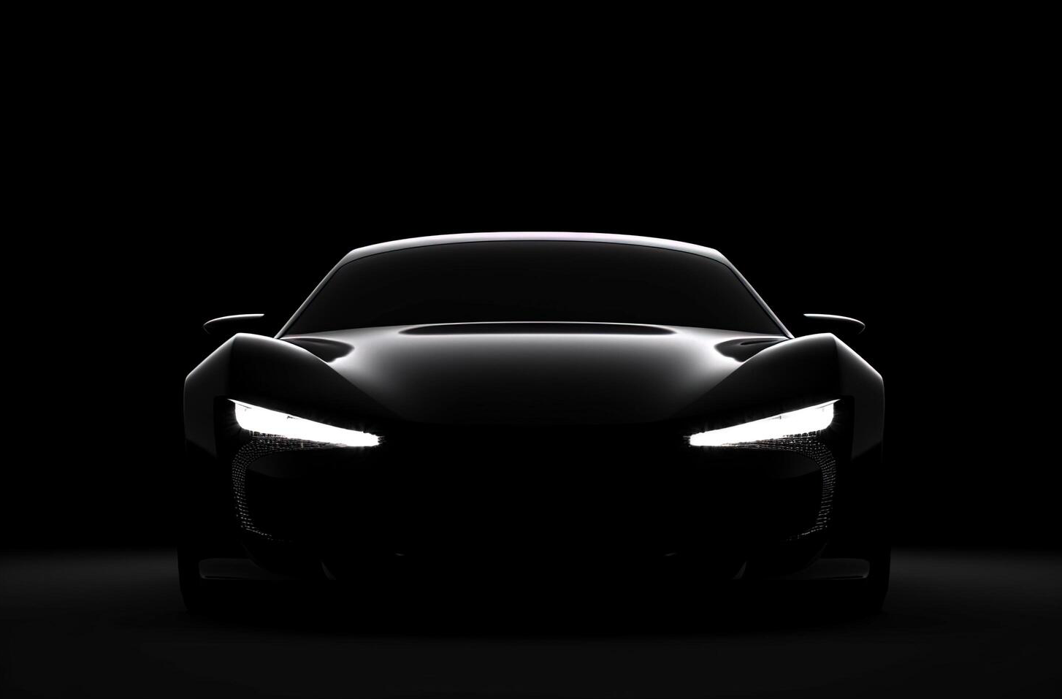
Documentation
Import photo onto Photoshop

Slide 12
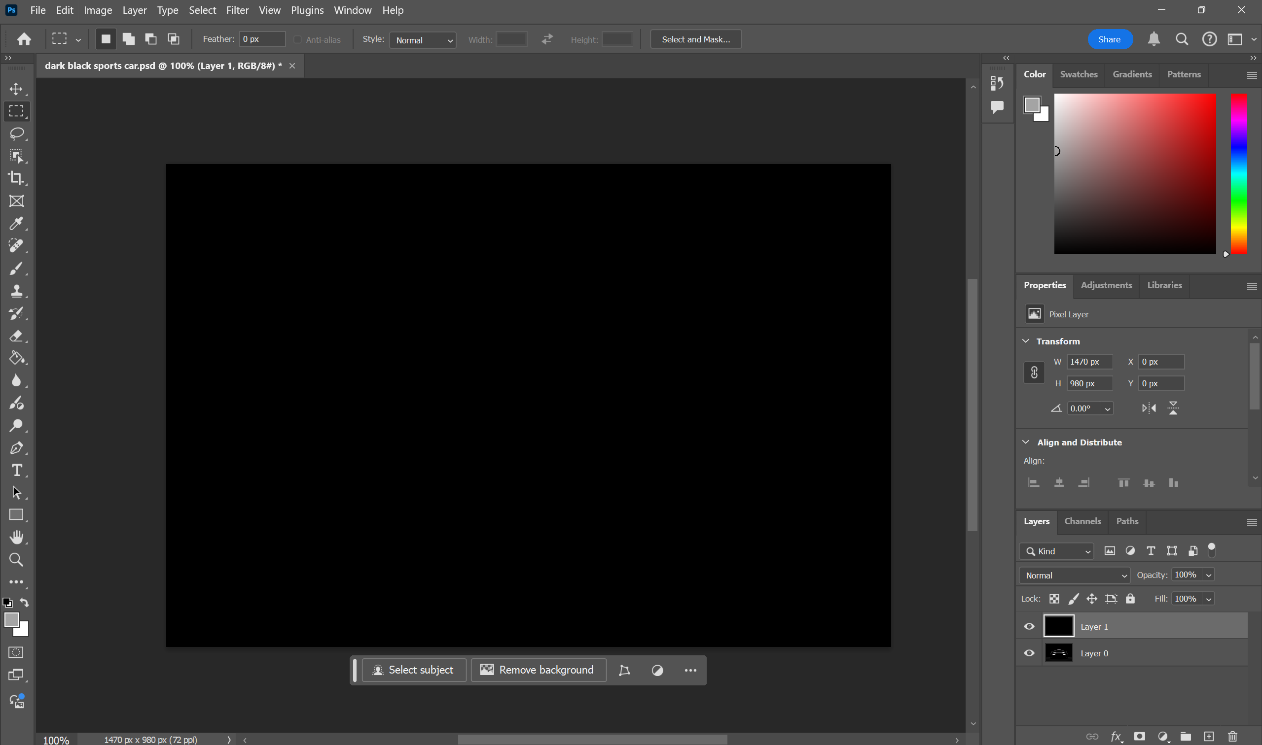
Documentation
Create new layer use the bucket tool to make it black

Slide 13
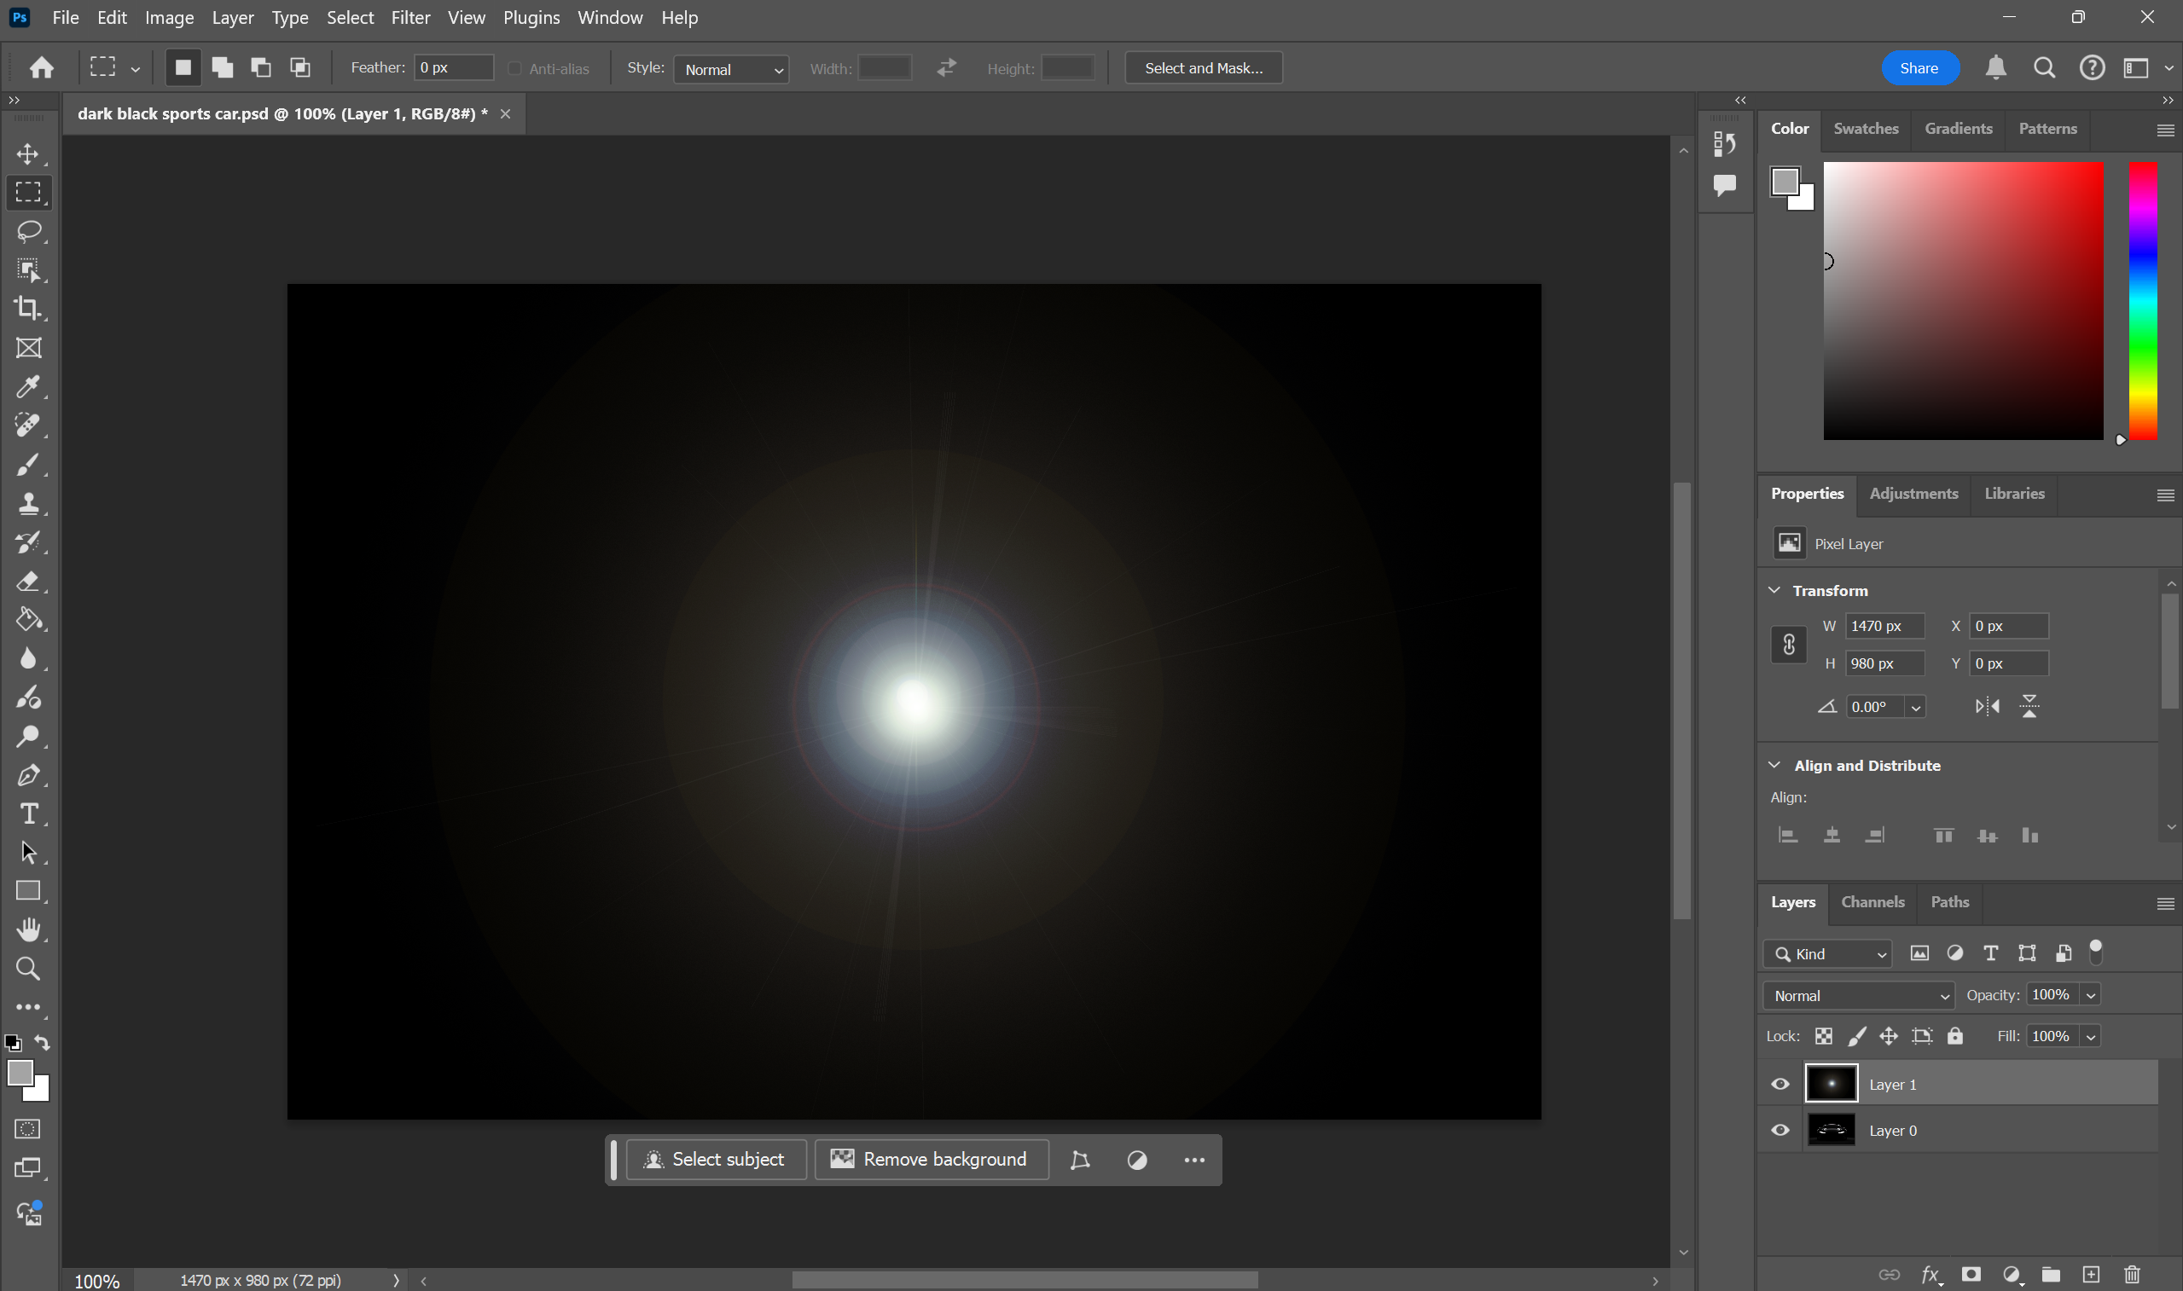
Documentation
Add lens flare through ‘Filter – Render – Lens Flare’
Adjust brightness of lens to 83%

Slide 14
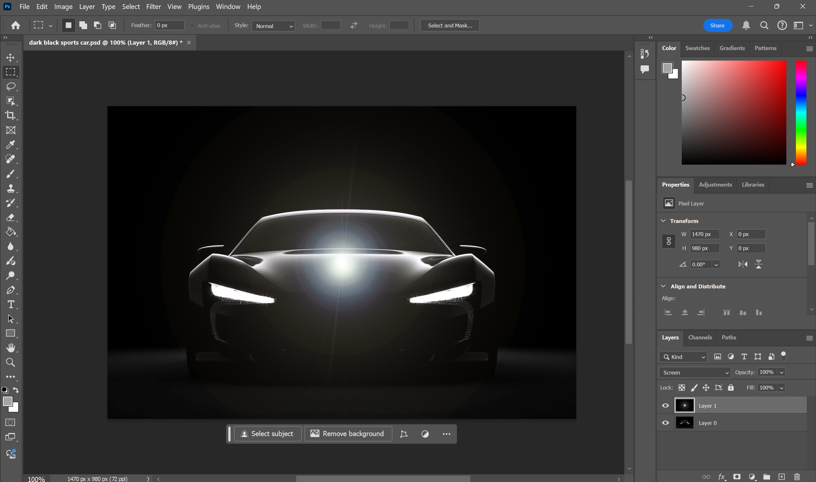
Documentation
Change layer from normal to screen

Slide 15
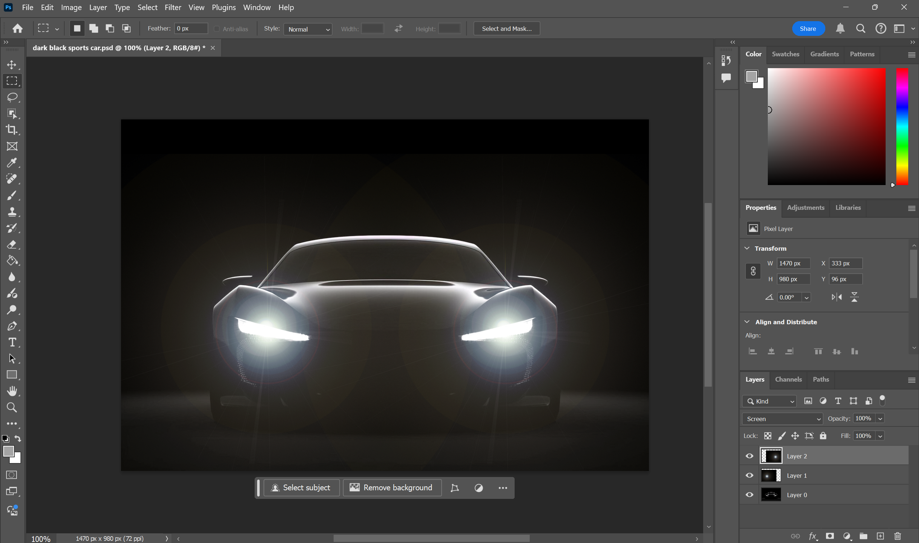
Documentation
Copy and paste lens flare
Move lens flares over car lights

Slide 16
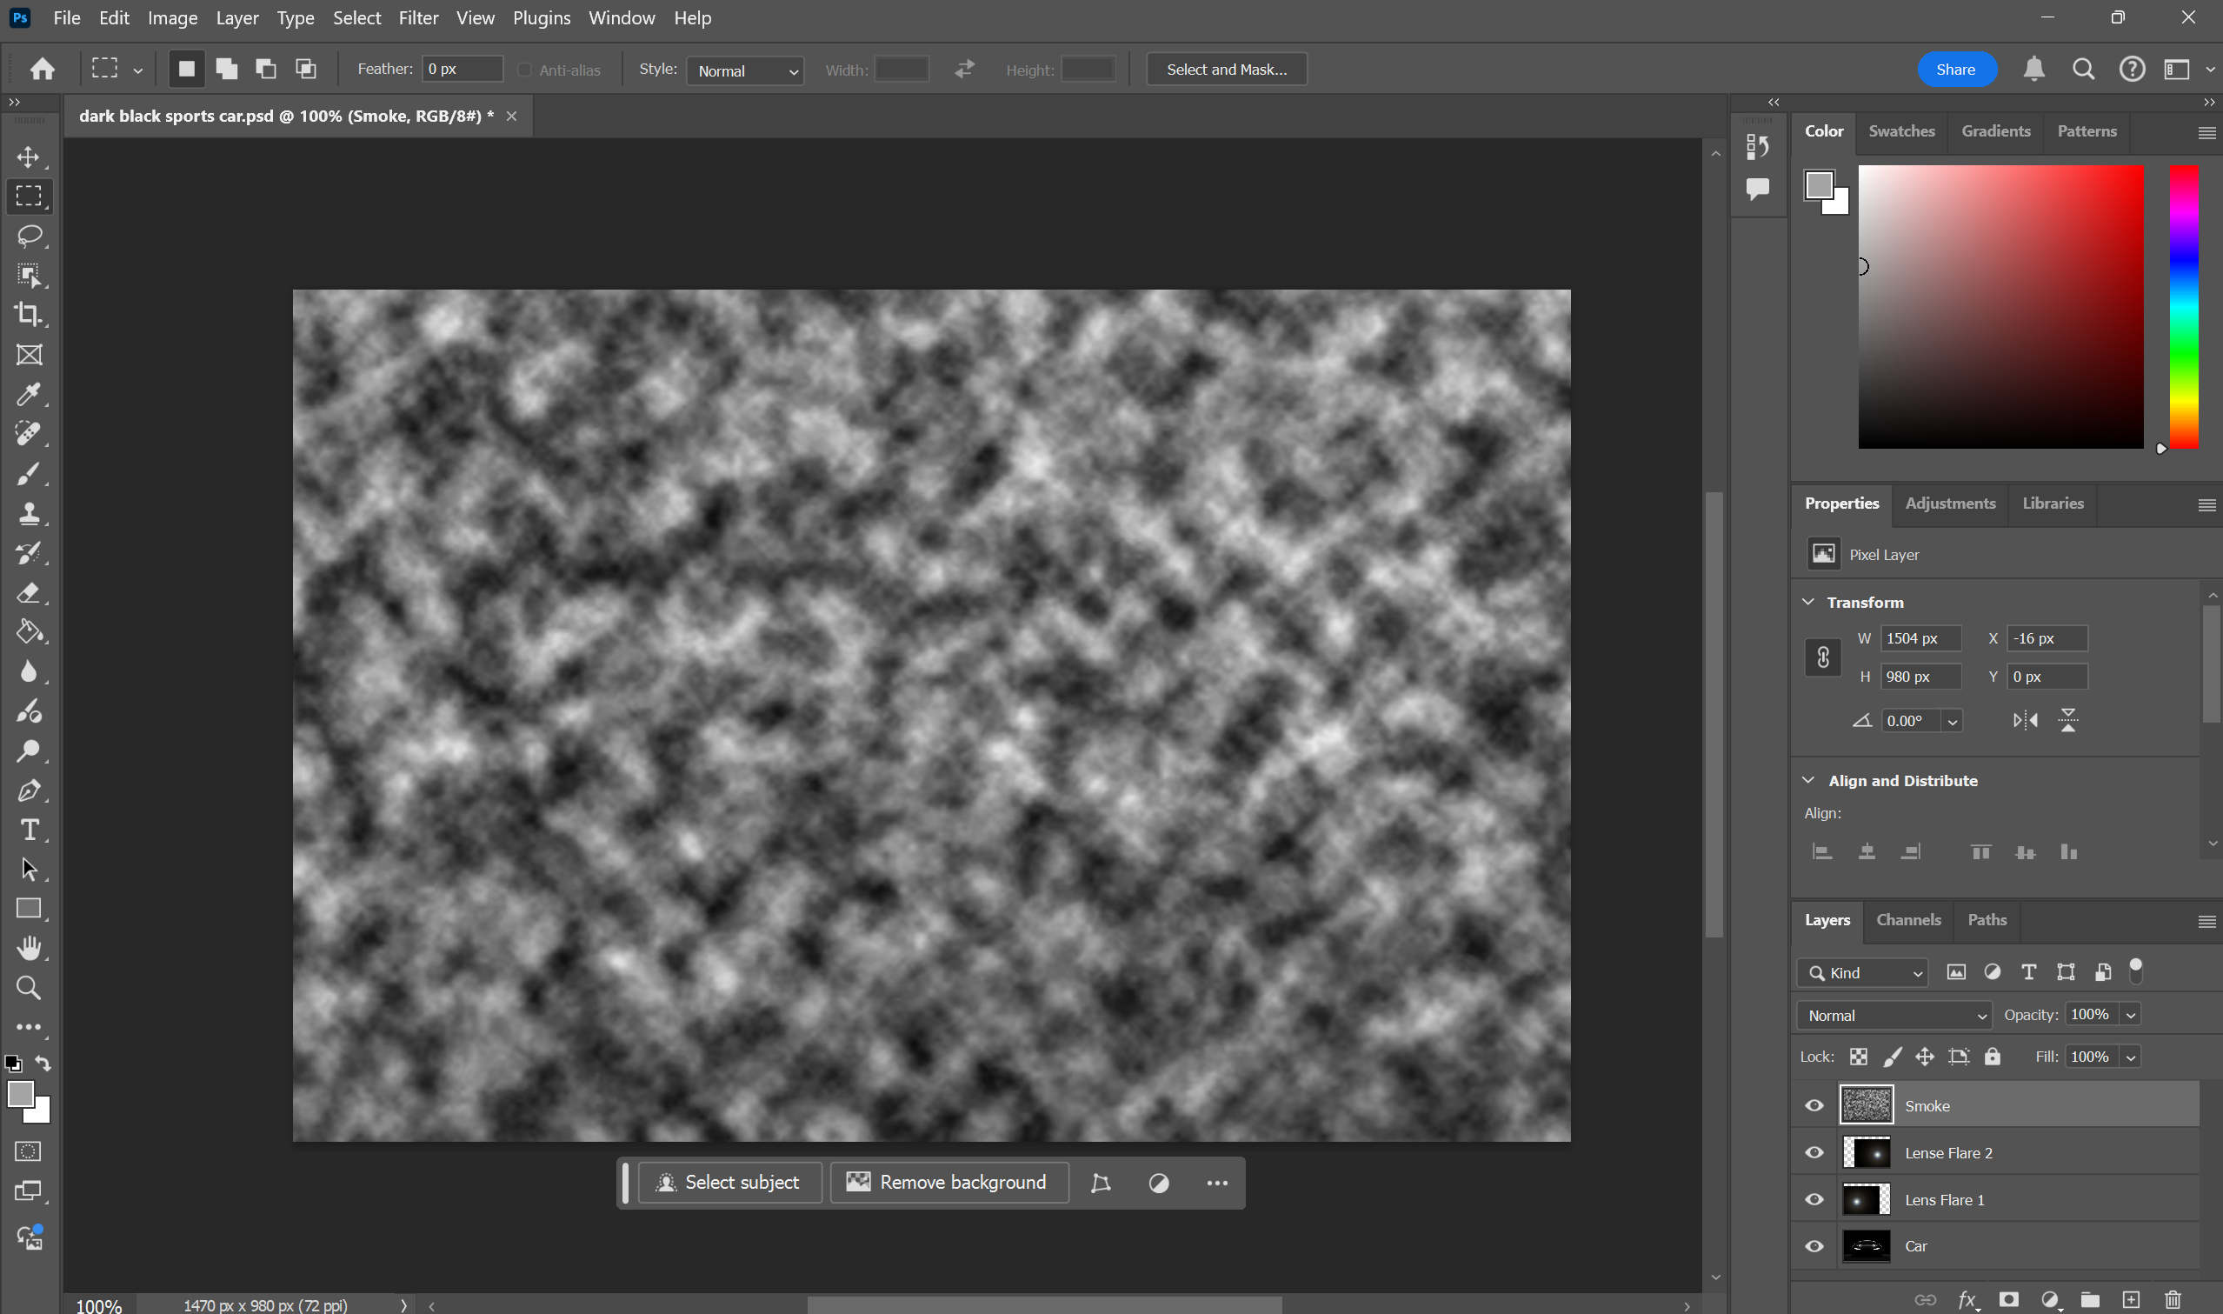
Documentation
Add a new layer
Copy and paste an image of cloud texture

Slide 17
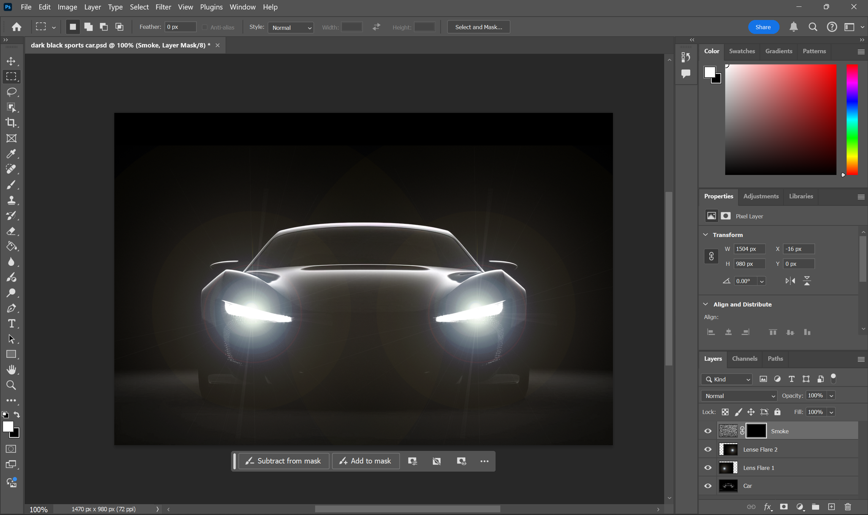
Documentation
Hold ALT and add a black screen.
Change layer from normal to screen

Slide 18
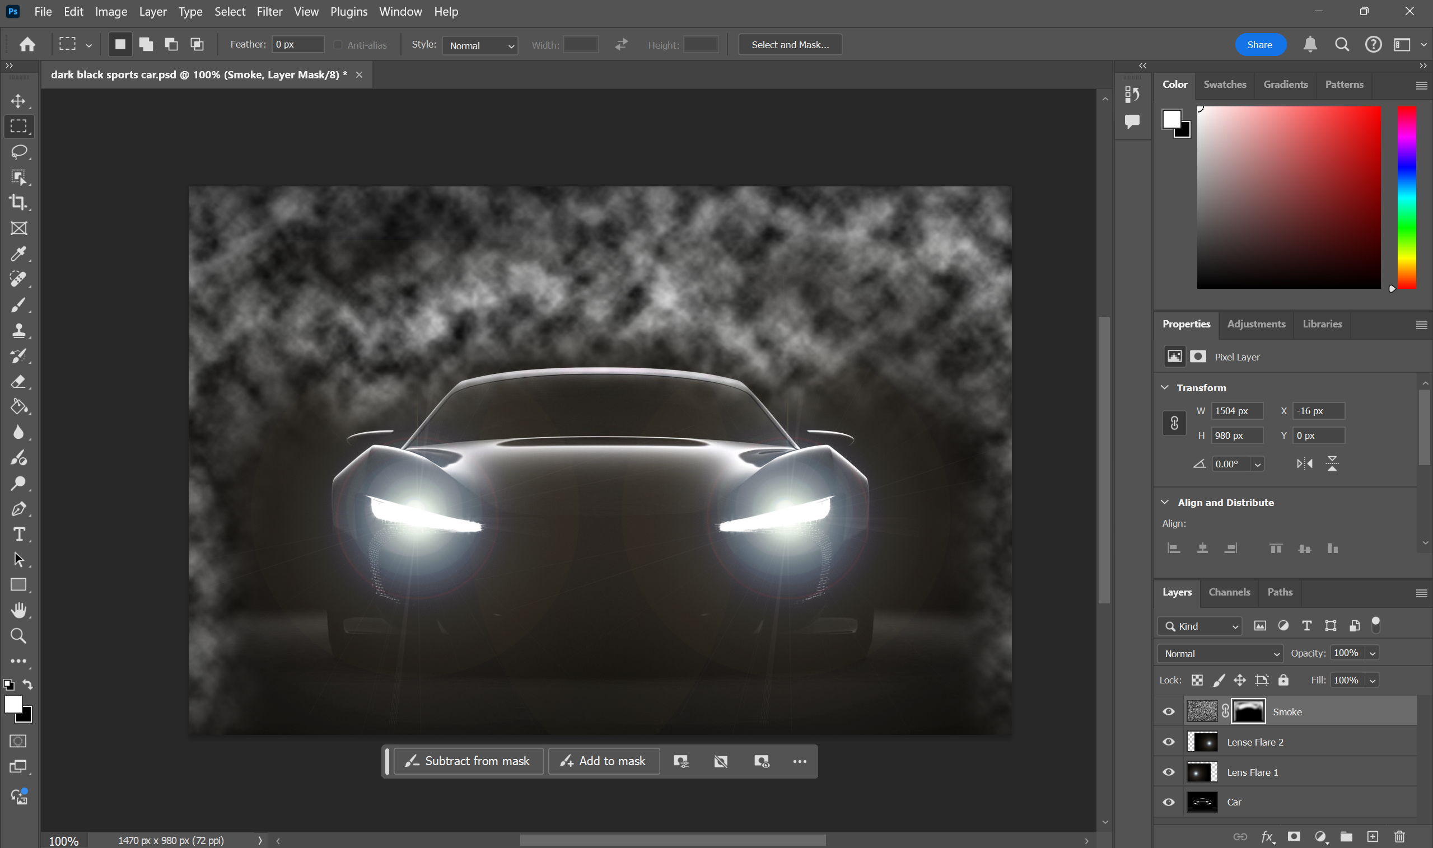
Documentation
Use a brush tool at 30% flow and use it on the edges and mainly the back of the car.

Slide 19
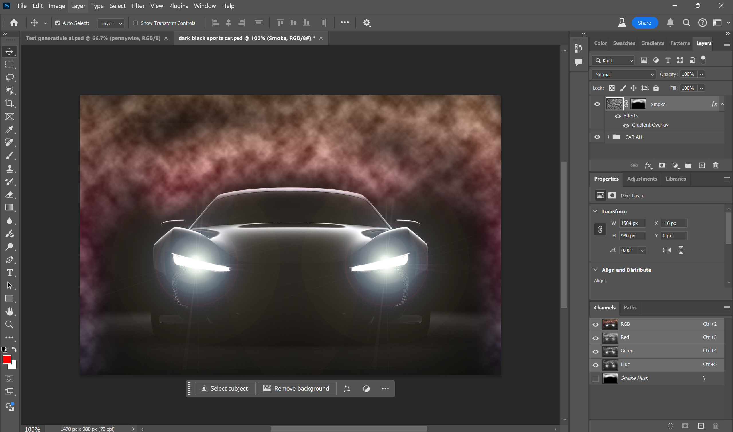
Documentation
Double click on the smoke layer.
Add a gradient overlay.
Select the last option in the red folder.
Make opacity 23%

Slide 20
Self Reflection
Working on this project has been both challenging and rewarding. Through the process, I gained a deeper understanding of how to use Adobe Photoshop to create a dynamic composition, especially with techniques like layering, blending, and effects like lens flare and smoke. These skills allowed me to convey the powerful themes of progress and its complexities in a visually impactful way.
I also learned the importance of balancing aesthetic appeal with meaningful symbolism. While I enjoyed creating a striking image, integrating elements like smoke and light to represent the duality of innovation added depth to my work. Reflecting on my initial concept and seeing how it evolved throughout the project has been insightful—I’m proud of how the final piece conveys both excitement and caution, following my original intent.
If I were to approach this again, I would experiment more with color grading to achieve even more contrast and mood, adding further depth to the concept. Overall, this project has improved my technical skills and pushed me to think more critically about the message behind my art.

Slide 21
Final Artwork

