Slide 1
YEAR 10 into VCE INFORMATION SESSION
Wednesday July 22 2020
Parent Session
Notes:
FKY

Slide 2
VCE Requirements
Sixteen units are required for the satisfactory completion of the VCE
3 Units of English (must include unit 3/4 sequence)
Minimum of 4 unit 3/4 sequences
Students usually complete 22 units (including VET) over the two years (12 units in Year 11 and 10 units in Year 12)
Tertiary ATAR (Australian Tertiary Admission Rank) Score is calculated by taking scores for an English + next best 3 subjects +10% of 5th and 6th subjects)
Notes:
FKY

Slide 3
VCE Requirements
VCE Baccalaureate ??
This is a bonus to some students. You do not apply for this.
Who would be eligible?
Students that complete
      English/ Literature/ English language (>30) / EAL(>33)
      Another Language
      Mathematical Methods or Specialist
      At least 2 other subjects

Slide 4
ATTENDANCE REQUIREMENTS – 90% in each unit
Medical certificate if absent for SAC
(School Assessed Coursework)
Special examination arrangements available (Please see Senior School staff to discuss)
Notes:
FKY

Slide 5
VCE subjects on offer at KSC
Accounting
Art
Australian and Global Politics
Biology
Business Management
Chemistry
Chinese Second Language
Chinese Second Language (Advanced)
Drama
English
English Language
English as an Additional Language
Environmental Science
Food Studies
French
Further Maths
Geography
Health and Human Development
History
Japanese
Legal Studies
Literature
Mathematics (Methods)
Mathematics (Specialist)
Mathematics (General)
Media
Music Performance
Physical Education
Physics
Psychology
Studio Arts
Visual Communication Design
Notes:
FKY

Slide 6
How do I choose subjects to study for VCE?
Consider pre-requisites for VCE subjects.
Choose subjects that you like.
Keep your options open at this stage.
Think about a broad course.
Notes:
FKY

Slide 7
English/EAL/
Literature/English Language
Notes:
MHA

Slide 8
English/EAL/
Literature/English Language
Students must choose English or EAL
Students may also choose Literature or English Language as well
Students must apply in writing to study Literature or English Language INSTEAD OF English
Notes:
MHA

Slide 9
VCE English options:
English – Students will be expected to:
Analyse texts such as plays, novels, films and media texts.
Respond both creatively and analytically to individual texts and complete a comparative analysis of two texts.
Complete a point of view in an oral presentation.
This is an ideal course for students to continue consolidating the English skills that they have been developing during their middle years.
Notes:
MHA

Slide 10
VCE English options:
EAL – Students will be expected to:
Analyse texts such as plays, novels, films and media texts.
Respond both creatively and analytically to individual texts and complete a comparative analysis of two texts.
Students also complete a point of view in an oral presentation.
This is an ideal course for students whose first language is not English.
To qualify for EAL in VCE a student must have no more than 7 years with English as their main language of instruction or have less than 7 years residency in a mainly English-speaking country (at the time of completion of Year 12).
Notes:
MHA

Slide 11
VCE English options:
Literature – Students will be expected to:
Able to analyse texts such as plays, poetry, short stories, novels and films. *There is no focus on media texts or persuasive speeches in this subject.
Write creative and analytical responses to texts.
Learn how to analyse passages with a focus on literary devices and the author’s intent. They are also introduced to literary perspectives and engage in critical readings about the texts they study.
This course is ideal for students who want to study more challenging and engaging texts in greater depth.
It can be taken in conjunction with English or on its own (with special approval).
Notes:
MHA

Slide 12
VCE English options:
English Language – Students will be expected to:
Analyse features of written and spoken texts through systematically pulling apart how a text has been constructed.
Students are required to read widely to develop their analytical skills and understanding of linguistics (the rules that govern language).
Students demonstrate knowledge through oral presentations, short answer tests as well as extended response essays and analytical commentaries.
This course is ideal for students who enjoy looking at how language is put together (grammar), how it has developed and changed over time and why we use the language we do in different contexts.
It can be taken in conjunction with English or on its own (with special approval).
Notes:
MHA

Slide 13




VCE English options:
VCE ENGLISH
VCE ENGLISH
ENGLISH/
LITERATURE / ENGLISH LANGUAGE
VCE LITERATURE
VCE ENGLISH LANUGAGE (UNIT 1 - 2)
VCE ENGLISH LANGUAGE (UNIT 3 - 4)
VCE EAL (UNIT 1 - 2)
VCE EAL (UNIT 3 - 4)
EAL (EAL)
Notes:
MHA

Slide 14
VCE Mathematics
Notes:
MHA

Slide 15
VCE Mathematic options
General Maths 1/2
Mathematical Methods 1/2
Specialist Maths 1/2
Further Maths 3/4
There a quite a few prerequisites that must be adhered to in order to study
the various streams of Mathematics.
Students will need to satisfy the levels to be eligible for these subjects.
Notes:
MHA

Slide 16
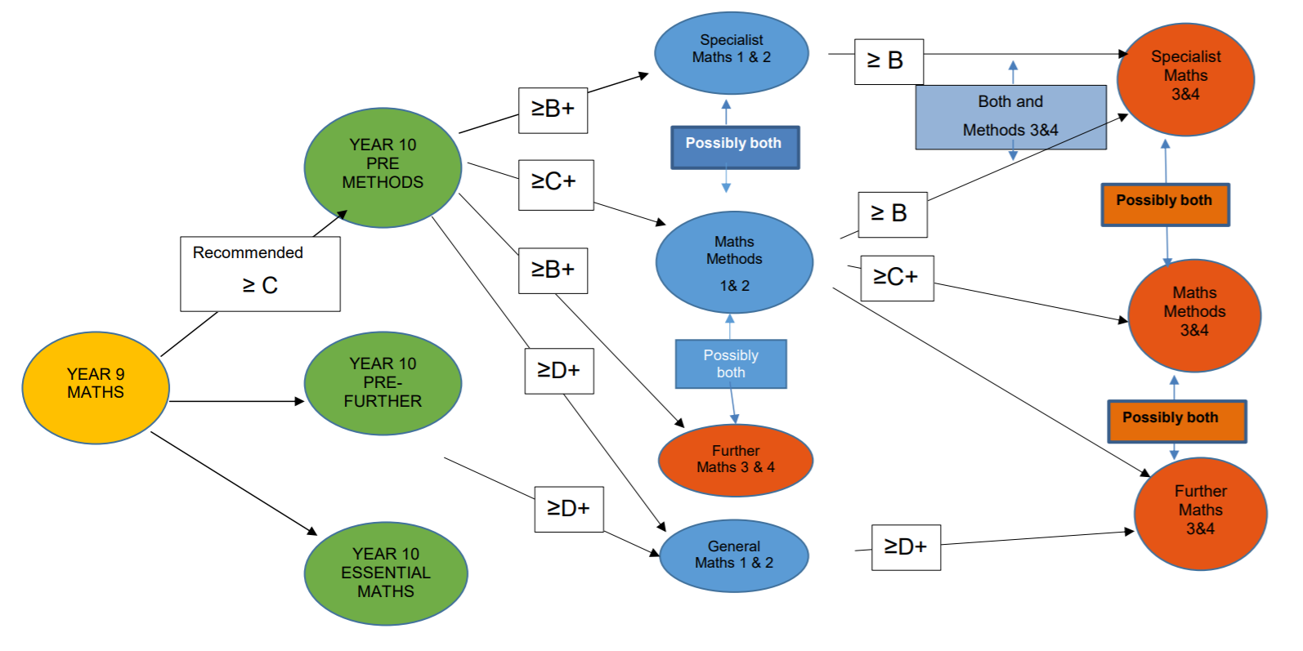
Notes:
MHA

Slide 17
Mathematics
Minimum standards
General Maths 1/2 | Minimum grade average of D+ for Semester 1 in Year 10 Maths
Mathematical Methods 1/2 | Minimum grade average of C+ for Semester 1 in Year 10 Pre-Methods Maths
Specialist Maths 1/2 | Minimum grade average of B+ for Semester 1 in Year 10 Pre-Methods Maths
Further Maths 3/4 | Minimum grade B+ average in year 10 Pre-Methods Maths
Notes:
MHA

Slide 18
VCE Science
Notes:
CSN

Slide 19
VCE Science
Biology
Chemistry
Environmental Science
Psychology
Physics
Notes:
CSN

Slide 20
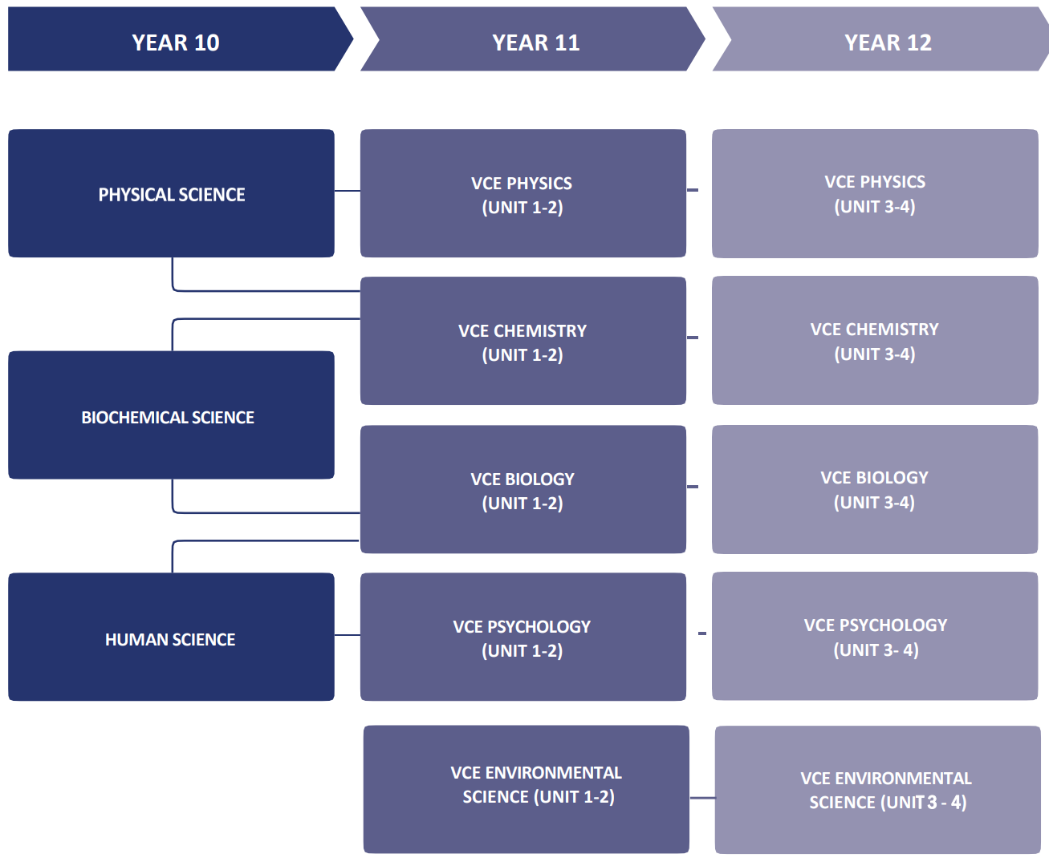
VCE Science
Notes:
CSN

Slide 21
VCE Humanities
Notes:
CSN

Slide 22
VCE Humanities
History
  How has the human race arrived at this point in time? History involves inquiry into human action in the past, to make meaning of the past using primary sources as evidence.
Geography
  Why do human and natural phenomena change their process across the earth? Geography is a structured way of exploring, analysing and understanding the characteristics of our world
Notes:
CSN

Slide 23
VCE Humanities
Legal Studies
  How do we protect the rights of individuals to achieve social cohesion? Legal Studies examines the institutions and principles which are essential to Australia’s legal system.
Australian and Global Politics
  Why should we be informed citizens, in local, national and international communities? A study of contemporary power at both national and global which examines political issues, and events.
Notes:
CSN

Slide 24
VCE Humanities
Business Management
  How do businesses manage resources to achieve a goal? Here you will learn the process from the first idea for a business concept, to planning and establishing, through to day-to-day management.
Accounting
  What is needed to make informed decisions to improve business performance? Accounting involves modelling, forecasting and providing advice to stakeholders through financial and non-financial accounting information.
Notes:
CSN

Slide 25
VCE Health and Physical Education
Notes:
CSN

Slide 26
VCE Health & Human Development
VCE Health and Human Development students investigate health and human development in local, Australian and global communities. Health is a dynamic condition that is influenced by complex interrelationships between individuals and biomedical and behavioural factors, as well as physical and social environments. Students will be required to analyse and interpret data across a number of settings.
Notes:
CSN

Slide 27
VCE Physical Education
VCE Physical Education explores the complex interrelationships between the body systems and human movement in Sport. The course also examines biochemical and skill acquisition principles used to analyse human movement skills and energy production from a physiological, psychological and sociocultural perspective. Students participate in practical activities to examine the core concepts that underpin movement and that influence performance and participation in physical activity, sport and exercise.
Notes:
CSN

Slide 28
VCE Art & Technology
Notes:
HBR/CSN

Slide 29
VCE Art & Technology
ART - Focussing on creating artworks as well as theory and analysis of the ways that artists interpret and present social issues. Painting, Drawing, Printmaking, Sculpture, Photography and more.
STUDIO ART - Students explore and analyse the practices of artists in society whilst developing their own studio process. Fashion, Fashion Photography, Sculpture, Installation, Textile Art, Printmaking and more
VISUAL COMMUNICATION DESIGN – Through theory and practice, students examine ways in which visual language can be used to convey ideas and messages. Exploring manual and digital methods in Architecture Design, Fashion Design, Poster Design and more
Notes:
HBR

Slide 30
VCE Art & Technology
DRAMA - Developing expressive skills in dramatic structures and performance of imaged characters.
MEDIA - Film making and developing skills in media design and production in a range of forms.
FOOD - Extending food knowledge and skills leading to pathways in wellbeing and practical food application
MUSIC - Presenting solo and group performances. Theory and analysis of music.
Notes:
HBR

Slide 31
VCE Art & Technology
Notes:
HBR

Slide 32
VCE Languages
Notes:
HBR/CSN

Slide 33
VCE Languages
FRENCH - Focussing on the modern standard version of French this subject enables students to use French to communicate with others as well as understand and appreciate the cultural contexts in which French is used.
JAPANESE – Both written and spoken forms of Japanese are studied in this subject. Hiragana and Katakana syllabaries and a prescribed number of Kanji are used.
CHINESE SECOND LANGUAGE – Focussing on the standard/official version of Mandarin Chinese. Students must have attended less than 12 months in a school where Chinese is the main language of instruction.
CHINESE SECOND LANGUAGE (Advanced) - Focussing on the standard/official version of Mandarin Chinese. Students must have attended less than 7 years in a school where Chinese is the main language of instruction.
Notes:
HBR

Slide 34
VCE Languages
OTHER LANGUAGES
Students interested in other languages can apply to do them externally.
Notes:
HBR

Slide 35
Subject Acceleration
Notes:
FKY

Slide 36
Subject Acceleration
Students are eligible to continue accelerating in a subject if they have satisfied the following criteria;
minimum B average overall
minimum B+ average in subject they have accelerated in
well organised
excellent attendance
Students that meet these criteria are encouraged to apply to complete a Year 12 (Units 3 & 4) subject in Year 11.
ALL students will be required to complete 5 subjects at Year 12.
Notes:
FKY

Slide 37
VCE Enhancement Subjects
Science | Art & Technology
VCE Biology | VCE Drama
VCE Psychology | VCE Music Performance
VCE Environmental Science | VCE Visual Communication & Design
Humanities | VCE Food Studies
VCE History | VCE Art
VCE Politics | VCE Studio Art
VCE Geography
VCE Business Management | Health & PE
VCE Legal Studies | VCE Health & Human Development
Mathematics | VCE Physical Education
VCE General Maths | Languages
VCE Mathematical Methods
Notes:
FKY
Students interested in pursuing the option of completing a VCE subject should consult the VCE handbook for information regarding the course requirements and content.

Slide 38
VET delivered in Schools
Notes:
KRI or CMA

Slide 39
VET delivered in Schools
Vocational Education and Training
(industry related training)
On completion students will receive an nationally recognised qualification. eg Certificate II in Automotive or Sport and Recreation
Notes:
KRI

Slide 40
VET delivered in Schools
Typically the courses run over 2 years
  1st Year = Unit 1 & 2
  2nd Year = Unit 3 & 4
Notes:
KRI

Slide 41
VET delivered in Schools
VET is a VCE subject and contributes to a students ATAR.
  Scored Program
  Students will sit an exam and this subject can contribute to a students primary 4 scored subjects.
  Non-Scored Program
  Students generally will not sit an exam but the subject contributes by adding 10% of the lowest primary 4 score to the ATAR.
Notes:
KRI

Slide 42
VET delivered in Schools
Provides an opportunity to try or learn more about a job whilst at school
Can provide pathways for students towards their aspired careers or further training.
Notes:
KRI

Slide 43
What happens now?
Log into Edval and follow the prompts to select subjects for 2021.
Student choices determine which classes will run in 2021, blocking grid and timetable grid will be determined late August/early September.
Students with subject clashes will be interviewed again.
Notes:
CSN

Slide 44
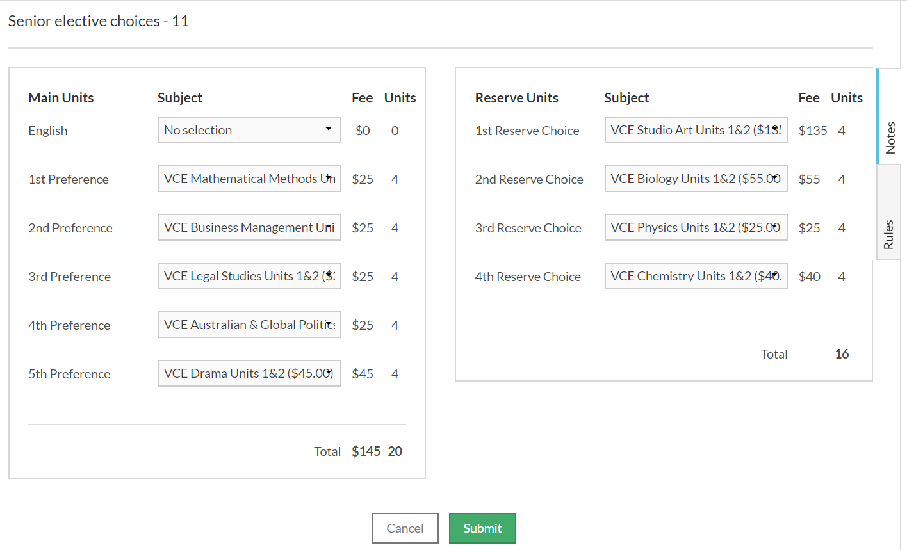
Entering Your Subjects
Notes:
CSN

Slide 45
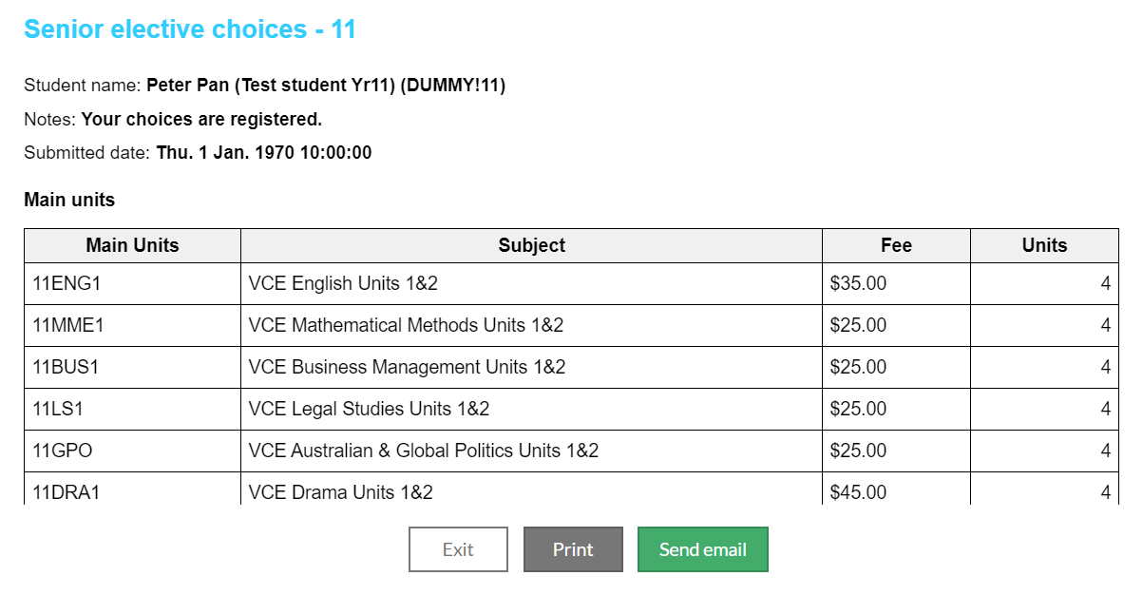
Sending Your Subjects For Review
Notes:
CSN

Slide 46
1:1 Zoom Interviews
Due to the COVID-19 restrictions our 1:1 Course Counselling Interviews will now be held via Zoom on Friday July 30
Students must book in their interview time with their allocated staff member using the Compass Conferences system (see screenshot in next slide for location)
A Zoom link and login details will be made available through the same Conferences tab on Compass. Students and parents should log into this meeting 2 minutes prior to its scheduled start.
There may be a delay in the staff member letting you in from the wait room so please be patient for it to begin.
Notes:
CSN

Slide 47
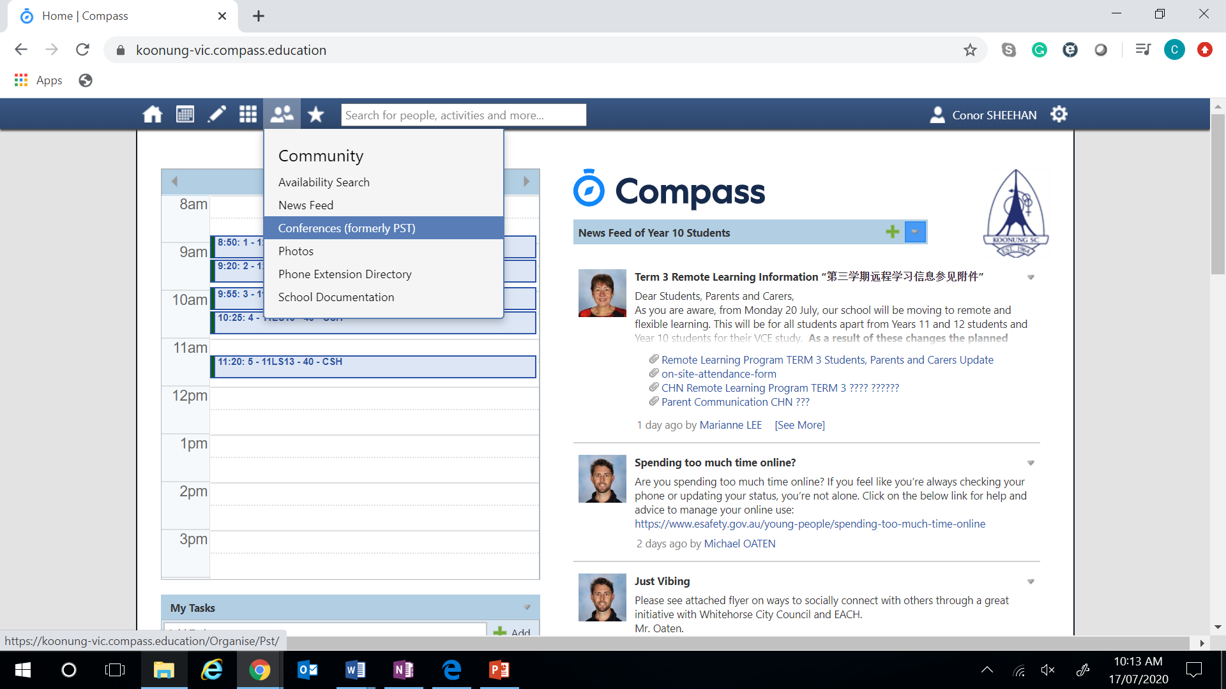
1:1 Zoom Interviews
Notes:
CSN

Slide 48
1:1 Zoom Interviews
Completed Course Counselling forms should be emailed to your allocated staff member the day before your interview.
Please also include your list of chosen subjects in this email either via a screenshot of Edval or a typed list in order.
We strongly encourage parents/carers to make time to attend the Zoom Interview alongside the student if this is possible.
Notes:
CSN

Slide 49
Subject information available from VCE handbook www.koonung.vic.edu.au
Online subject selections open Wednesday July 22 and
close Thursday July 30 2020.
Individual interviews will be carried out with ALL students on
Friday July 31 2020.
Follow up interviews as required
ALL deadlines must be met
Notes:
CSN

Slide 50
Student & Parent/Carer Questions???
Notes:
PANEL

Slide 51
Student & Parent/Carer Questions Continued
Please don’t hesitate to ask questions as you go through this process or ask anything that was not covered in this presentation.
Questions can be emailed to Conor.Sheehan@education.vic.gov.au
There is no such thing as a stupid question
Notes:
CSN

