Slide 1
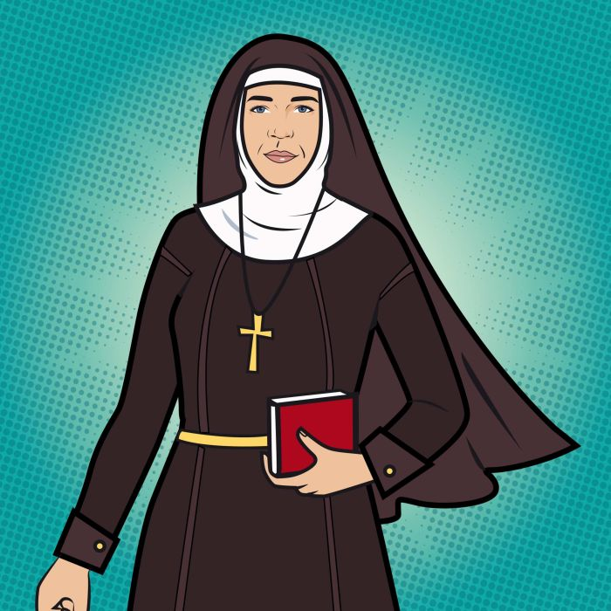
Feast of St Mary of the Cross

Slide 2
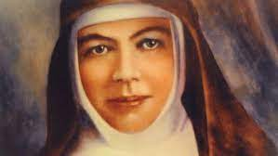
Introduction
Welcome everyone to our special celebration today of the life of Mary MacKillop, Australia’s first saint. Mary MacKillop is not only the first Australian to be recognised by the Church as a Saint, she is truly a very Australian saint. She characterises the spirit of the Australian mythology.
She was an extremely hard worker who always put the needs of others before herself. Her commitment to the schooling of children
from poor and rural communities established a model of Catholic education that continues today. She is truly a Saint for and of Australia!
Please stand and join in our opening hymn.

Slide 3
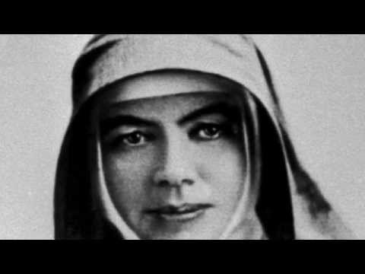

Slide 4
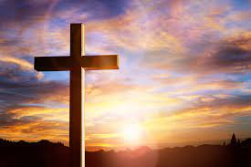
In the name of the Father, Son and Holy Spirit.
Amen.

Slide 5
Opening Prayer
Lord God, be with us this morning as we gather to celebrate Saint Mary. May we follow her example to live the Gospel in changing times and to respect and defend the human dignity of all in our land.
All: Amen

Slide 7
Prayers of the Faithful
For Pope Francis, the Bishops and all the Priests. We ask that you watch over them as they continue to show their love for the church and the world.
Lord, hear us:
All: Lord, hear our prayer.

Slide 8
Prayers of the Faithful
For every Catholic in Australia. May they follow the Example of St Mary, centering their lives on Christ, and generously sharing in the work of the Church.
Lord, hear us:
All: Lord, hear our prayer.

Slide 9
Prayers of the Faithful
For your children. May we see, like St Mary, that all children have the right of an education, and so work to give that opportunity to all, including those who are disabled, those who live in difficult family circumstances and those who are asylum seekers.
Lord, hear us:
All: Lord, hear our prayer.

Slide 10
Prayers of the Faithful
For all Australians. May they be proud, like St Mary, of this nation, and be united, work for National Reconciliation, and develop a tolerant, respectful and compassionate country.
Lord, hear us:
All: Lord, hear our prayer.

Slide 11
Prayers of the Faithful
For the Sisters of St Joseph. May they be blessed as they continue the work begun by Mary MacKillop and making sure that education is accessible to all.
Lord, hear us:
All: Lord, hear our prayer.

Slide 12
Closing Prayer
Thank you for coming to our celebration of St Mary of the cross. Through the example of Saint Mary of the Cross, may you learn to recognise God’s will for you and trust in his providence.May her life of service awaken in you a deep respect for the poor and a strong will for justice. May you share in her courage, see with the eyes of Christian love, and learn from her holy deeds.

Slide 13
In the name of the Father, Son and Holy Spirit.
Amen.

Slide 14
A CROSS OF STARS
Andrew Chin
Across these great lands she brought the Good News
With courage and love in her heart
That faith and hope and love may live
Beneath a Cross of Stars
Beneath a Cross of Stars

Slide 15
Early in life she heard God’s call
The call of Christ to stand with the poor
To serve like Joseph, to serve indeed
To teach, to love, to answer a need

Slide 16
A cross these great lands she brought the Good News
With courage and love in her heart
That faith and hope and love may live
Beneath a Cross of Stars
Beneath a Cross of Stars

Slide 17
Soon others saw Mary’s shining light
They came from far and they came from wide
To stand with the poor to teach with the young
To see that Christ’s song would one day be sung

Slide 18
A cross these great lands she brought the Good News
With courage and love in her heart
That faith and hope and love may live
Beneath a Cross of Stars
Beneath a Cross of Stars

Slide 19
“Have courage no matter what your crosses are”
This Mary knew when times were hard
She trusted in God, and God did provide
And Mary’s love traveled far and wide

Slide 20
A cross these great lands she brought the Good News
With courage and love in her heart
That faith and hope and love may live
Beneath a Cross of Stars
Beneath a Cross of Stars

Slide 21
Across a vast land from north to south
And to the land of the Long White Cloud
She carried her dream, she followed her call
So that our faith would live in us all

Slide 22
A cross these great lands she brought the Good News
With courage and love in her heart
That faith and hope and love may live
Beneath a Cross of Stars
Beneath a Cross of Stars (x2)

Slide 23
Feast of St Mary of the Cross

