Slide 1

The Gap SHS
Athletics
Carnival
Week 2 – Term 3

Slide 2

Pre-Carnival Events
These will all occur at Morning Tea on the oval.
20/07 - Monday - 1500m
21/07 - Tuesday - Javelin (parent permission required - come and get a form from the sports hall)
22/07 - Wednesday - Discus (parent permission required - come and get a form from the sports hall)
Thursday - Junior school carnival during P3 & 4.
Friday - Full school carnival
Start collecting points for your house, as well as Age Champions.
Any questions, come and have a chat to the HPE staff in the sports hall

Slide 3

Junior School (Yr. 7, 8 & 9)
Athletics Carnival - Thursday
Period 1-2 normal classes
11:00 – 11:35 Morning tea break
11:35 – 11:40 All students to move to Period 3 classroom. Teachers to mark period 3 SUBJECT rolls. Teachers to instruct students of the first round of events and where they will be located.
11:45 Events Start
12:50 – 1:15 Lunch
1:15 – 1:20 Students to meet at their next round of events.
2:20pm Students to be seated in grandstand for final instructions and dismissed. Roll Marking in P4 classes by P4 teachers.

Slide 4
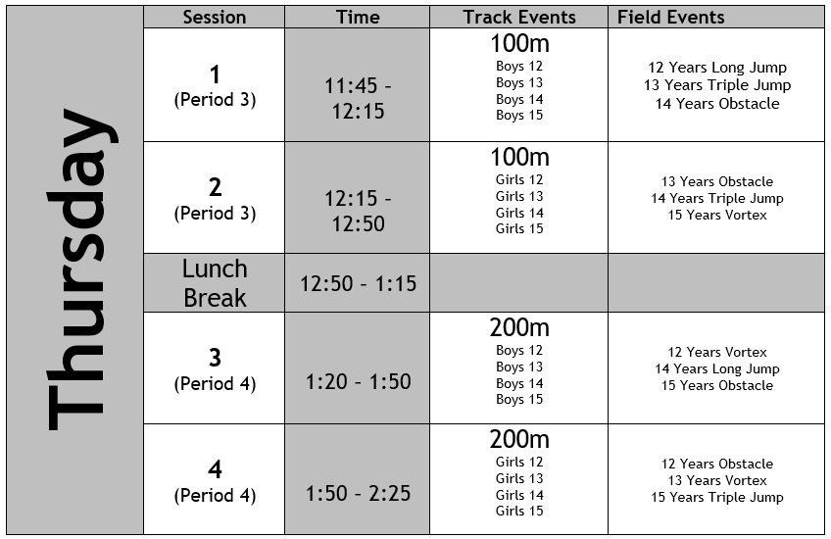
Thursday Event Times:

Slide 5

Athletics Carnival – Friday Timetable
8:35 FULL SCHOOL ASSEMBLY & ROLL MARKING (SPORTS HALL)
    Students to line up in connect classes.
8:50 STUDENTS MOVE TO GRANDSTAND/HOUSE AREAS
8:50 HOUSE WAR CRY
9:10 TRACK AND FIELD EVENTS COMMENCE
1:20 INTERHOUSE 4 x 100 RELAYS
1:55 THE GAP GIFT
2:15 ROLL MARKING -Students to in connect classes.
2:25 PRESENTATION OF TROPHIES CLEAN UP HOUSE AREAS AND OVAL
2.30 STUDENTS DISMISSED

Slide 6

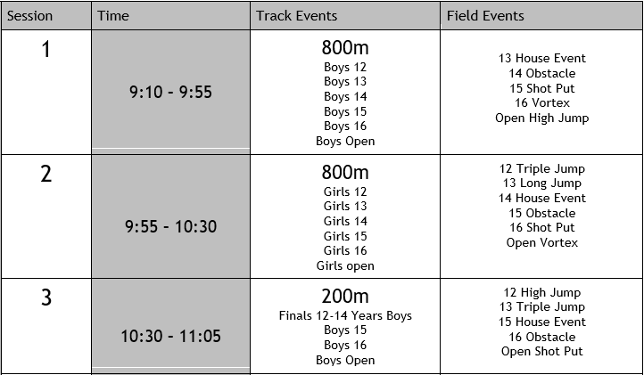
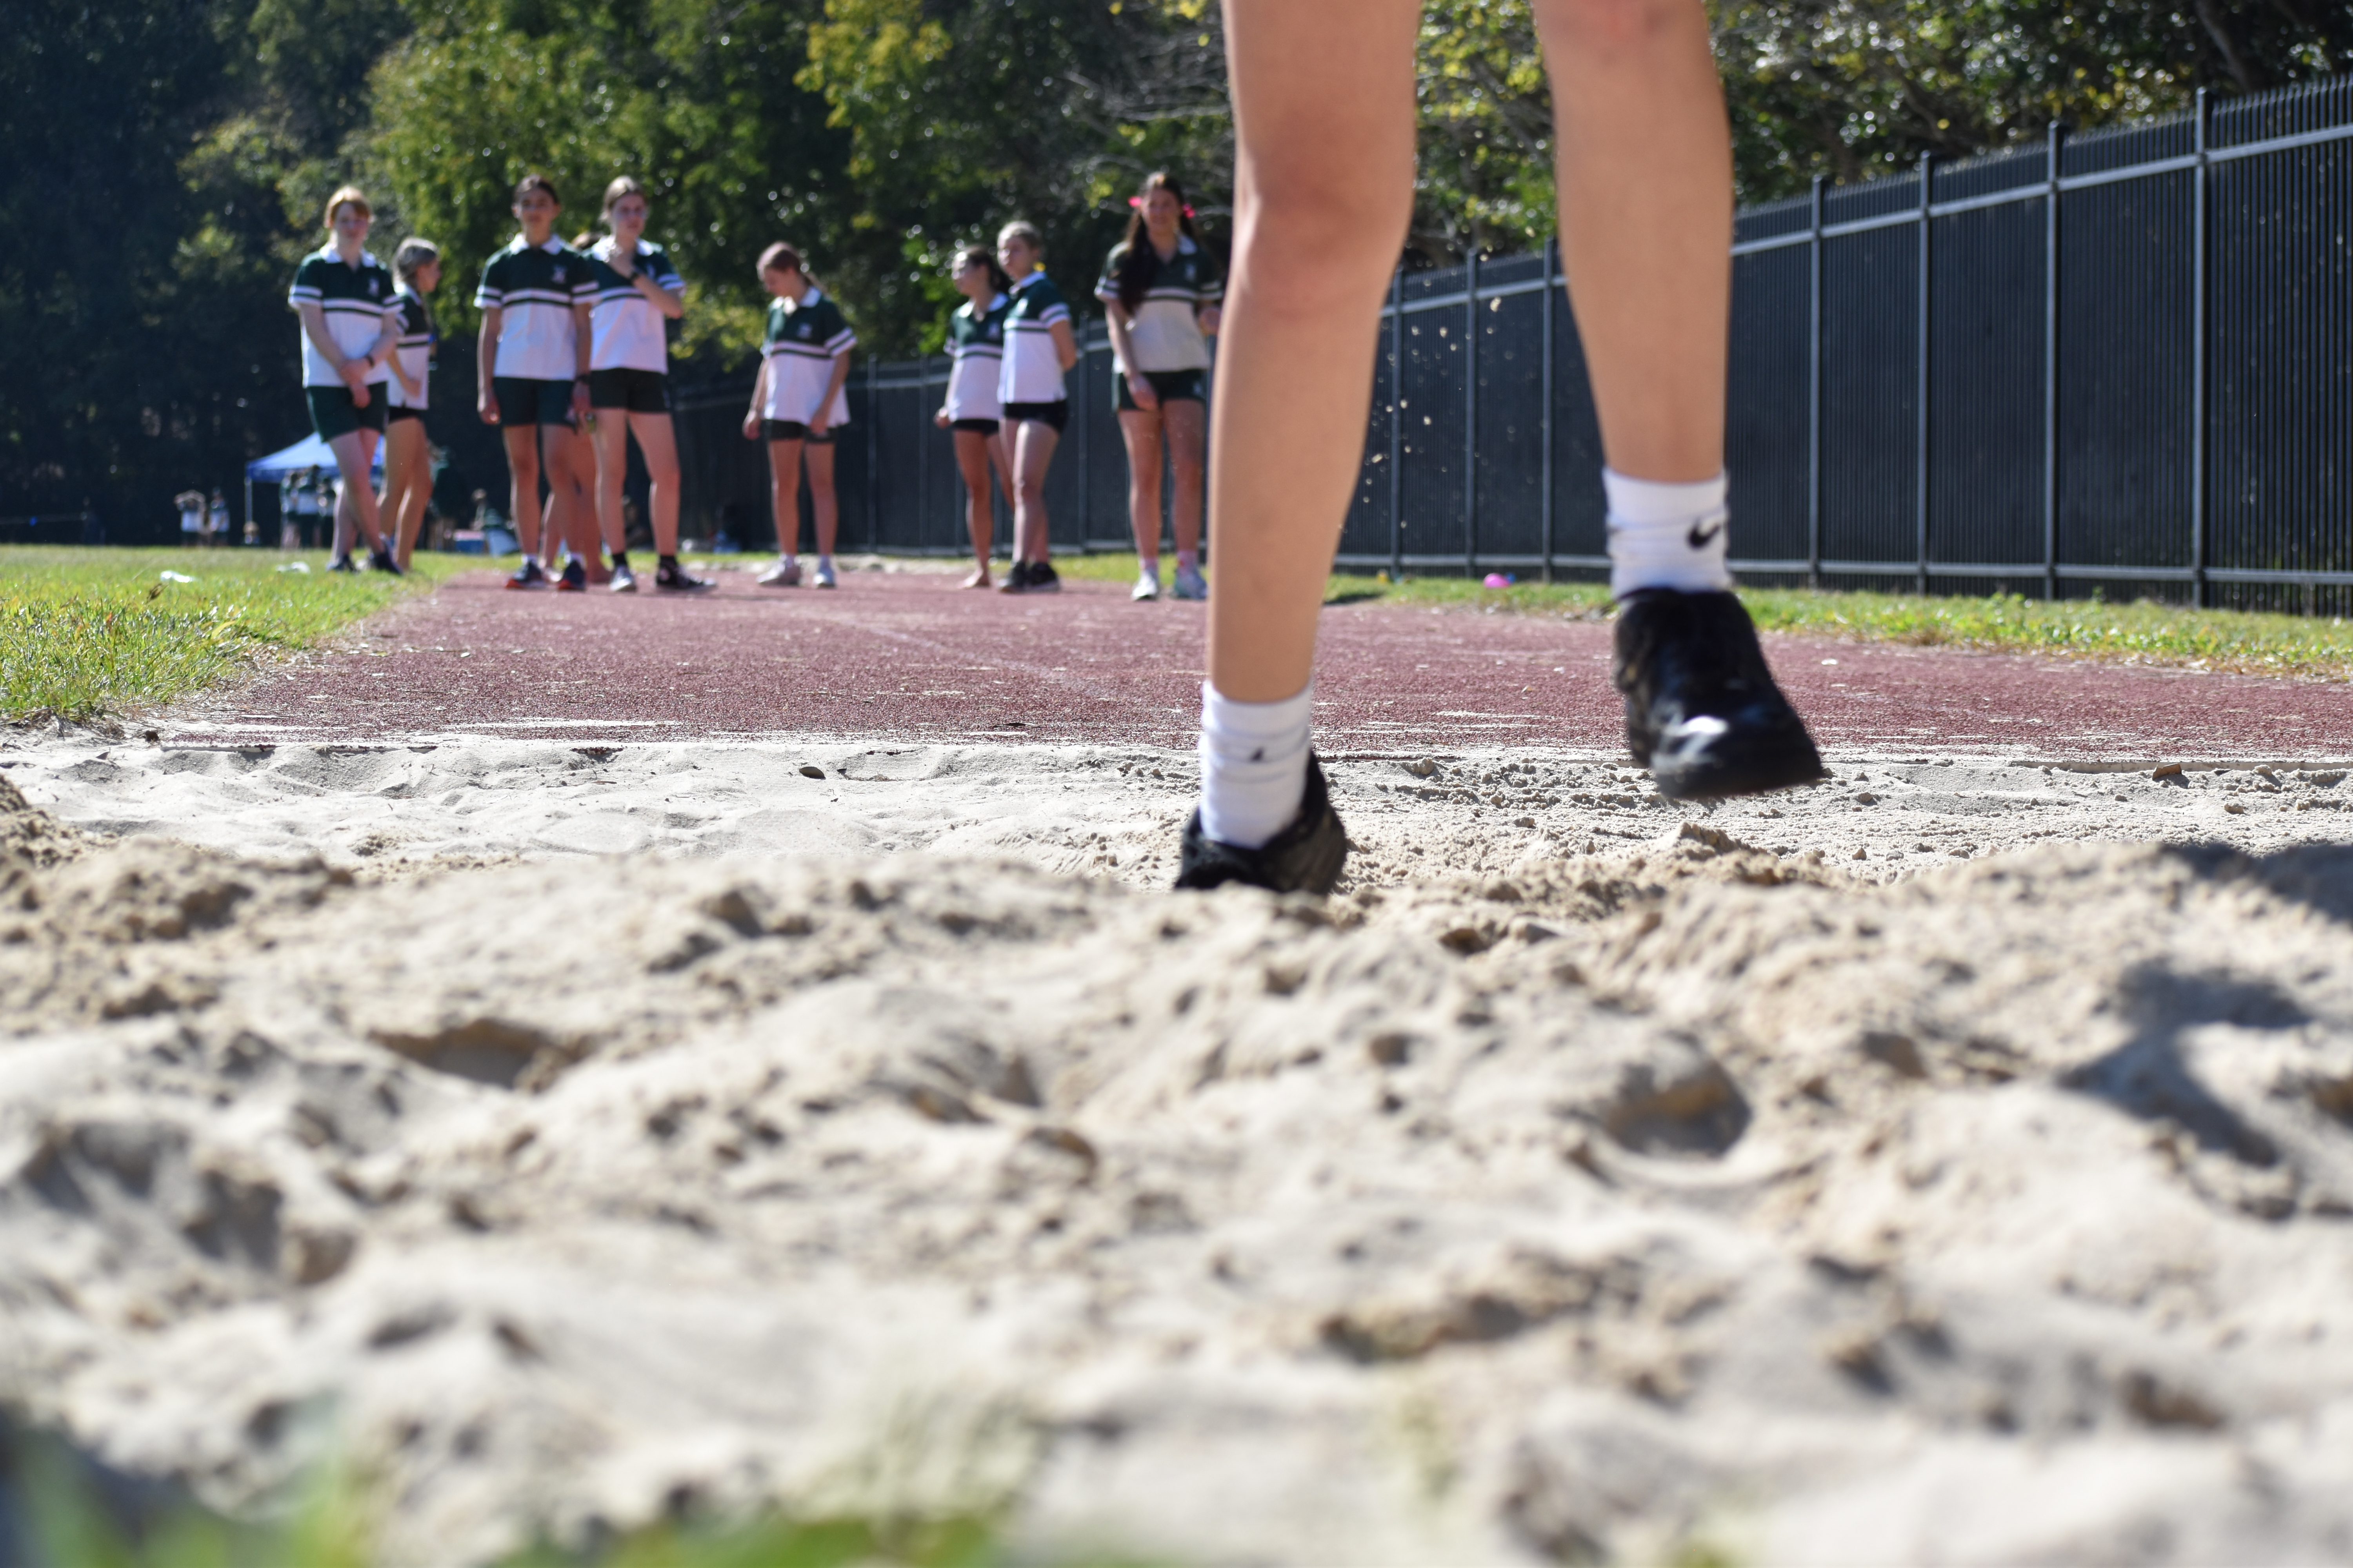
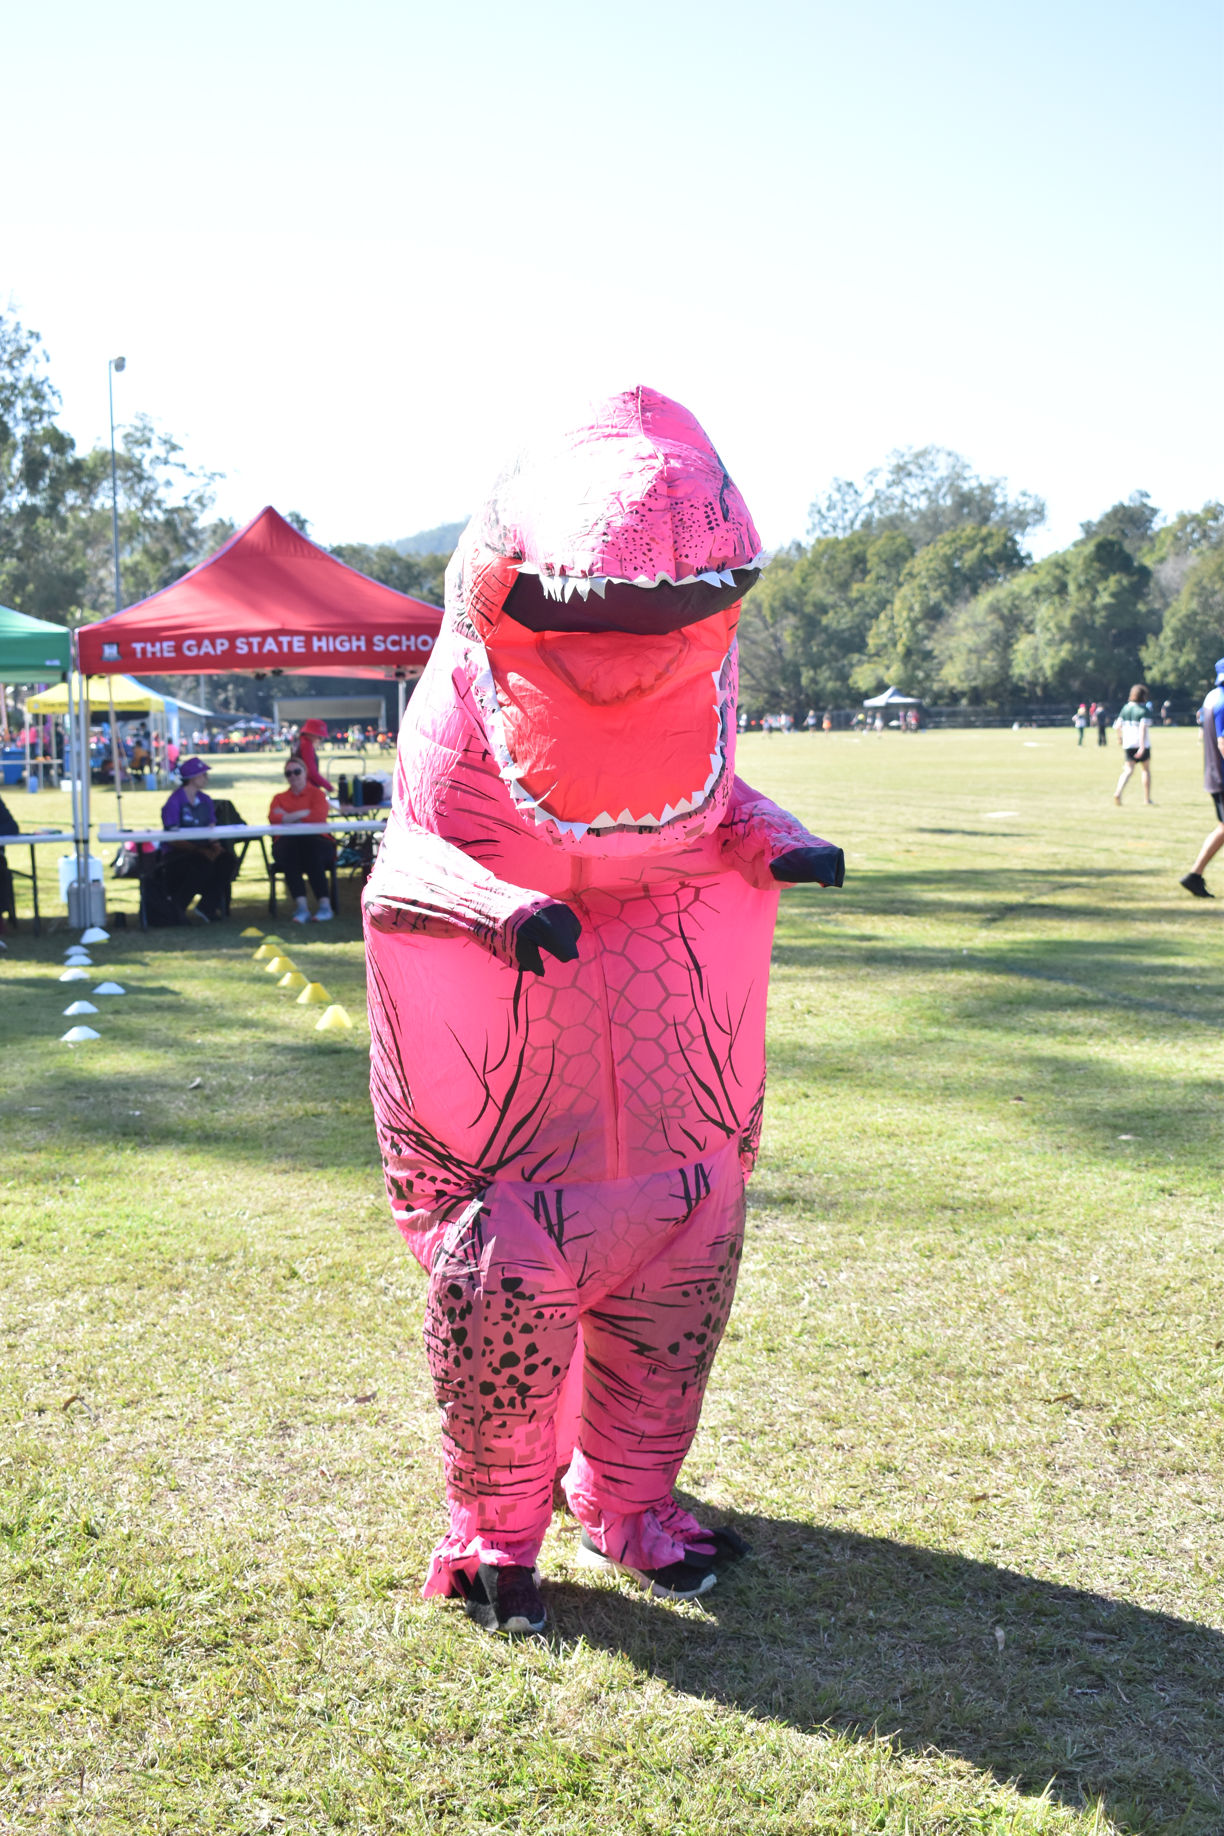


Friday Event Times

Slide 7
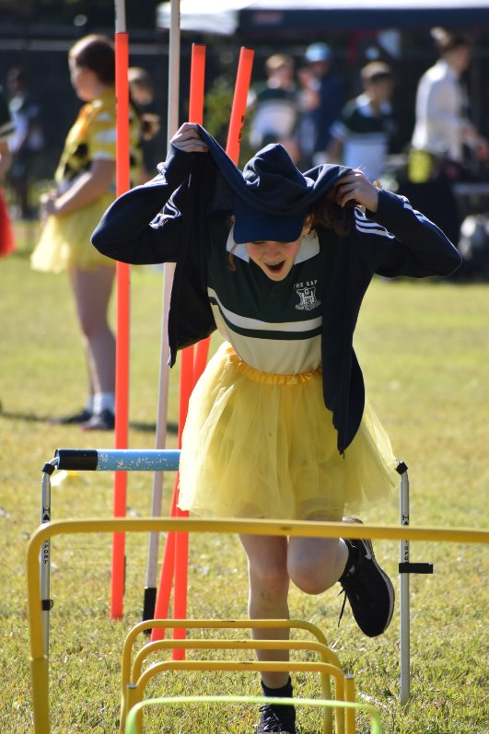
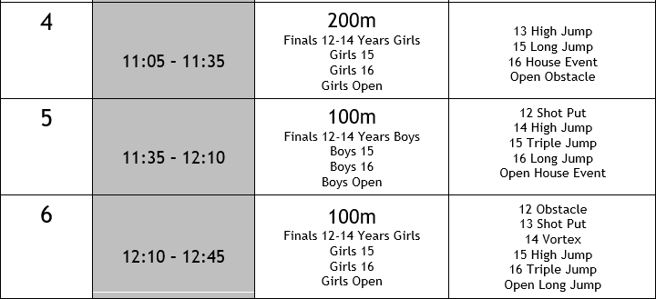


Slide 8
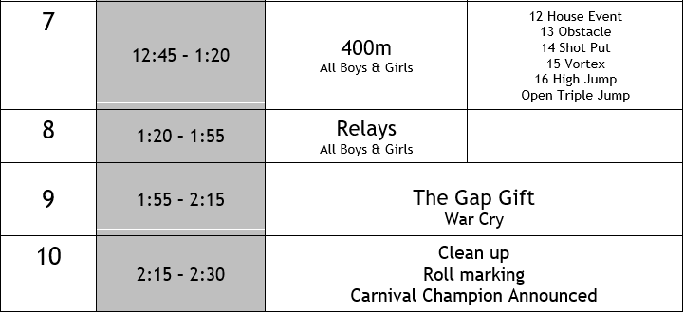
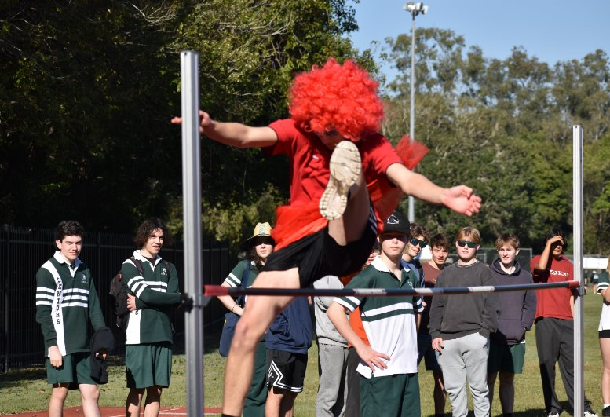


Slide 9
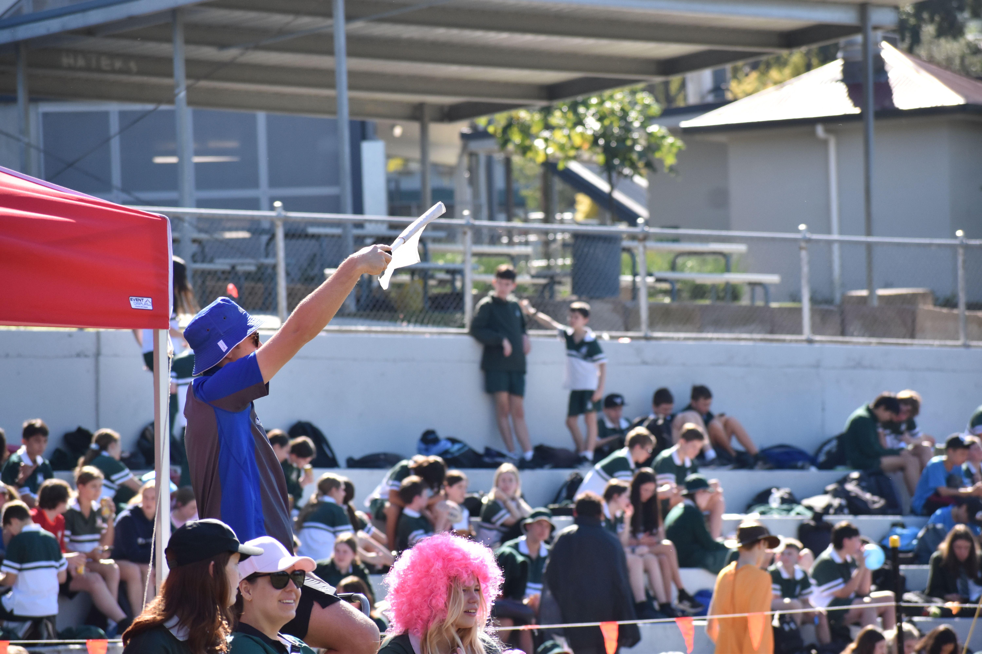
Athletics Carnival Uniforms
Thursday: Year 7 – 9
    Sports Uniform all day
      Bring house colours for P3 & 4
Friday: Whole School
    House Colours or Sports Uniform
    Must have sports shoes (no slides etc)

Slide 10

Spare Long Jump
Girls Long & Triple Jump>>
<<Boys Long & Triple Jump
Spare Long Jump
Obstacle Event Area – Near Discus Nets
Girls High Jump
Boys High Jump
200m Marshalling
Infield Out of Bounds to Spectators
Infield Out of Bounds to Spectators
Girls Vortex
Boys Vortex
House Event Area – End of 100m
100m Marshalling
Time Keepers
Boys Shot
Girls Shot
BBQ
Audio equipment
Recording Tent
Athletics Shed
400m/800m Marshalling
Goolagong
Blackburn
Paterson
Hollows
Cowan
Irwin
Freeman
Mabo

