Slide 1
National Science Week 2023
CPS Diorama Competition

Slide 2
National Science Week 2023 Theme:
Innovation - Powering Future Industries
Innovation is a fantastic word, and it's not as complicated as it may sound. Innovation means using your imagination and creativity to come up with new and clever ideas or ways of doing things. It's about finding better solutions to problems and making things that can help people in different ways.
For example, think about how we used to communicate long ago—by writing letters and waiting for days or weeks for a reply. But then, someone had an innovative idea! They invented phones and later smartphones. Now, we can talk to people instantly, even if they're on the other side of the world!
Innovation can happen in all kinds of fields, like technology, art, sports, and even in your schoolwork! It's about being curious, asking questions, and trying out new things.

Slide 3
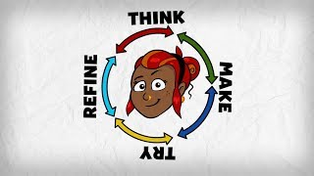

Slide 4
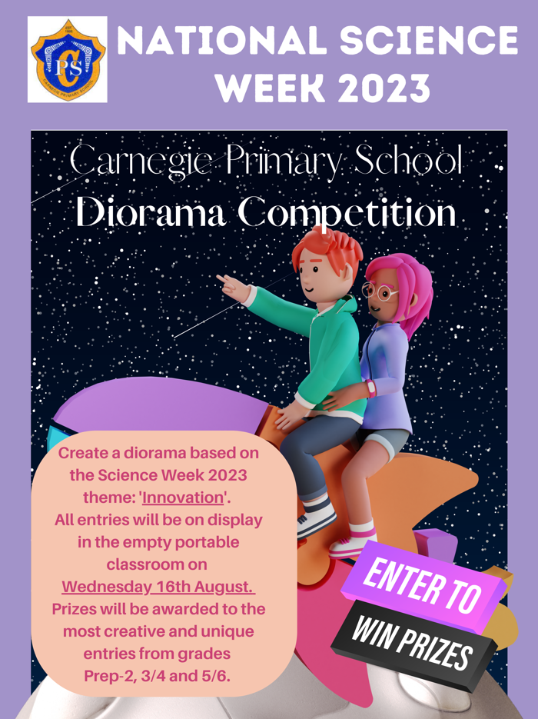
Diorama Competition
Task - Build a diorama based on the theme of ‘innovation’. Watch this video to learn how to make a diorama. You will find some pictures of dioramas on the following slides for some extra inspiration.
Due - Bring your diorama to the empty portable classroom (middle row of portables) between 8.45am - 9.00am on Wednesday 16th August (during Science Week),
Prizes - Prizes will be awarded to the most creative and unique entries from grades Prep-2, 3/4 and 5/6 . Winners will be judged by our student Discovery leaders and announced during our whole school assembly on Monday 21st August.
Expo - Classes will be invited to view the dioramas throughout the day on Wednesday 16th August.

Slide 5
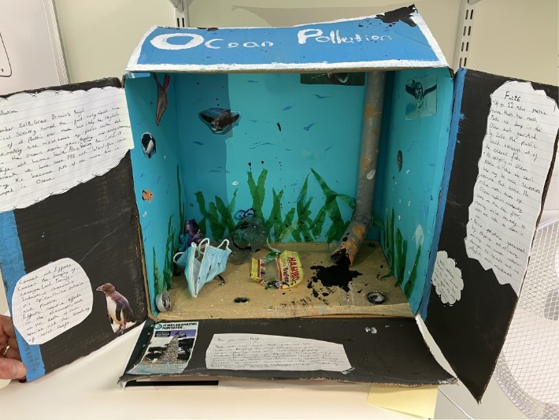
Diorama Inspiration

Slide 6
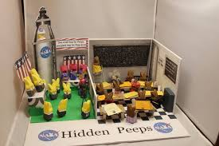
Diorama Inspiration

Slide 7
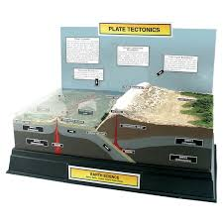
Diorama Inspiration

Slide 8
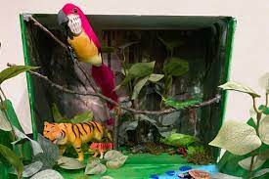
Diorama Inspiration

Slide 9
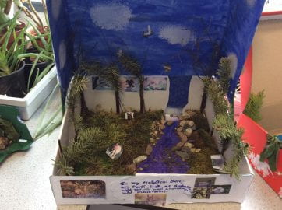
Diorama Inspiration

Slide 10
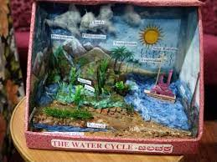
Diorama Inspiration

Slide 11
Happy Innovating!

