Slide 1

Starting school in 2025
Parent information session
We learn at Newlands Primary School,
We walk hand in hand.
We would like to say thank you for letting us share the land that you love.
We promise to to take care of it.
We want to pay respect to our Elders, past, present and future.
Presented by Sonya O’Brien
Student Wellbeing Leader

Slide 2
Can you remember your first day at school?
Write down ten words to describe your first day/year.
Starting school is an important event for children and their families and a positive experience can set the tone for the rest of their school experience.
Are you ready for your child to start school?
Is your child ready to start school?
What information do you need to support you through this period of time?
Write down any questions you have and we will revisit them at the end of the session.

Slide 3

I’m Worried
As the first day approaches, listen to your child and their specific concerns. While some students are anxious over a new school and teacher, others are anxious over learning the layout of a new building, going to the toilet or how they will manage the playground with all the ‘big kids’.
Instead of saying “Oh, you’ll be fine!” take some time to talk about the concerns.
Conversations over the fears can take away so many of the anxious feelings. These conversations may need to be repeated during the first few weeks of school while children are still learning routines and getting used to the school environment.
Can we turn anxiety into resilience?

Slide 4
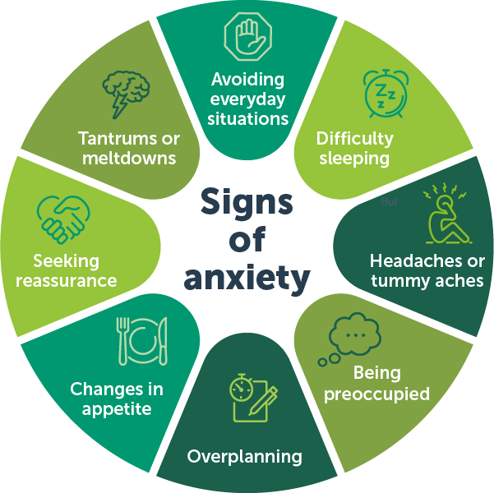
Feeling worried or anxious sometimes is normal. But some children have excessive or repeated fears, worries and anxious feelings that can last for weeks or more. These strong feelings can interfere with typical daily activities, such as going to school or seeing friends, which children may try to avoid. When children’s anxiety is severe or long-lasting it may be an anxiety disorder.
For parents, it can be hard to spot the signs of anxiety as it can show up in a variety of ways. Avoiding a situation that makes your child anxious may seem best, but it can quickly become a pattern that is hard to break.
Common signs and symptoms
Regularly avoiding everyday experiences and situations, such as school, social events, playing, sport, eating or sleeping
Physical complaints, such as tummy aches and headaches
Sudden emotional or angry outbursts, tantrums or ‘meltdowns’
Difficulty sleeping
Changes in appetite
Seeking reassurance often
Being preoccupied or unable to concentrate
Many children will show these signs from time to time, and they may not be related to anxiety.
When these signs appear frequently, in an ongoing pattern and cause your child to struggle with everyday life, you may need to seek professional support. The school can assist you to do this.
Source: RCH website: https://www.rch.org.au/anxiety/

Slide 5

What happens when you are anxious?
What might the clues be for your child?

Slide 6
Resilience is being able to bounce back and stay grounded after the bad stuff happens and it is vital for all children to have.
A child’s greatest resource is the support system they have in their environments.
Part of this support can be how we model working through the tough days or situations.
This can start in the home and become an everyday part of life.

Slide 7
Foster Independent Skills
Anxious feelings can be very different based on age. For younger children, they may be anxious about not knowing who is going to help them when parents are not around. Prior to the school year, it can be helpful to spend time practicing ways to, zipping up jackets, put clothes on and off and opening snack containers. If these issues arise in school and children are not prepared, so many anxious feelings can come at once. However, if children may be able to complete these items by themselves, they may not worry as much. If your child is unable to do some of these items before school starts, just let them know it is okay to ask for help.
Use Visual Supports
Anxiety can increase greatly when children don’t know what to expect. As a parent, think of the nerves of starting a new job and being unsure of what to wear, where to go, and what to expect. This is the same for children but multiplied greatly due to the young age and unfamiliarity with the unknown. For younger students, visual reminders may be helpful, such as what to do before bed: go to the bathroom, brush teeth, lay out clothes for tomorrow, and pack a backpack. For teachers, this can mean a visual schedule posted in the classroom to help students know what to expect next, such as a breakdown of the day: morning routine, math, lunch, recess, reading, specials. By having visual aids, children have consistent reminders and can breathe easier knowing what is next or what is expected.
Your classroom teacher will have a visual outline of what their day at school will look like displayed for them to see each morning.

Slide 8
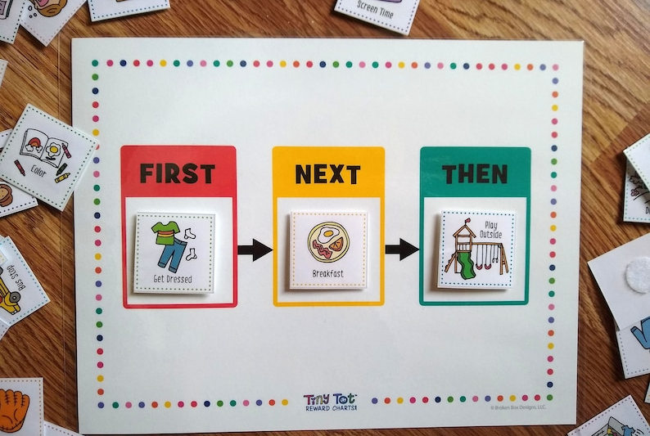
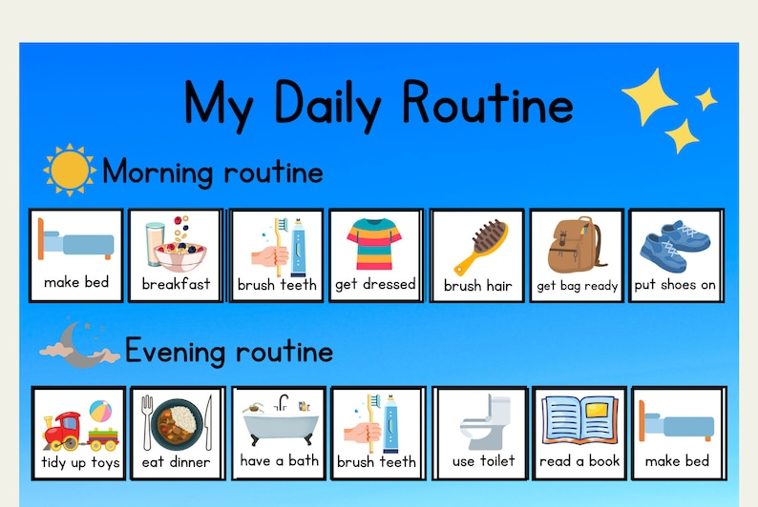
Visual Organisers
Daily organiser
First, Then, Next Charts

Slide 9
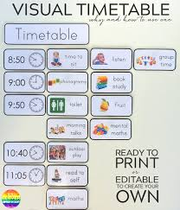
Zones of Regulation

Slide 10
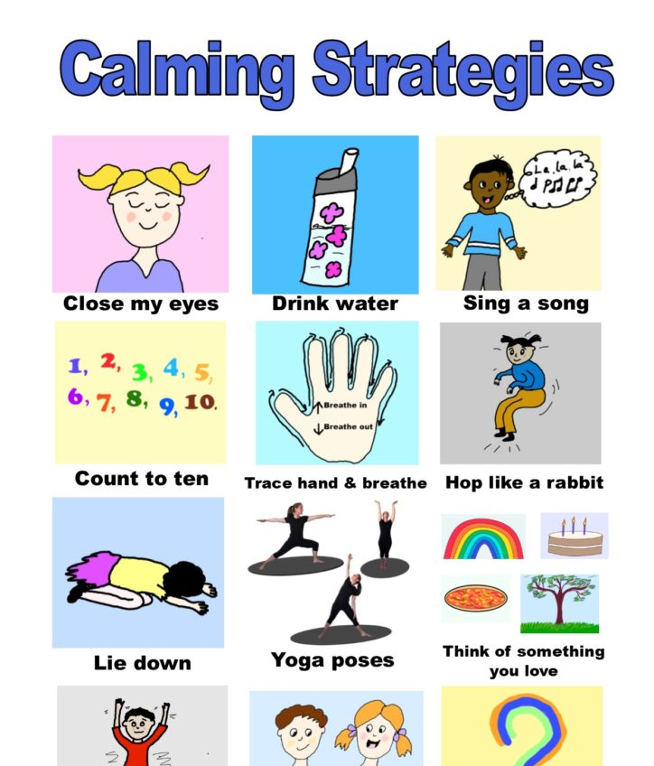
Calming Strategies
Calming strategies can help ease some of the anxiety symptoms children feel by providing a distraction from whatever is causing their anxiety. They are excellent for helping them to feel safer and more in control. And they can provide a way to manage the overwhelming feelings that come with anxiety and teach them coping skills that they can use when they're feeling anxious or stressed in any new environment.
What calming strategies work best for your child?
Create a time for your child to desegulate on their way to and from school if these times are trigger points.
Talk to them about what they would like to do if they need support to stay calm.

Slide 11
Practical tips on getting ready for your child to begin school.

Slide 12

Getting ready for the beginning of the school year
During the summer holidays
Show your child where the school is and talk about how you will get there.
If possible, arrange play times with other families whose children will be going to the same school. It helps if your child knows another child at their school at the start of prep.
Practise the things your child will need to do to get ready for school (e.g. putting things in their bag, remembering to take a hat).
Confirm your before or after school care arrangements and explain these to your child.
Read our school social story with your child and get them to share it with others.
Be positive about starting school and enjoy your child’s excitement.
Get family members to share their experiences of their first day at school.
The First Day
Make sure your child knows who will take them to school and pick them up on the first day.
Help your child to organise their clothes, hat, shoes and socks the night before.
Help your child to pack their school bag with a snack, drink, lunch and a hat.
Place a spare pair of underpants and a change of clothes in a plastic bag. Let your child know these clothes are in their bag in case of any accidents at school.
At the end of the day talk to your child about what they enjoyed about their day at school. Ask specific questions about part of their day. Eg: what story did your teacher read you? What was your favourite thing from your lunchbox?

Slide 13
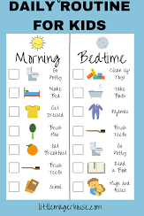
Establish routines
Practice Routines
During summer, students often get off the traditional school schedule. Bedtimes get pushed back, eating occurs at different times, and there is no homework to worry about. It can be very helpful to set up a school routine about a week or two before school starts. Before the back to school anxiety starts kicking in. Practice going to bed at an earlier time and waking up at the required time for school. Being well rested will help to reduce upset feelings that may arise during drop off. It can also be helpful to set out clothes at night for the next day to build this into a routine. By doing this, the morning may be much smoother and can help lessen school anxiety.
Practice opening food items and eating in the same amount of time that school allows. No one wants to have a hungry stomach while learning for several more hours. This will also help parents/guardians see what containers work and what food works best. Remember that your child will have a snack at -----and eat their lunch at 11:45 a.m. each day.

Slide 14
How the school can support your child if they are experiencing anxiety during their transition to school?
Each case will be individual and require an indivualised approach.
Your child’s classroom teacher is the most important person in this process. It is important that we help your child to make a connection with their teacher and begin to develop a relationship with them where they see them as a person to trust.
An individual plan may be developed with steps outlined on strategies and supports which will be put in place to support your child. This will be done through a support group meeting with their teacher/s, parent/s and wellbeing teacher.
Outside agencies who already are supporting your child will be contacted for advice and support. Eg: OT, Speech therapist.
Recommendation for referral to specialist services will be made if that is deemed as an appropriate step to take.

Slide 15
Overview
Developing relationships - Your child will spend an hour with their teacher before beginning school. This will give them time to get to know their teacher and their teacher to know them. Think of taking something with them on that day that will let their teacher know something special about them.
Supporting your child on the way to school
Established morning routine
Follow their lead – First, Next, Then chart
Calm beginning –be prepared
Morning play before going into class
All these ideas are helpful even if your child is attending OHSC
Supporting your child after school
Calm down box in car
Favourite snack
Walk or ride home –stop at park for play
Read story or play favourite game
Wait until they are ready to talk about their day
Limit after school activities
Be mindful of them sometimes feeling too tired to share their day straight away

Slide 16
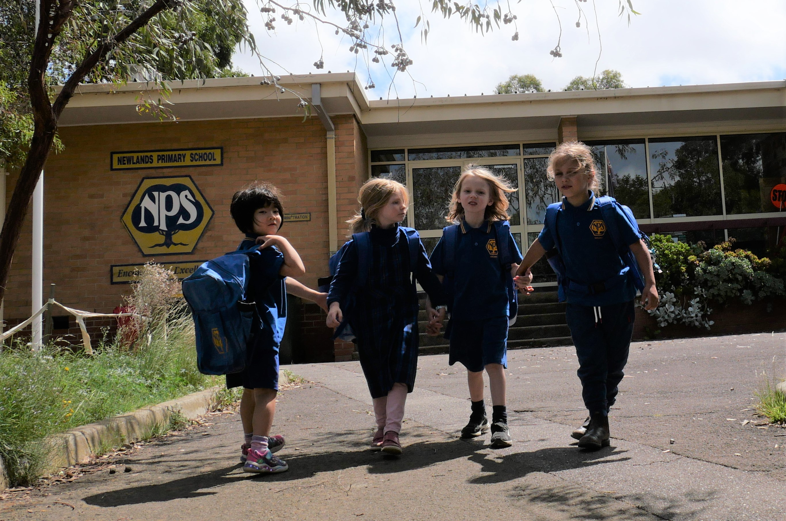
The first year of school
Find out about what your child is learning at school. By doing this, you can support your child’s learning and find out how your child is adjusting to school.
If your child is having difficulty at school, talk to their teacher or school wellbeing support staff. Your child can also say what they think might help them.
Talking to your child about school. Ask them about their new experiences, what they like and what they find hard.
Share feedback about your child’s experience of starting school with the school.
Organise time for your child and their new friends to play together outside of school.

Slide 17
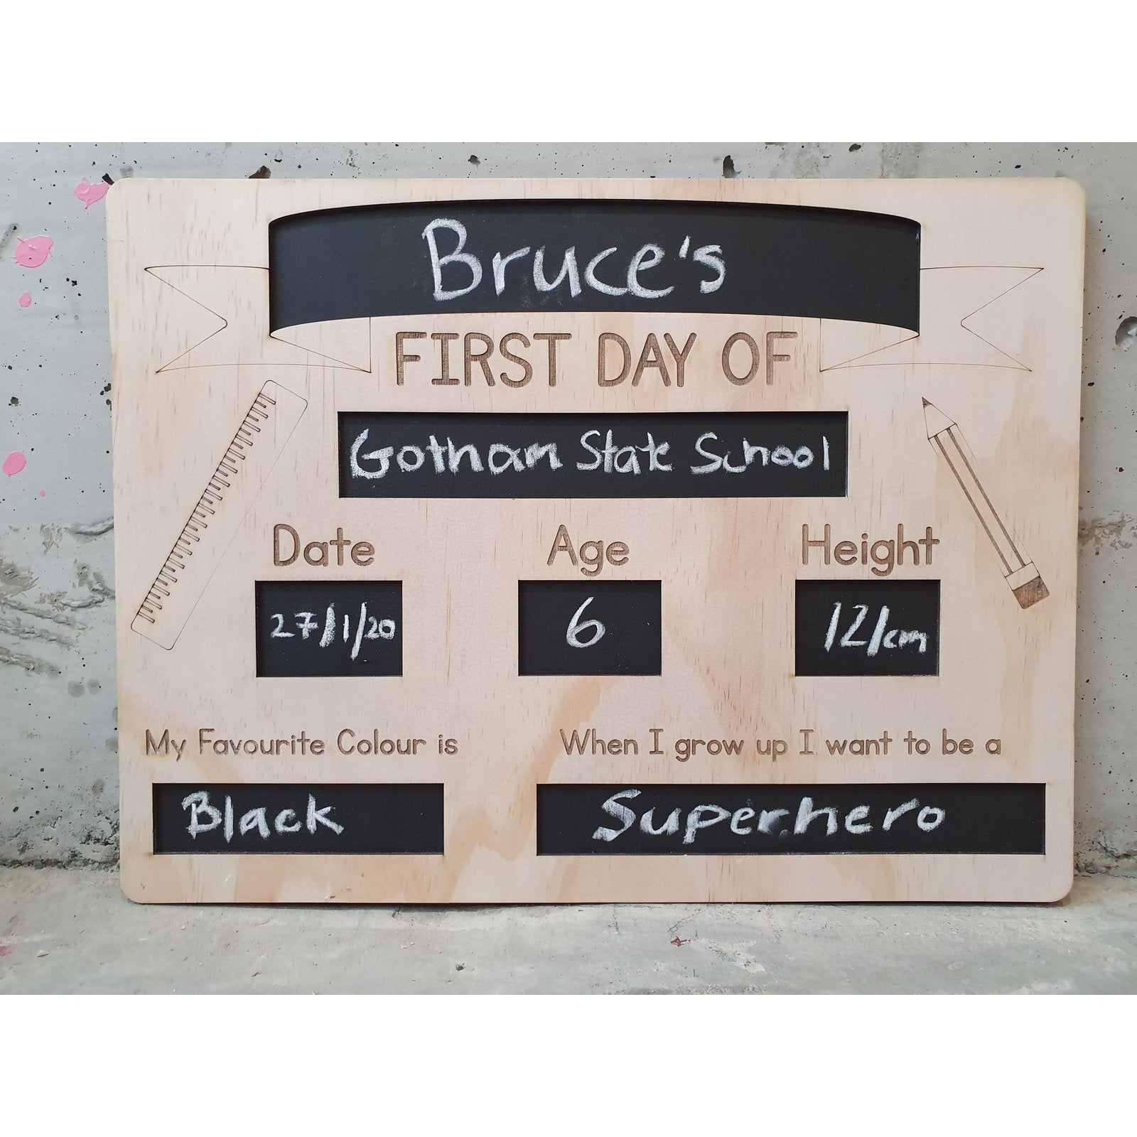
Celebrate their first day at school
Have family and friends share their expierences on their first day at school with your family.
Have them send messages to your child telling them how excited they are for them and that they are waiting to hear about their experiences.

Slide 18
Resources:
Information for families:
KidsMattter
Kids Helpline
Parents Helpline
Education department website
RCH website

Slide 19

Kidsmatter
https://www.youtube.com/watch?v=UcINGGuysBE

