Slide 1
HOW DO GUITARS Produce sound?
By Emily Smith

Slide 2
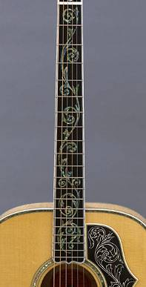
Anatomy of the guitar
To understand the physics behind how a guitar produces sound, It’s important to first understand the different parts of a guitar which are ultimately designed to efficiently turn the kinetic energy from vibrating strings into sound energy.
IN SUMMARY
Includes the sound hole
Hollow air cavity inside
Also referred to as the ‘machine head,’
Has the tuning pegs used to alter the tension of the string; ultimately manipulating the pitch produced.
Holds the frets and strings
Guitar Head
Guitar Body
Guitar Neck
Figure 1-3 (above) Anatomy of an acoustic guitar courtesy of Gibson Guitars
Notes:
Do at end

Slide 3
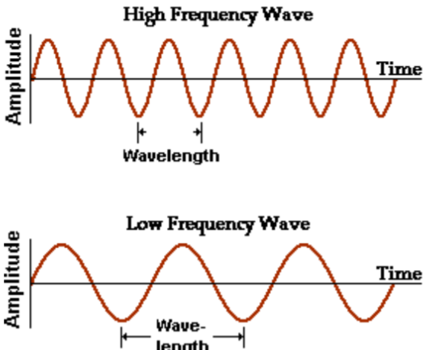
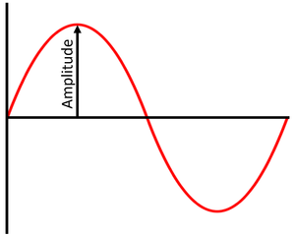
Resonance
Another important concept to understand is the idea of resonance.
Resonance refers to when an external force (for example your hand,) and a vibrating system – force another system to vibrate with greater amplitude at a specified frequency of operation
Amplitude = the maximum displacement from the crest (or trough,) of the wave to the origin
A higher amplitude = louder sound
A lower amplitude = a quieter sound
Frequency = Number of waves that pass a point per unit time
A higher frequency = shorter wavelengths (as seen in the diagram)
A lower frequency = longer wavelengths
Figure 4: (above,) Amplitude by KeyStageWiki
Figure 5: (right,) frequency by Toronto.edu
Notes:
Explain amplitude and frequency

Slide 4
THE PROCESS – 1. PLUCKING A STRING
(As plucking a string causes friction against surrounding air molecules – some of the energy is lost as heat energy.)
Plucking a guitar string causes it to vibrate
As we know; energy is neither crated nor destroyed.
Tension in the strings allows strings to have potential energy. Plucking a string converts potential energy into kinetic energy.
The vibration created is referred to as a standing wave.
THE STANDING WAVE MODEL
Nodes: the points on the string that don’t move at all as it vibrates.
Antinodes: the parts of the string that oscillate back and fourth as the it vibrates.
Figure 6: The standing wave model by Ted-Ed - Oscar Fernando Perez 2015

Slide 5
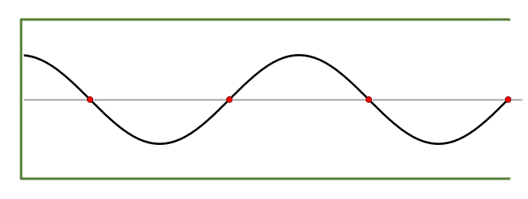
THE PROCESS – 1. PLUCKING A STRING
Nodes
This…
Creates this…
Figure 7 (above) plucking guitar strings by Alex Burns
Figure 8 (above right,) Standing wave animation by Jorge Stolfi 2019
Anti-Nodes

Slide 6
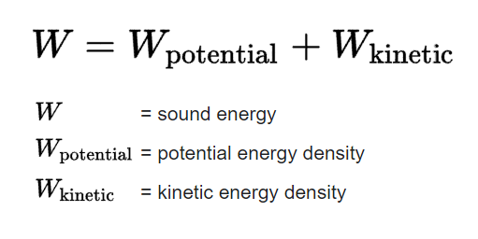
THE PROCESS – 2. THE BODY OF THE GUITAR
RESONANCE
The vibration is translated through the neck and bridge to the body of the guitar.
The wood of the guitar body is thin and flexible and so begins vibrating.
Resonance occurs; where the hollow body of the guitar allows the vibration from the strings to be amplified.
The sound energy that is produced by the body originally comes from the kinetic energy put into the strings when they’re played and vibrated.
The body of the guitar makes the conversion process from kinetic energy to sound energy more efficient
Sound waves are produced through disturbances of air particles.
Thus, a guitar string on its own, being plucked doesn’t produce nearly as much sound as an acoustic guitar would when played.
The greater sound produced by an acoustic guitar is due to resonance.
Figure 9 (right,) energy conversion from kinetic + potential energy -> sound energy sourced from Wikipedia.

Slide 7
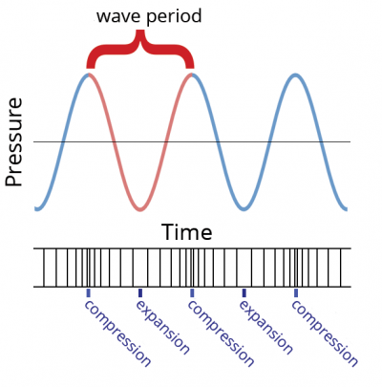
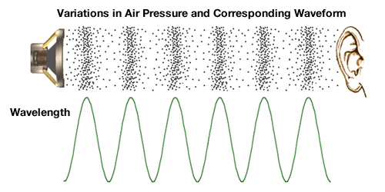
THE PROCESS – 3. Production of Sound Waves
The internal air cavity at the body of the guitar, along with it’s sound hole transmit the vibration from the bridge of the guitar to the surrounding air molecules.
As a result air molecules are jostled and compressed
They’re pushed together (compressions,) and then apart (refractions,) and thus sound waves are produced as a result.
Where there are air molecule expansions/refractions there are troughs
Where there are air molecule compressions there are crests
Figure 11 (above, right) Air pressure compressions vs sound waves by DOSITS.org
Figure 10: (left) Variations in air pressure and corresponding waveform via Mertination

Slide 8
variables OF STRINGS AND THEIR EFFECT ON PITCH
Pitch is determined by the frequency of the air compressions caused by the vibrating strings.
A string that vibrates quickly will cause lots of compressions of air molecules close together; producing a high pitched sound with a sound wave of higher frequency.
A string that vibrates slowly will produce a low pitched sound with a sound wave of lower frequency.
THERE ARE 3 VARIABLES THAT AFFECT THE PITCH OF THE SOUND AND THUS THE FREQUENCY OF THE WAVE PRODUCED BY THE GUITAR:
The mass of the string
The tension of the string
The length of the string.

Slide 9
EQUATION FOR FINDING FREQUENCY OF VIBRATION CAUSED BY STRING
Found by considering the three factors; Tension, Length and Mass of the string
String Mass/Density per unit length (kg/m) or (g/cm)
μ = m/L
Where m = mass of the string (g)
And L = string length (cm)
String Tension (N)
f = (1/2L)*√(T/μ)
Frequency of the sound (Hz) or cycles per second
String Length (cm)

Slide 10
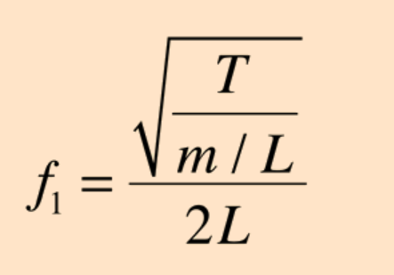
Thus, the equation for frequency can also be written like this…
String Tension (N)
String mass divided by string length = μ
2 x String Length (cm)
Figure 12: String Frequency Equation by HyperPhysics.com
Frequency of sound (Hz)

Slide 11
THE IDEAL STRING
Not everything is perfect in physics.
The equation to find frequency when considering a strings mass/density, tension and length is an approximation for an ideal string.
Factors such as material of the string, elasticity, and diameter of the string are not considered in the equation.

Slide 12
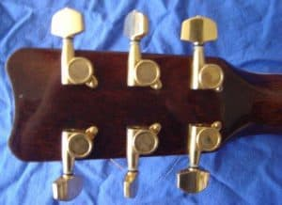
STRING TENSION
Tension can be found when the frequency of the sound as well as the length and mass of the string are known with the following equation:
Length of string (cm)
Increased string tension = higher frequency = higher pitch
Decreased string tension = lower frequency = lower pitch
T = 4μL²f²
Frequency of sound wave (Hz)
μ = m/L (cm/g)
m = mass (g)
L = Length (cm)
String Tension (N)
The machine head of the guitar has tuning pegs attached to it which are used to alter and control the tension of the strings and thus “tune the guitar,” to the correct pitch.
Figure 13: Machine head of the guitar by howstuffworks

Slide 13
STRING length
The length of the string can be found when string mass and tension are known, as well as sound wave frequency.
Whilst most standard guitars have the same string length; the length of the string is altered when a string is firmly held down against the fret board.
When this occurs the length of string able to vibrate is reduced and the pitch of the sound is increased.
This is why to play higher notes, you must hold the strings down at the frets closer to the body of the guitar.
RULE: Reducing the string length/ holding it down on the fret board gives the produced sound a higher pitch. Increasing string length results in a lower pitch; wave with a lower frequency.
String Tension (N)
L² = T/4μf²
Frequency of sound wave (Hz)
Length of string (cm)
μ = m/L (cm/g)
m = mass (g)
L = Length (cm)

Slide 14
STRING MASS
The mass of the string can be found when string tension and length are known, as well as sound wave frequency.
String Tension (N)
Frequency of sound wave (Hz)
m = T/4Lf²
Mass of string (g)
Length of string (cm)
A string with a larger mass will vibrate more slowly and thus have a lower frequency producing a lower sound. Strings with smaller mass will vibrate more quickly.

Slide 15
SUMMARY ON VARIABLES
Factor | Increasing | Decreasing | Equation
(f) Frequency (Hz) | Shorter wavelengths Higher pitch sound | Longer wavelengths Lower pitch sound | f = (1/2L)*√(T/μ)
(T) String tension (N) | Higher Frequency Shorter wavelengths Higher pitch sound | Lower frequency Longer wave lengths Lower pitch | T = 4μL²f²
(L) String Length (Cm) | Lower frequency Longer wavelengths Lower pitch | Higher frequency Shorter wavelengths Higher pitch | L² = T/4μf²
(m) String Mass (g) | Lower frequency Longer wavelengths Lower pitch | Higher frequency Shorter wavelengths Higher pitch | m = T/4Lf²

