Slide 1
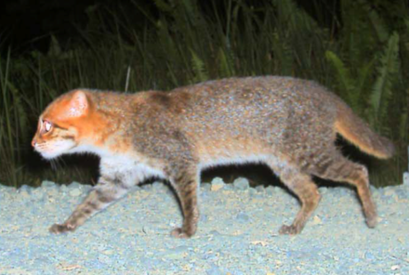
FLAT HEADED CAT
This Photo by Unknown Author is licensed under CC BY-SA
By Oliver
This Photo by Unknown Author is licensed under CC BY-SA

Slide 2
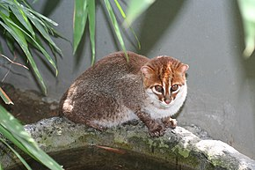
DESCRIPTION
The flat headed cat is a mammal . It can have 1-2 cubs, its belly is white , its head is brown that fades into grey for the body. It can weigh up to is 2.5 kg . It has sharp teeth , usually has brown eyes and small ears. It is a carnivore.
This Photo by Unknown Author is licensed under CC BY-SA

Slide 3
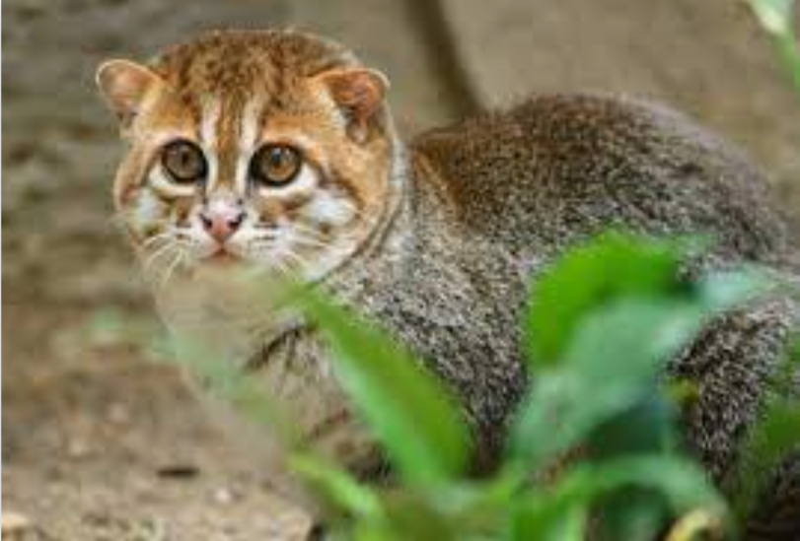
HABITAT/EATS
The flat headed cat eats mostly fish, sometimes mice , and rats, birds or fruits.
The flat headed cat is a wetland species ,the habitat is the Malaysian rainforest.

Slide 4
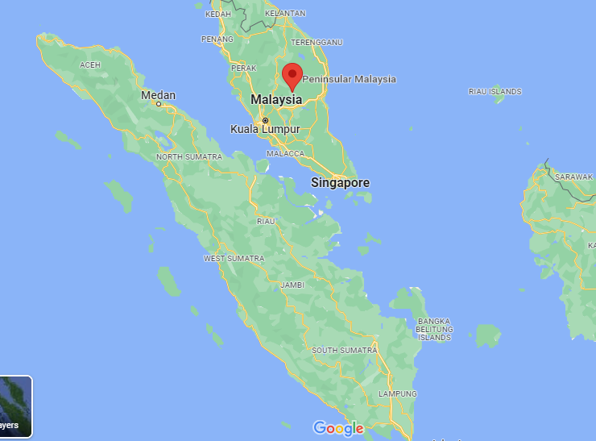
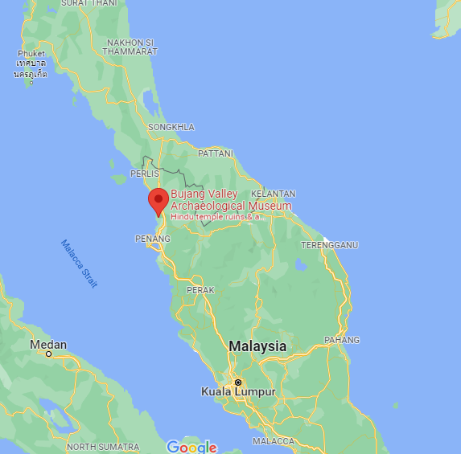
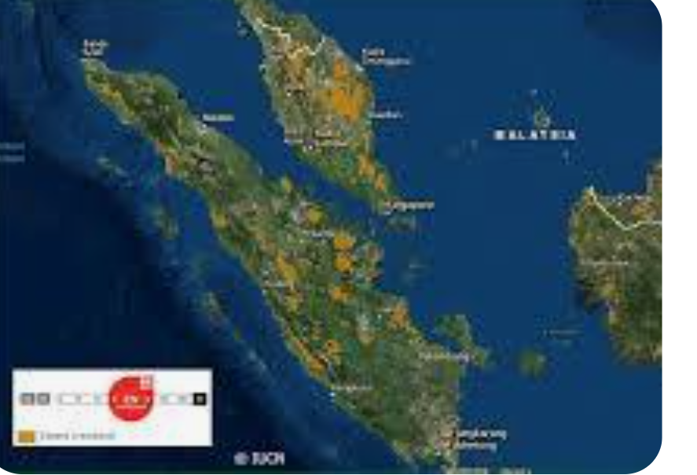





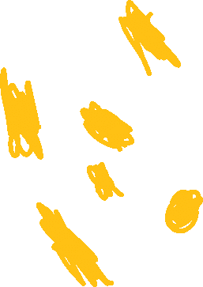
The yellow is where the cat lives in 2022

Slide 5
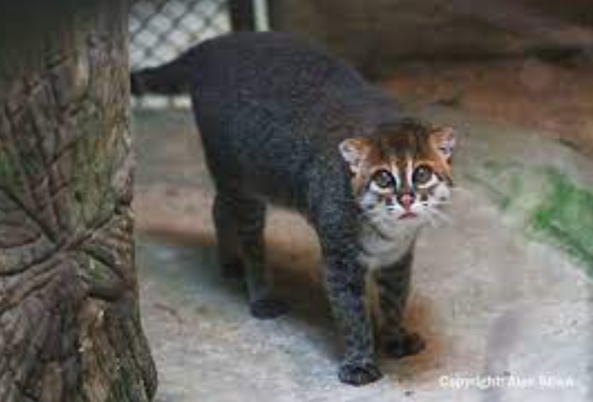

THREATS
The flat headed cat is threatened by forest destruction from oil plantations like palm oil and oil for cars which causes toxic water pollution by cargo ships spiling the oil.

Slide 6


HOW CAN WE HELP?
You can help the flat headed cat by cleaning water, planting trees and not buying palm oil products.

Slide 7
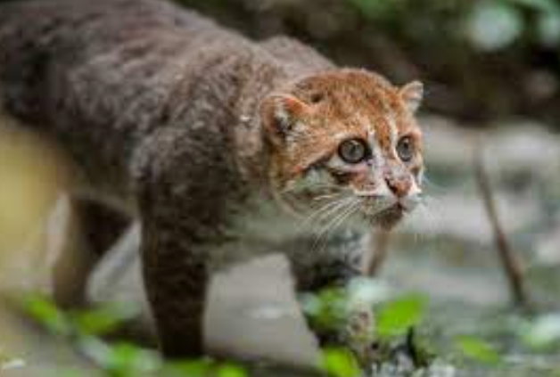
Three interesting facts
The flat headed cat got its name from the long snout that is flat at the end.
The flat headed cat has small ears.
There are 2,500 left.

Slide 8
REFRENCES
https://www.kiddle.co/s.php?q=flat+headed+cat#gsc.tab=0&gsc.q=flat%20headed%20cat&gsc.page=1
https://www.thainationalparks.com/species/flat-headed-cat#
:~:text=Threats,wood%2Dcutting%2C%20and%20fishing.
http://www.catsg.org/index.php?id=119#:~:text=The%20flat%2Dheaded%20cat%20is%20thought%20to%20prey%20mainly%20on,reported%20to%20take%20domestic%20poultry.
https://wildcatconservation.org/wild-cats/asia/flat-headed-cat/
https://bigcatrescue.org/flat-headed-cat-facts/#:~:text=Size%20and%20Appearance%3A%20One%20of,it%20has%20unusually%20small%20ears.

