Slide 1






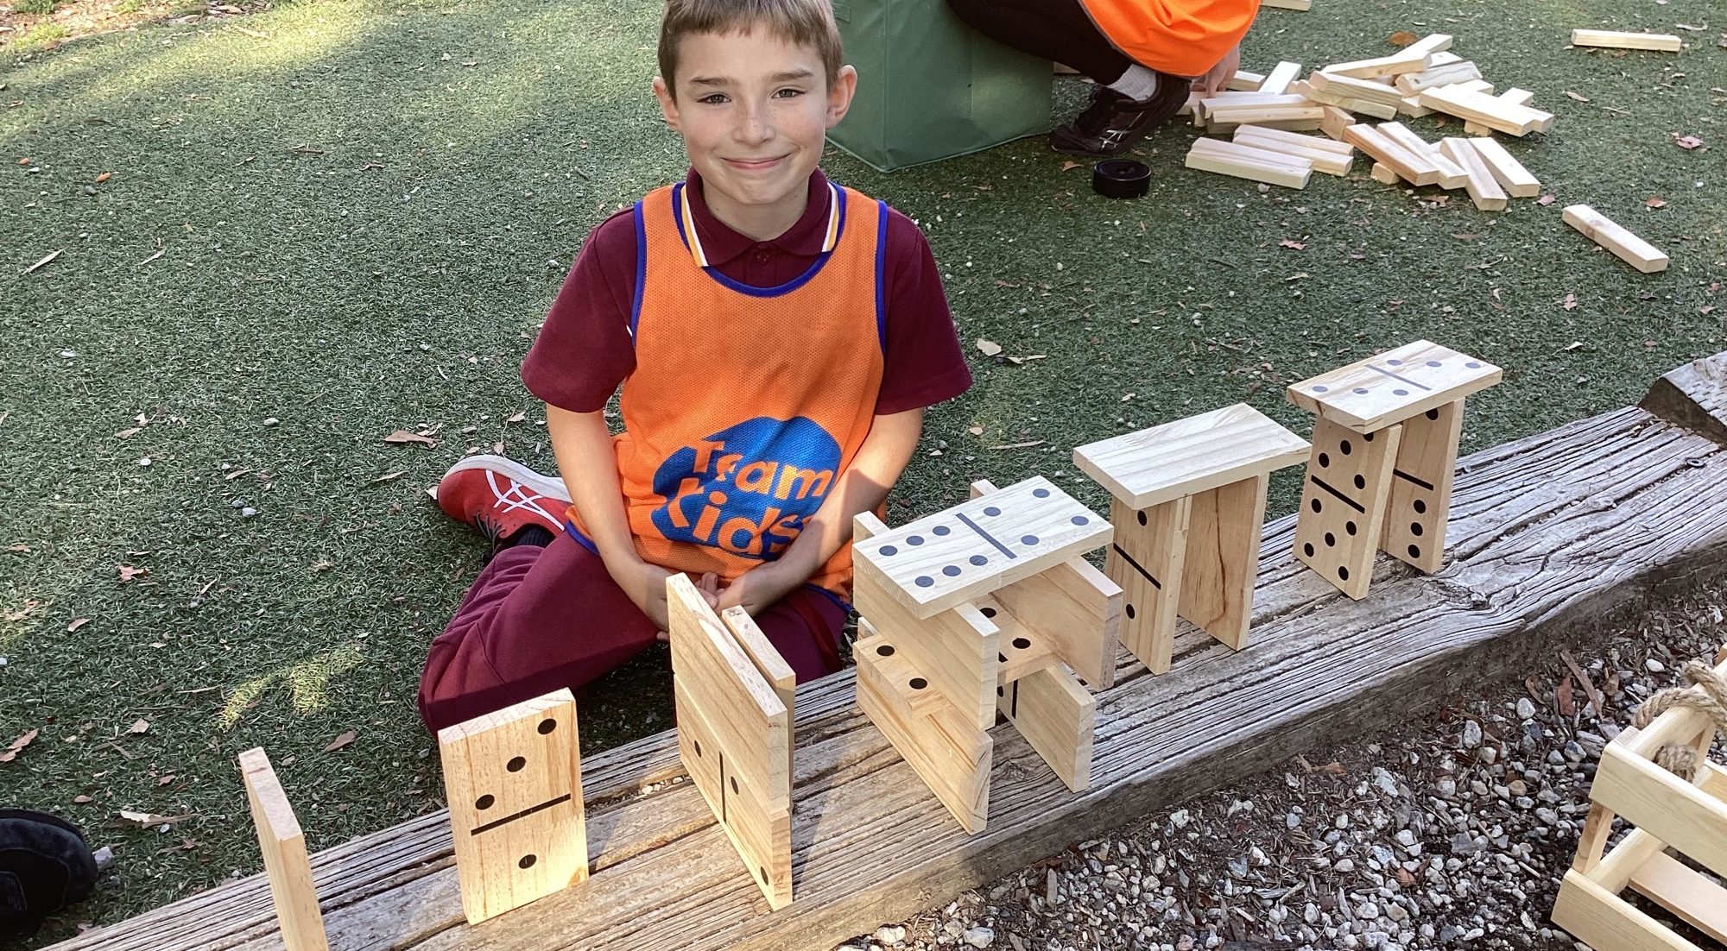
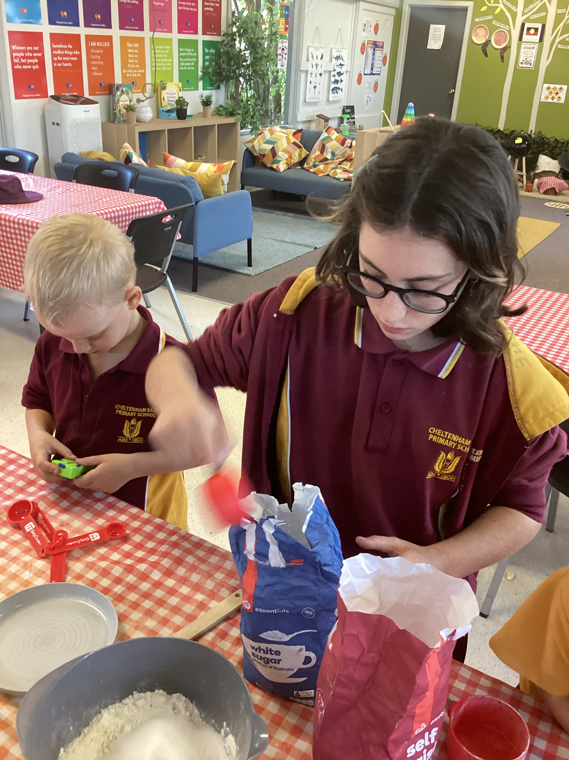
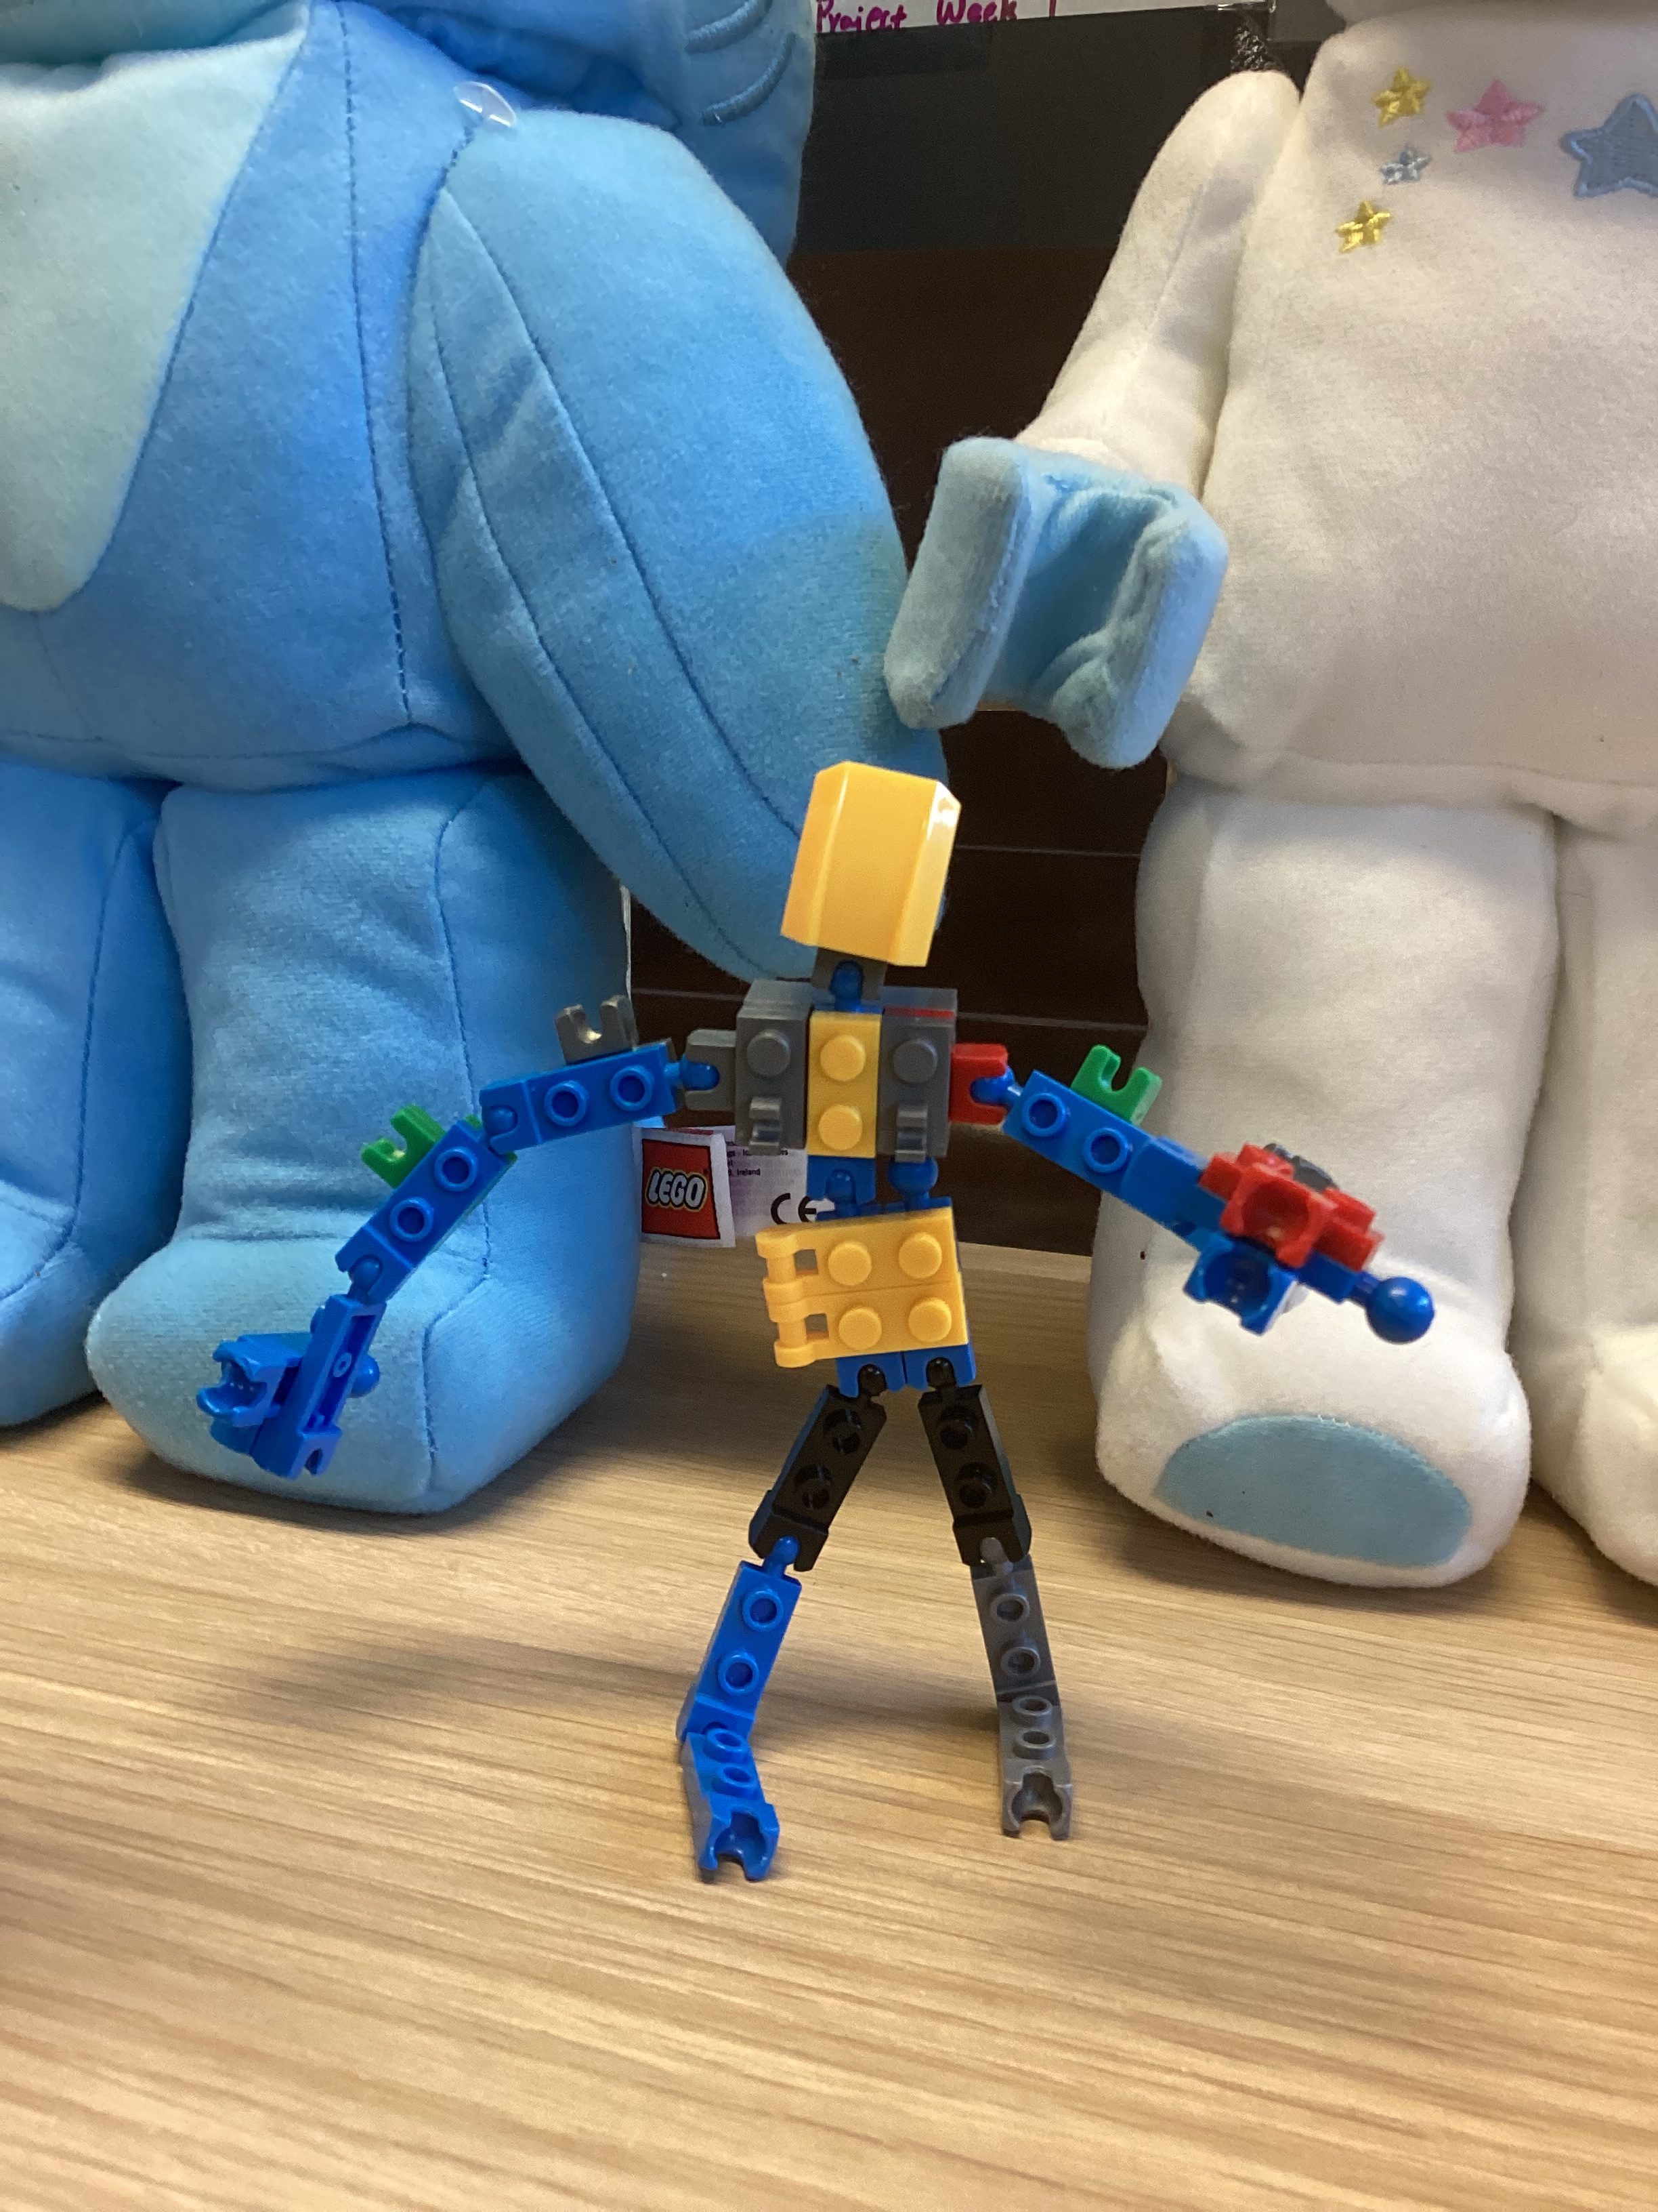
Cheltenham East Team Kids
Dear children and parents,
On Friday, we had a great afternoon! Family picnic was such a great chance to meet families, children, teachers and school staff! Team Kids children enjoyed themselves chatting with their friends and families, meeting their teachers and playing Team Kids giant games! ☺
There are four lucky parents who picked up their lucky raffle number to win tickets to the Lunar Drive-In, which was provided by the School Council. Thank you very much! The four lucky parents are Ineke (Mason’s Mum), Anjelika (Mary-Ann and Elai’s Mum), Amelia (Madeleine’s Mum) and Wenyi (Hong’s Mum). Congratulations! Enjoy the time with your families!
Our school holiday program is set to get started on the 11th of April for two weeks, and finish on the 22nd of April. Booking for the holiday program has been opened, if interested please book your children in on the Team Kids website.
Thank you!
9
Lego Masters and Art Attack Club
Cooking Club and Musical Theatre
Lego Masters Club and Epic Game
Art Attack Club and Music Theatre
Cooking Club and Epic Games
Thu 06th April
Easter Celebrations
Tue 11th - Fri 21st April
School Holiday Program
Mon 24th April
The First Day of Term 2
0432 299 468
CheltenhamEastPS@teamholiday.com.au
1300 035 000
info@teamkids.com.au

