Slide 1
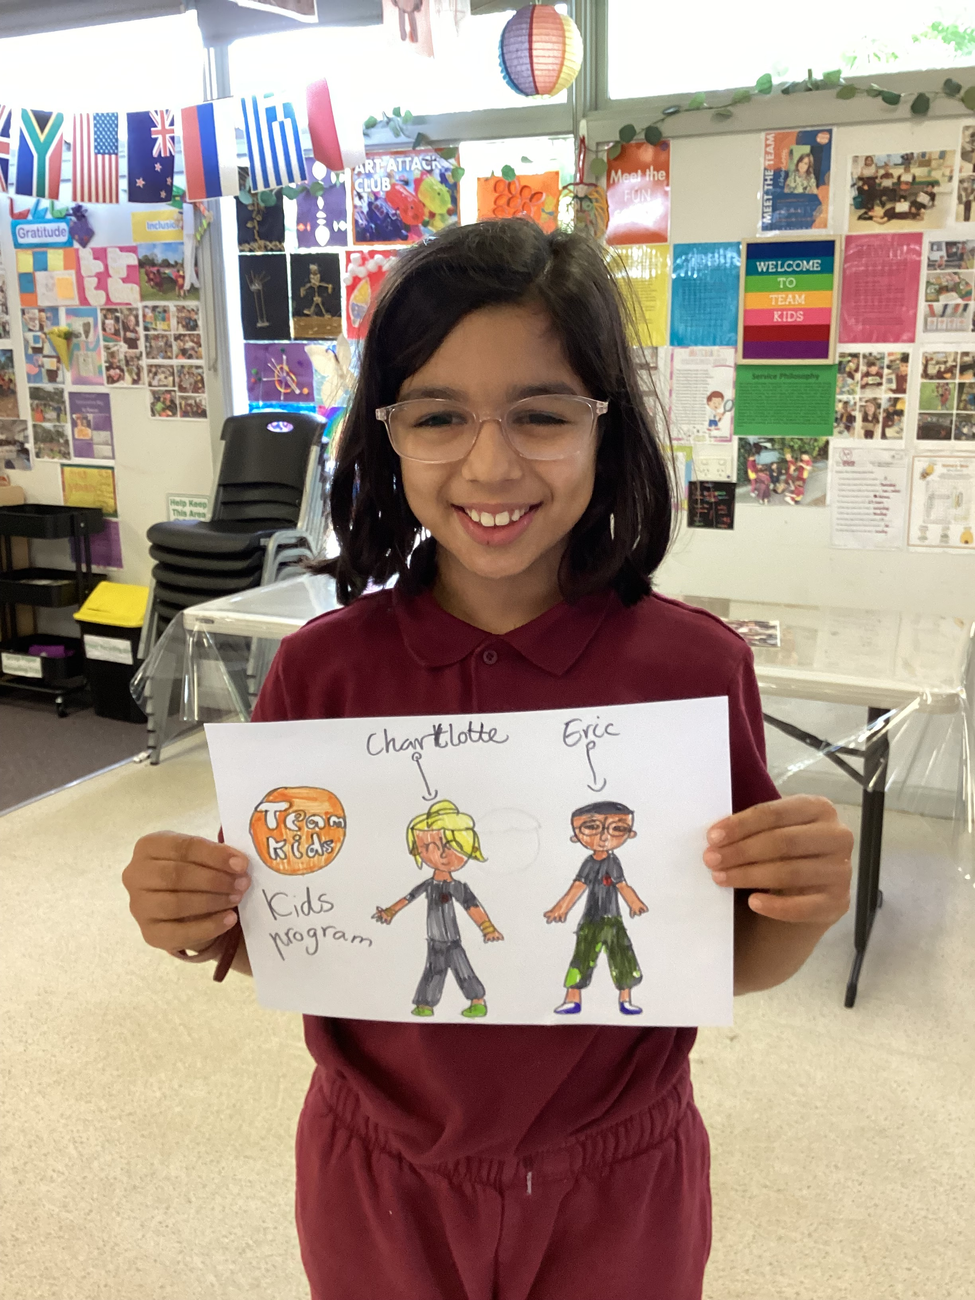
Cheltenham East Team Kids
Dear families,
We are thrilled to announce the exciting launch of our three new clubs here at Team! After weeks of anticipation and eager planning, our clubs are set to commence in Week 4.
Art Attack Club: Our Art Attack Club is ready to unleash your child's imagination through various artistic endeavours.
Lego Master Club: With endless possibilities and a plethora of bricks at their disposal, children will explore the world of engineering, architecture, and problem-solving in this engaging club.
Super Sports Club: From soccer to basketball, and everything in between, this club aims to promote teamwork, physical activity, and healthy competition among our young athletes.
We are immensely proud of our students for their autonomy and cooperation throughout this decision-making journey. Their brainstorming sessions yielded fantastic ideas, which we've incorporated into the club activities.
If you have any questions, please reach out to our staff. Thank you.☺
Warm regards,
Eric
Director of Team Kid Before and After School Care
4
Art Attack Club (BSC)
Super Sports Club (ASC)
Lego Masters Club (BSC)
Art Attack Club (ASC)
Super Sports Club (BSC)
Lego Masters Club (ASC)
3rd March
World Wildlife Day
3rd March
Clean Up Australia Day
8th March
Internation Women’s Day
0432 299 468
CheltenhamEastPS@teamholiday.com.au
1300 035 000
info@teamkids.com.au

