Slide 1
Year 9 Camps/ Urban Expeditions Program 2022
Choose your own adventure!
Week 9 – Term 2

Slide 2
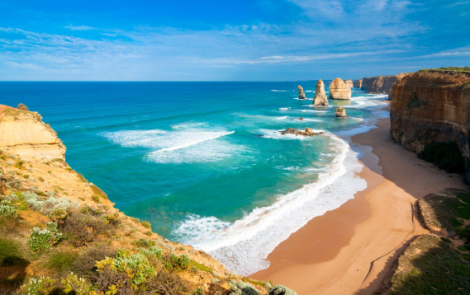
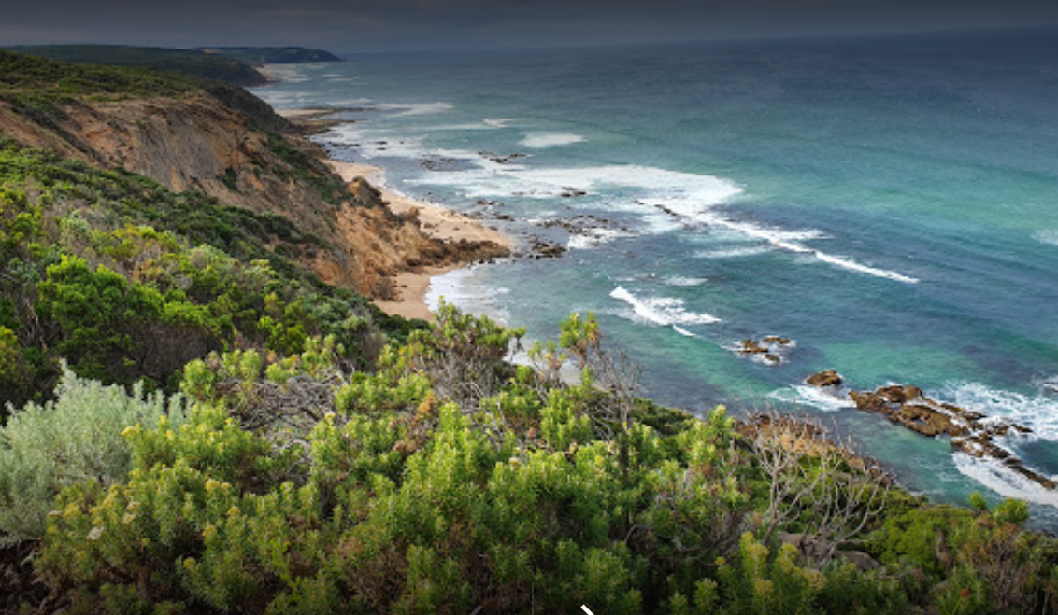
Great Ocean Road Hike
Mon – Thurs 20th- 23rd June
Highlights:
Amazing Scenery…dramatic coastline of soaring cliffs and remote beaches!
Picturesque campsites
Kangaroos, wallabies and koalas, and birdlife.
Camp (Trangia) cooking
10-13km each day
Approx. Cost $390-
Includes Tent and Pack hire

Slide 3

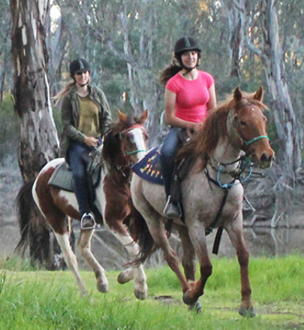
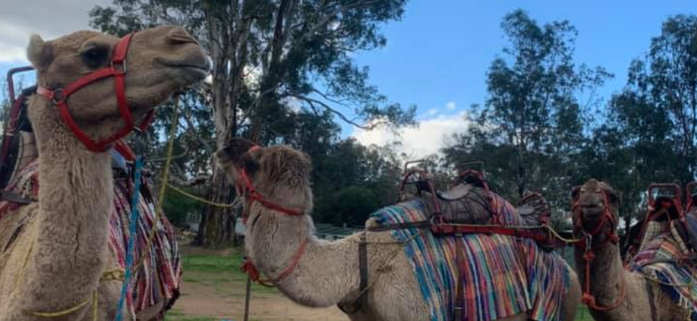
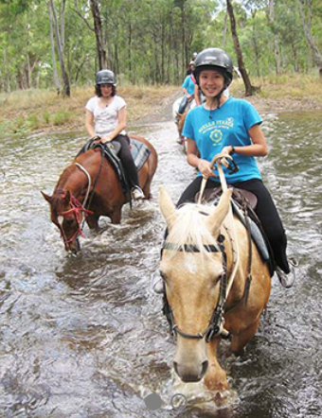
Billabong Ranch HBR(Echuca)
Mon 20th– Wed 22nd June
Highlights:
Trail rides each Day
Camel Rides
Bungee Trampolines
Commando course
Campfire
Stockman show
Approx. Cost: $490-

Slide 4
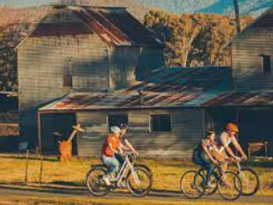
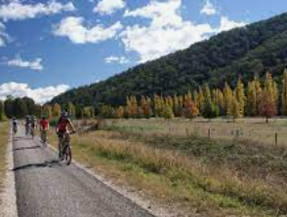
Bright and Surrounds Rail Trail Bike Riding Camp
Mon 20th – Thurs 23rd June
Highlights:
Riding the rail trails around the high country
Day 1:Bright and surrounds to Myrtleford (25+kms)
Day 2:Myrtleford – Beechworth (50kms )
Day 3:Beechworth – Bright (75kms)
Day 4: Bright and surrounds (20km)
Accommodation in cabins
Visit to Old Beechworth Gaol (Ned Kelly)
Approx cost: $550

Slide 5
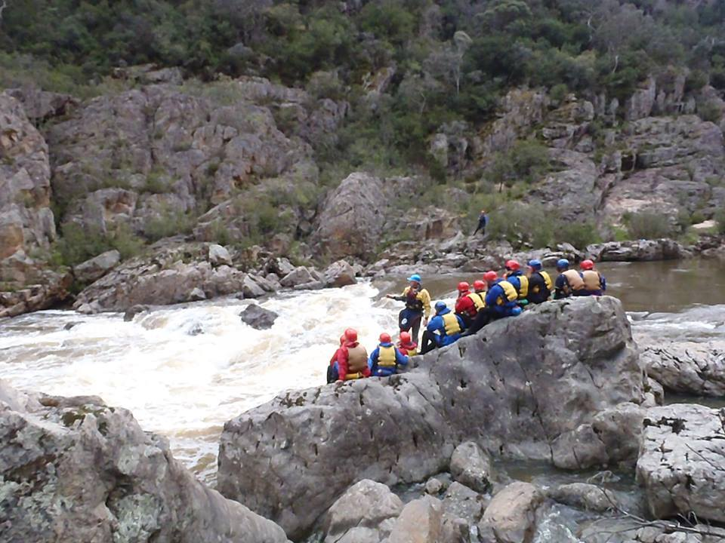
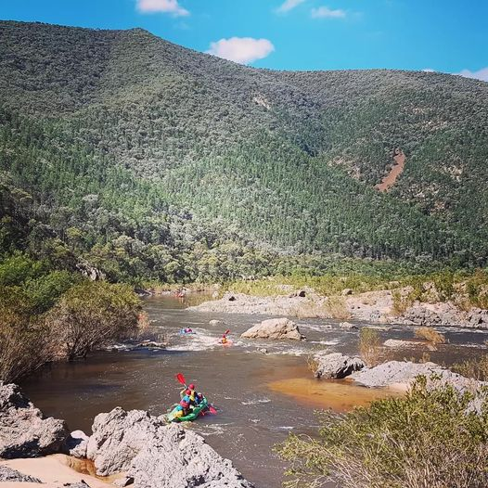
Snowy River 5-day Journey
Mon 20th - Fri 24th June
Highlights:
White water rafting. through the Tulloch Ard Gorge.
Guided or self guided rafts
Camping each night by the river.
Approx. cost $1240

Slide 6
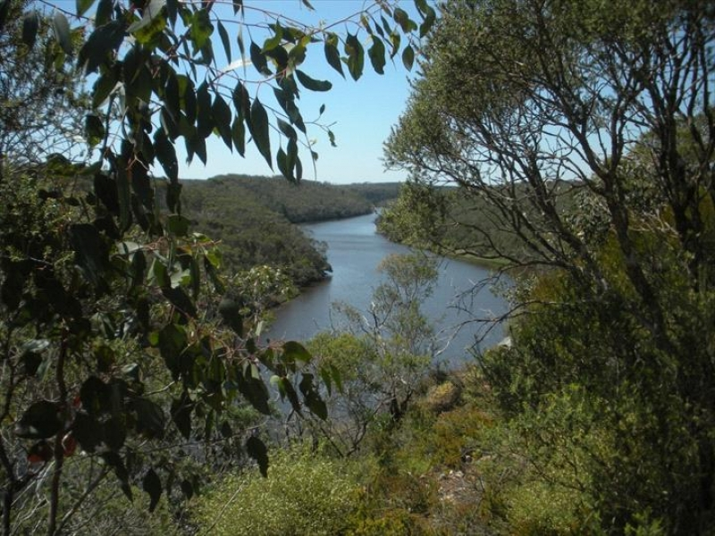
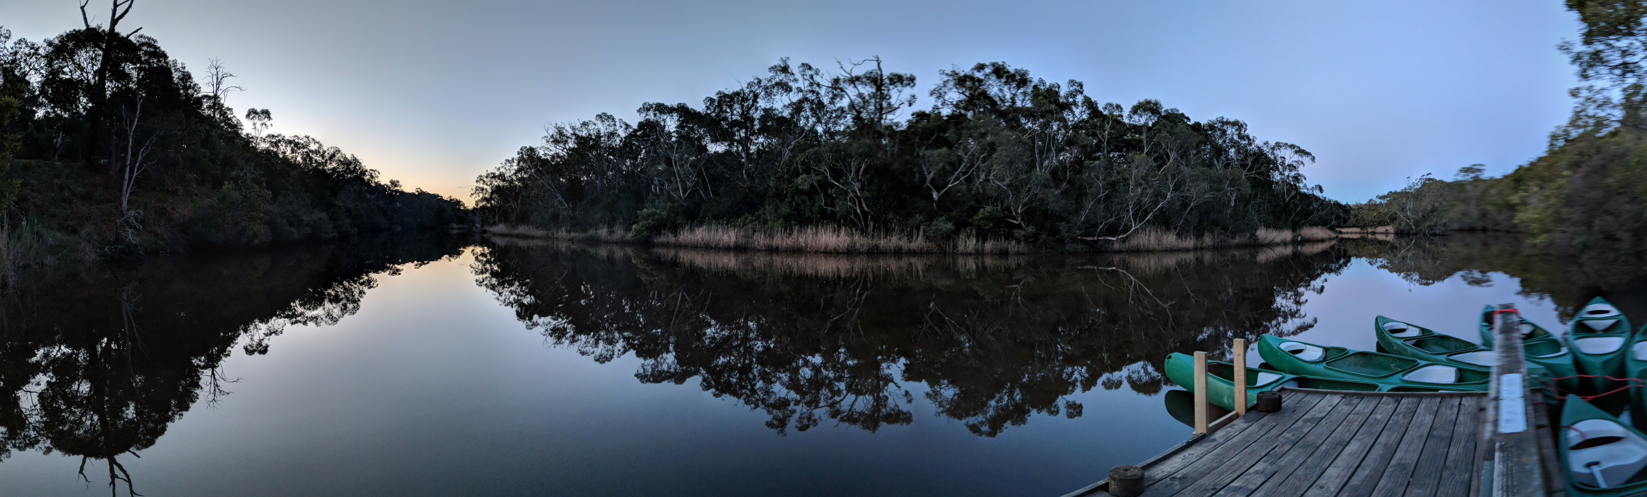
Great South-West Walk / Glenelg River Canoe
Mon 20th - Fri 24th June
Highlights:
Awesome scenery
Two days canoeing along the Glenelg River
Two days hiking in Lower Glenelg N. P.
Picturesque campsites
Relaxed camping and journeying
Group cooking on Trangias
Approx. cost $660

Slide 7
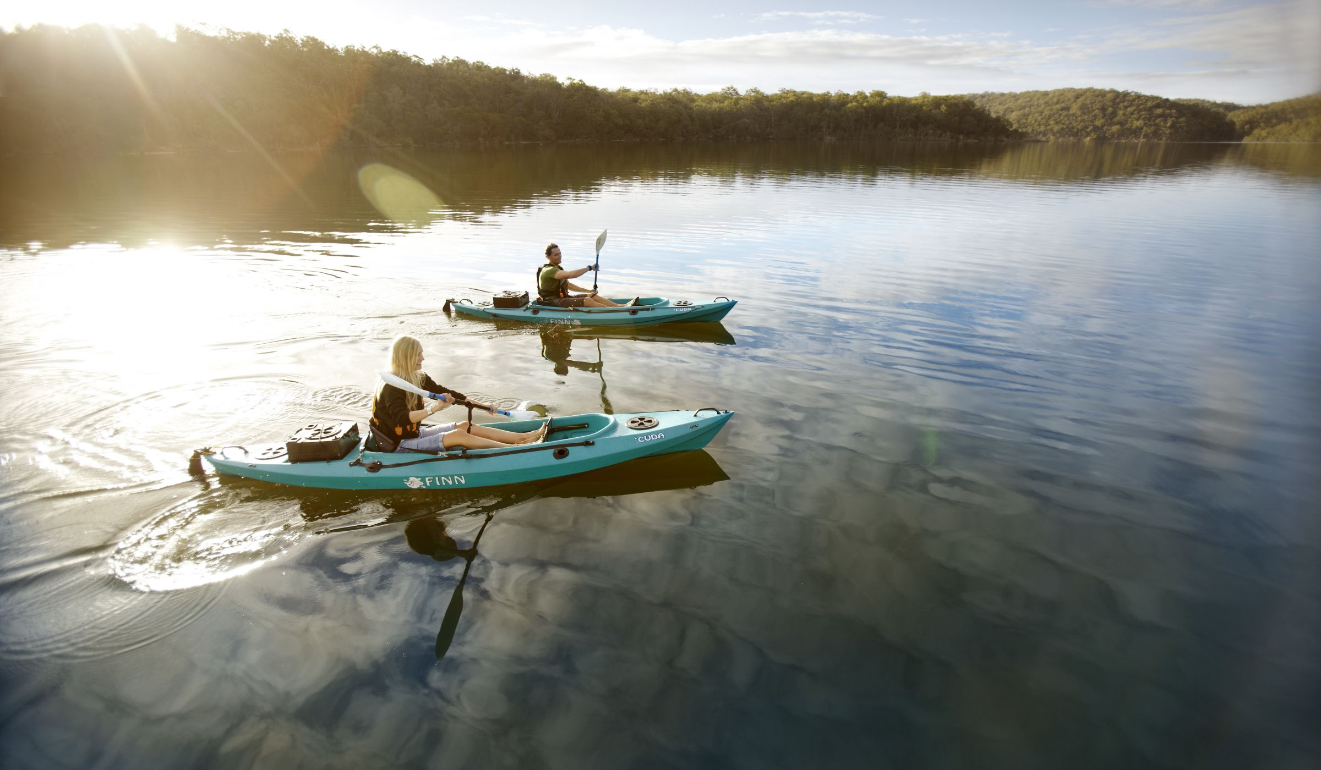
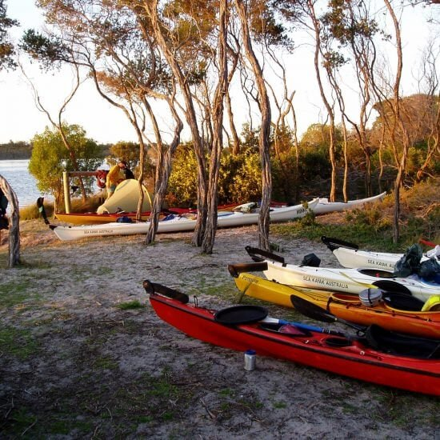
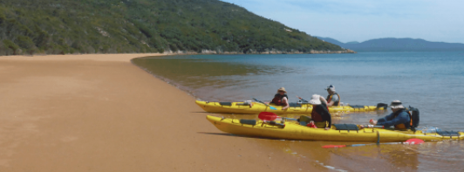
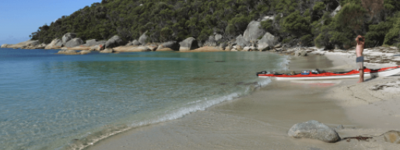
Sea Kayaking
Mon 20th - Fri 24th June
Group choice of:
Departing from Paynesville, exploring the Gippsland Lakes or departing from Port Welshpool, exploring Wilson's Prom
Highlights:
Four-day guided sea kayaking tour of secluded marine areas and pristine islands
Remote and stunning landscape
Explore some of Australia’s best regions by sea kayak… now that’s an adventure!
Four nights camping
Group cooking on Trangias
Approx. cost $825

Slide 8
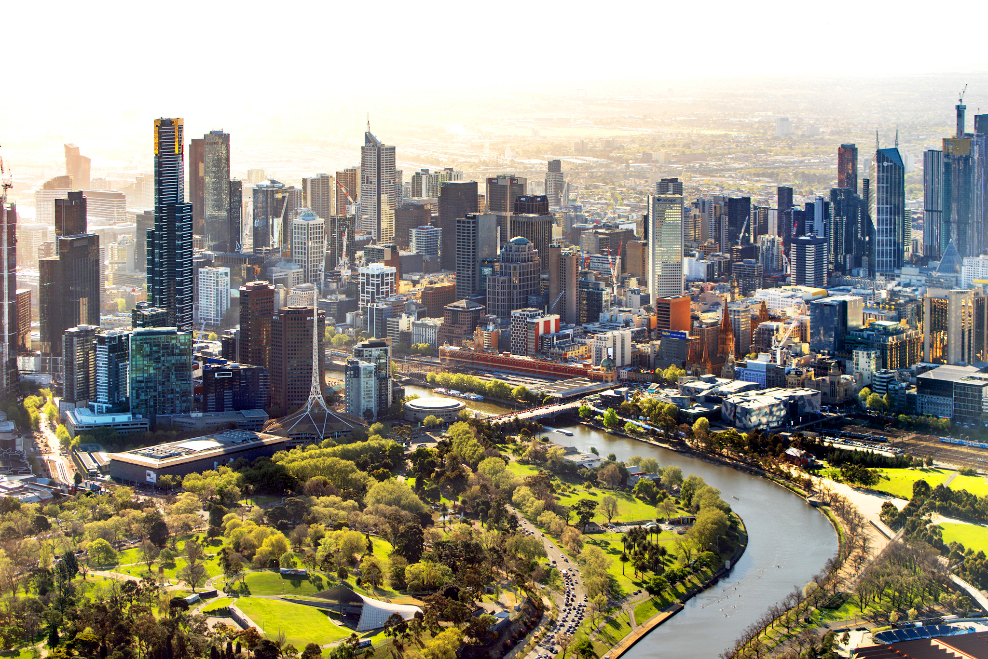
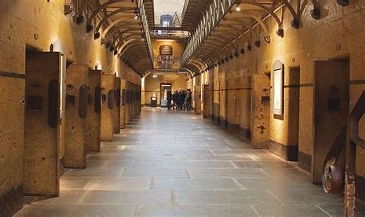
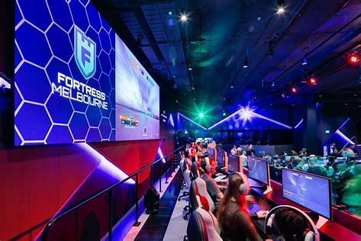
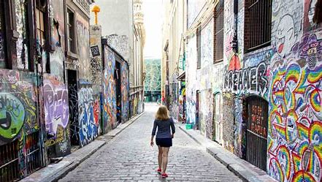
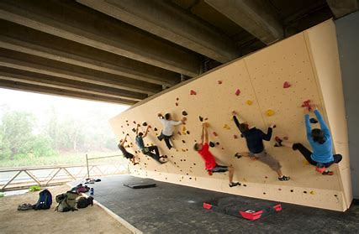
Urban Expeditions
Mon 20th - Fri 24th June
Activities:
Eureka Skydeck
Fortress Gaming
Old Melbourne Gaol Tour
Melbourne Street Art Discovery
MCG/Melbourne Sport Museum/Meet an Olympian
Escape room
Rock climbing and bouldering
Hoddle Waddle city discover experience
Lunch in different city gardens each day
Students use public transport to travel between locations
Approx. cost $180

