Slide 1


WELCOME
PARENTS

Slide 2

Acknowledgement of Country
We would like to acknowledge the traditional custodians of this land , the Anaiwan people and pay our respects to the Elders both past, present and future, for they hold the memories, the traditions, the culture and the hopes of indigenous Australia.

Slide 3

PRAYER
We begin today knowing we are loved by God.
We thank you God for
all that you have given to us, our school,
our family and our
friends.
May we always share
our talents and gifts with others.
May our hearts
respond to those in need.
May we always act
justly and love tenderly.
May we learn more
about Jesus and become
His Light in our world.
Amen.

Slide 4
AGENDA
Introduce Staff 2022
CSO AIP
School 2022 AIP
School Goals,
Student Expectations,
Attendance,
Reading for Homework,
Partnership & Communication.

Slide 5
2022 Staff
Kindergarten Jessie Simpson, Shani Marshall
Year 1 Dorote Sluma, Emma Johnson, Madeleine Murtagh
Year 2 Carrie Fittler, Hayley Burton
Year 3 Cathy Ross, Lucy Harman
Year 4 Tabitha Dowse, Emily Adams
Year 5 Darren Lester, Natalia Mayes
Year 6 Marcel Garraud, Kelly Walters
RFF Sara McNeal, Leesa Bible, Madeleine Murtagh, Dale Cane

Slide 6
2022 Staff
Leadership Belinda Burton, Louise Reinke, Dale Cane, Catherine Stephen, Jessica Scully
CSO Leadership Justin Matthews, Kristy Curry
Office Barb Hoskin, Penny Patricks, Judi Hansen, Rebecca McCann
Education Assistants Jodi Troon, Jenny Teege, Felicity Turnbull, Joshua Cane, Phoebe Biddle, Gen Tavener
Aboriginal Educational Assistants Elizabeth Stahlhut, Emma Widders
Canteen Jodie Kratz, Sonja Symons
Grounds im Murray

Slide 7
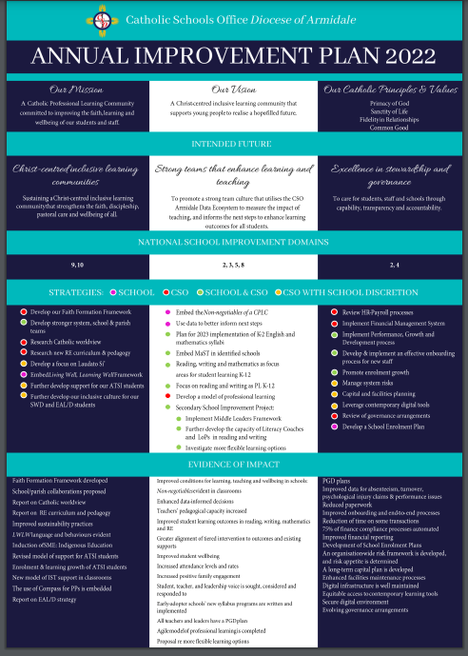

Slide 8
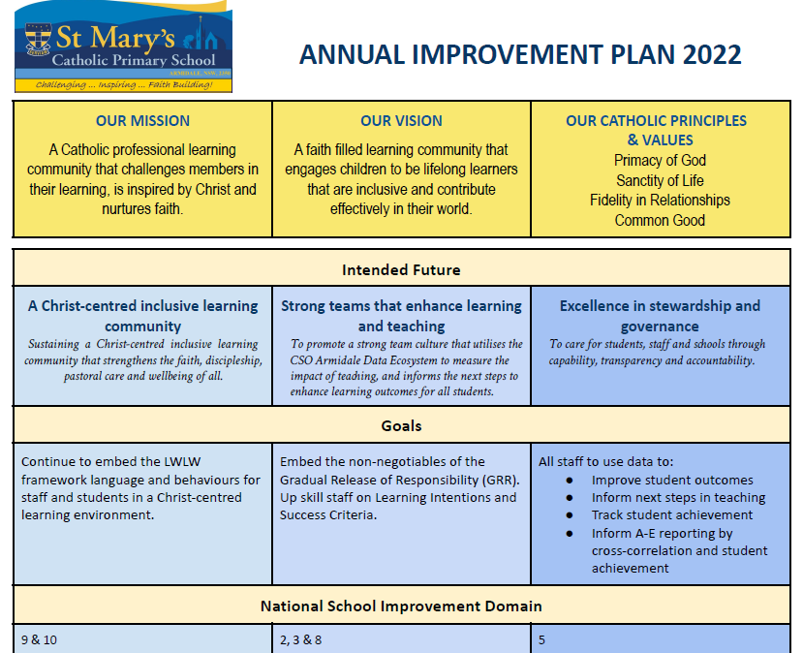
Notes:
.

Slide 9
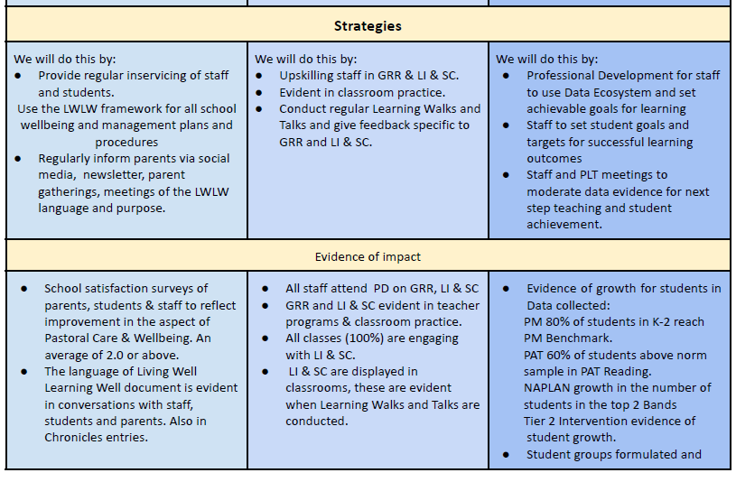
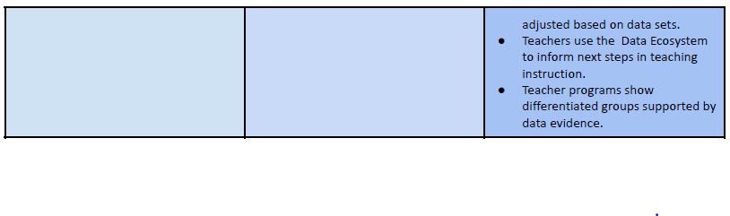

Slide 10
GOAL - A Christ Centered Inclusive Learning Community
Continue to embed the LWLW framework language and behaviours for staff and students in a Christ-centred learning environment .

Slide 11


Slide 12
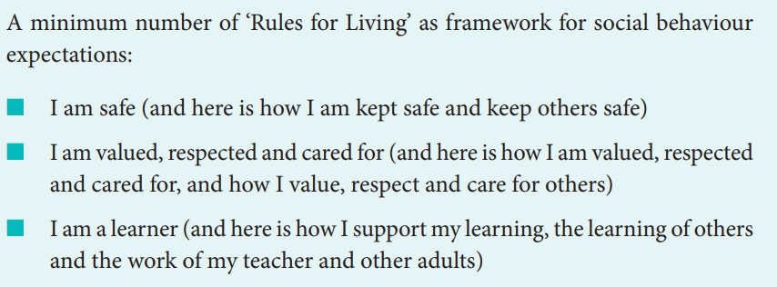
I am Safe,
I am valued, respected & cared for
I am a learner

Slide 13
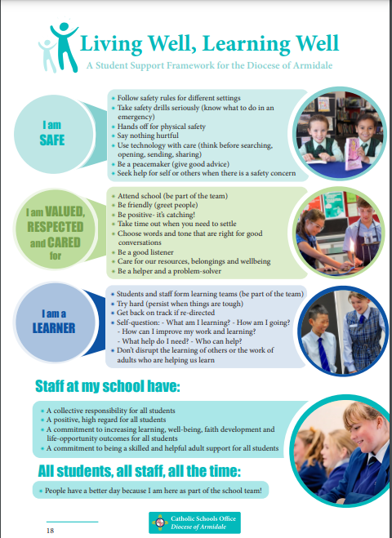

Slide 14


Slide 15
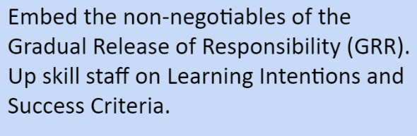
GOAL - Strong Teams that Enhance Teaching & Learning

Slide 16
IMPROVING PEDAGOGY
● Gradual Release of Responsibility
● Worthwhile Lesson
● Uninterrupted Literacy Block
● Big Write /VCOP (Writing)
● High Impact Strategies, eg Differentiated
Instruction, The Third Teacher

Slide 17
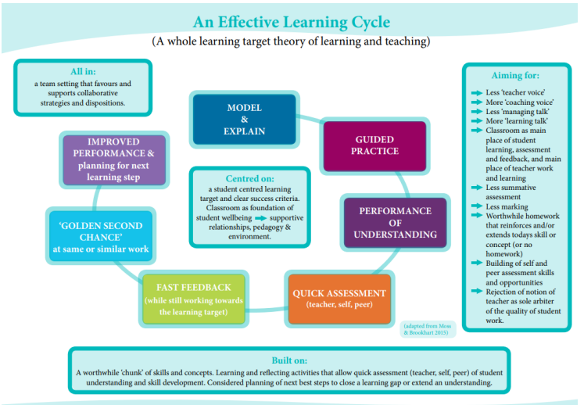

Slide 18
Learning Intentions & Success Criteria
LI & SC focus students' engagement on the What? Why? and How? of learning.
Using the 5 questions the students can articulate the LI & SC.
What are you learning? How are you going?
How do you know? How can you improve?
Where can you go for help?

Slide 19
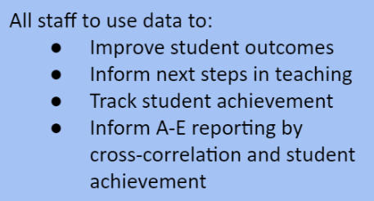
GOAL -Excellence in Stewardship and Governance

Slide 20
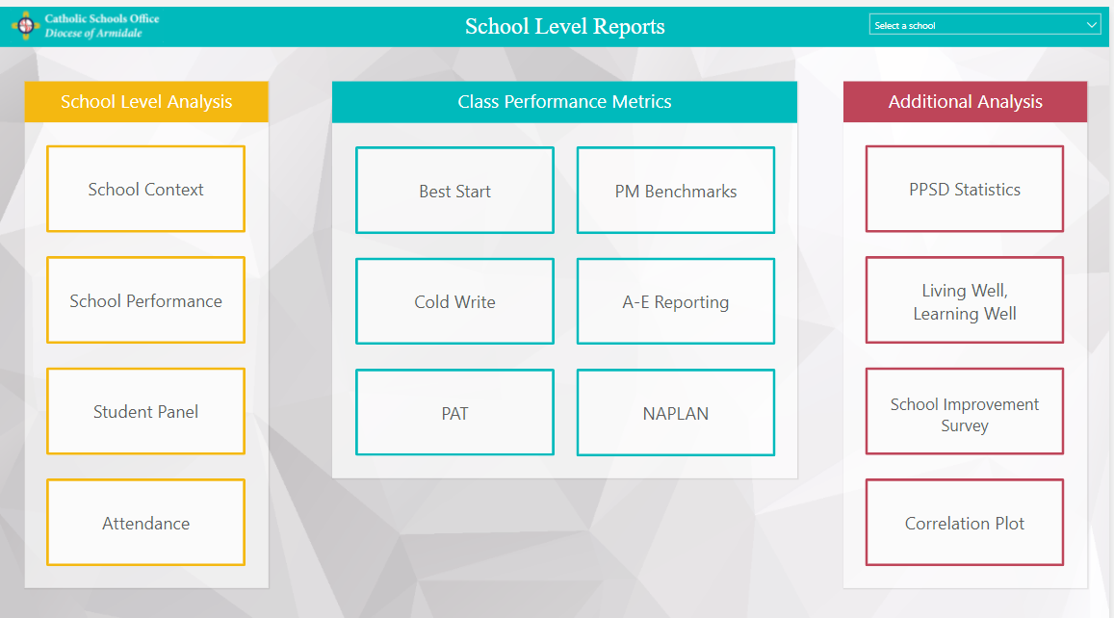

Slide 21
Well Being Expectations
A consistent approach to learning,
being safe and respectful.
5 Steps

Slide 22
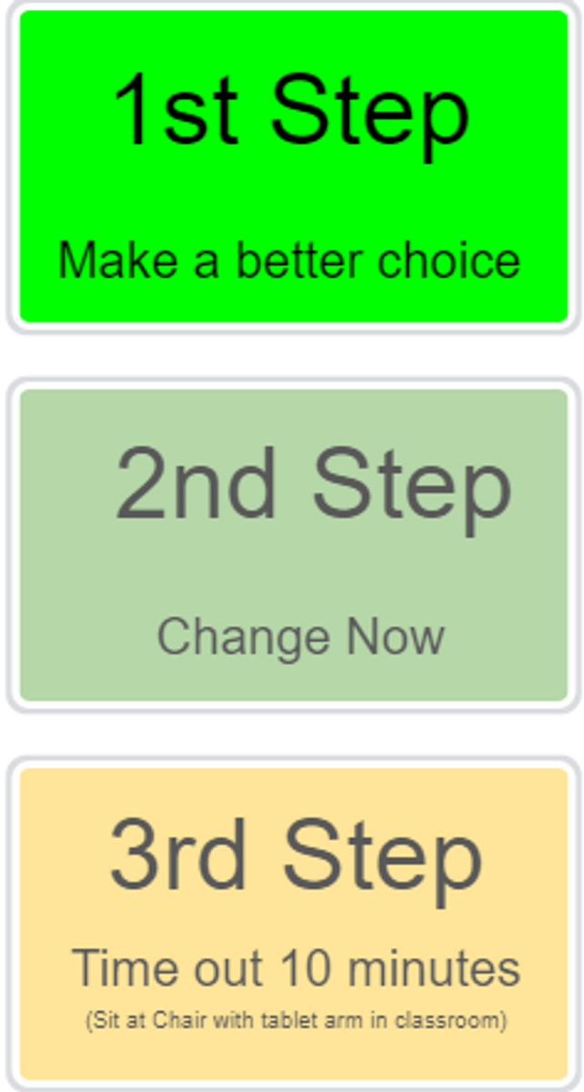

Slide 23
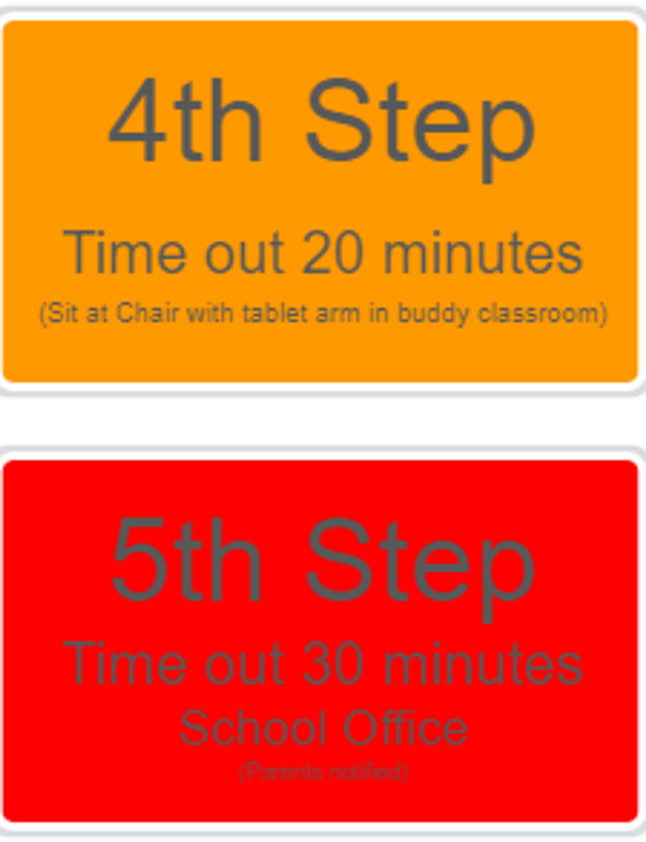

Slide 24
2022 A Successful Year
Student Success
Attendance = 90% of the time
A Multi-Tiered System of Support for Academic, Wellbeing and Positive Behaviour Support
Partnership home & school

Slide 25
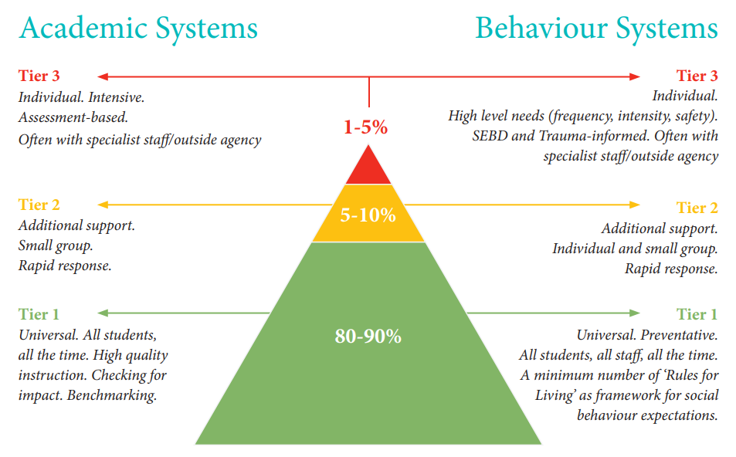

Slide 26
Home & School Partnership
Respect - learning, fellow students, adults, property
Manners - speak politely and have outstanding manners
Pride - Uniform is to be worn with pride. Correct uniform everyday. Pride in student presentation for learning, hair, jewellery, classroom equipment…
Homework - Reading for homework

Slide 27
Reading for Homework
Regular, consistent reading can increase your child’s vocabulary.
A strong vocabulary often leads to a higher level of academic success. Your children will amaze you with their growing conversational skills!
Reading exercises your child’s comprehensions abilities.

Slide 28
Reading for Homework
It stimulates your imagination and your memory. It helps to recall information.
What’s really important in this entire process is raising your children with a love of books so they are interested and keen to read.

Slide 29
Homework
Talk Homework - Cold Writes
Tricky Words - Sight words, spelling
Times Tables - Year 3-6
Reading Eggs
PM Online Readers
Maths Seeds
Mathletics

Slide 30
Communication
Newsletter
Compass
Email smaadmin@arm.catholic.edu.au
Phone the school
Call into the Office
Write a note
Parent Teacher Interviews

Slide 31
Communication
P & F - Joanne Ward
P & F Welcome Sausage Sizzle 7th April 5:30pm, Term 2 Disco, Quiz Night…
School Advisory Council - Pilar Brown
Building Maintenance Storme Damage, flooring Roofing. ICT Upgradien Phones Boards in Classrooms
Catholic Parents NSW - Kristy Curry

Slide 32
Questions ?
Tea & Coffee

