Slide 1


Year 5 Daily Review
Term 3 Lesson 30

Slide 2






Means of participation
Choral response - students give the answer verbally in unison
Mini-whiteboard - students write their answer on a mini-whiteboard before showing it to the teacher.
Pair share - Students discuss with the person next to them.
At the expected level for the lesson; nearly all students should be able to do these questions.
A small increase in difficulty from the expected level, eg larger numbers or a more complex calculation.
Extension - increased difficulty; suitable for a small number of students.
2

Slide 3

Write this abbreviation as a number
$7K
$7000

Slide 4
Write this number using the abbreviation (K)
10 000
10K

Slide 5
Multiplication and division facts
3 x 8 =
24
80 ÷ 10 =
8
9 x 4 =
36
96 ÷ 8 =
12
Notes:
Give students 1-2 minutes to answer as many questions as they can.
Ask students to chin their whiteboards, scan over the answers.
Recite answers to the first ten as number sentences together “three 5s are 15, eight 5s are 40” etc.

Slide 6

180 x 100 =
135 x 10 =
36 x 10 000 =
18 000
1350
360 000

Slide 7
19 ÷ 10 =
312 000 ÷ 1000 =
86 ÷ 1000 =
1.9
312
0.086

Slide 8


I’m thinking of a number…
Multiply it by 3
Multiply it by 8
The result is 21
The result is 104
What is the number?
What is the number?
3 x
7
= 21
8 x = 104
13

Slide 9
Use bar models to solve the problem
Mario has 90 marbles.
He has twice as many glass marbles as metal marbles and three times as many wooden marbles as glass marbles.
How many marbles of each type does he have?
60
Wooden marbles
20
Glass marbles
90
10
Metal marbles
Metal marbles
90 ÷ 9 = 10
There are 10 metal marbles
Glass marbles
10 x 2 = 20
There are 20 glass marbles
Wooden marbles
10 x 6 = 60
There are 60 wooden marbles

Slide 10

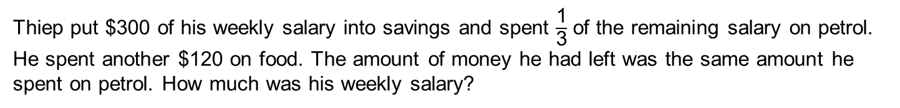

Use bar models to solve the problem
Thiep put $300 of his weekly salary into savings and spent $\frac{\text{1}}{\text{3}}$ of the remaining salary on petrol. He spent another $120 on food. The amount of money he had left was the same amount he spent on petrol. How much was his weekly salary?
$300
  Remaining money
Thiep’s salary
$300
$$\frac{\text{1}}{\text{3}}$$ | $$\frac{\text{1}}{\text{3}}$$ | $$\frac{\text{1}}{\text{3}}$$
$\frac{\text{1}}{\text{3}}$is $120
savings
petrol
$120 food
Money left
  Weekly salary
$660
Value of Remaining money
120 x 3 = 360
Thiep’s weekly salary is $660
Total weekly salary
300 + 360 = 660

Slide 11

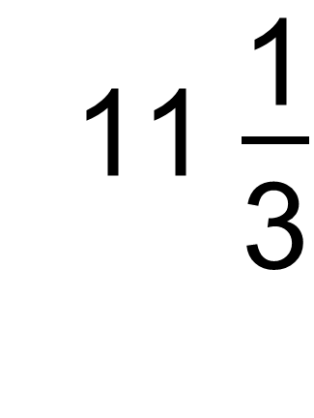
Convert the mixed numeral to an improper fraction
11 $\frac{\text{1}}{\begin{aligned} \\ \text{3}\end{aligned}}$
$\frac{\text{34}}{\begin{aligned} \\ \text{3}\end{aligned}}$

Slide 12

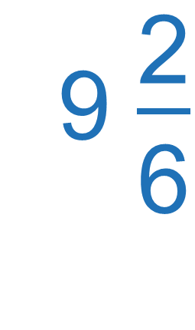
Convert the improper fraction to a mixed numeral
$\frac{\text{56}}{\begin{aligned} \\ \text{6}\end{aligned}}$
9 $\frac{\text{2}}{\begin{aligned} \\ \text{6}\end{aligned}}$

Slide 13
Calculate the perimeter of this rectangle and the cost to build it, if fencing costs $20 per metre
8 m
4m + 8m = 12m
12m x 2 = 24m
4 m
24m x $20 = $480

Slide 14
Calculate the missing side length of the rectangle
? cm
Area = 40 cm²
10 cm
40 = ? x 10
? = 4 cm

Slide 15
Calculate the cost of covering this area
3 m
Area =
3 x 2
=
6 m²
2 m
Cost =
6 x 9
=
$54
Cost = $9 per m²

Slide 16
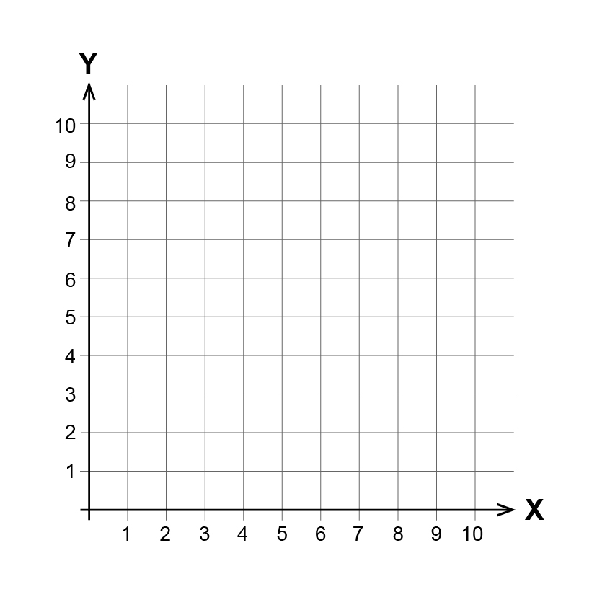
Plot the coordinates and state the shape
(3, 5), (3, 9), (7, 9), (7, 5)
square

Slide 17
What is the probability of the spinner landing on red?
certain
possible
equal chance
impossible

Slide 18

What is the probability of the six-sided die landing on a number between 1 and 6?
certain
possible
equal chance
impossible
Image credit: Free SVG

Slide 19




True or false: these graphs show the same data
True
Favourite sport Year 4 = 10 votes
Votes
Image credit: Clipart

Slide 20
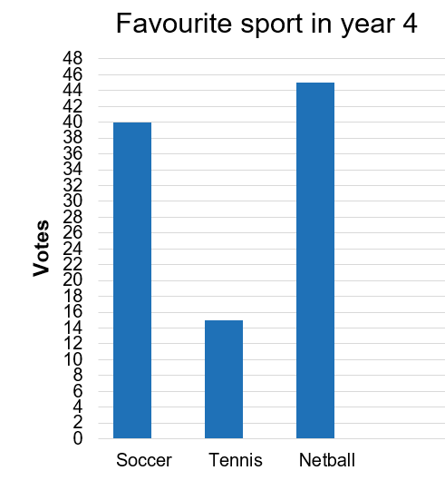
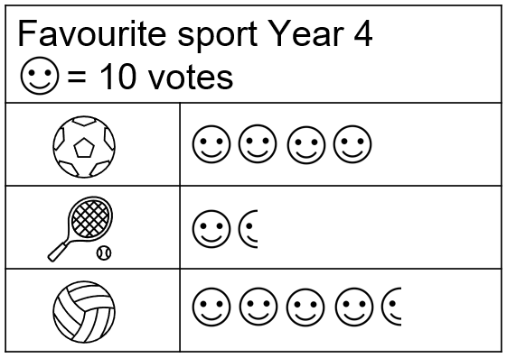
Which graph best displays the data?
Votes
The picture graph represents the data more clearly. The y-axis intervals on the column graph are too small and are harder to read.
Image credit: Clipart

Slide 21

With the support of
David Morkunas
Michael McKinnon
For more resources
ochre.org.au
@ochreeducation
These materials have been made available to the public under Creative Commons Attribution 4.0 International license. They may be reproduced for non-commercial educational purposes only.

