Slide 1
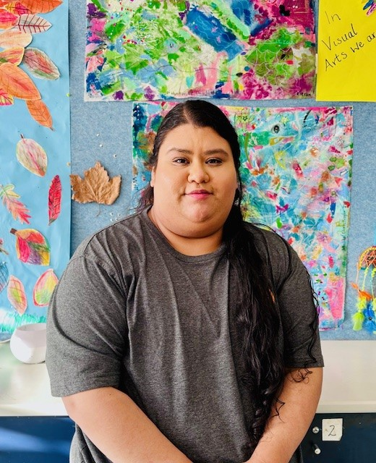
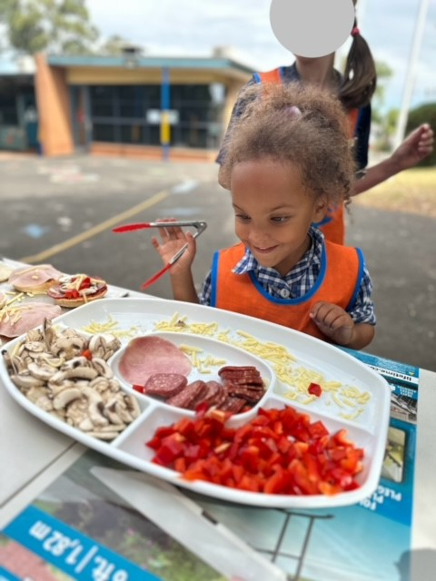
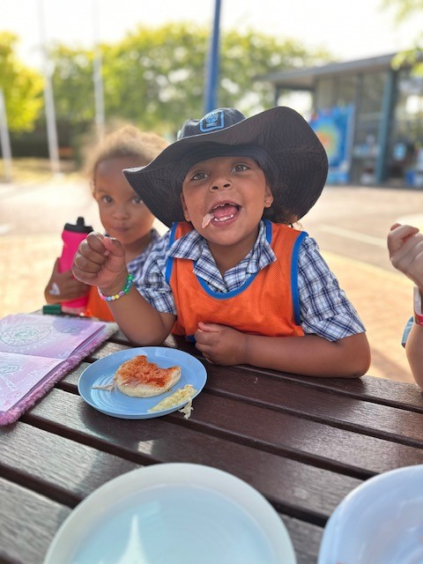
Skye Primary School
Hello Families ☺
Welcome back to school in the year 2024, I hope you all enjoyed your summer holidays and are ready to ‘ let the fun begin’ with TeamKids!
My name is Christina, I am the director of service at TK Seaford North and acting director of Skye. I greatly look forward to continuing to get to know the children, families and collaboratively working with the staff and school. If you have any questions about the service, please feel free to contact via phone, email or in-person,
Cooking Club
During the fifth week of term 1, TK Skye had a cooking class together during our afternoon session. The children helped and assisted in the making of English pizza muffins.
They loved working together in adding the different topping and discussing what you can put on a pizza. It was a great encouragement of independence and involvement within their space!
In term 1, there will be celebrations highlighted throughout the program and special events within the community. The dates are provided in the section below, if you would love your child/ren to attend. Book Now!
MON 11TH MARCH
Ramadan Begins | BSC & ASC
MON 18TH MARCH
St Patrick’s Day | BSC & ASC
WED 20ND MARCH
International Day Of Happiness | BSC & ASC
0478 755 385
skyeps@teamkids.com.au
1300 035 000
info@teamkids.com.au

