Slide 1


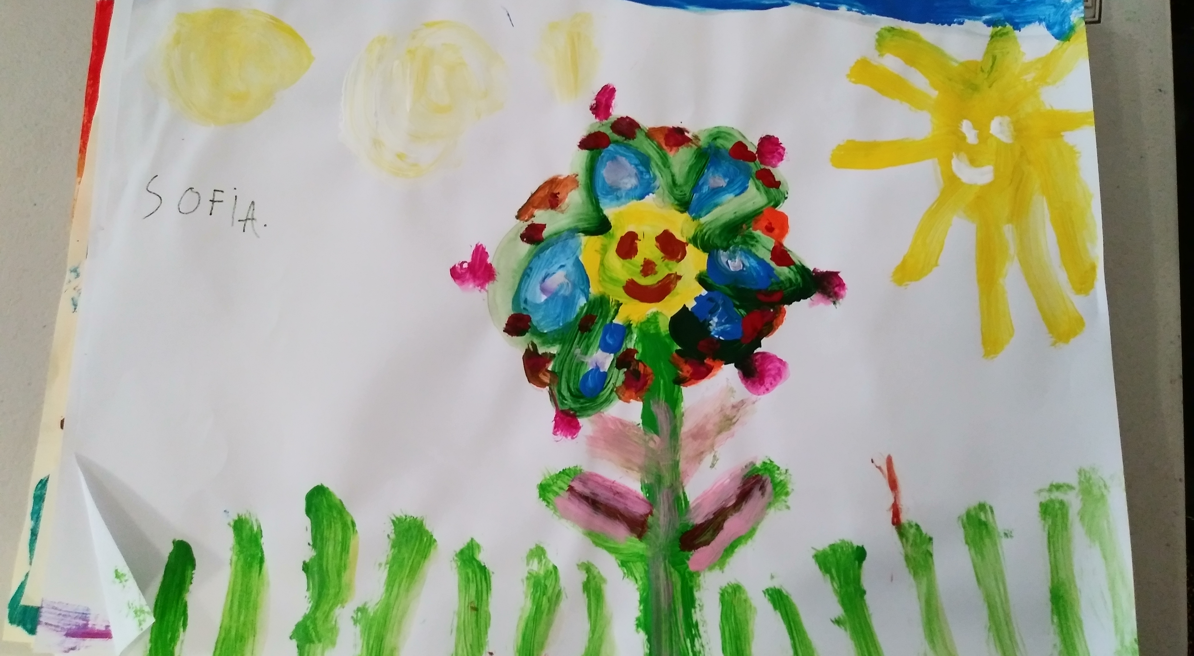
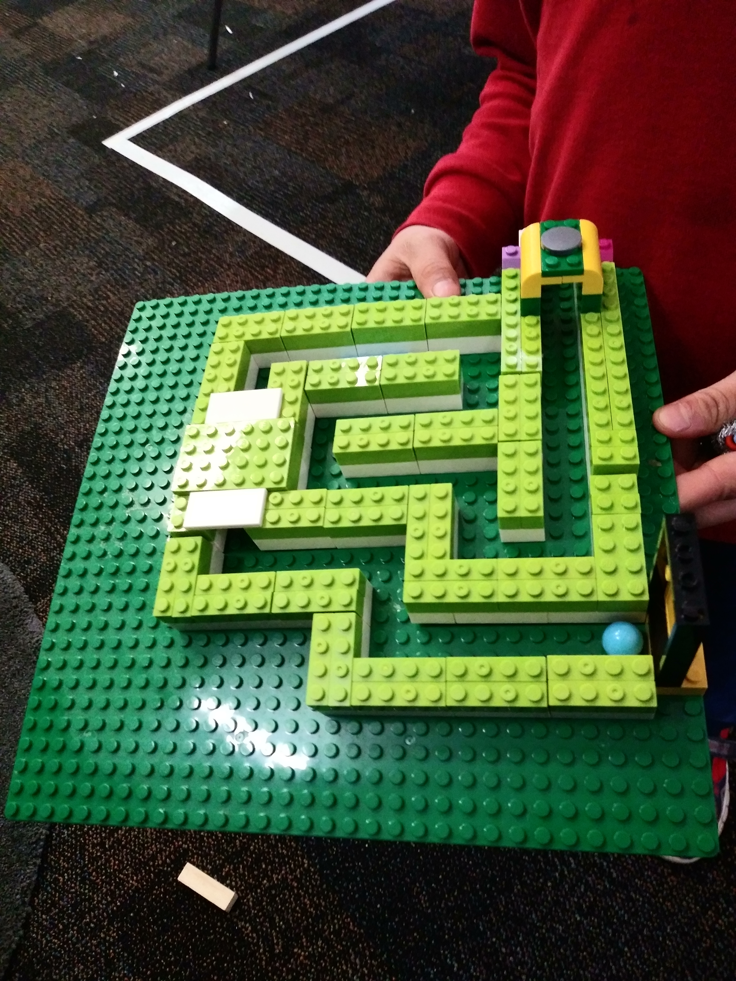
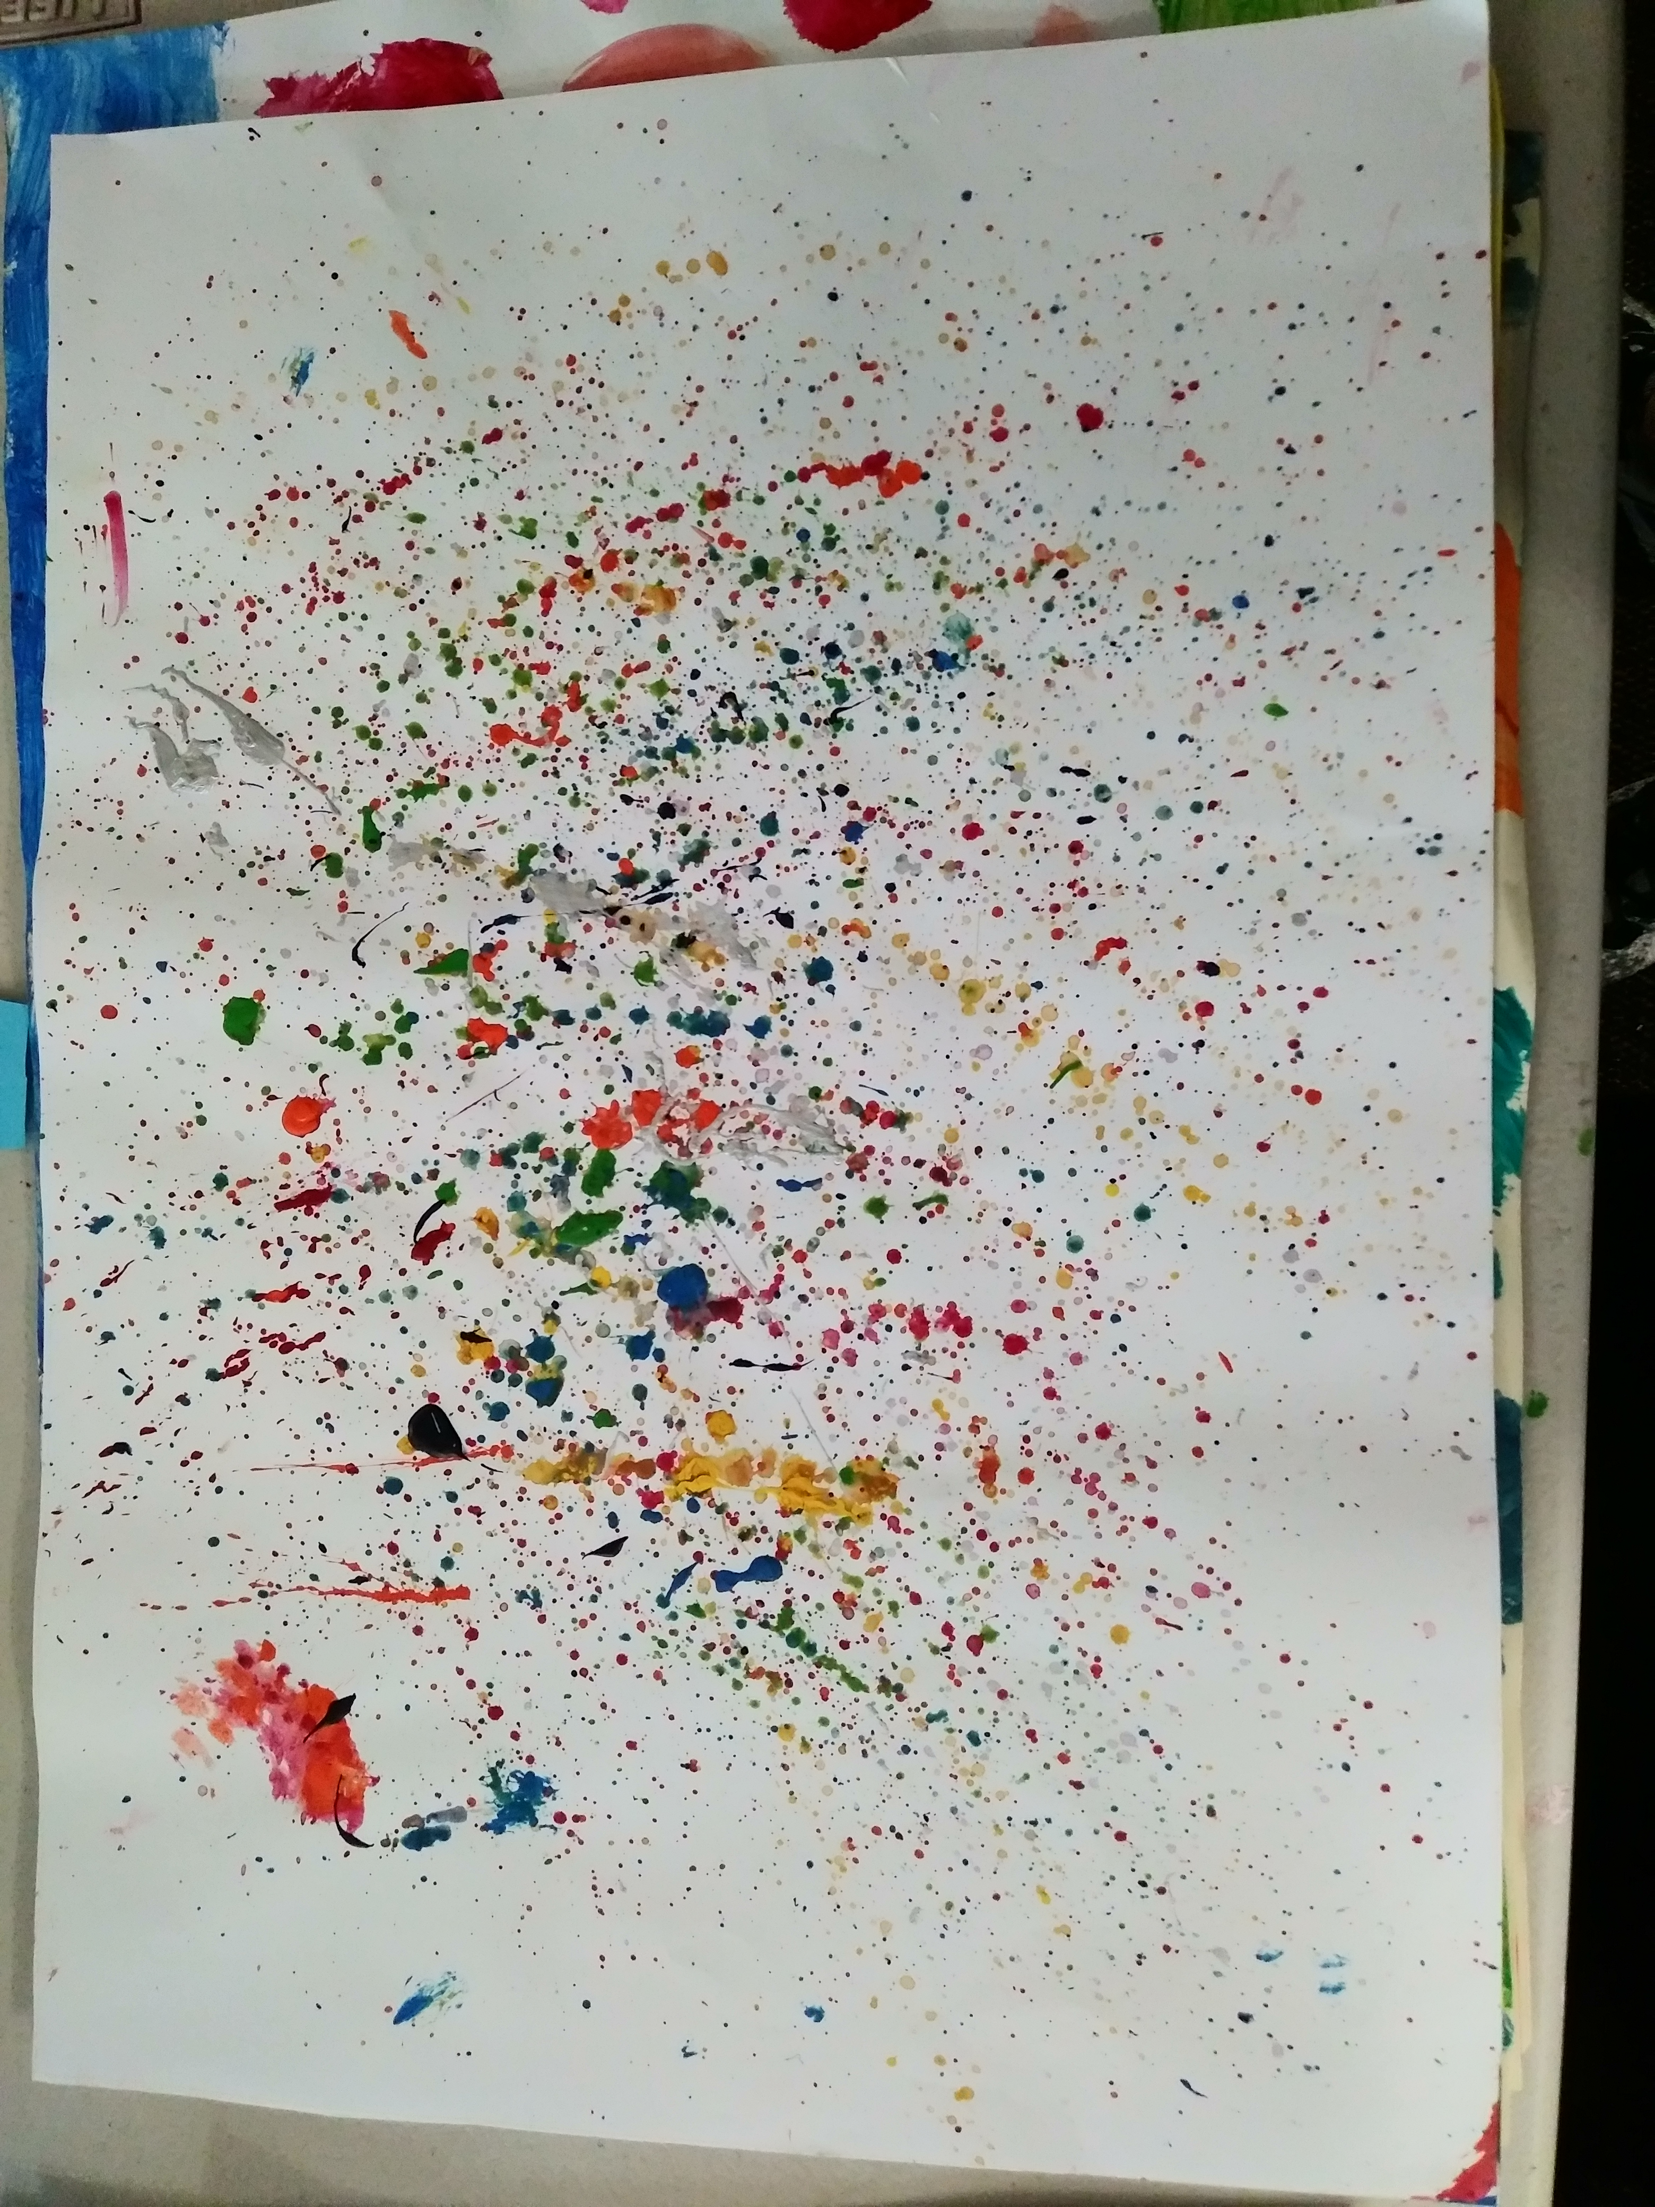
PORT MELBOURNE TEAMKIDS
Hello Everyone!
Welcome back for Term 4, we hope you are all well rested and ready for a big term ahead. The team here at Port Melbourne are looking forward to creating a fun and engaging program with your children.
As you would have noticed we have had some new faces introduced to the service. Our regular educator team for this term will consist of Hannah, Emmanuel, Samira, Valerie, Tatjana and Noah. We are all dedicated to ensuring consistency and continuity for families and children. If you have any queries, questions, or feedback please do not hesitate to approach one of our friendly educators - we are always happy to support where possible.
A quick note on bookings, if for any reason your child is absent, or you need to cancel a booking please give the service a call-in advance.
1-5
Epic Games and S.T.E.M
Epic Games and LEGO MASTERS
Epic Games and LEGO MASTERS
Art Attack and Performers Club
Art Attack
THUR 20TH OCTOBER
3-6 Live music performance ‘Taking Shape’
MON 24TH OCTOBER
Diwali Festival of Lights
TUES 1ST NOVEMBER
Melbourne Cup Day | TeamKids Closed
0448 056 705
portmelbourneps@teamkids.com.au
1300 035 000
info@teamkids.com.au

