Slide 1
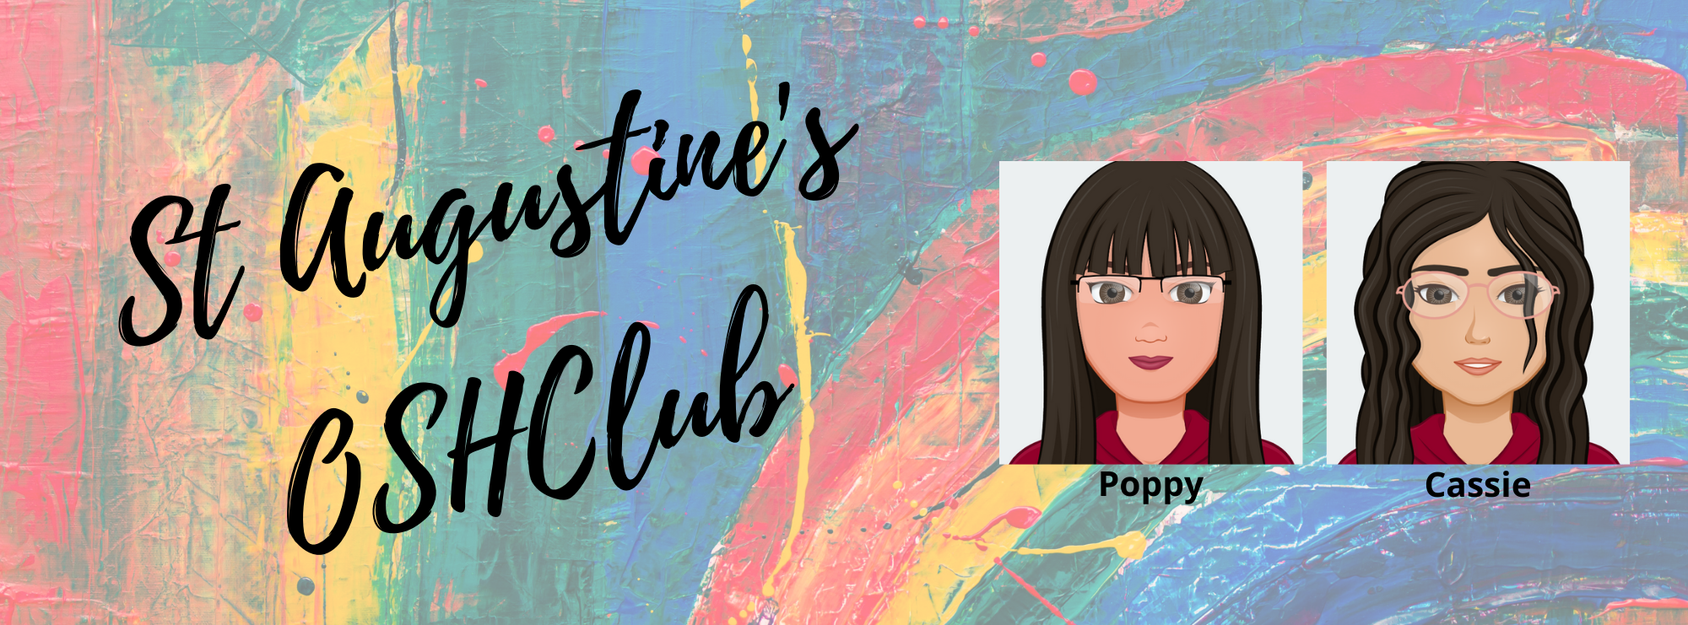
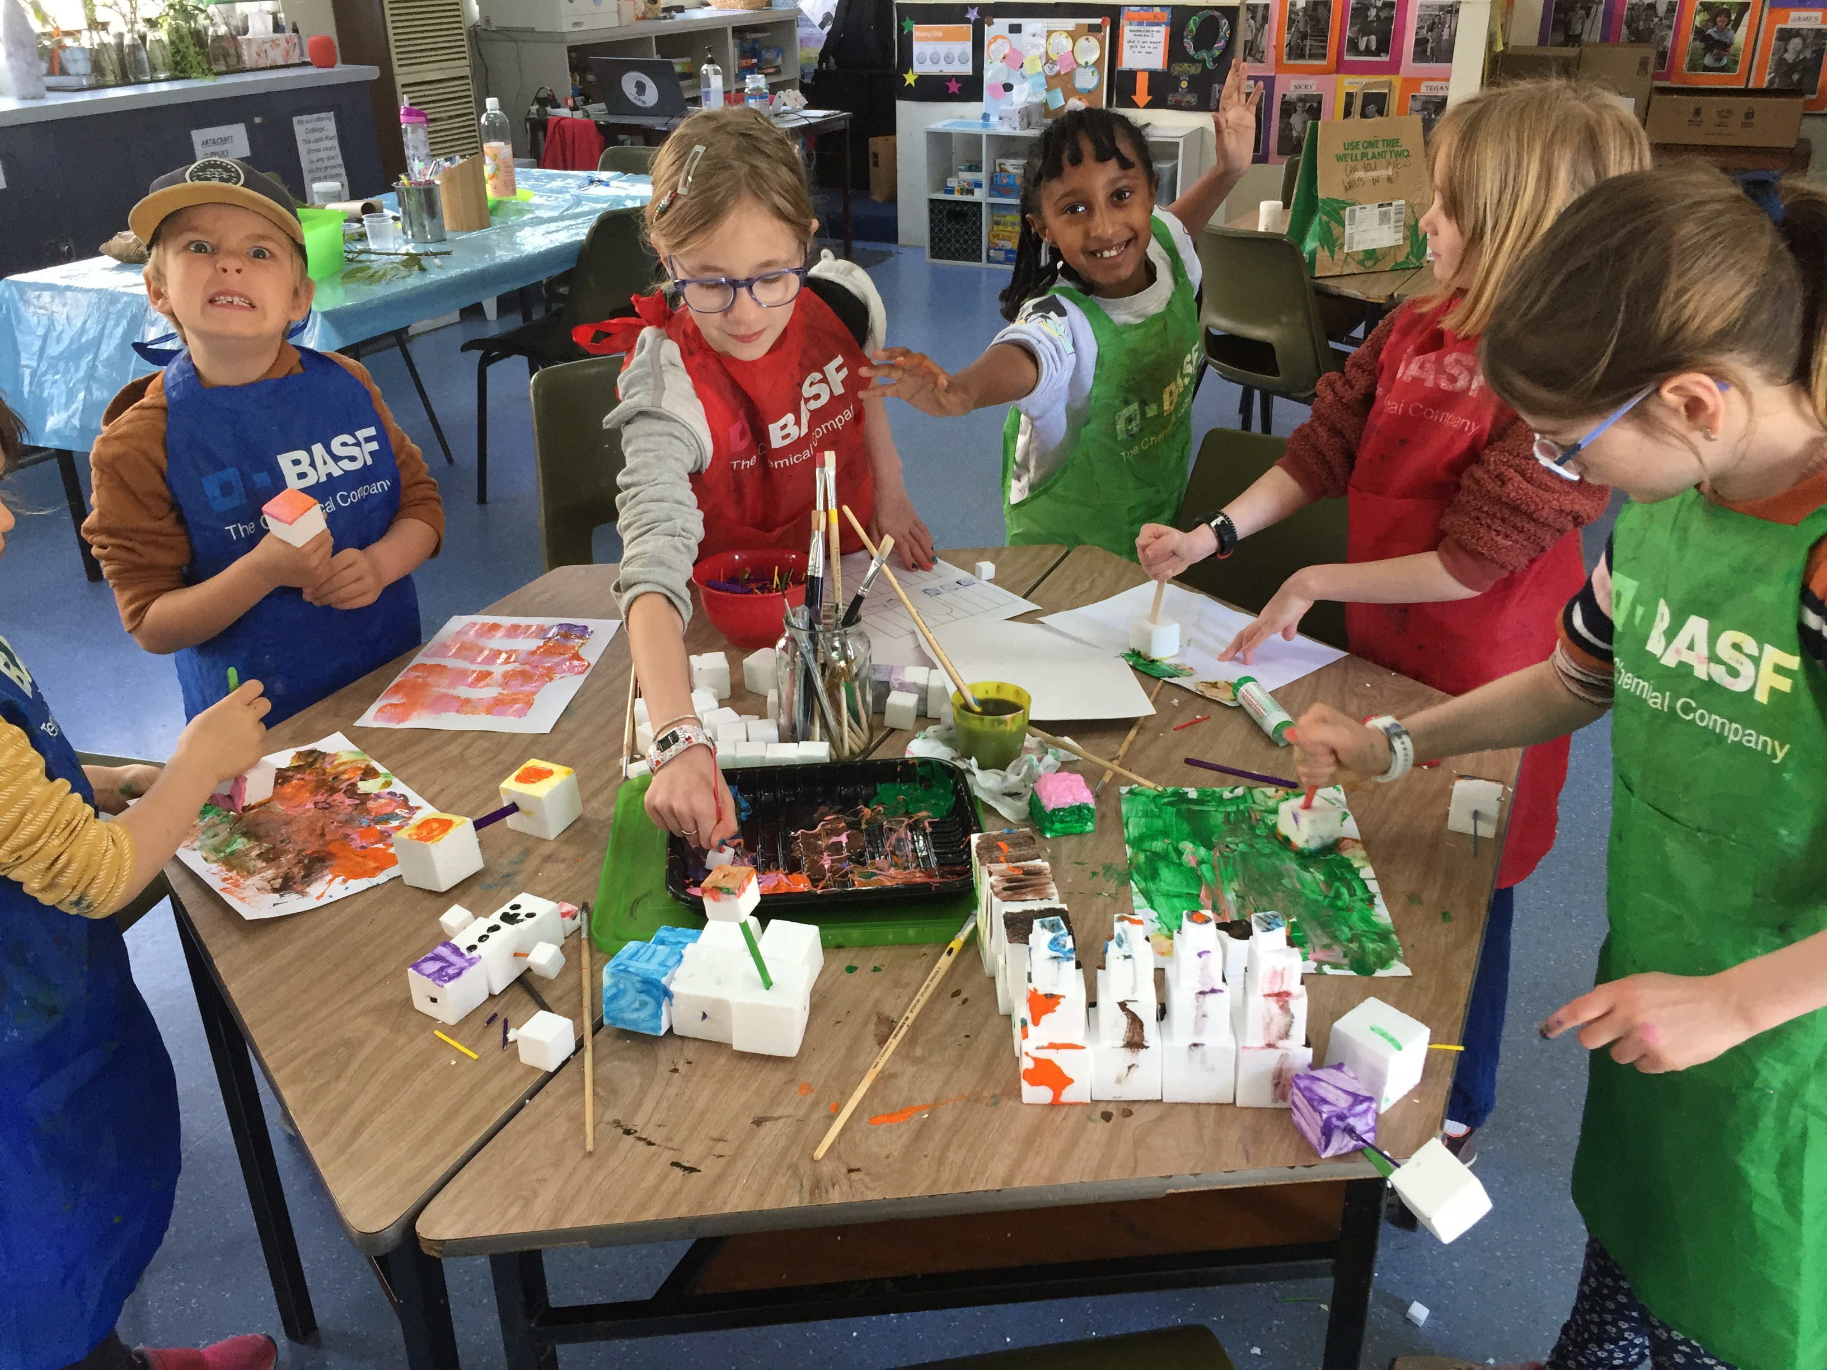
Welcome back for TERM 2☺
WHAT’S BEEN HAPPENING…
Welcome back to Term 2.
Over the last fortnight we have had the opportunity to facilitate our legendary Vacation Care program which was a smashing success! It was so amazing to see faces old and new.
The kids had the opportunity to learn how to breakdance (which was awesome) and get up close and personal with some Australian Wildlife (aka a dingo, wombat, snake, frogs and a small kangaroo).
We also had the time of our lives playing multiple rounds of mini golf and got to get up close and personal with some interactive artwork at ARTVO.
It was a real pleasure to see some faces from other schools that we usually don’t get to see which allowed for friendships to be reignited.
We ended the VAC program with a chilled out Pajama party which we all loved.
SPECIAL ANNOUNCEMENTS
We would like to throw a shout out to the infamous Adam Mulvaney ☺
He came in on the first day of VAC and showed off his break dancing moves during our incursion.
We hope to see him on Dancing with the Stars soon.
Transitions
Our policy for the next two weeks will be on transitions.
We are going to look at ways on how we can transition children back into the program after a break. We are also focusing on imbedding practices and routines in regards to OSH ASC pickups.

Slide 2
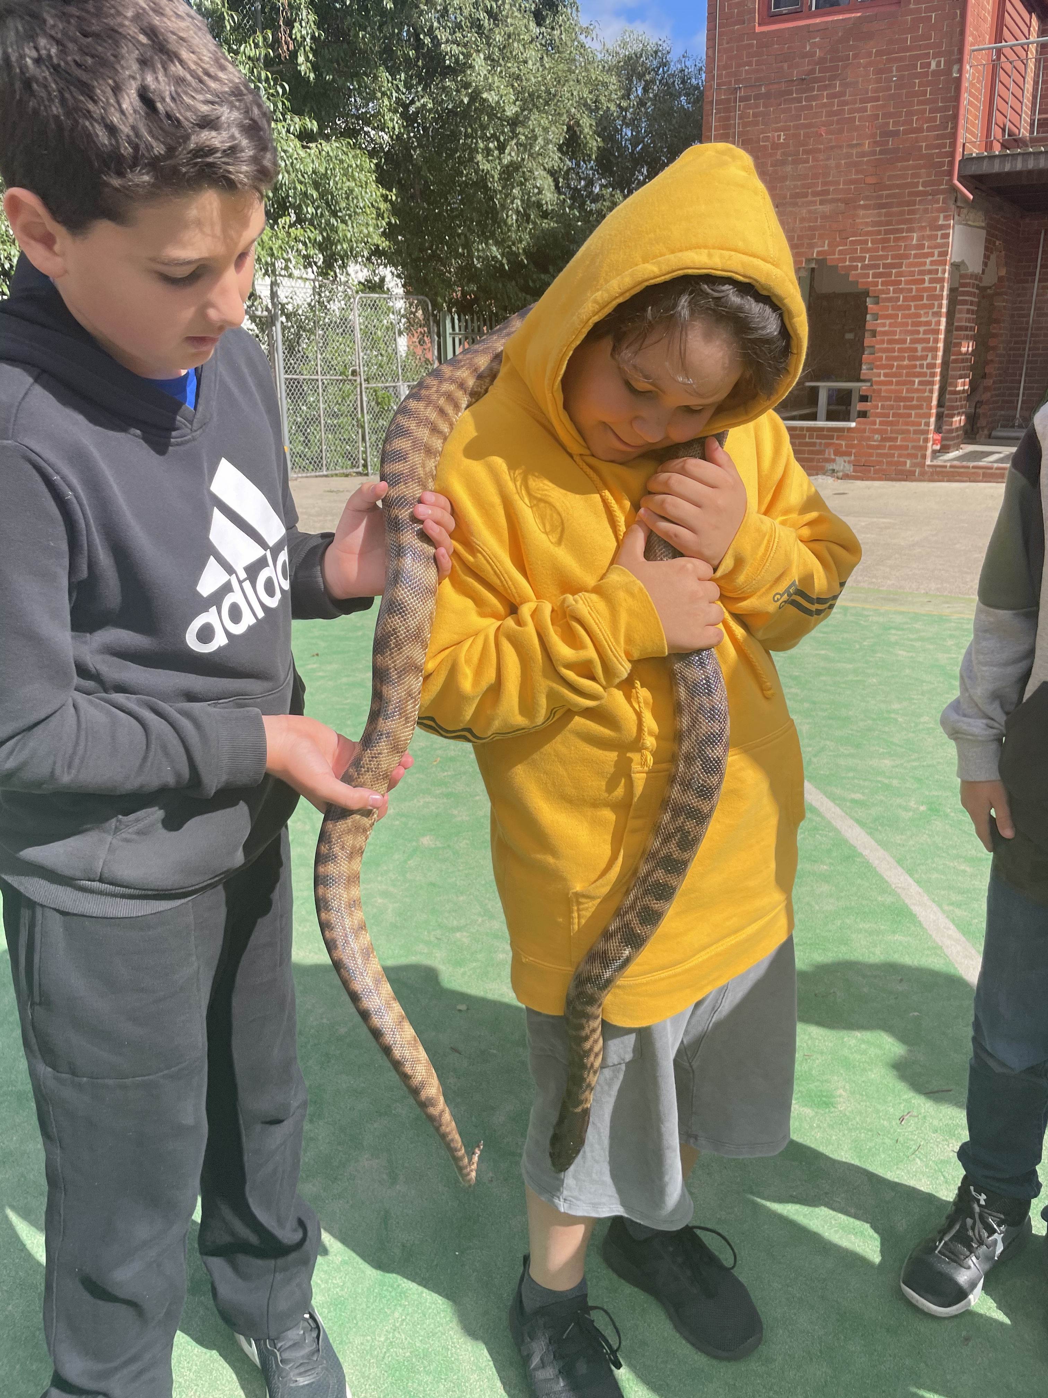
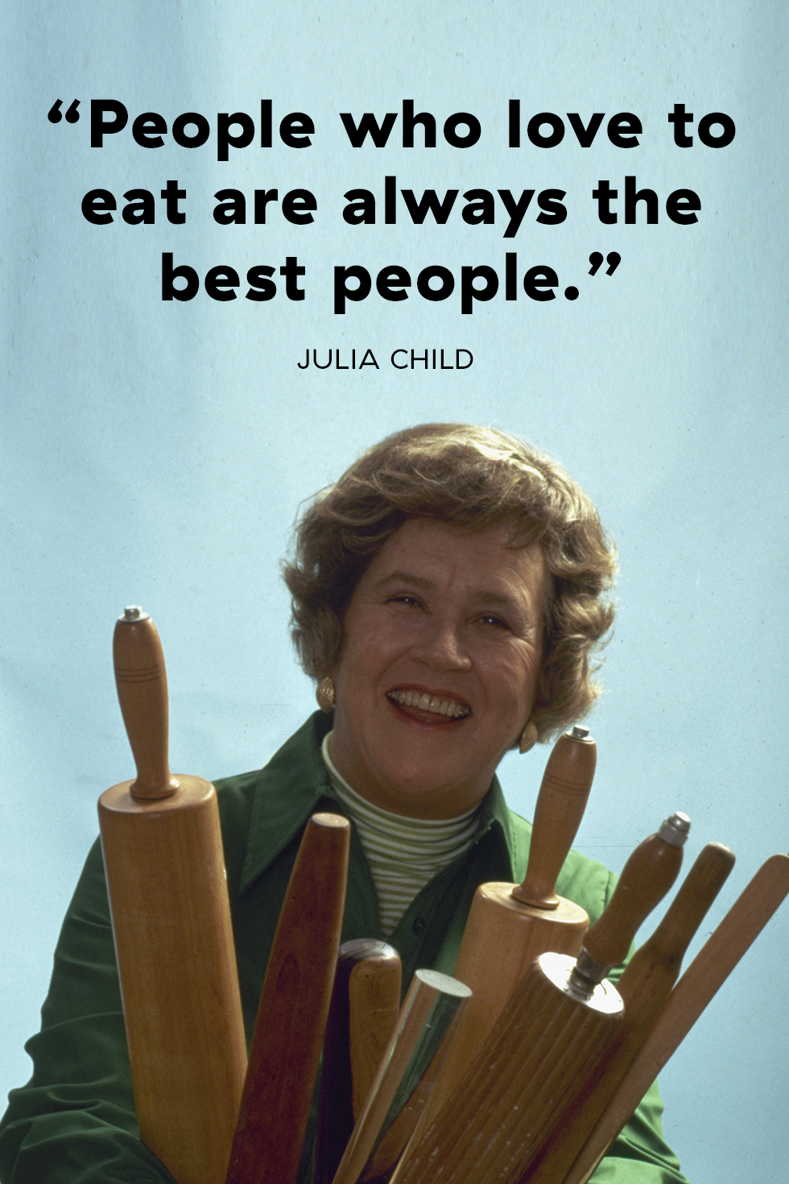
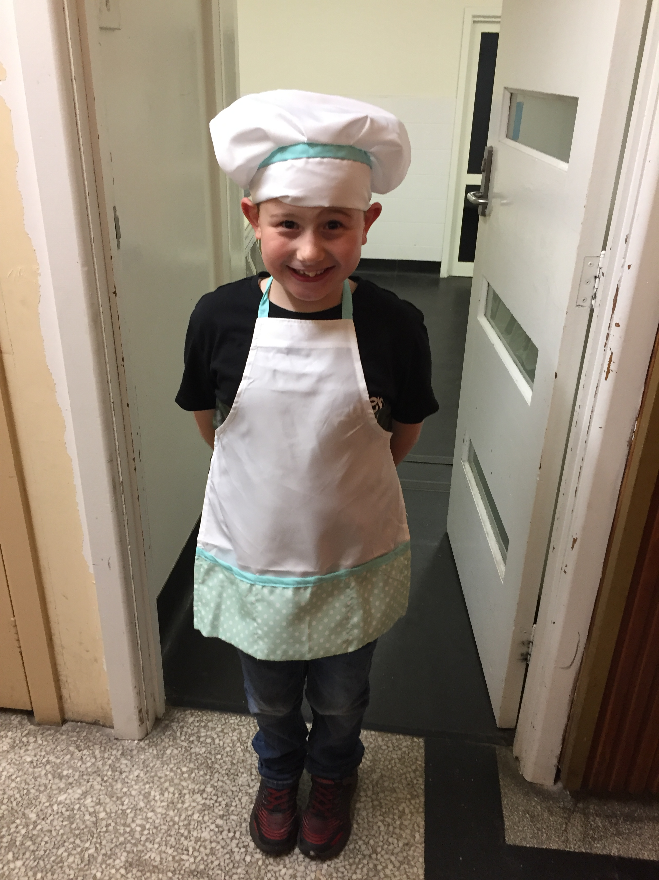
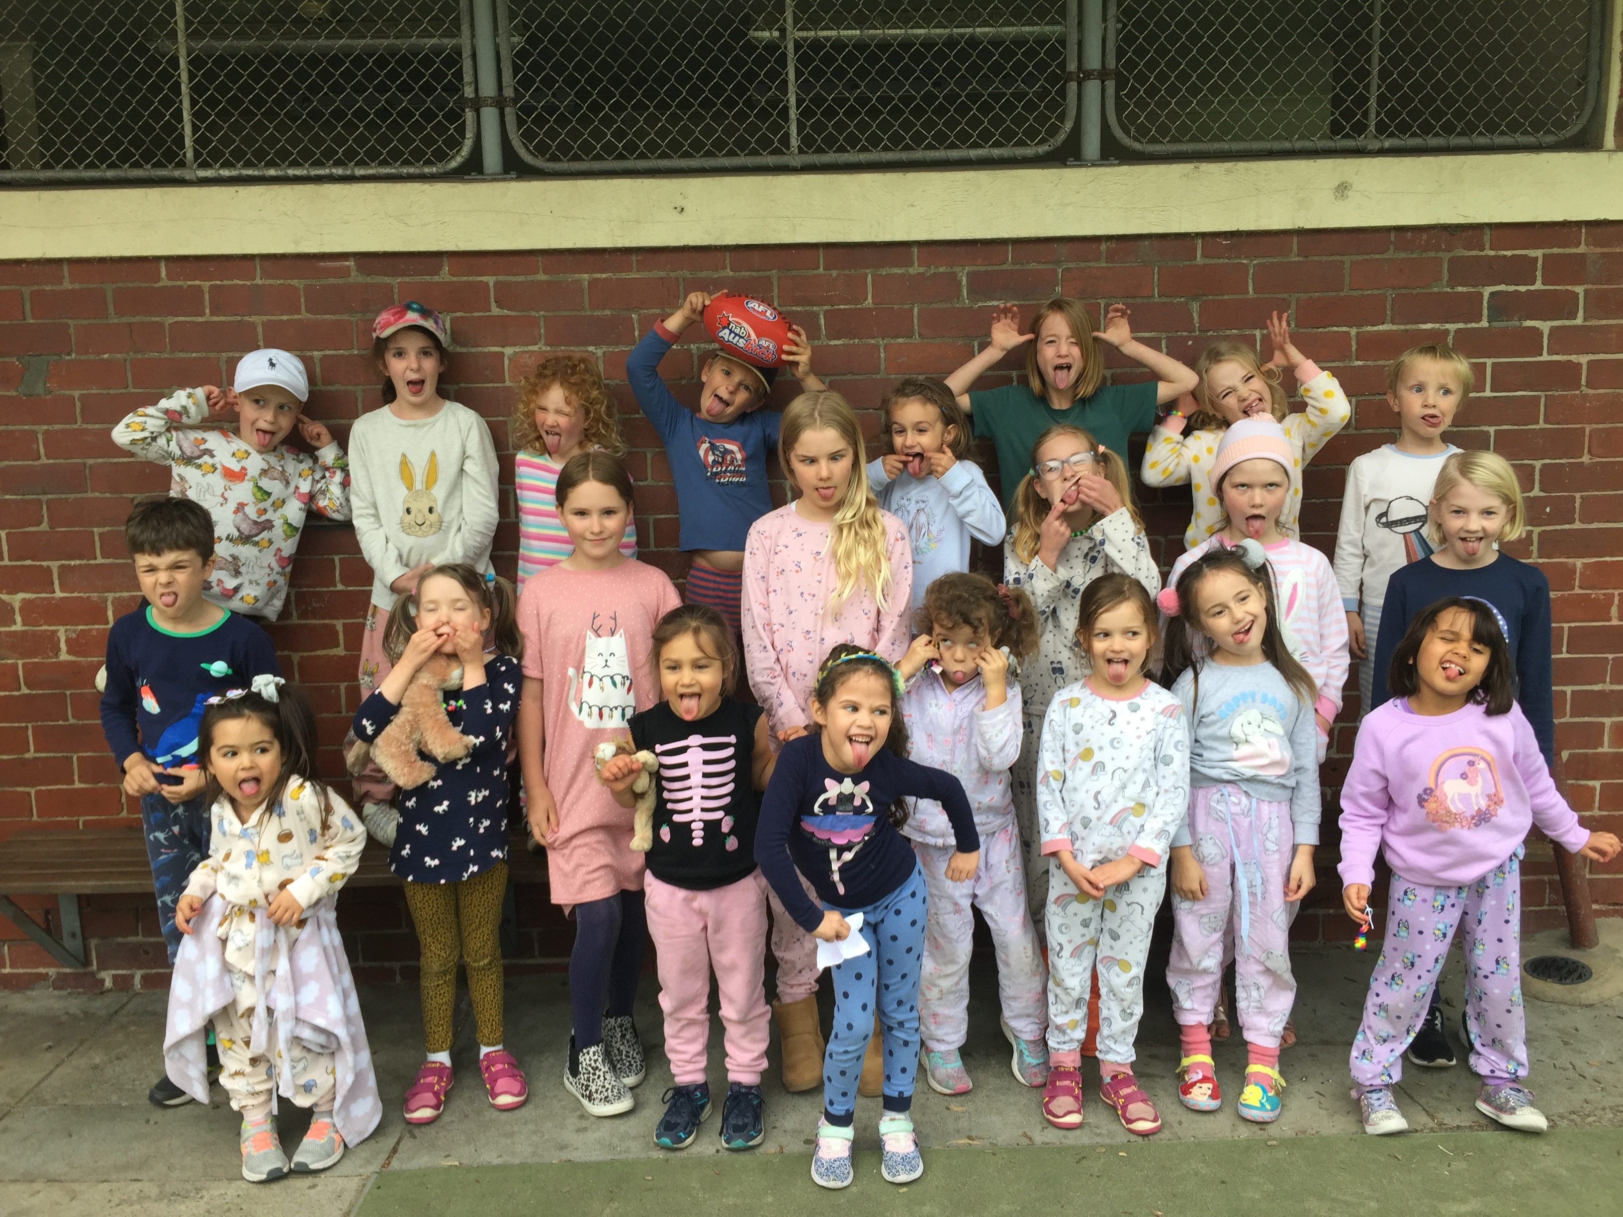
COMING UP
RECIPE
ANZAC WEEK
Coconut Biscuits.
April
WE ARE STILL COLLECTING BREDTAGS SO FREE FEEL TO DROP THEM OFF
https://ozbreadtagsforwheelchairs.org.au/
April
Ingredients:
Desiccated coconut
300 mls of Condensed milk
April
WELCOME BACK
Feel free to pop in and say hello ☺
Method:
Combine coconut with 300mls of condensed milk. Stir.
Once formed, roll mixture into cookies and place on greased pan.
Put in oven at 180 degrees and bake for 15 minutes
PHOTO GALLERY
Pajama Party
James the chef!

