Slide 1
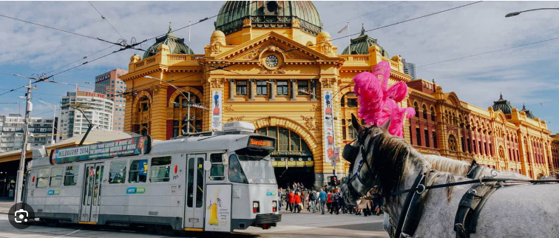
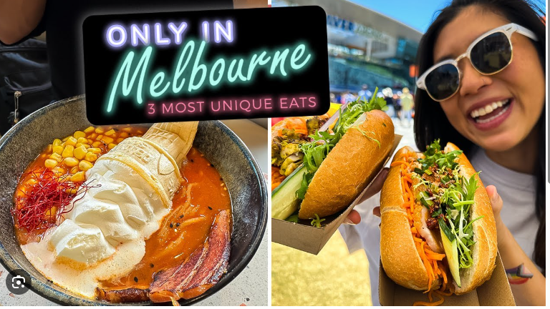
FOOD TOUR TO MELBOURNE
Check out some of the awesome places students have explored on past residentials! While we’ll be heading to similar spots, our adventure next year will have its own unique twist—depending on what’s available at the time. Get ready for something exciting!

Slide 2
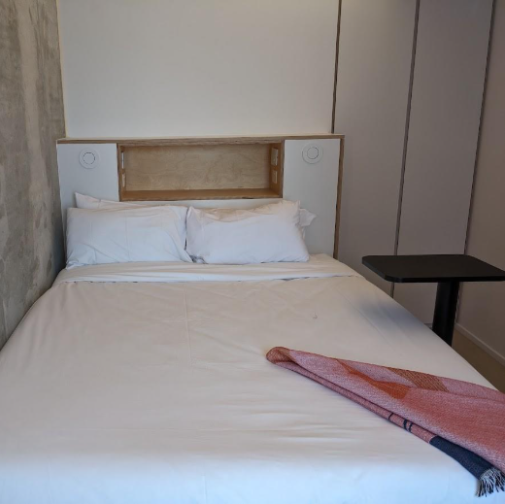
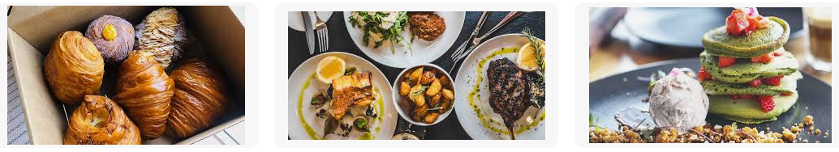
Accommodation
Scape Melbourne
https://youtu.be/x-8qrK9oKOs
We will be staying in secure student college accommodation
Students will have their own room and bathroom

Slide 3
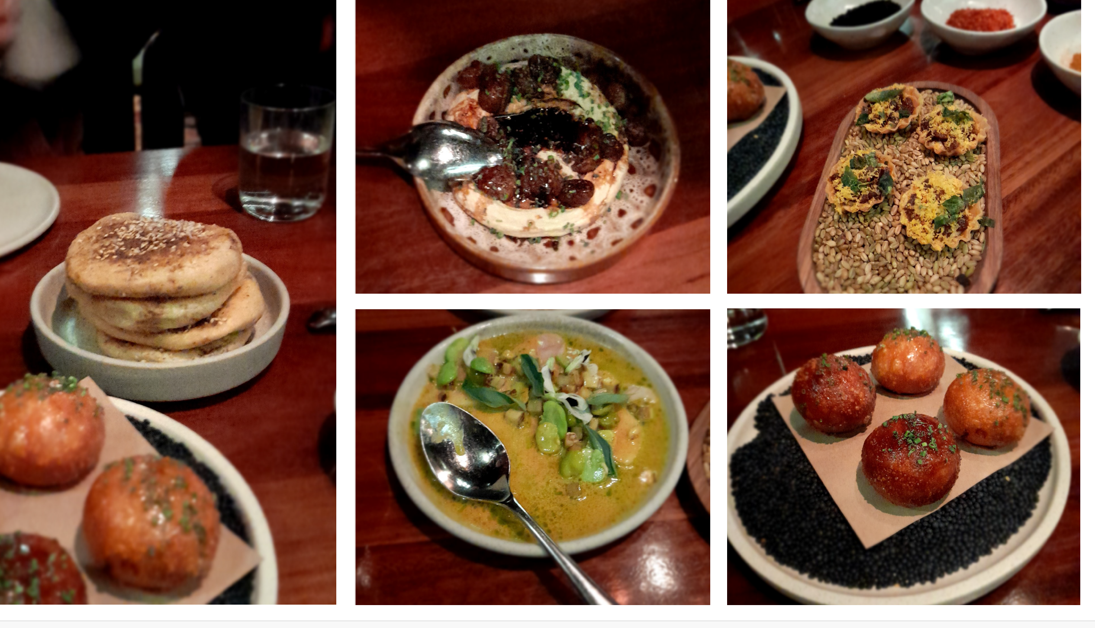
Le Cordon Bleu Melbourne
Website - Cooking Classes | Le Cordon Bleu Melbourne
Expert Chef classes
https://www.youtube.com/watch?v=KYXJZeW_ccc

Slide 4
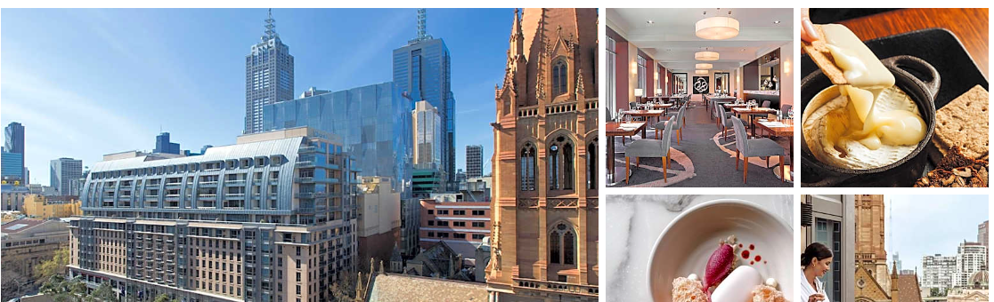
Activities from previous tours
This is a representation of activities we will be engaged in subject to vendors availability April 2026
The Westin Hotel is one of the luxury brands within the
global Marriott conglomerate. We will be met by Executive Chef
Apoorva Kunte, members of his Food & Beverage team, the HR
manager and potentially the hotel’s General Manager who will
speak on the great career opportunities within luxury international
hotels.
The Westin Melbourne - Guest Reservations
Westin Hotel

Slide 5
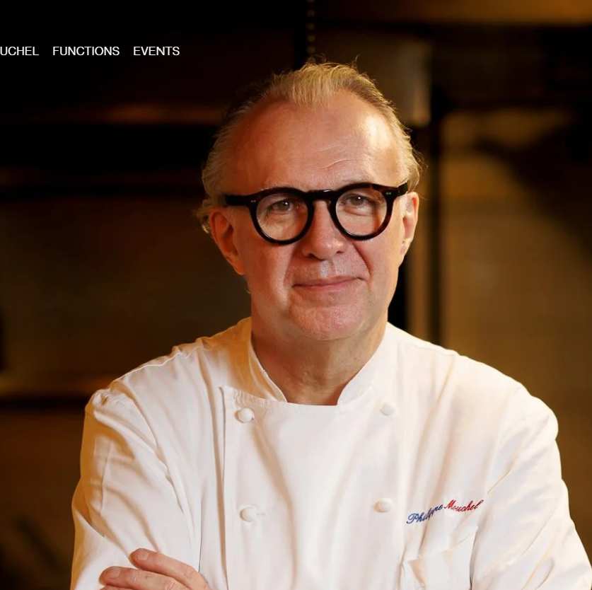
Activities from previous tours
This is a representation of activities we will be engaged in subject to vendors availability April 2026
Philippe Restaurant
Philippe is a Melbourne institution; one of the first authentic French bistros in Melbourne and still one of the best, owned and run by Philippe Mouchel who trained under the legendary Paul Bocuse.
You will have a tour of Philippe’s kitchen with a talk from Philippe himself and a former Le Cordon Bleu student who now works there, followed by dinner.
- Menu+for+website+-+15.10.pdf
The Westin Melbourne - Guest Reservations

Slide 6

Activities from previous tours
This is a representation of activities we will be engaged in subject to vendors availability April 2026
Breakfast @ News – Penny for Pound

Slide 7
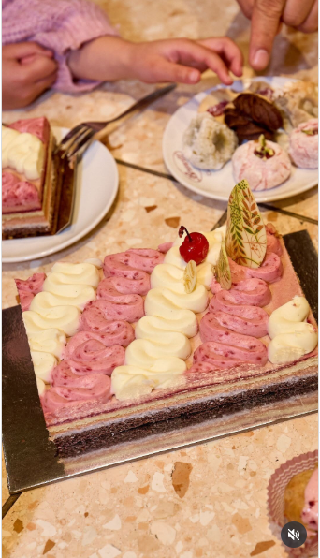
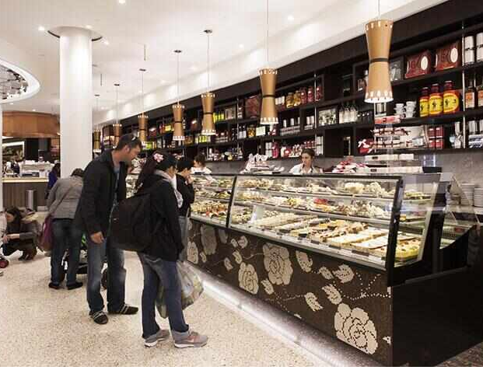
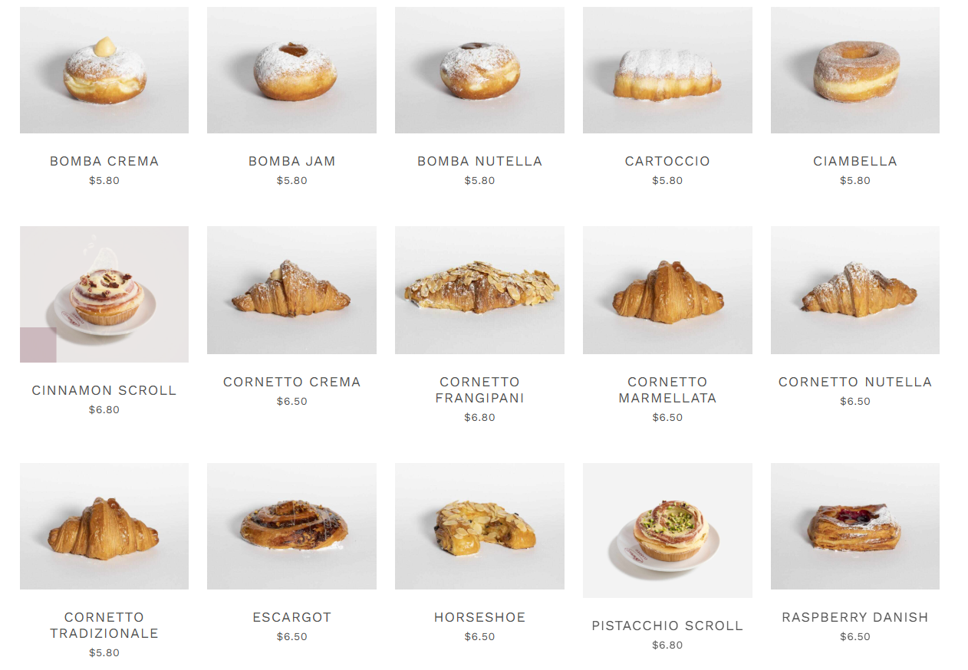
Activities from previous tours
This is a representation of activities we will be engaged in subject to vendors availability April 2026
Visit : BRUNETTI CLASSICO CARLTON

Slide 8
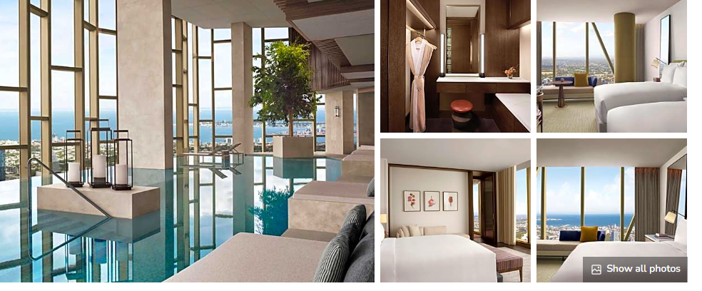
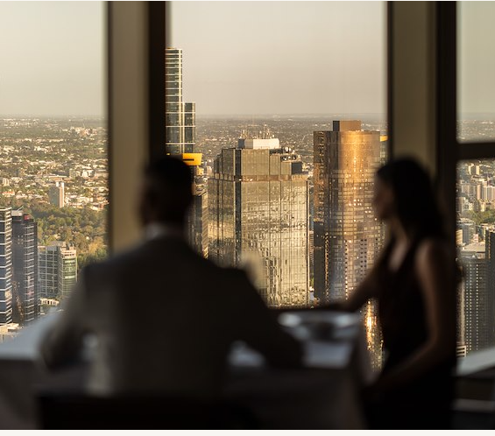
Activities from previous tours
This is a representation of activities we will be engaged in subject to vendors availability April 2026
The Ritz-Carlton, Melbourne - Guest Reservations
Ritz Carlton Melbourne Tour of the hotel
Dinner at
Atria Melbourne | What’s On – Seasonal Experiences & Dining Events

Slide 9
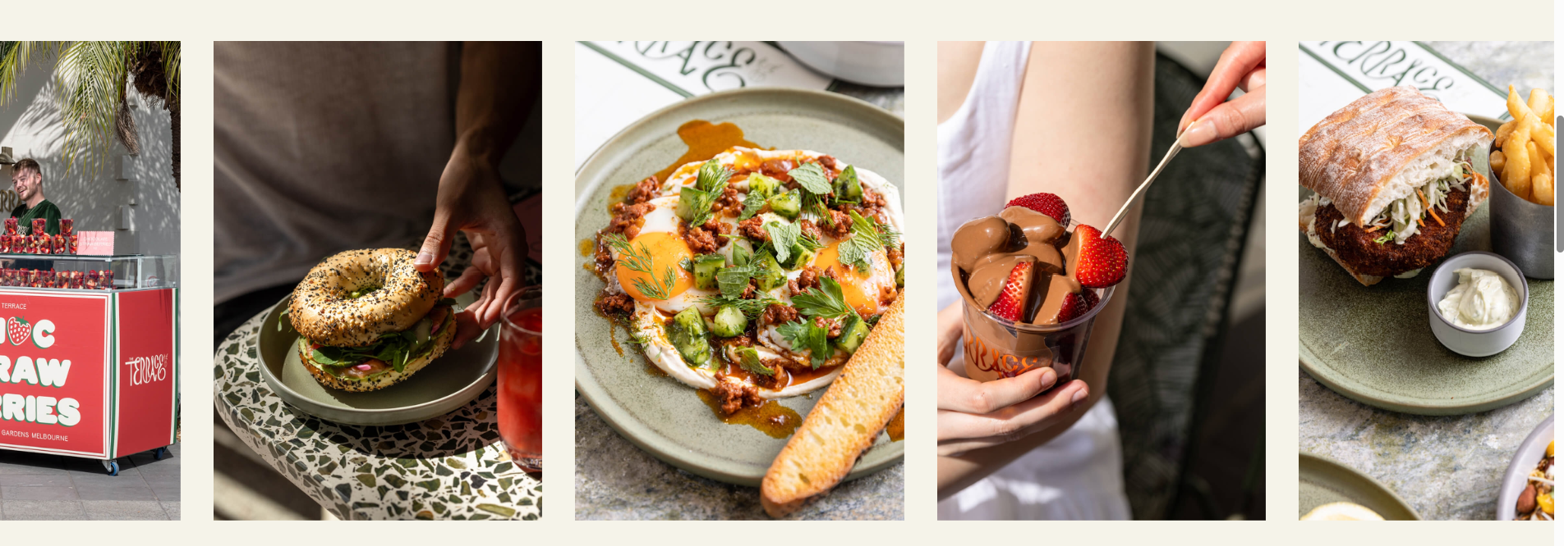
Activities from previous tours
The Terrace, Royal Botanic Gardens
This is a representation of activities we will be engaged in subject to vendors availability April 2026
. Brekky at Cafe & Kiosk - The Terrace
Far from the simple tea house it once was, The Terrace is now operated by the Darling Group
under the direction of culinary maestro Chris Mitchell who has worked with the likes of Gordon Ramsey. You’ll have a full breakfast and a tour of their facilities including their new
‘Observatory’ space.

Slide 10
Eligibility to Attend
Melbourne Food Tour
As a dedicated Food Studies Tour, eligible students include:
• those who have completed Year 10 Food Studies in 2025;
• current Year 11 General Food Science and Technology students (2025); and
• students who are enrolled in Year 11 or 12 General Food Science and Technology in 2026.
Please see Expression of Interest attached to this newsletter item for further details.

Slide 11
We will accept Expressions of interest one week past the due date of 24th October 2025
Contact: Melinda.Toleman@johnxxiii.edu.au

