Slide 1
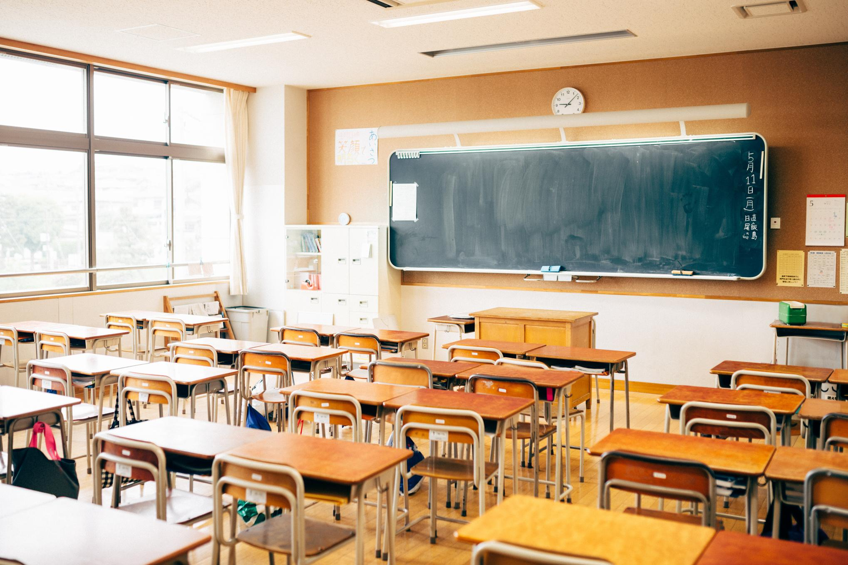
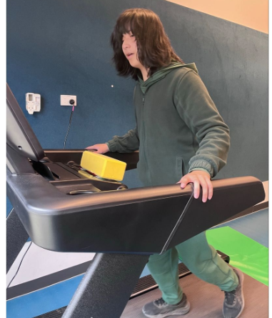
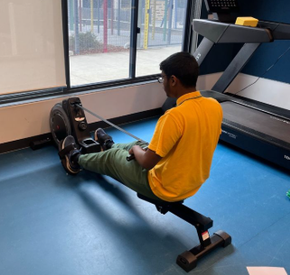
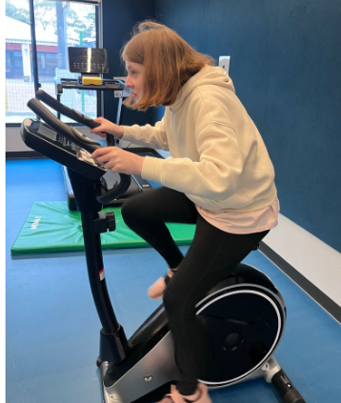
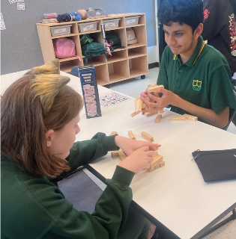
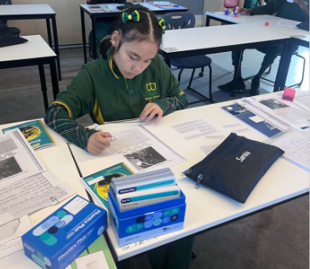
4E Moments
TEACHER MESSAGE
What an incredible term it has been! I have loved watching the students in 4E grow this term - some have picked up new skills, some have found their confidence to speak up more, and others have surprised themselves by sticking with something tough instead of giving up. It has been wonderful to watch.
I am so proud of this class. Every single student has shown up, tried hard, and pushed through challenges in their own way this term. Progress doesn't look the same for everyone, and that's okay - every bit of growth, no matter how small it might seem, is something to celebrate.
A big thank you to our families for everything you do at home. It really does make a difference, and I can see it in how the students approach their learning each day.
Teacher’s Note
Here is a snapshot of what we have been exploring this term:
Maths - Practising equal sharing, conducting surveys, and exploring duration and measurement concepts.
English - Reading and enjoying our Magic Belt series together.
Personal and Social Learning - Learning about our personal strengths and how to cope with challenging situations.
Integrated Studies - Exploring technologies people have used in the past, present and future, such as phones, cameras, vehicles and televisions.
Working out in the heavy-work room
Playing games with friends
Working hard on completing English tasks"
Tram Dang and Karen McVicar

