Slide 1
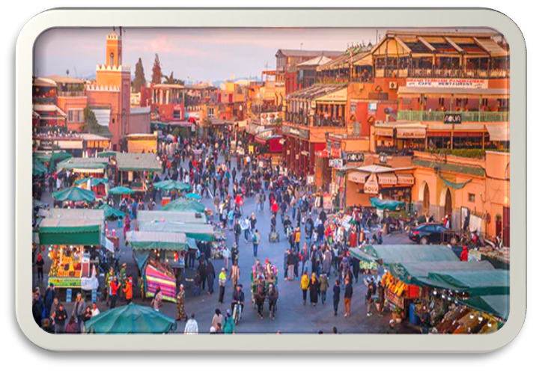
“Une description de ma ville” In Year 7, we wrote a description in French about a city. We used various adjectives and details that we had researched. We watched videos of Australian students who studied French and how that will help them in the future. We completed online Quizzes (on Microsoft Forms) that assessed our learning.

