Slide 1
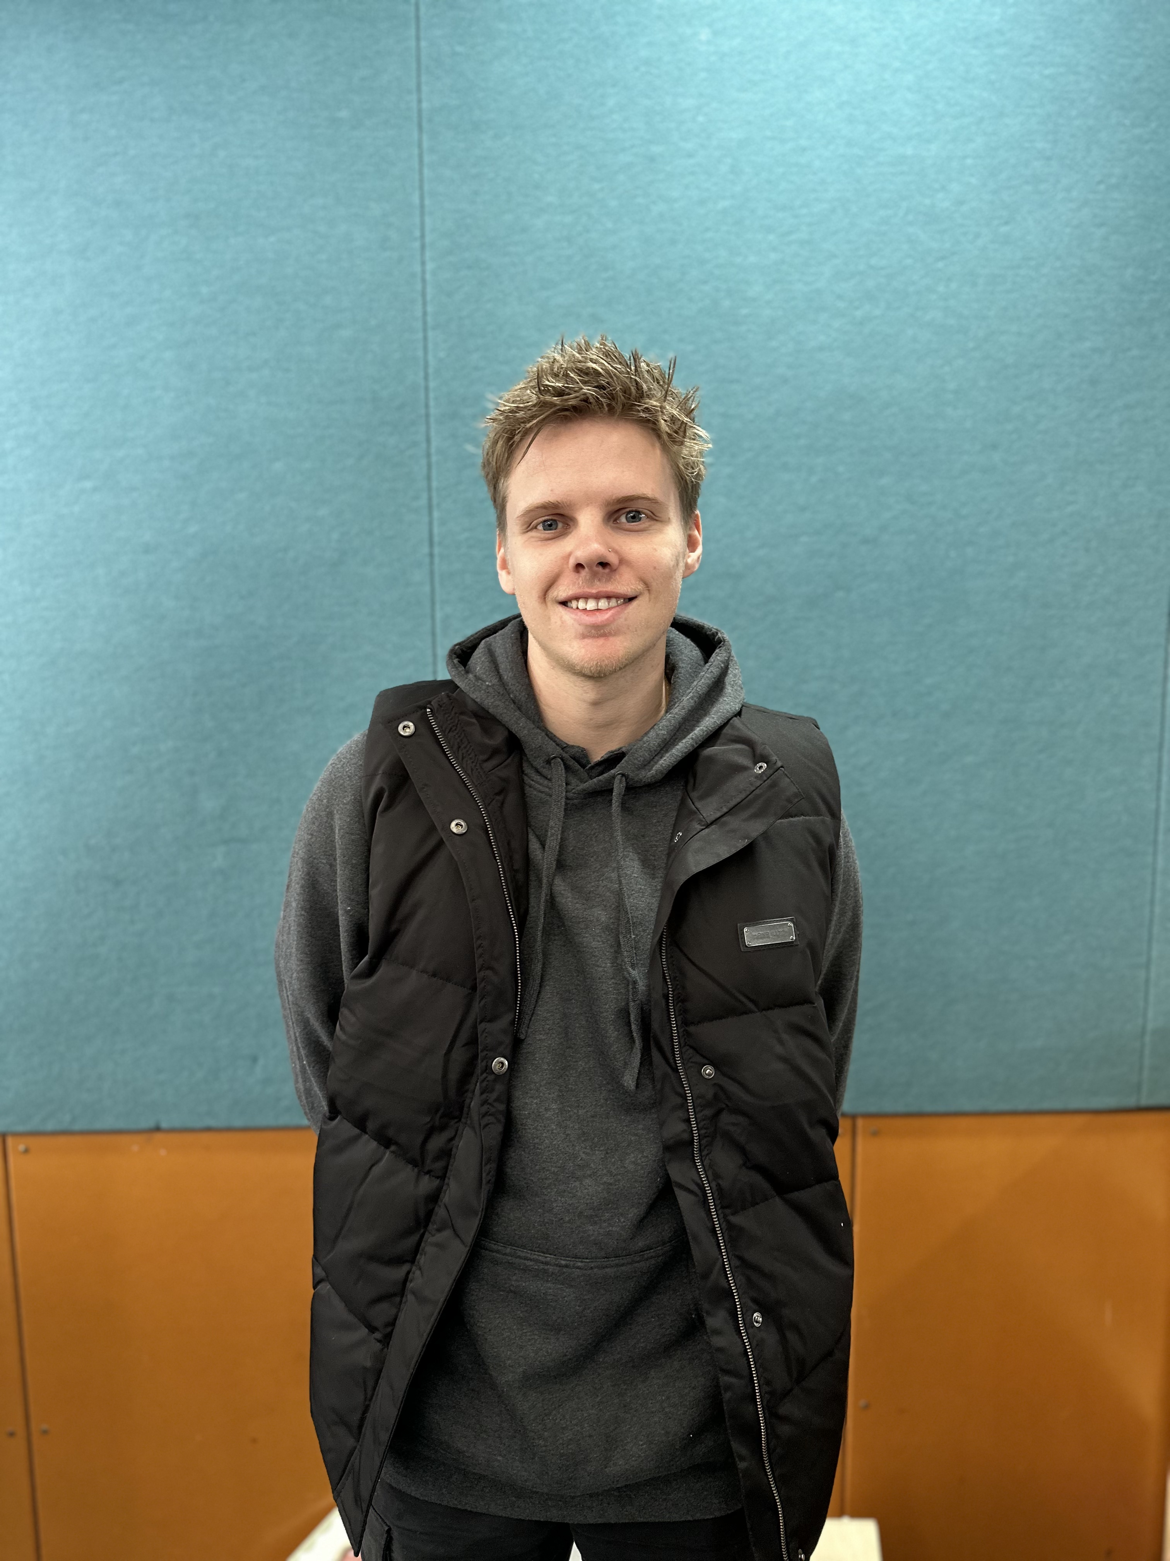
Skye Primary
Hello Families ☺
I hope you enjoyed the school holidays and are ready for Term 2 to begin!
I want to introduce the new director of service, Samual. We wish him a warm welcome to TeamKids and TK Skye. He has prepared an introduction for you all.
Hi, I’m Samual, I have 4 years of experience in OSHC and coordinated my service for one of those years. I come from a sporting background, having played and coached basketball for many years. I have a passion for working with children and would consider myself a child at heart.
I look forward to working with you all, I love a good chat so feel free to pop in and say hello or ask any questions that you might have.
Lost Property
Missing clothing / items?
Just a friendly reminder to families to have a look in the lost property located in the OHSC room. If your child/ren are missing their belongings from term 1 and vacation care.
In term 2, there will be celebrations highlighted throughout the program and special events within the community. The dates are provided in the section below, if you would love your child/ren to attend. Book Now!
MON 22ND APRIL
Earth Day| BSC & ASC
WED 24TH APRIL
ANZAC DAY | BSC & ASC
FRI 10TH MAY
Mother’s Day | BSC & ASC
On Thursday 25 ^{th} of April, is a public holiday and TeamKids services will be closed.
0413 725 510
seafordnorthps@teamkids.com.au
1300 035 000
info@teamkids.com.au

