Slide 1




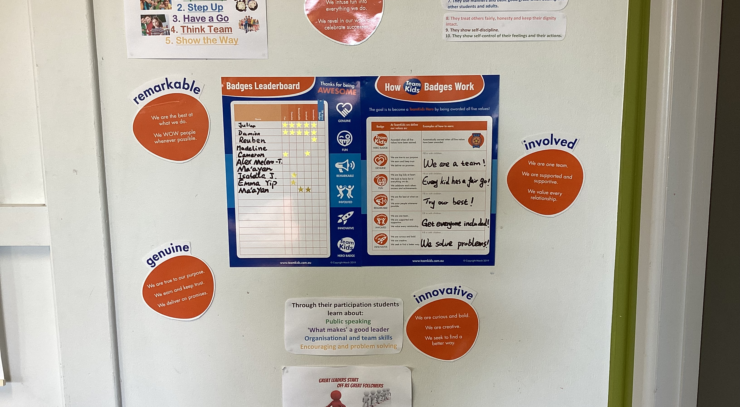
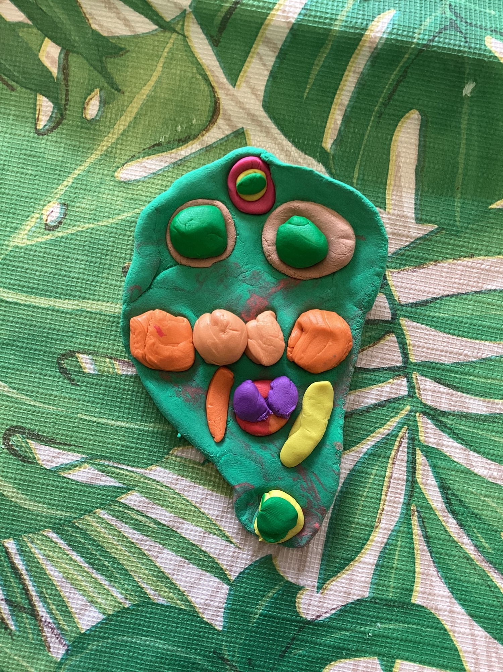
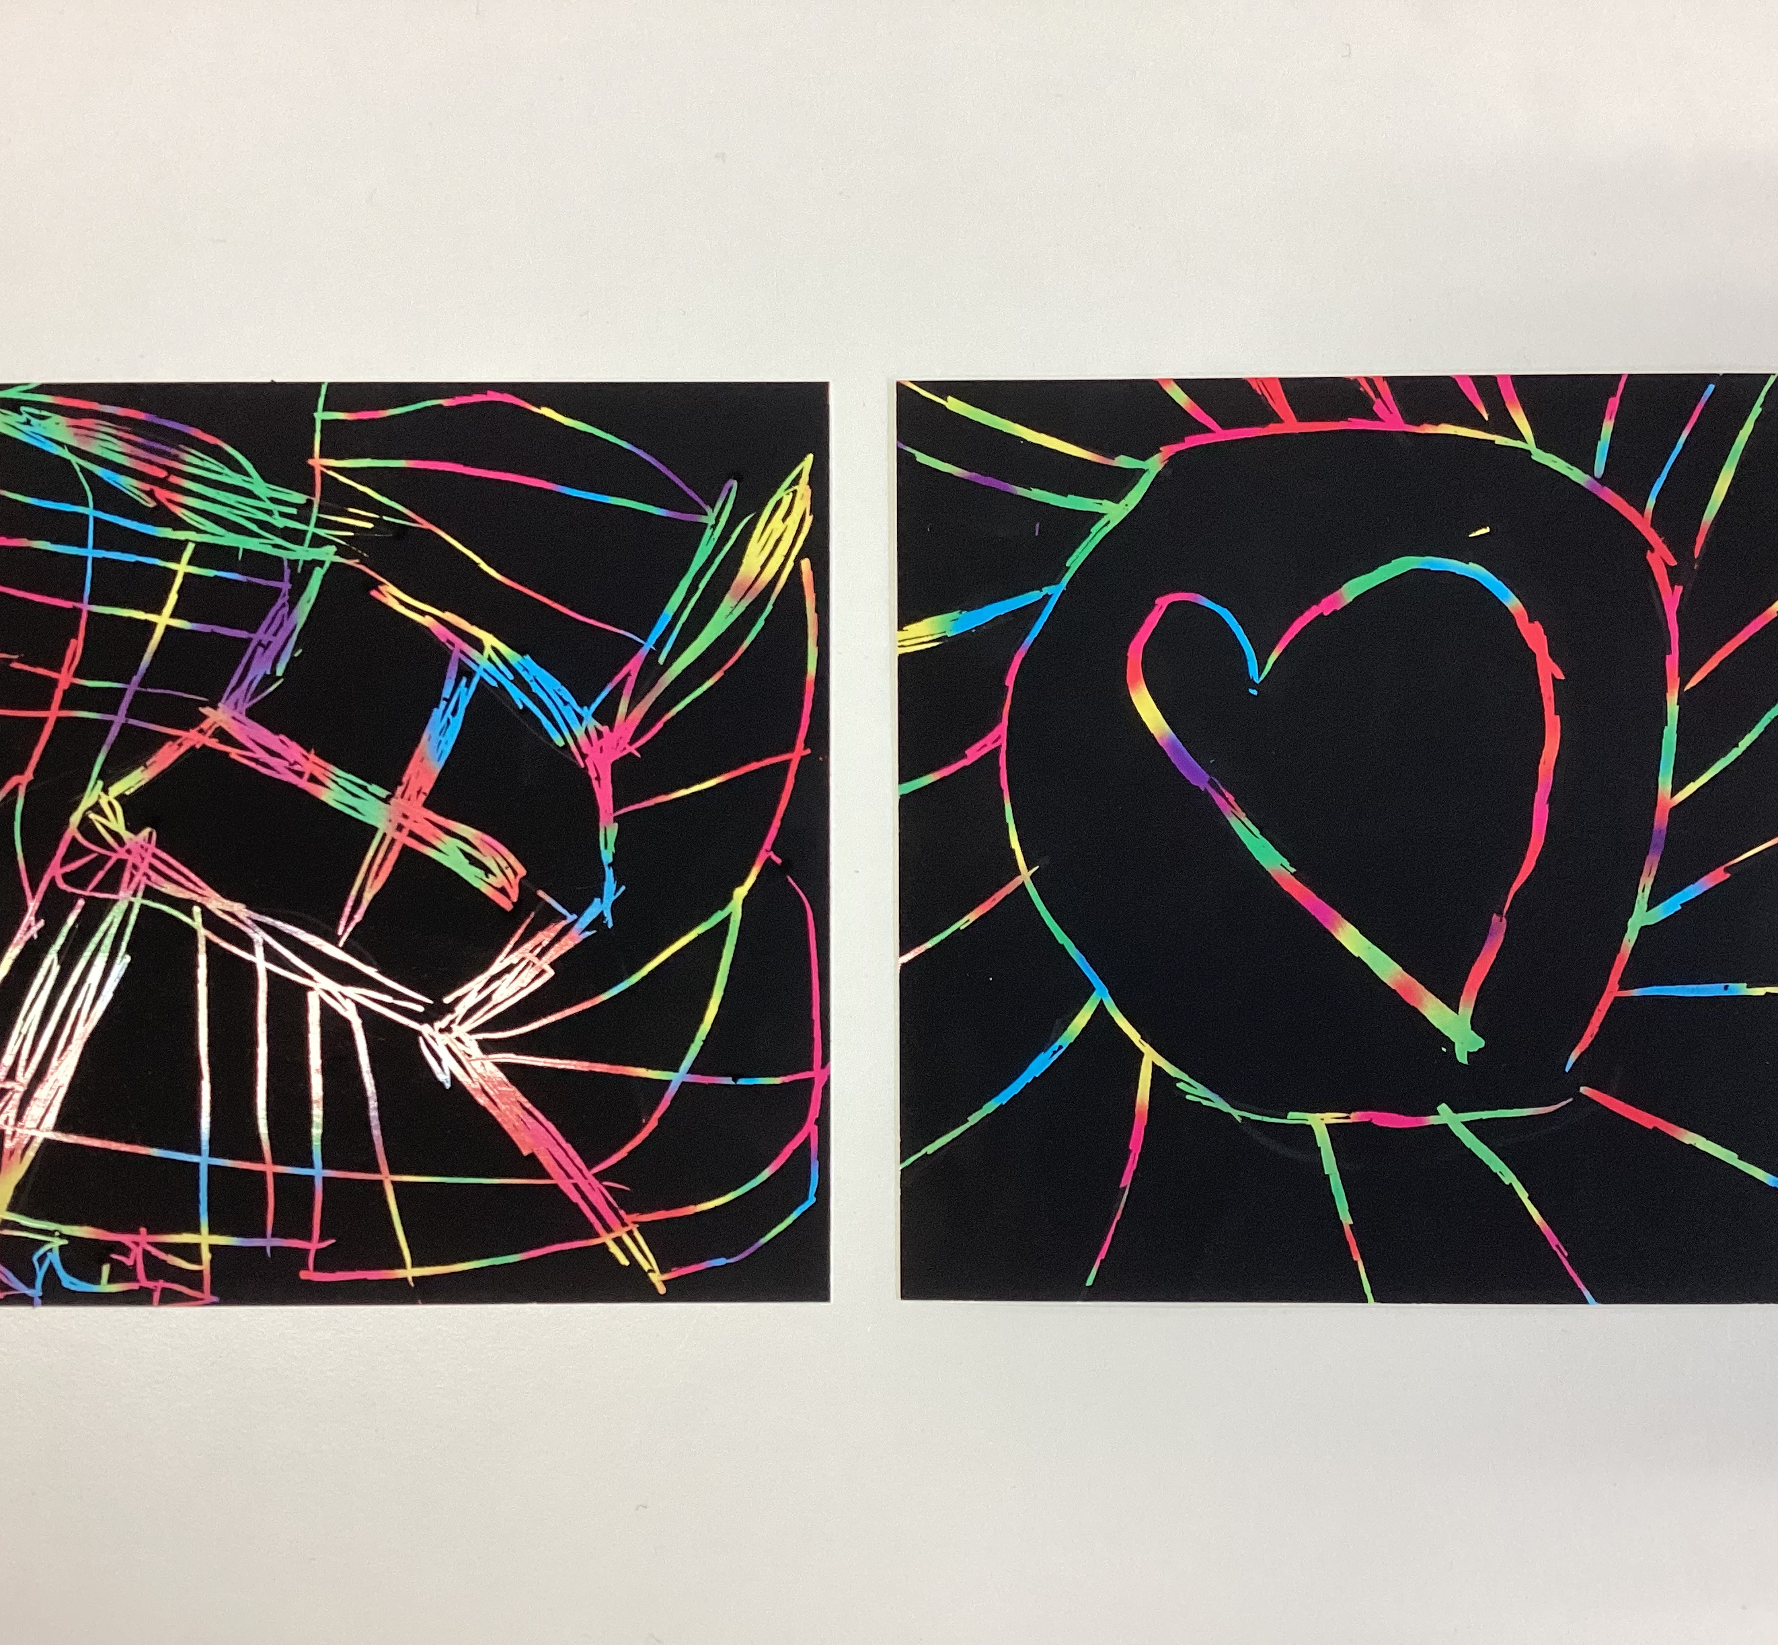
ELWOOD TEAMKIDS
Dear children and parents,
Thank you very much for your support for the service. We are so glad that we have seen some positive changes so far. Our routines have been well followed by Team Kids children. Old children have shown their potentials to be great leaders. We are so proud of them. They are bright sunshine that brings their positive attitude to everywhere they go. There are five badges for leaders to collect, which are FUN, INVOLVED, INNOVATUVE, REMARKABLE and GENUINE. Every leader who collects all badges will be rewarded a Leader badge. ☺
In additional, our lovely preps did a good job in the past couple of weeks. They all listen to educators’ directions, follow the service routines and have fun at this fun land! ☺ Well done!
Let’s keep going! Let’s enjoy everyday! ☺
3
Lego Masters and Art Attack Club
Cooking Club and Musical Theatre
Lego Masters Club and Epic Game
Art Attack Club and Music Theatre
Cooking Club and Epic Games
Tue 21st FEBRUARY
Pancake Day
Fri 03rd MARCH
World Wildlife Day
Wed 08th March
International Women’s Day
0432 299 468
CheltenhamEastPS@teamholiday.com.au
1300 035 000
info@teamkids.com.au

