Slide 1
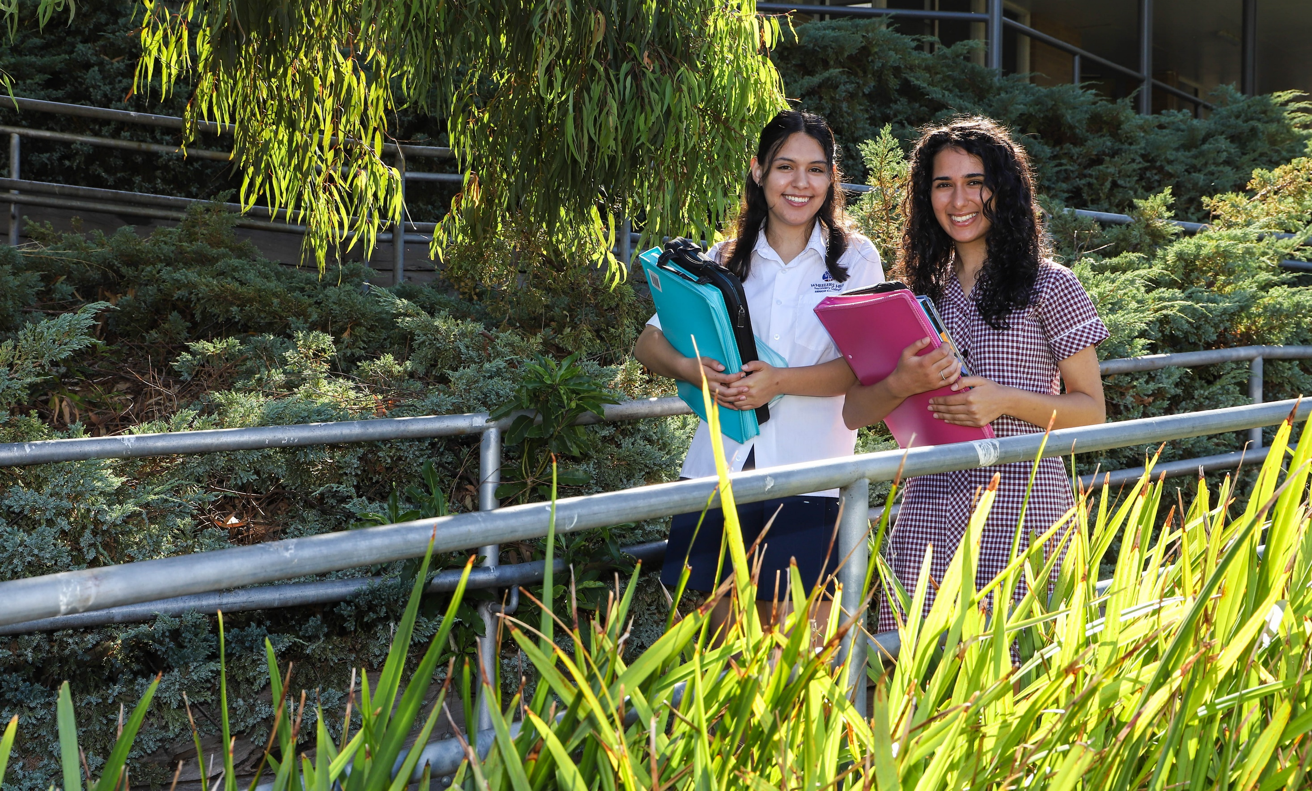




Visual Communication Design
Wheelers Hill Secondary College
Visual Communication Design
Visual Communication Design

Slide 2
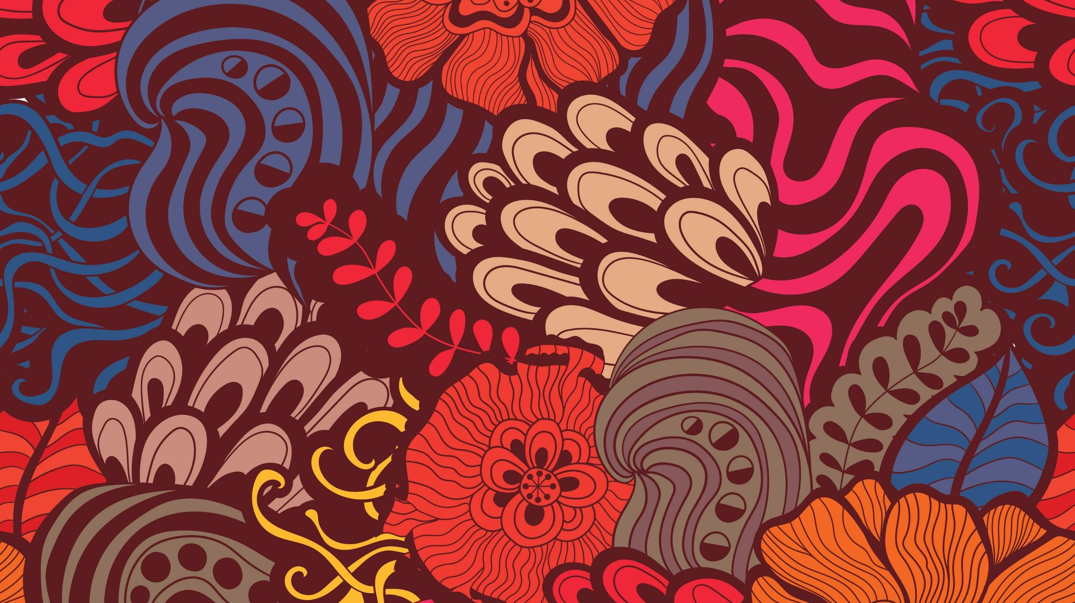
Visual Communication Design
Wheelers Hill Secondary College
Visual Communication Design 2024 -2028
2024 - 2028

Slide 3
What is
Visual Communication Design
Wheelers Hill Secondary College
Visual Communication Design 2024 -2028
The 4 different fields of Visual Communication
In our study we sort them into three different categories.
They are known as fields of design. Each design field has a set of distinguishing characteristics.
These characteristics that distinguish between each field, refer to the ways designers work, the conventions they follow and the kinds of designs they produce.
Messages
Objects
Environmental
Interactive Experience

Slide 4
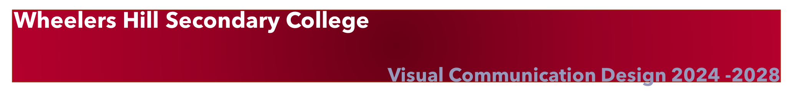
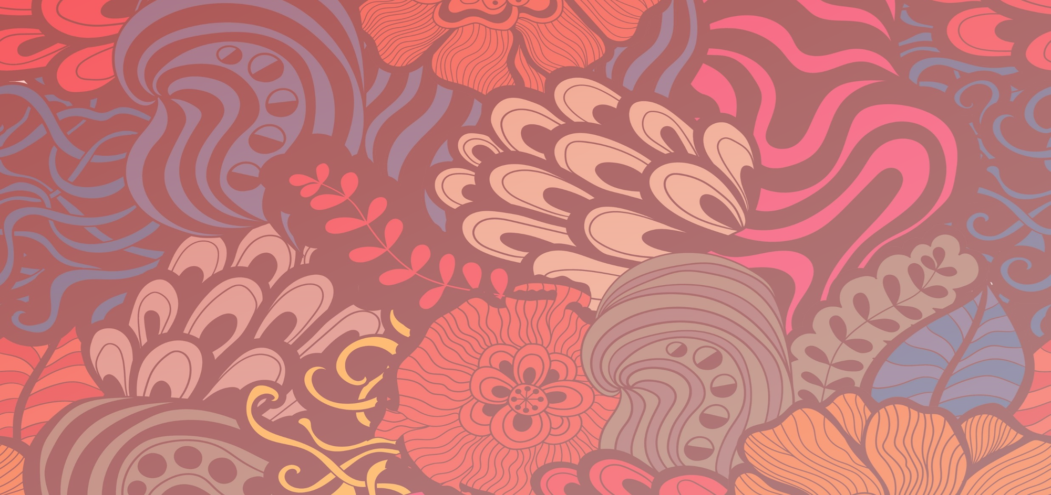

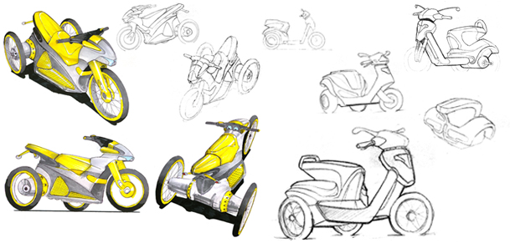
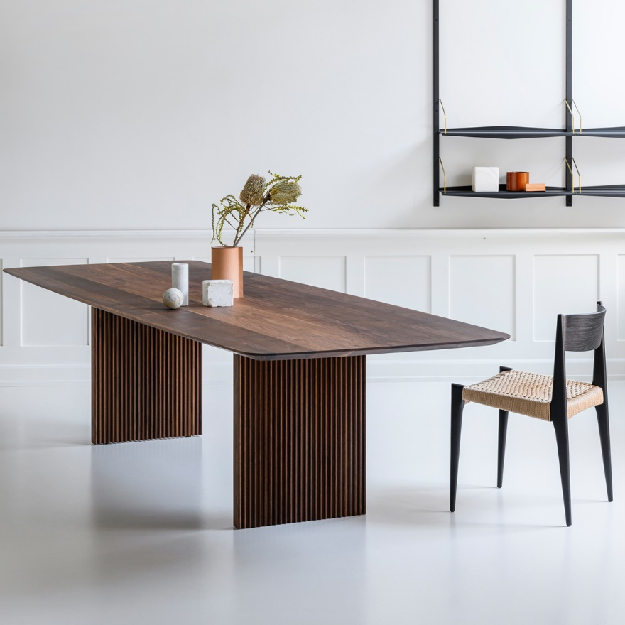
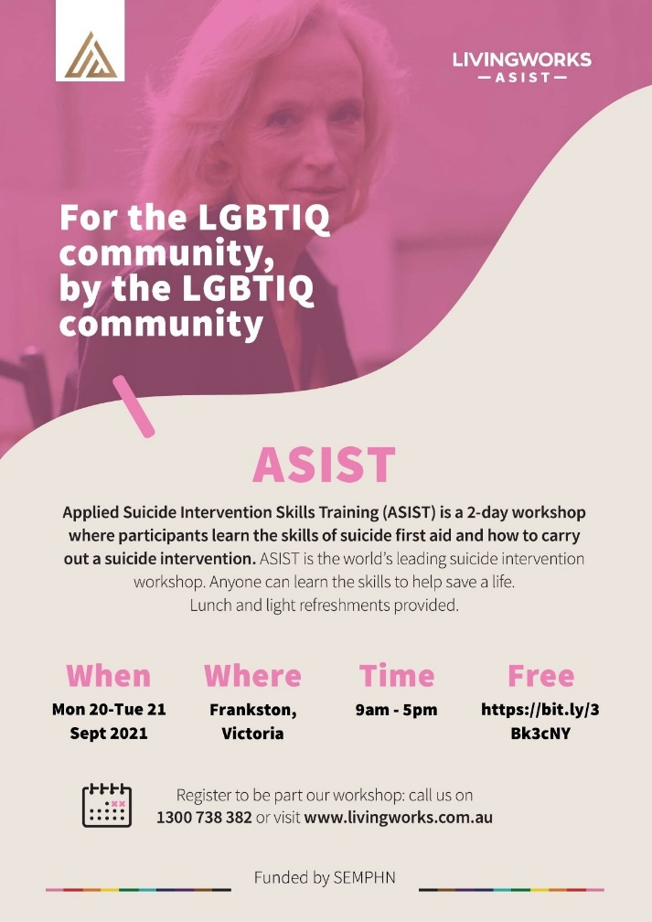
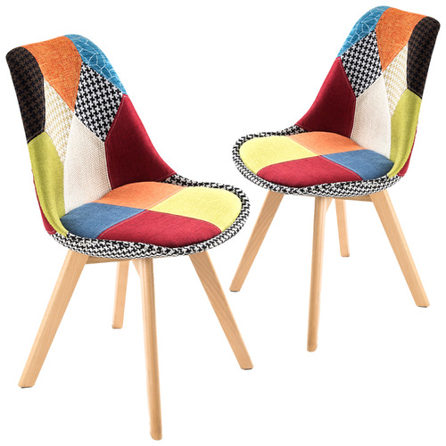
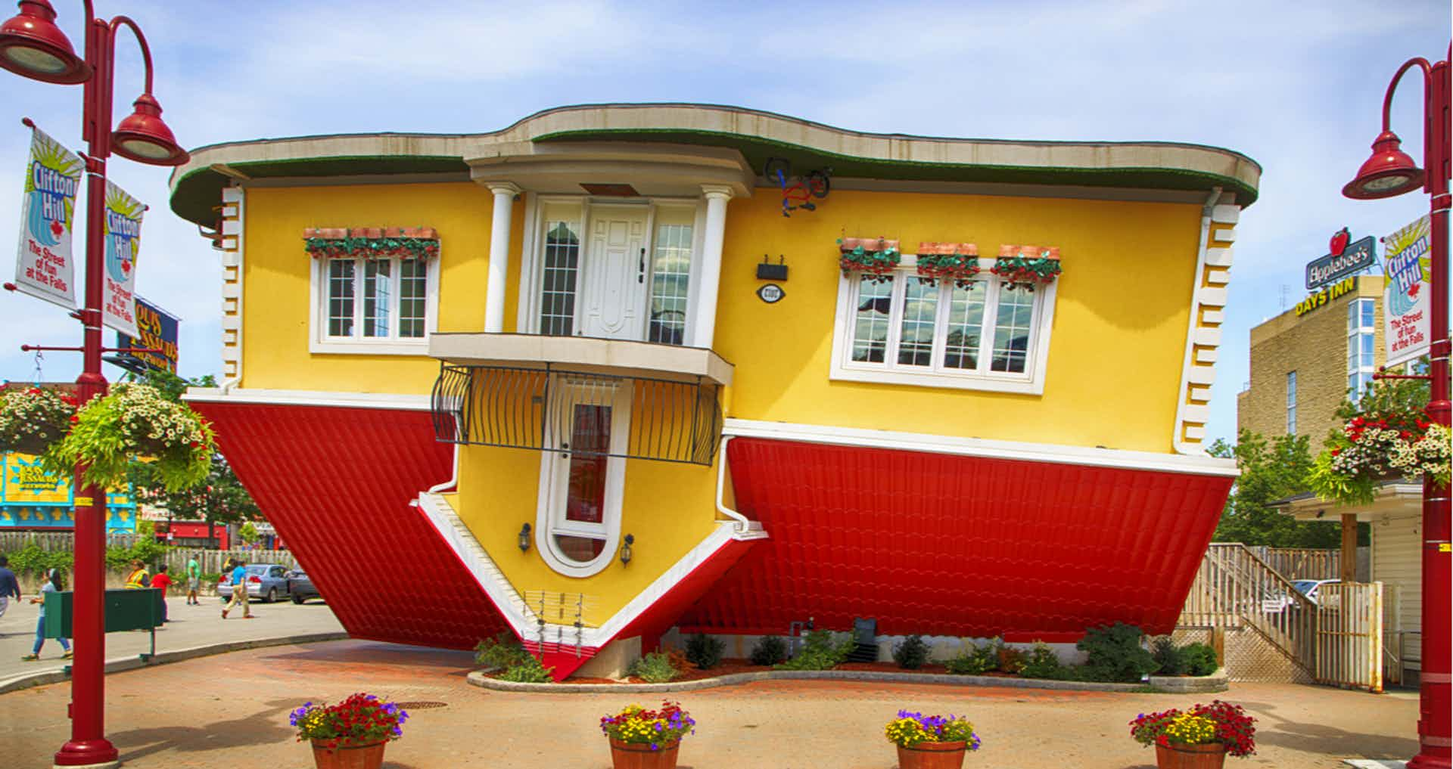
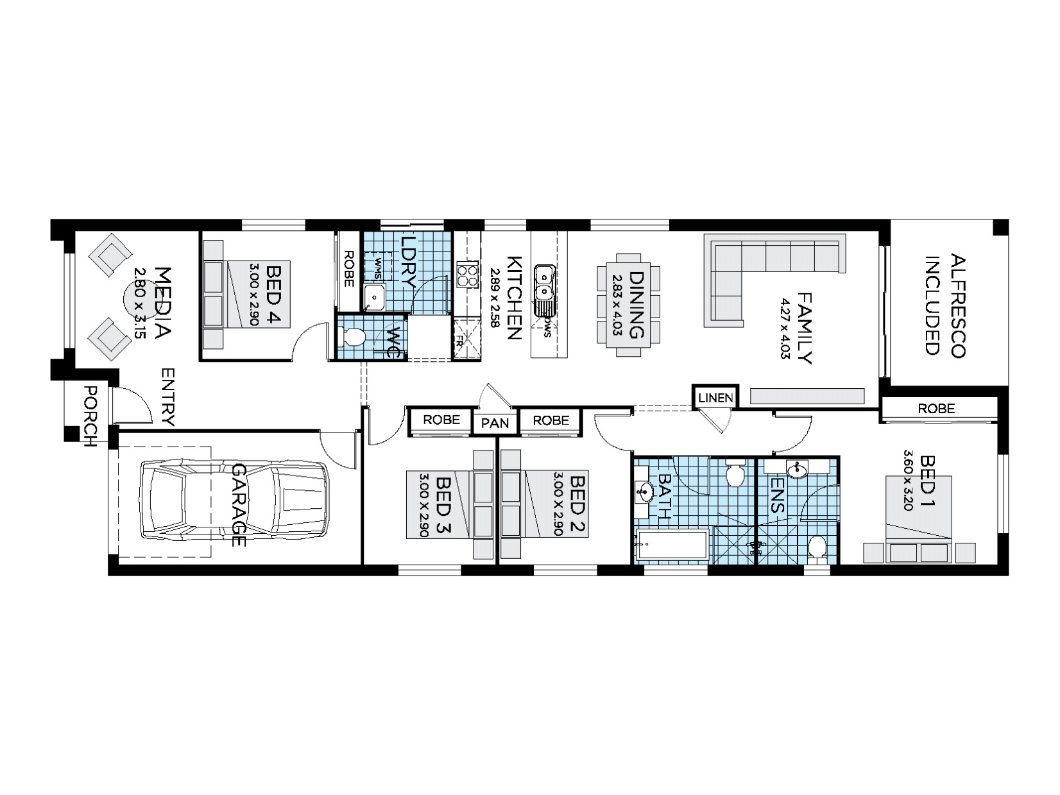
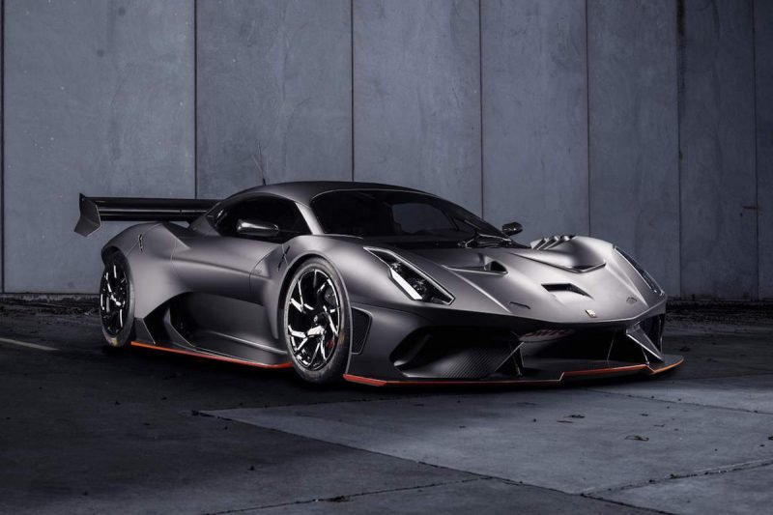

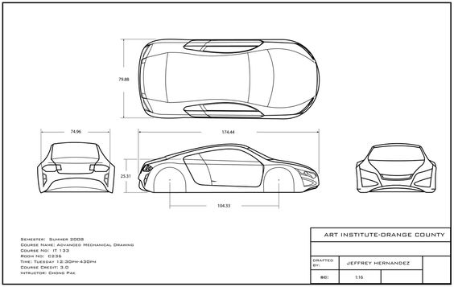
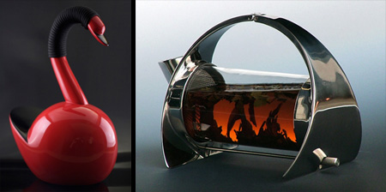
Design Fields
The study of Visual Communication Design looks at a variety of design areas.
This means everything from tickets, posters, mobile phone apps, web sites, dispensers, packaging, kitchen appliances, tools, furniture, cars, boats to houses, offices and sky scrapers.

Slide 5
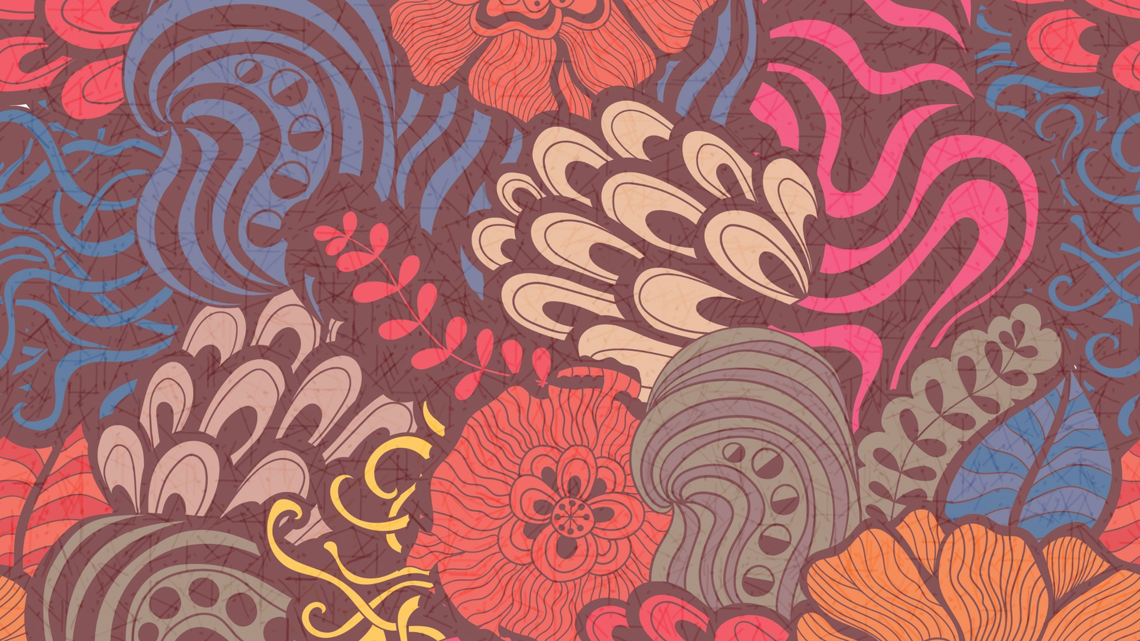
HOW DESIGNERS WORK
Wheelers Hill Secondary College
Visual Communication Design 2024 -2028
OUR DESIGN PROCESS
The 6 stages of Design Thinking Journey
Students of Visual Communication Design study the ways designers work.
Although there are many different kinds of designers who work in the different design fields, they all seem to follow a similar pathway to propose solutions to problems posed by their clients.
This pathway is called the Design Process.
In our study, there is a formal model that students must use in both their practical work and in written analysis.

Slide 6
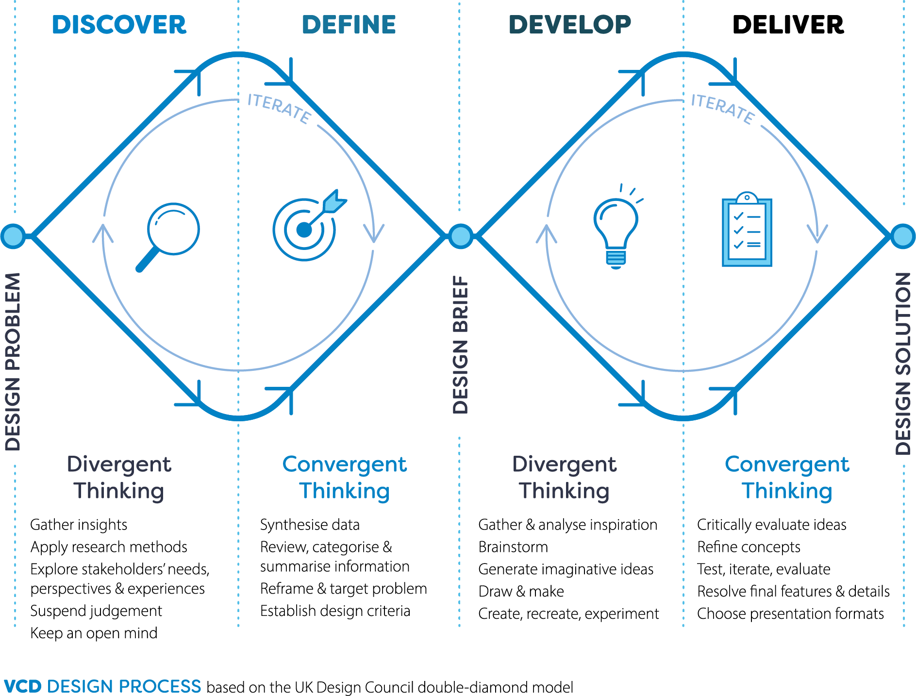
HOW DESIGNERS WORK
Wheelers Hill Secondary College
Visual Communication Design 2024 -2028
The VCD Design Process
A design process is both relational and situational, and designers tailor their approach in response to the problem at hand.
However, there are modes of thinking and phases of development common to the practice of design, and these have been captured in various design process models devised by academics, companies and professional organisations.
Students of VCE Visual Communication Design apply an iterative design process based on the Double Diamond model, passing through and revisiting the four distinct phases of Discover, Define, Develop and Deliver.
In the context of this study, this process is referred to as the VCD design process.

Slide 7
Wheelers Hill Secondary College
Visual Communication Design 2024 -2028
Unit 1 – Finding, Reframing and
Resolving Design Problems
Area study 1 – Reframing Design
Outcome 1 – On completion of this unit student should be
able to to use human-centred research
methods to reframe a design problem and
identify a communication need.
Area Study 2 – Solving Communication Design Problem
Outcome 2 – On completion of this unit the student should
be able to create visual language for a
business or brand using the Develop and
Deliver stages of the VCD design process.
Area Study 3 – Design’s influence and influences on
design
Outcome 3 – On completion of this unit student should be
able to develop a sustainable object,
considering design’s influence and factors
that influence design.

Slide 8

Wheelers Hill Secondary College
Visual Communication Design 2024 -2028
Unit 2 – Design contexts and connections
Area study 1 – Design, place and time
Outcome 1 – On completion of this unit student should be
able to present an environmental design
solution that draws inspiration from its
context and a chosen design style.
Area Study 2 – Cultural ownership and design
Outcome 2 – On completion of this unit student should be
able to apply culturally appropriate design
practices and an understanding of the
designer’s ethical and legal responsibilities
when designing persona iconography.
Area Study 3 – Designing interactive experiences
Outcome 3 – On completion of this unit student should be
able to apply the VCD design process to
design an interface for a digital product,
environment or service.

Slide 9
Wheelers Hill Secondary College
Visual Communication Design 2024 -2028
Unit 3 – Visual Communication Design
Practices
Area study 1 – Professional design practice
Outcome 1 – On completion of this unit student should be able
to compare the ways in which visual
communication practices are used
by contemporary designers, using research
methods and practical exploration.
Area Study 2 – Design analysis
Outcome 2 – On completion of this unit student should be able to compare and analyse design examples from
selected field(s) of design practice, describing
how aesthetic considerations contribute to the
effective communication of information or
ideas.
Area Study 3 – Design process: defining problems and
developing ideas
Outcome 3 – On completion of this unit student should be able to identify two communication needs for a
client, prepare a brief and develop design ideas,
while applying the VCD design process and
design thinking strategies.

Slide 10

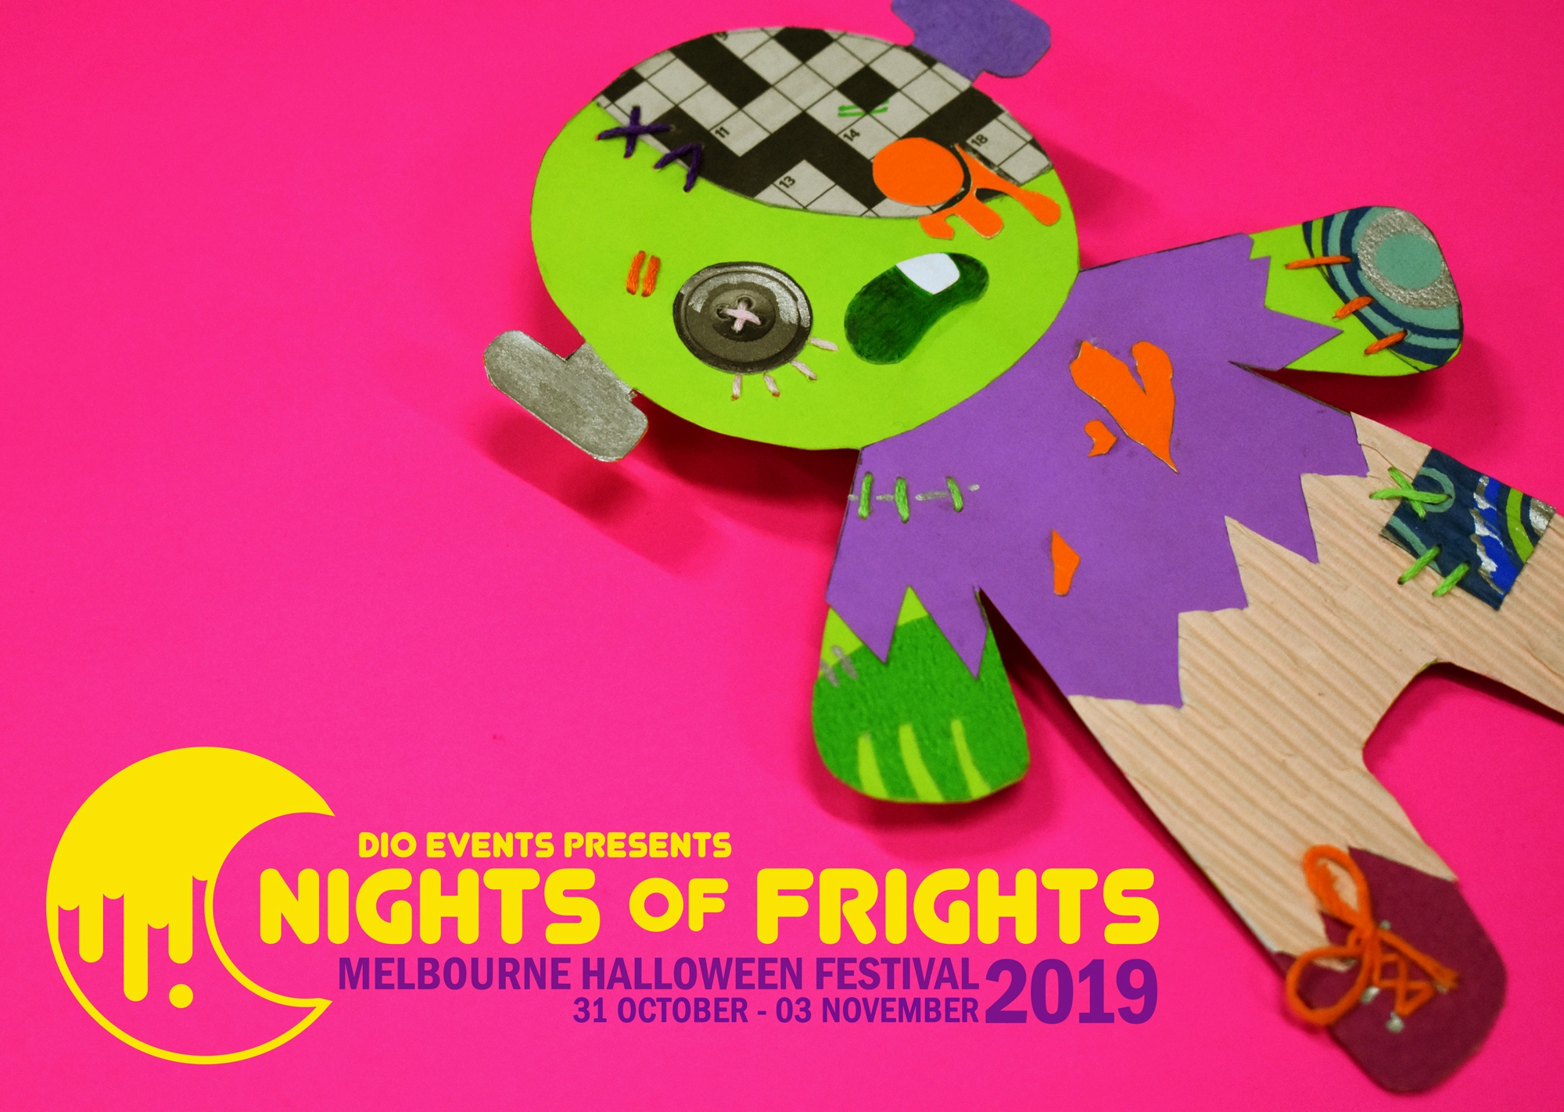
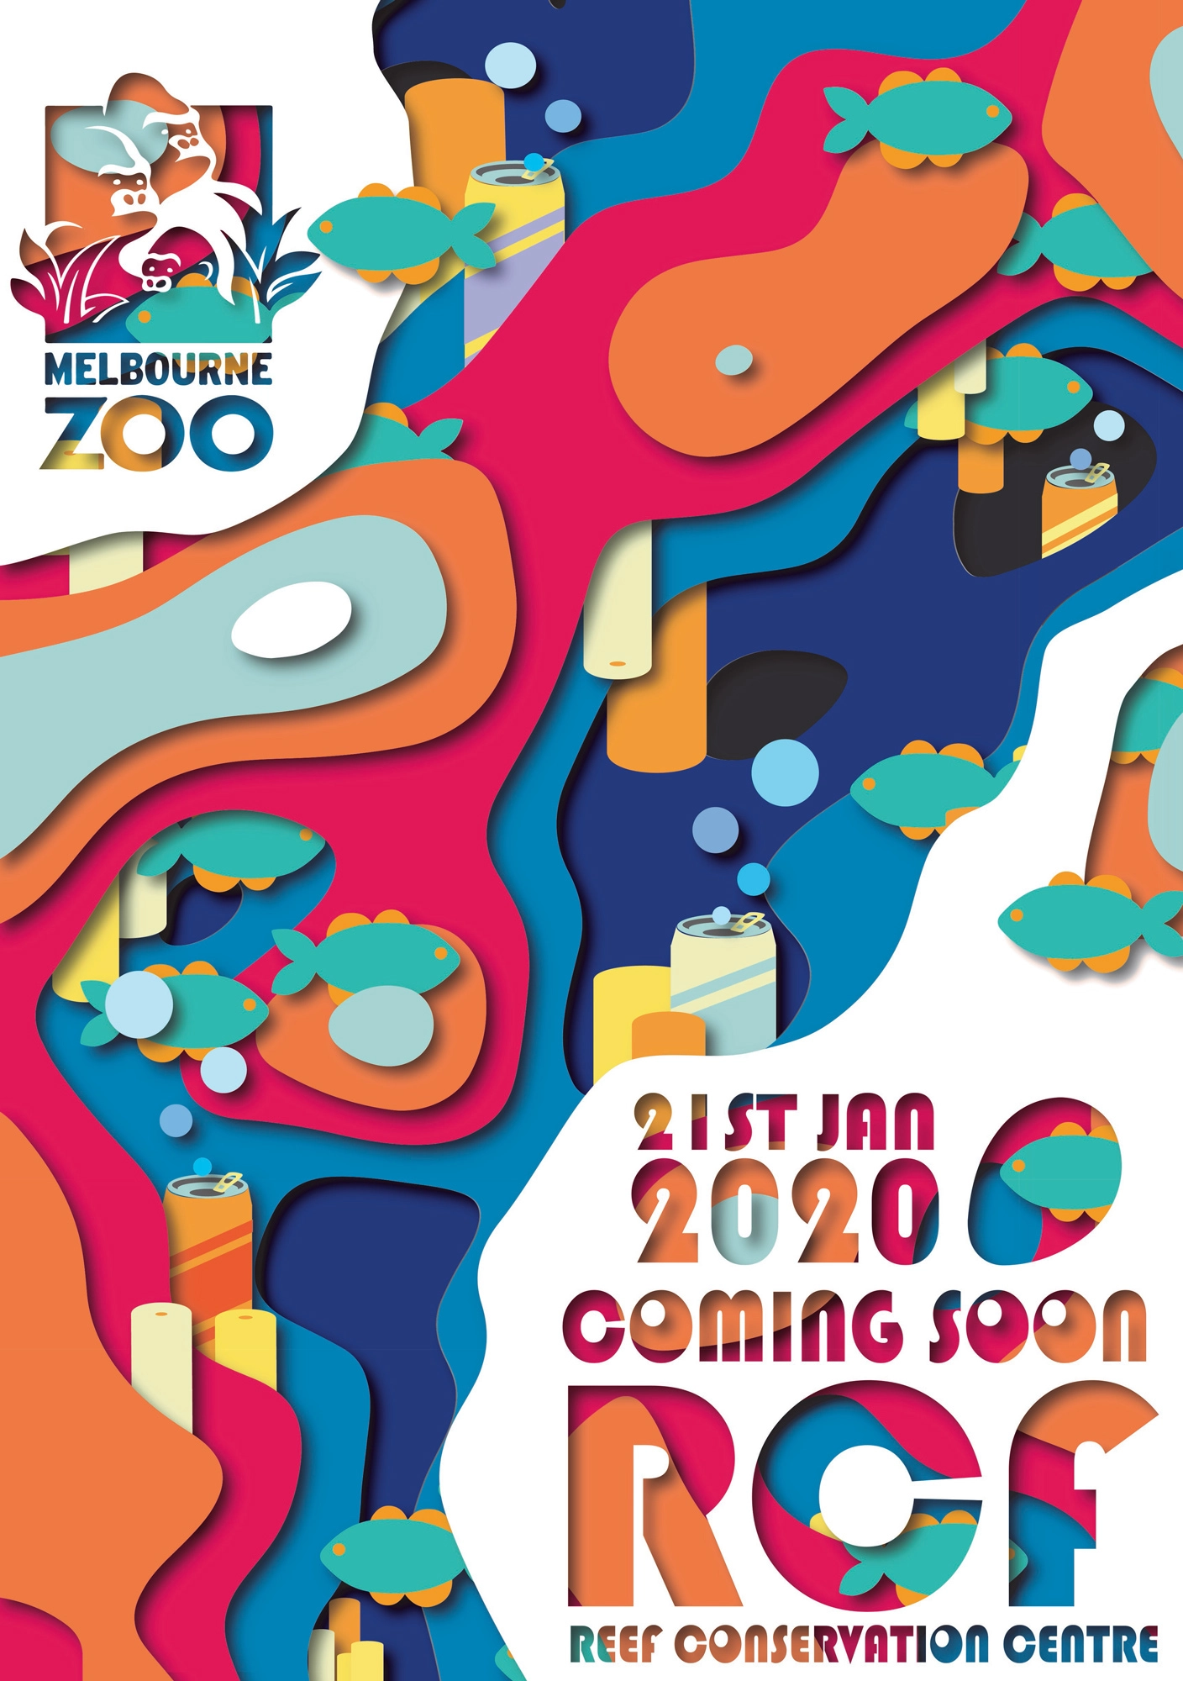
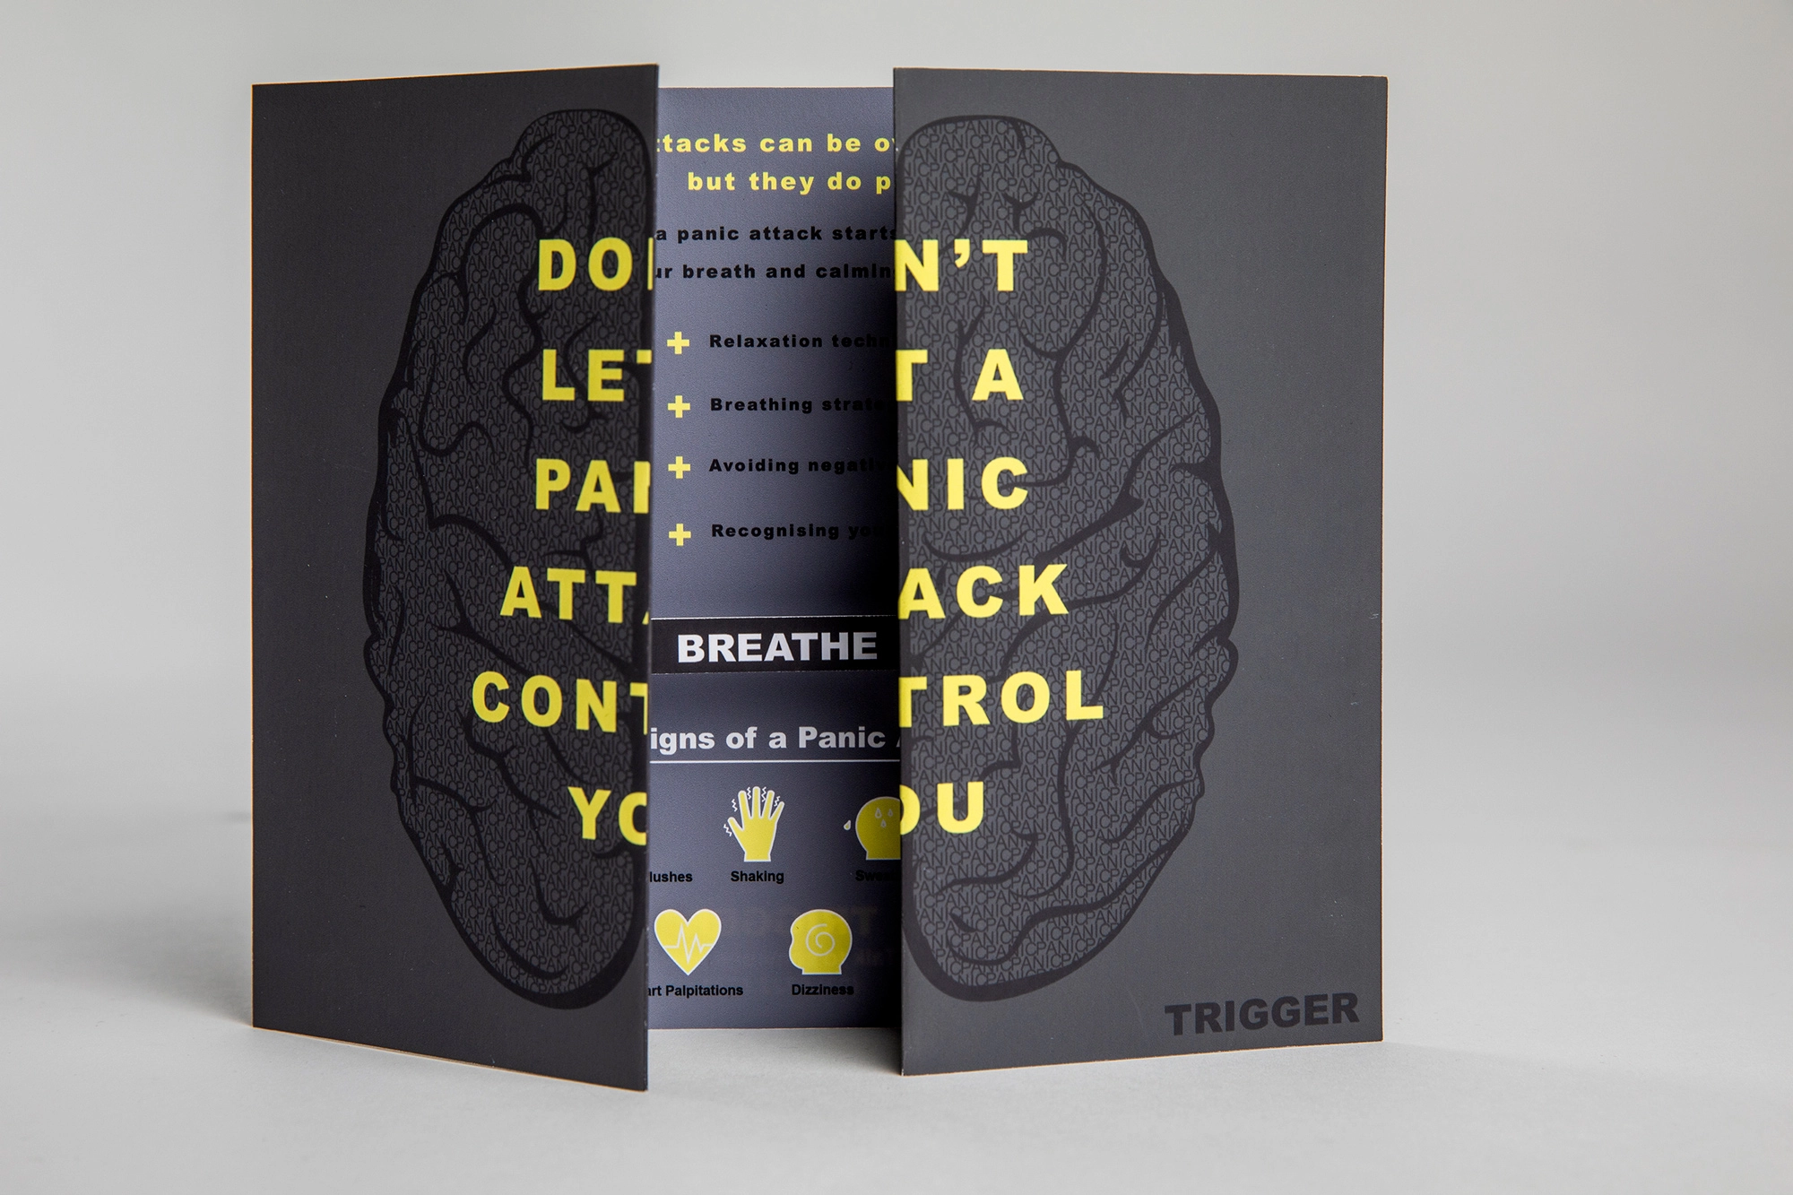
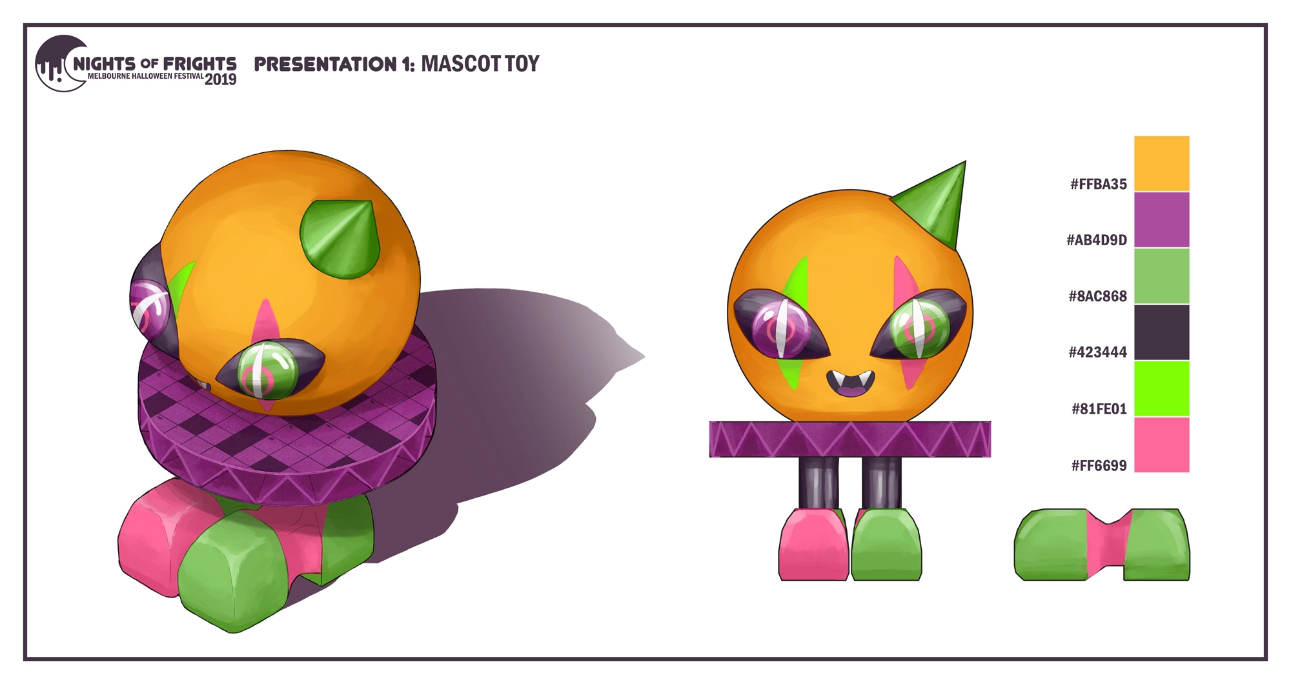
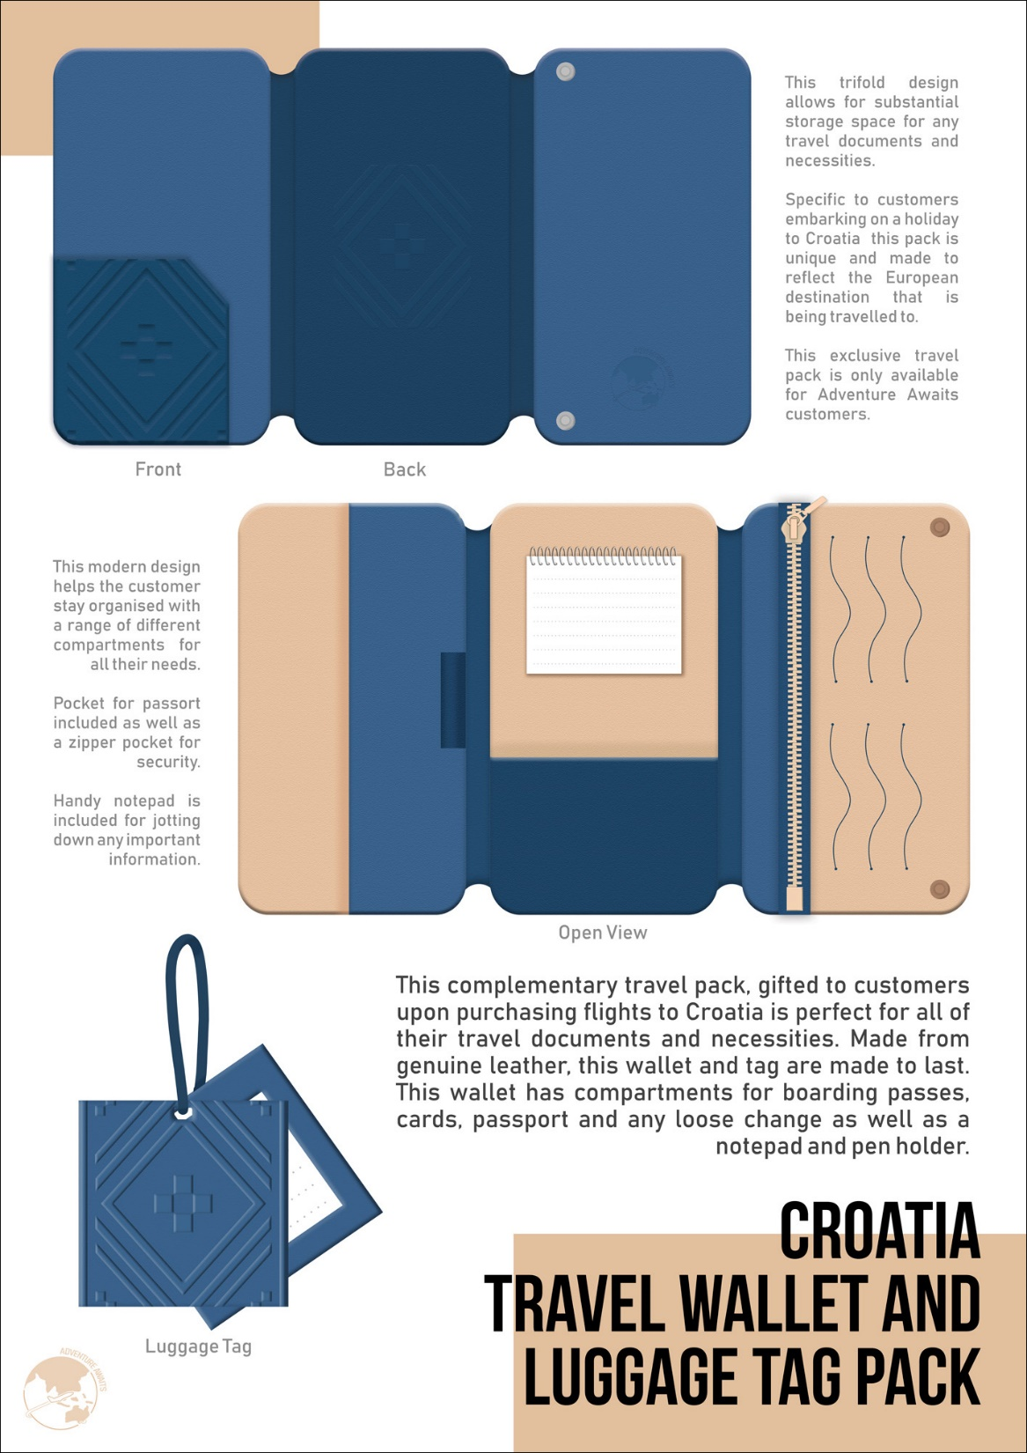
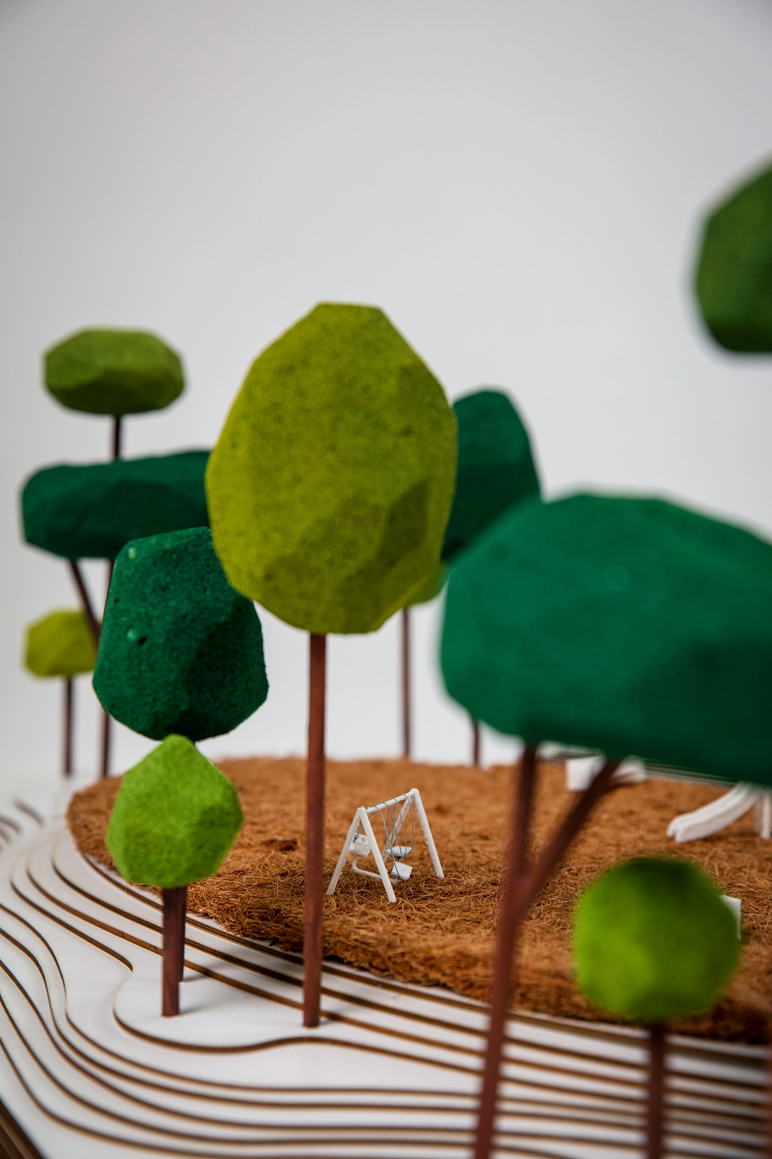
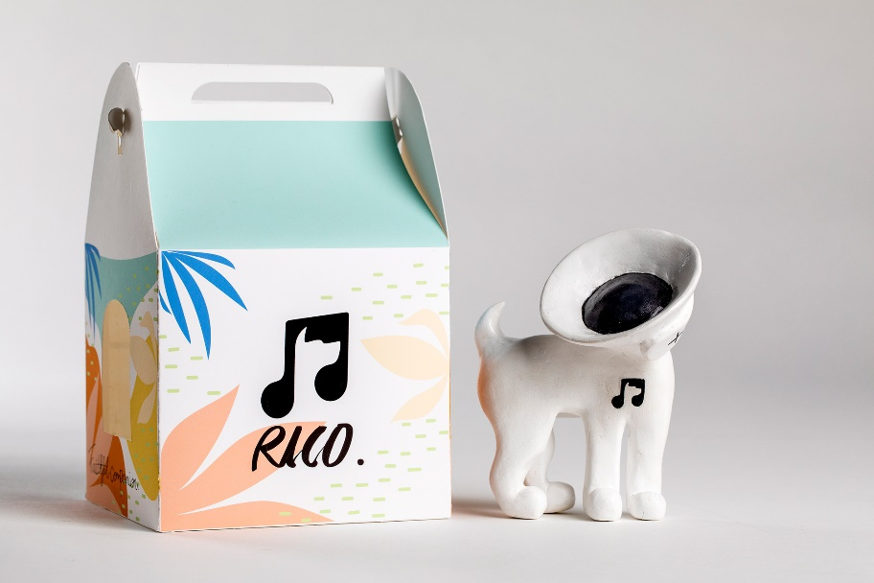
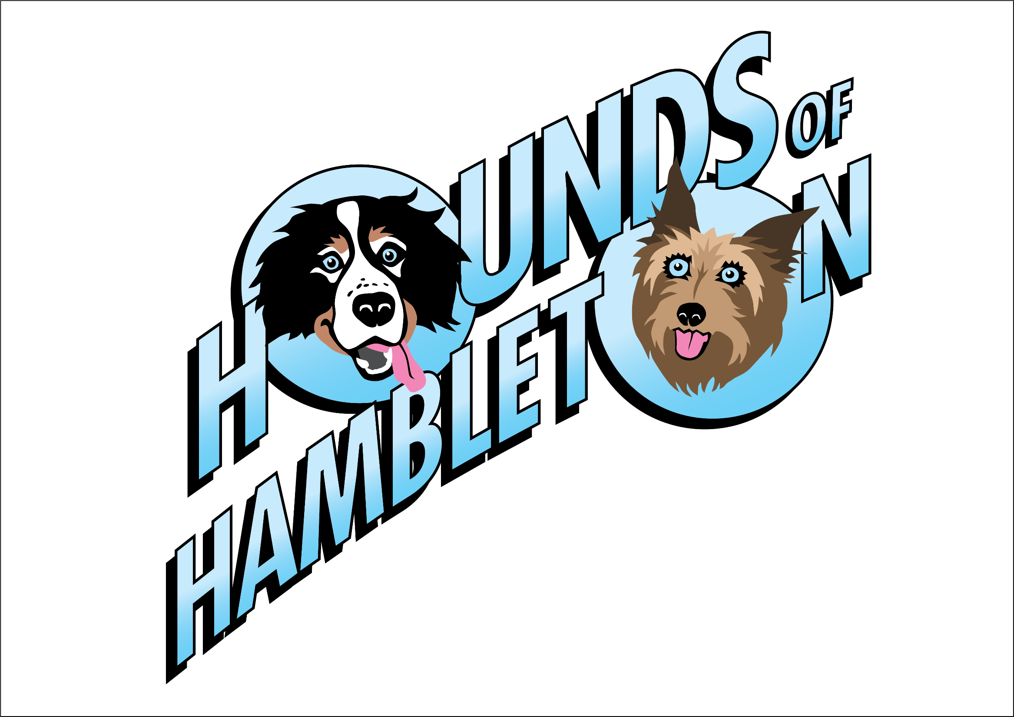
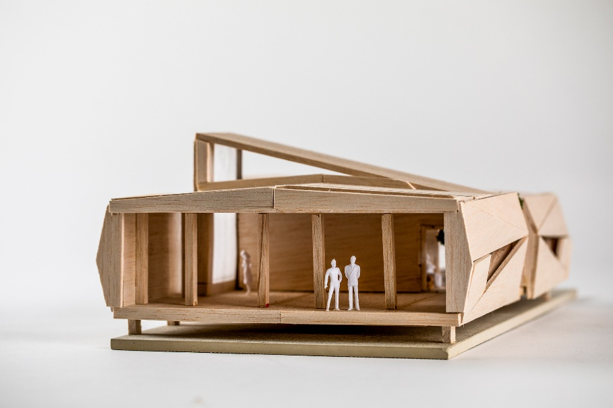
SAT – School Assessed Task
Development of Design FOLIO and Final PRESENTATION
Congratulations. You've made it!
Finally, you have reached the stage where you can design exactly what you want in class.

Slide 11
Folio Development
This part of VCD, spread over Unit 3 and 4 and It is the big, practical design component
of your course
UNIT 4
Delivering design solutions
Area Study 1 - Design process: refining
Outcome 1 and resolving design
concepts
On completion of this unit the student should be able to refine and resolve distinct design concepts for each communication need, and devise and deliver a pitch to communicate concepts to an audience or users, evaluating the extent to which these meet the requirements of the brief.
Area Study 1 - Presenting design solutions
Outcome 2
On completion of this unit the student should be able to the student should be able to; develop
distinctly different concepts for each
communication need and devise a pitch to present concepts to an audience, evaluating the extent to which these concepts meet the requirements of the brief.

Slide 12
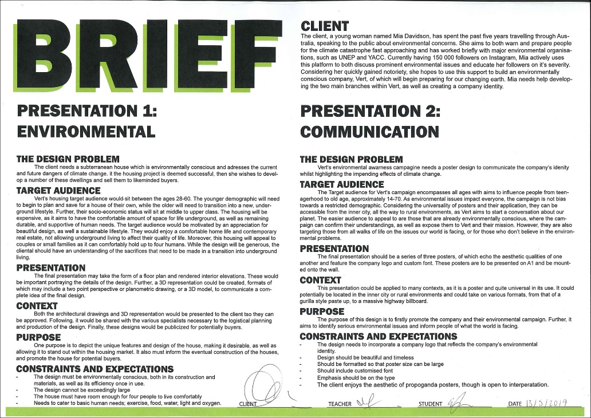
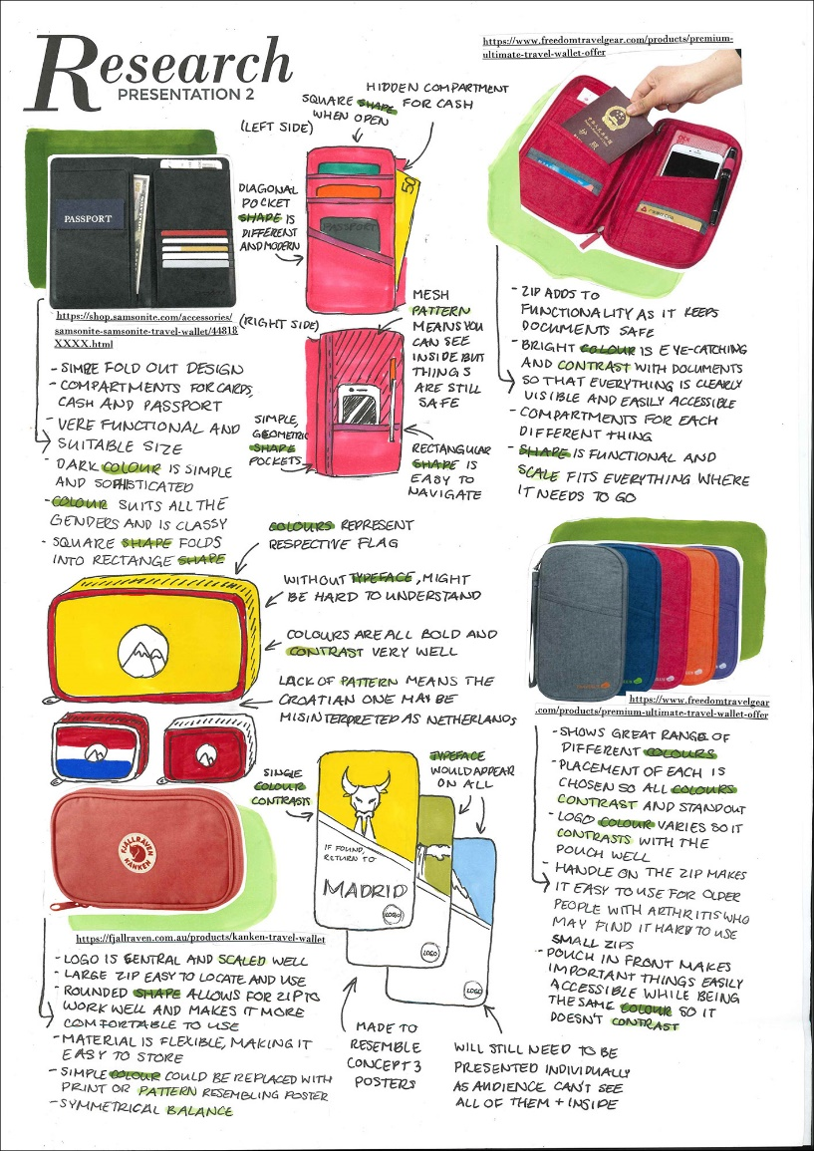
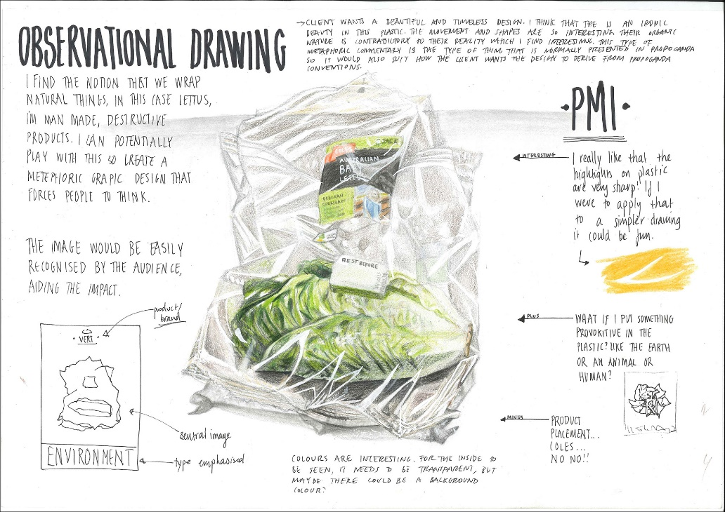
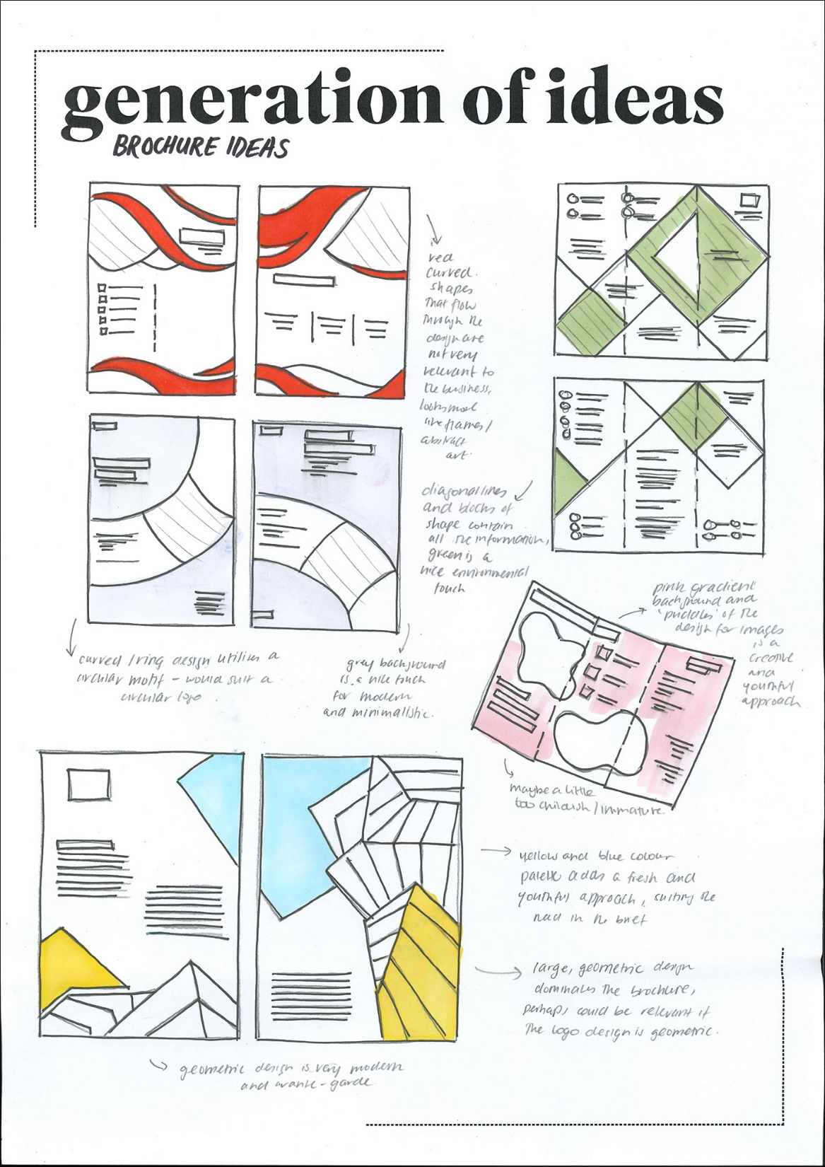
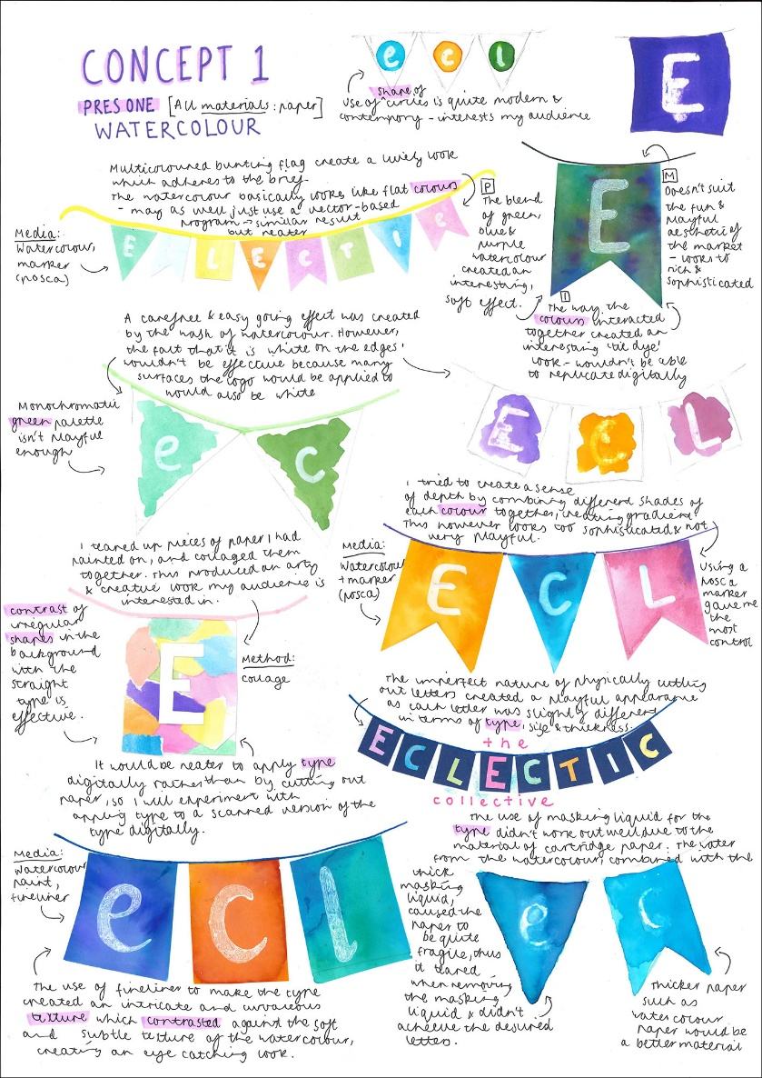
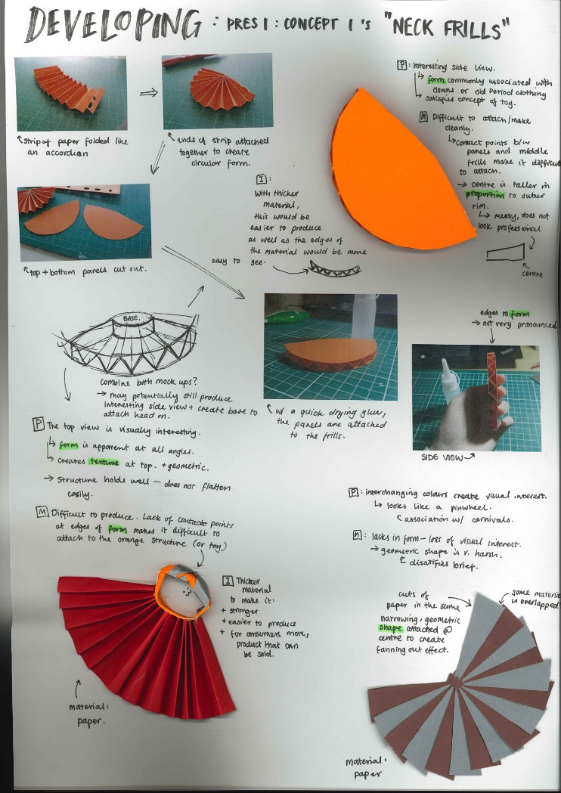
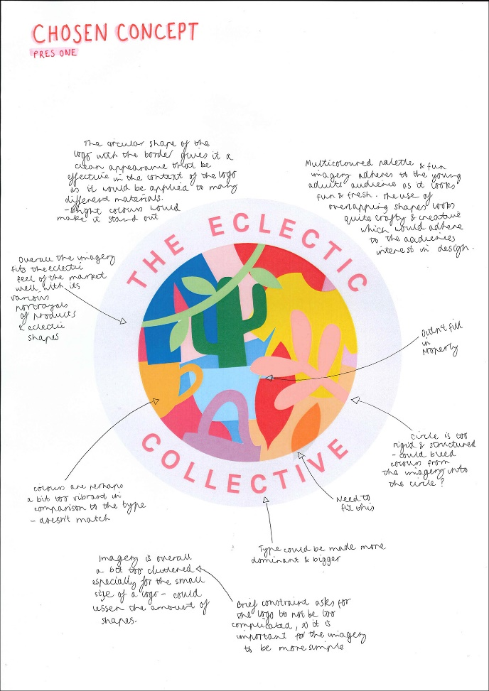

Folio Presentation

Slide 13
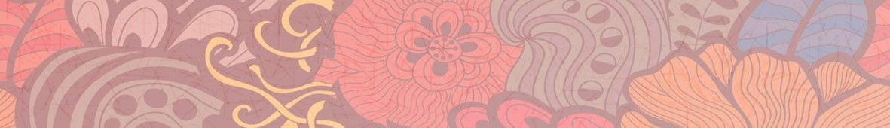
Careers in
Visual Communication Design
COMMUNICATION DESIGN
INDUSTRIAL DESIGN
ENVIRONMENTAL DESIGN
JOBS IN THIS FIELD
Graphic design
Art director
Information design
Digital and Web design
Advertising
Illustration
Book design
Typographic design
Package/ surface design
Logo, Corporate and Brand Identity design
JOBS IN THIS FIELD
Product/ Industrial design
Engineering design
Furniture design
Automotive design
Aeronautic design
CAD engineer
Model maker
3D printer
Computer programmer
Software developer
Engineer
JOBS IN THIS FIELD
Architectural design
Interior design
Landscape design
Theatre set design
Exhibition/ display design
Nautical architecture
Draftsperson
Illustrator, Renderer
Model maker,
Laser cutter
Photographer

