Slide 1
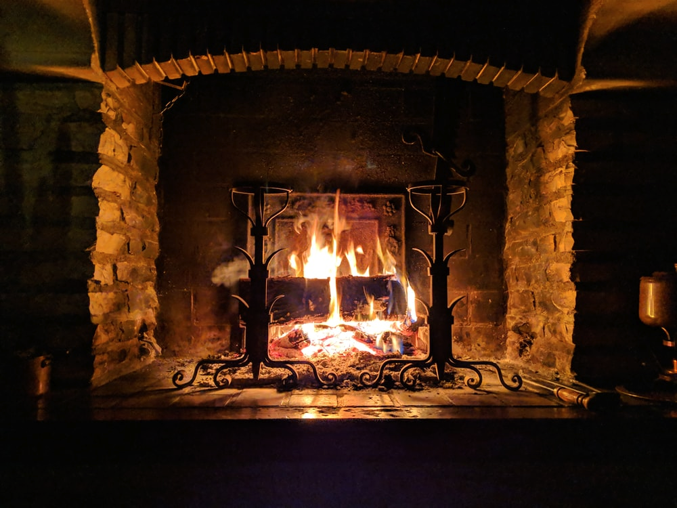
Fireside Chat
Welcome to the Peppercorns!

Slide 2
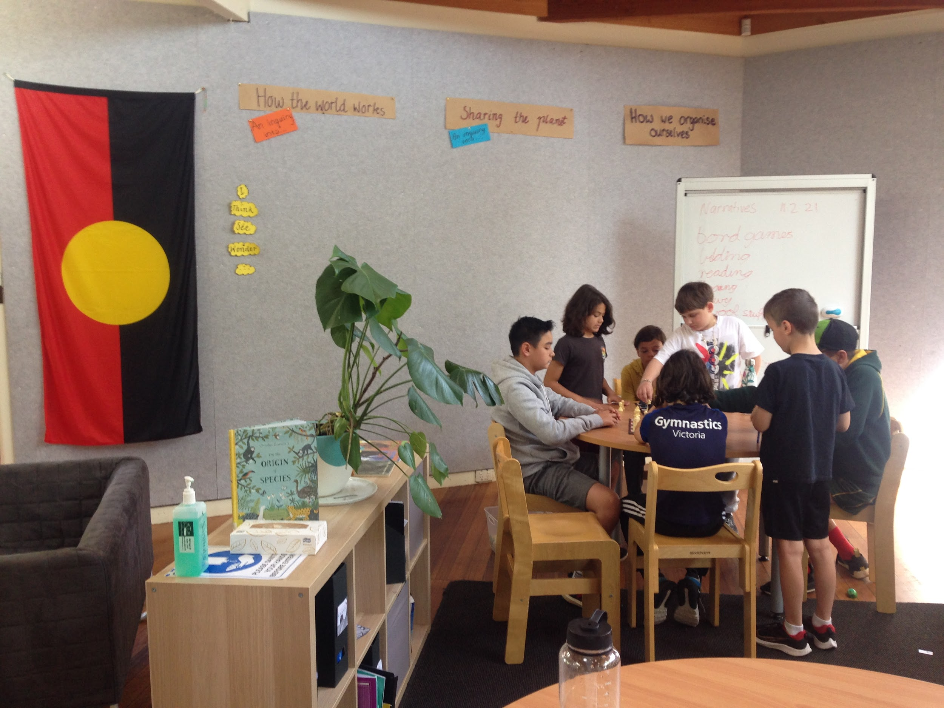
Acknowledgement of Country
Preshil respectfully acknowledges the traditional custodians of country throughout Australia and pays respect to elders past, present, and emerging. We acknowledge the people of the Kulin nation as the traditional custodians of the land on which our school stands and pay our respects to their elders past, present, and emerging.

Slide 3
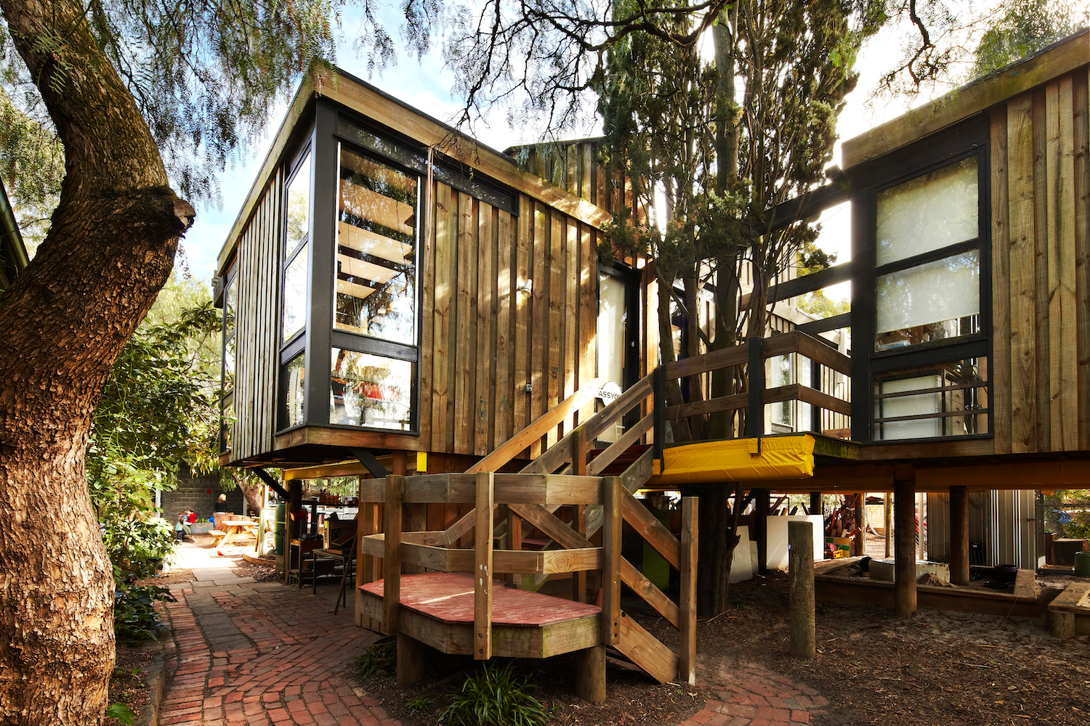
Specialists
Art
PE
French
Music
Philosophy

Slide 4
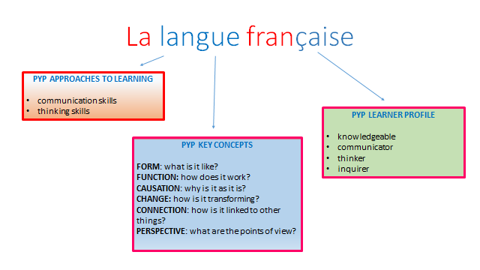

Slide 5
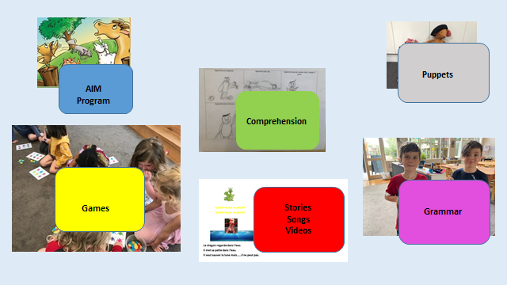

Slide 6


PE Term 1
Amanda Barnetby

Slide 7
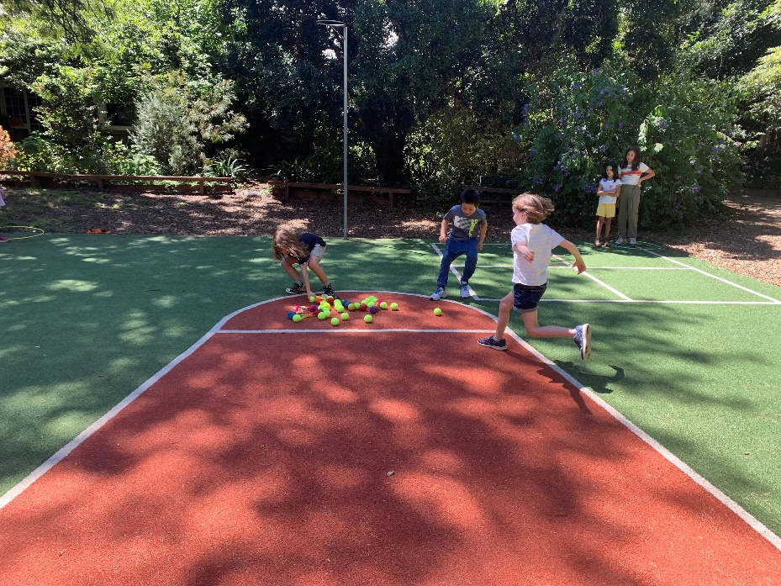
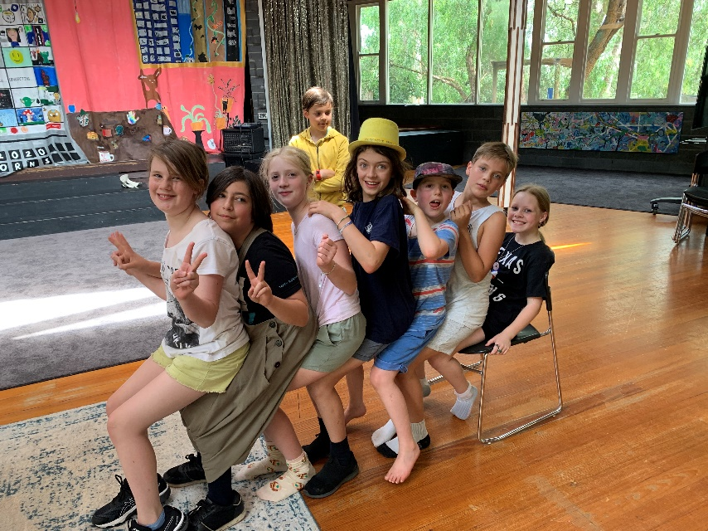
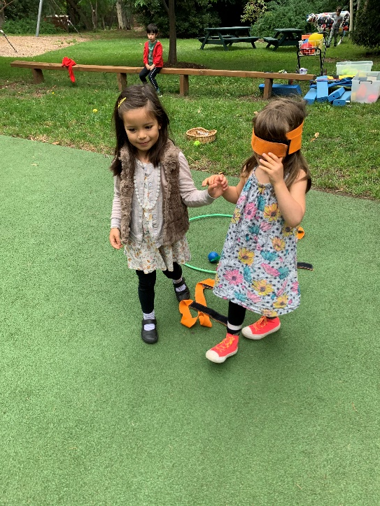
PE at Arlington
Focus
  Teamwork
  Communication
How will that look?
  Cooperation games
  Basketball
  Soccer

Slide 8
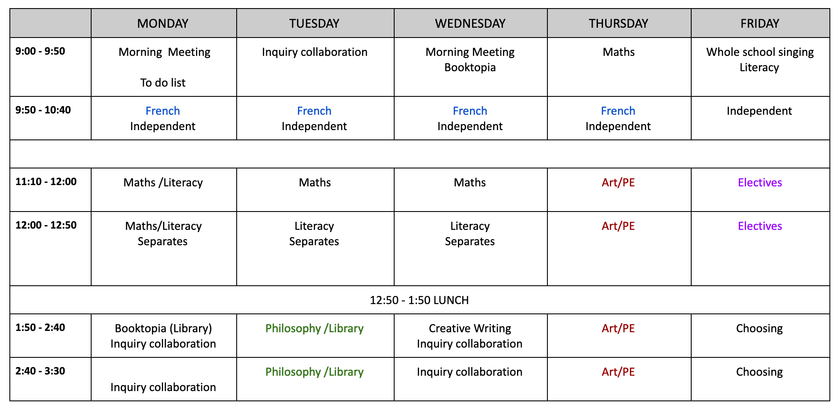
Indicative Timetable

Slide 9
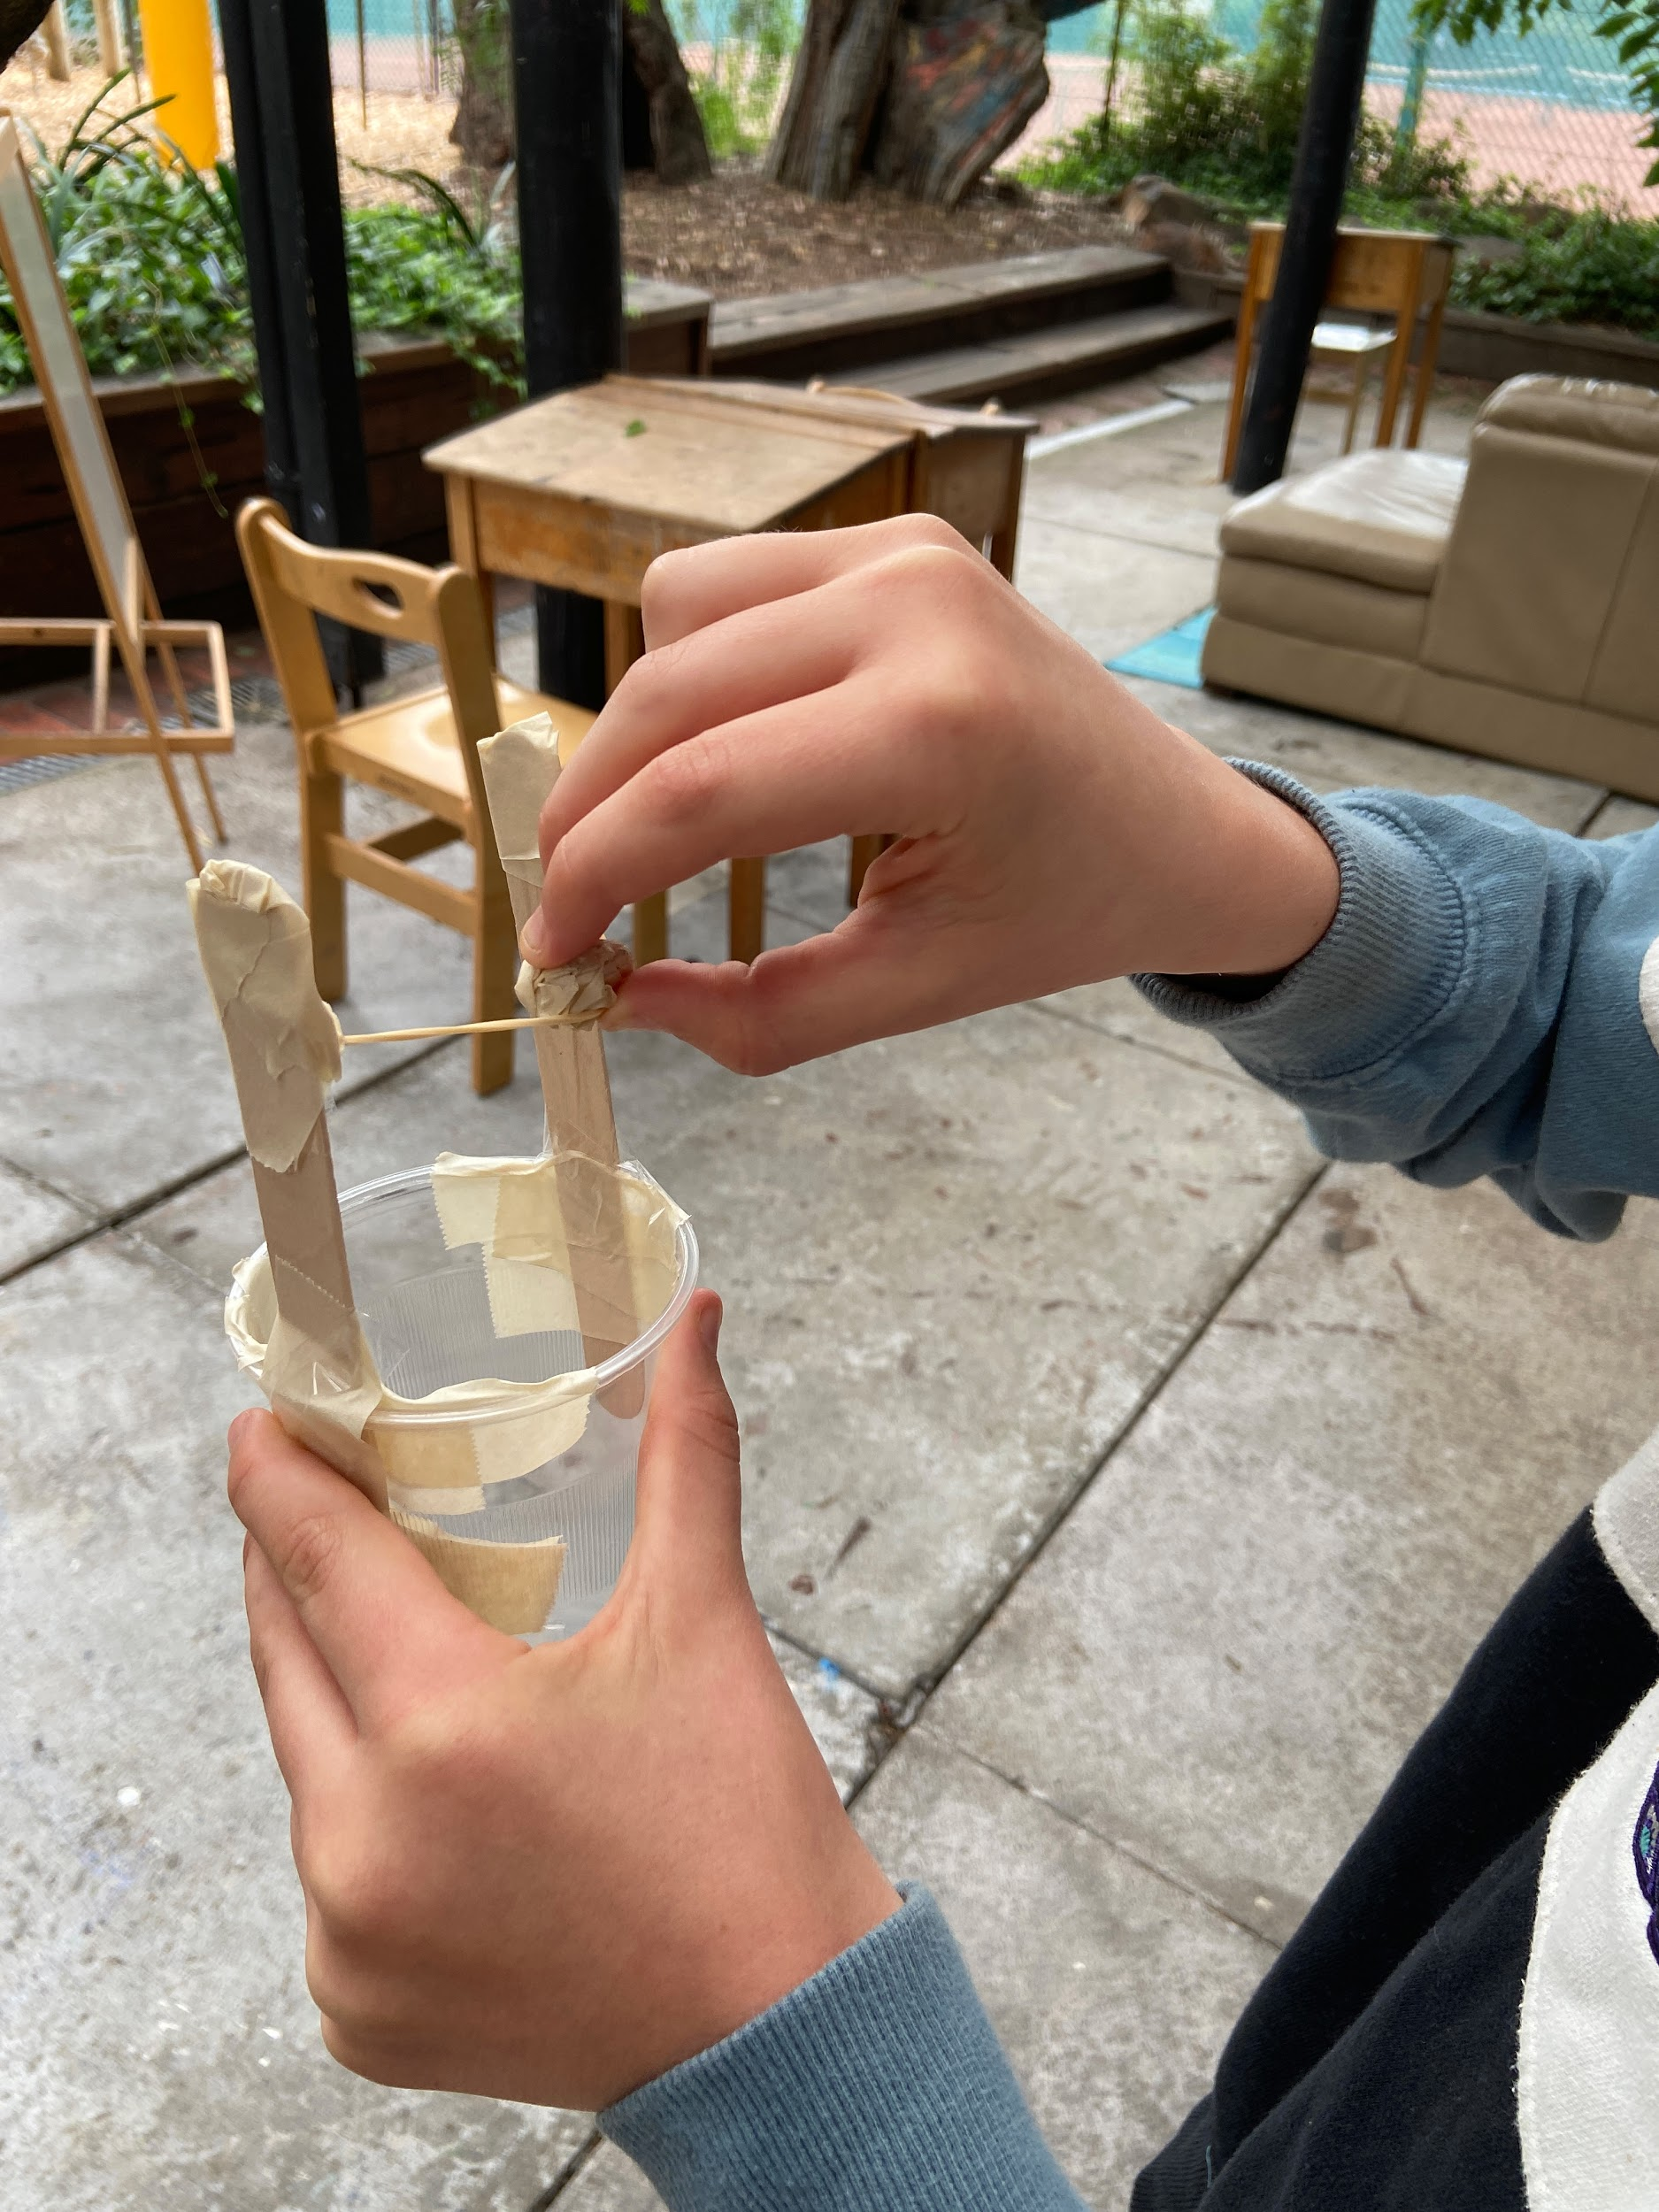
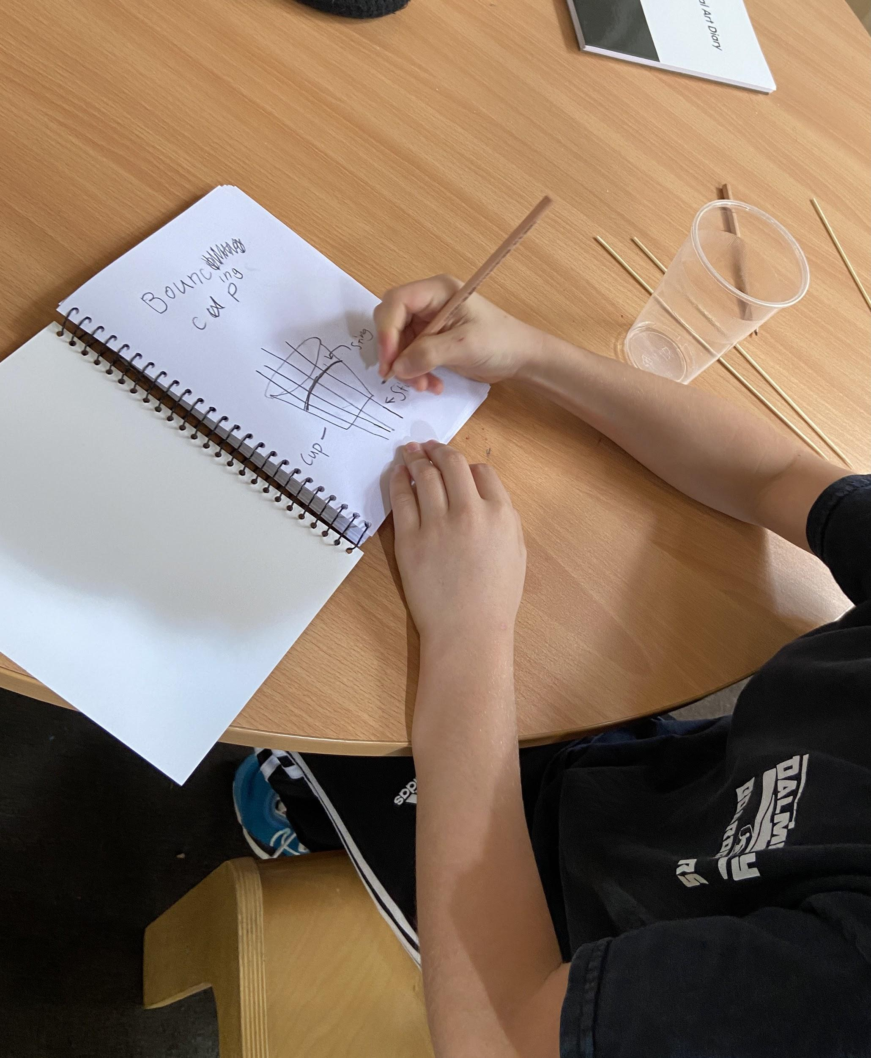
PYP - Unit of Inquiry
Central Idea:
The world is constantly evolving through natural events and human influences.
Lines of Inquiry:
The surface features of the Earth and how they change.
The progress of technology and its impact on society and the world.
Key concepts:
Form, Causation, Change.

Slide 10
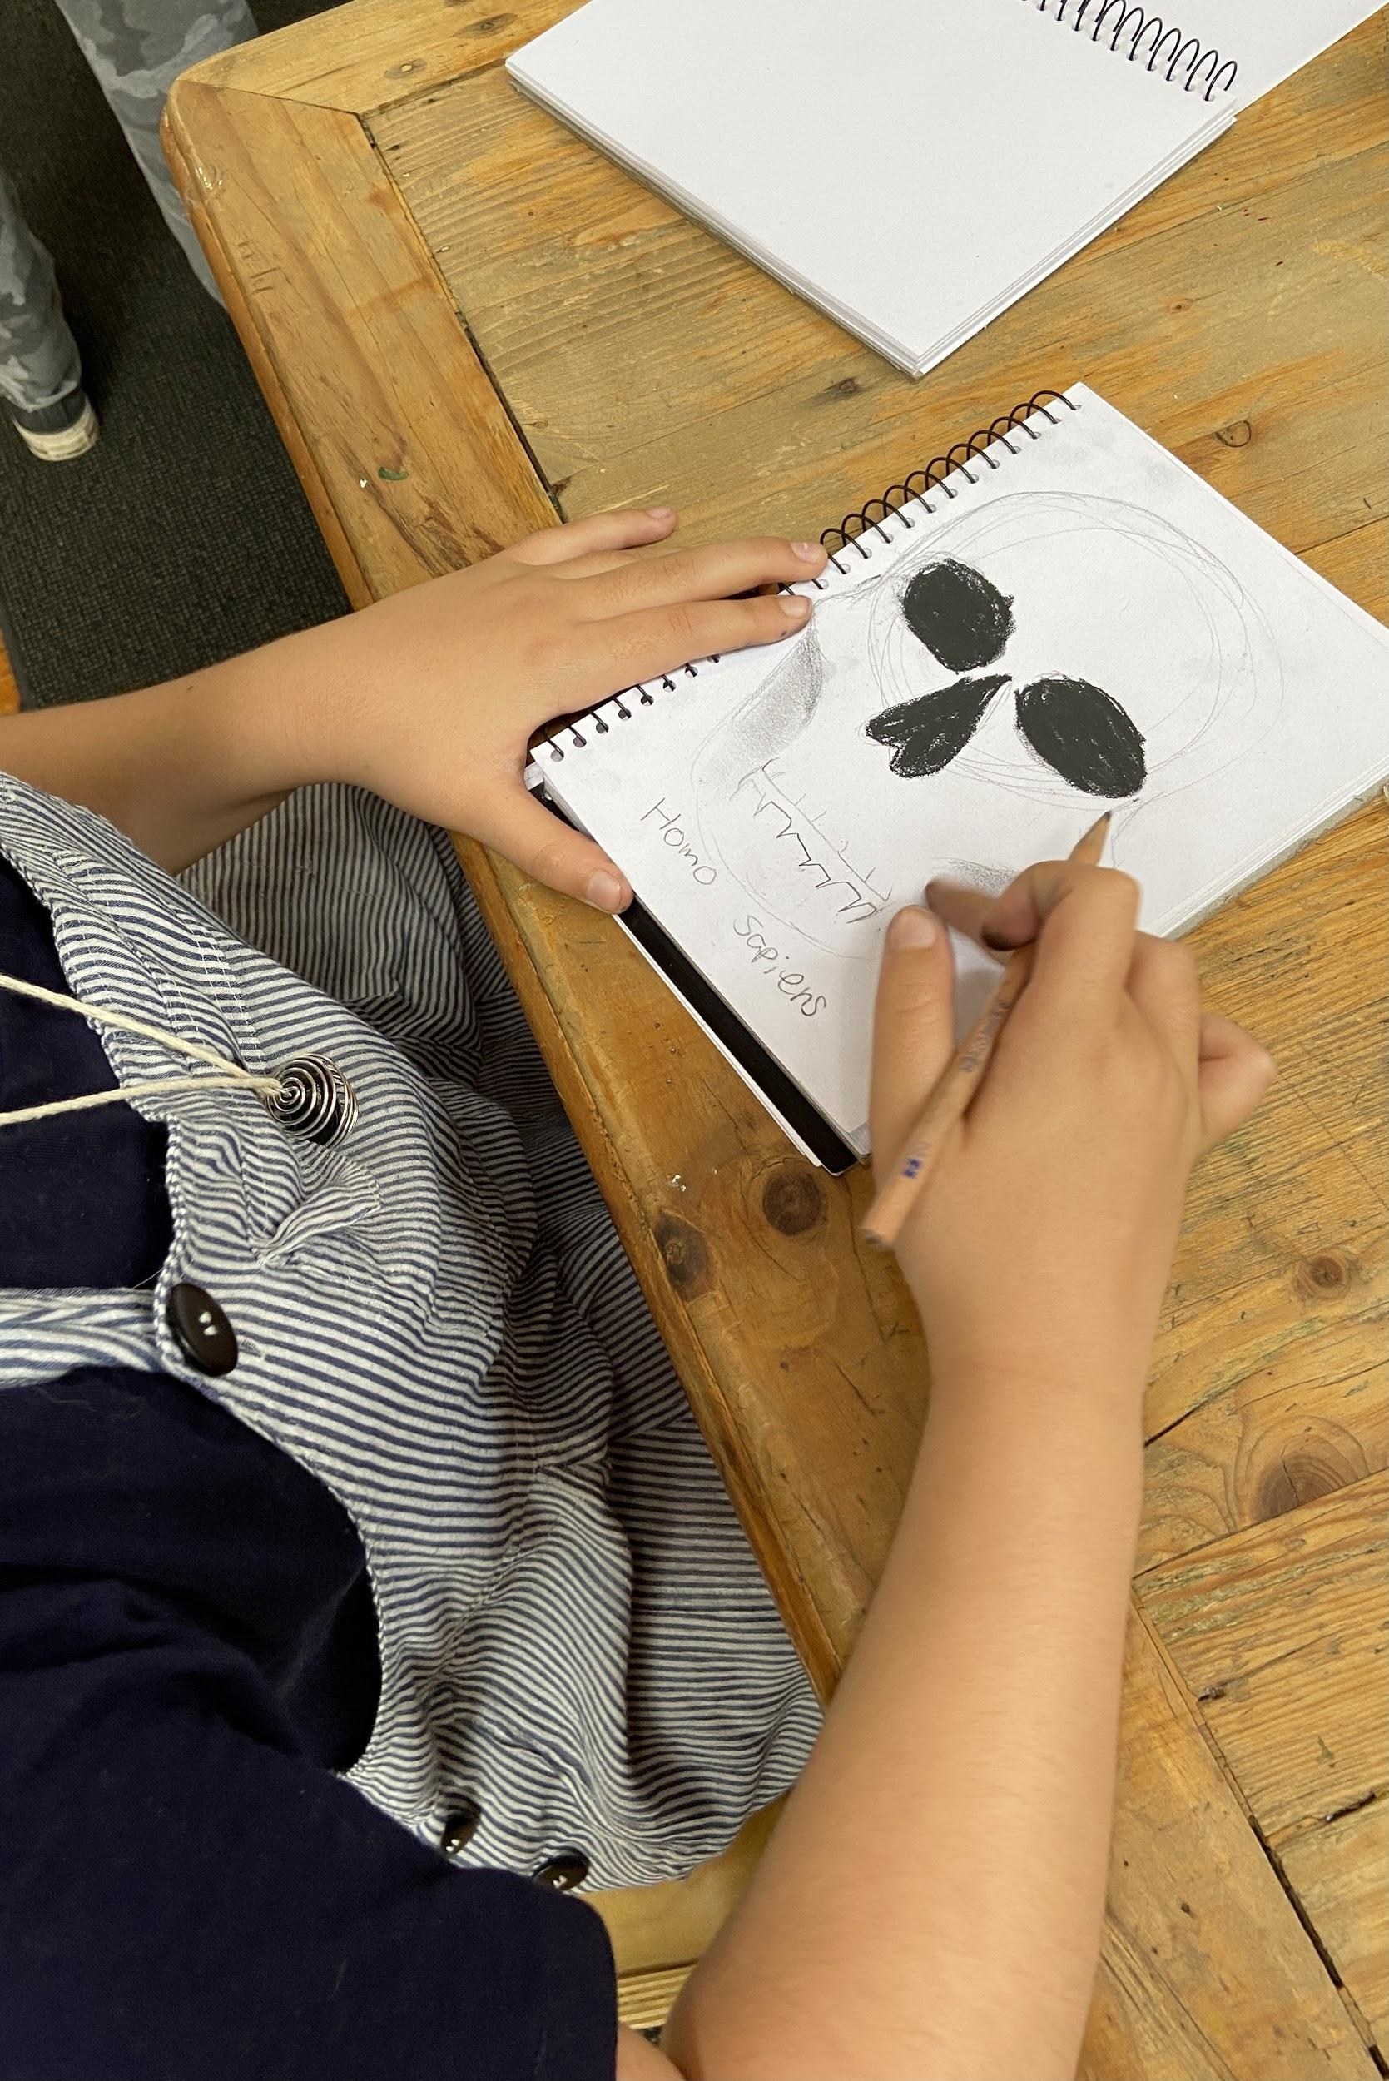
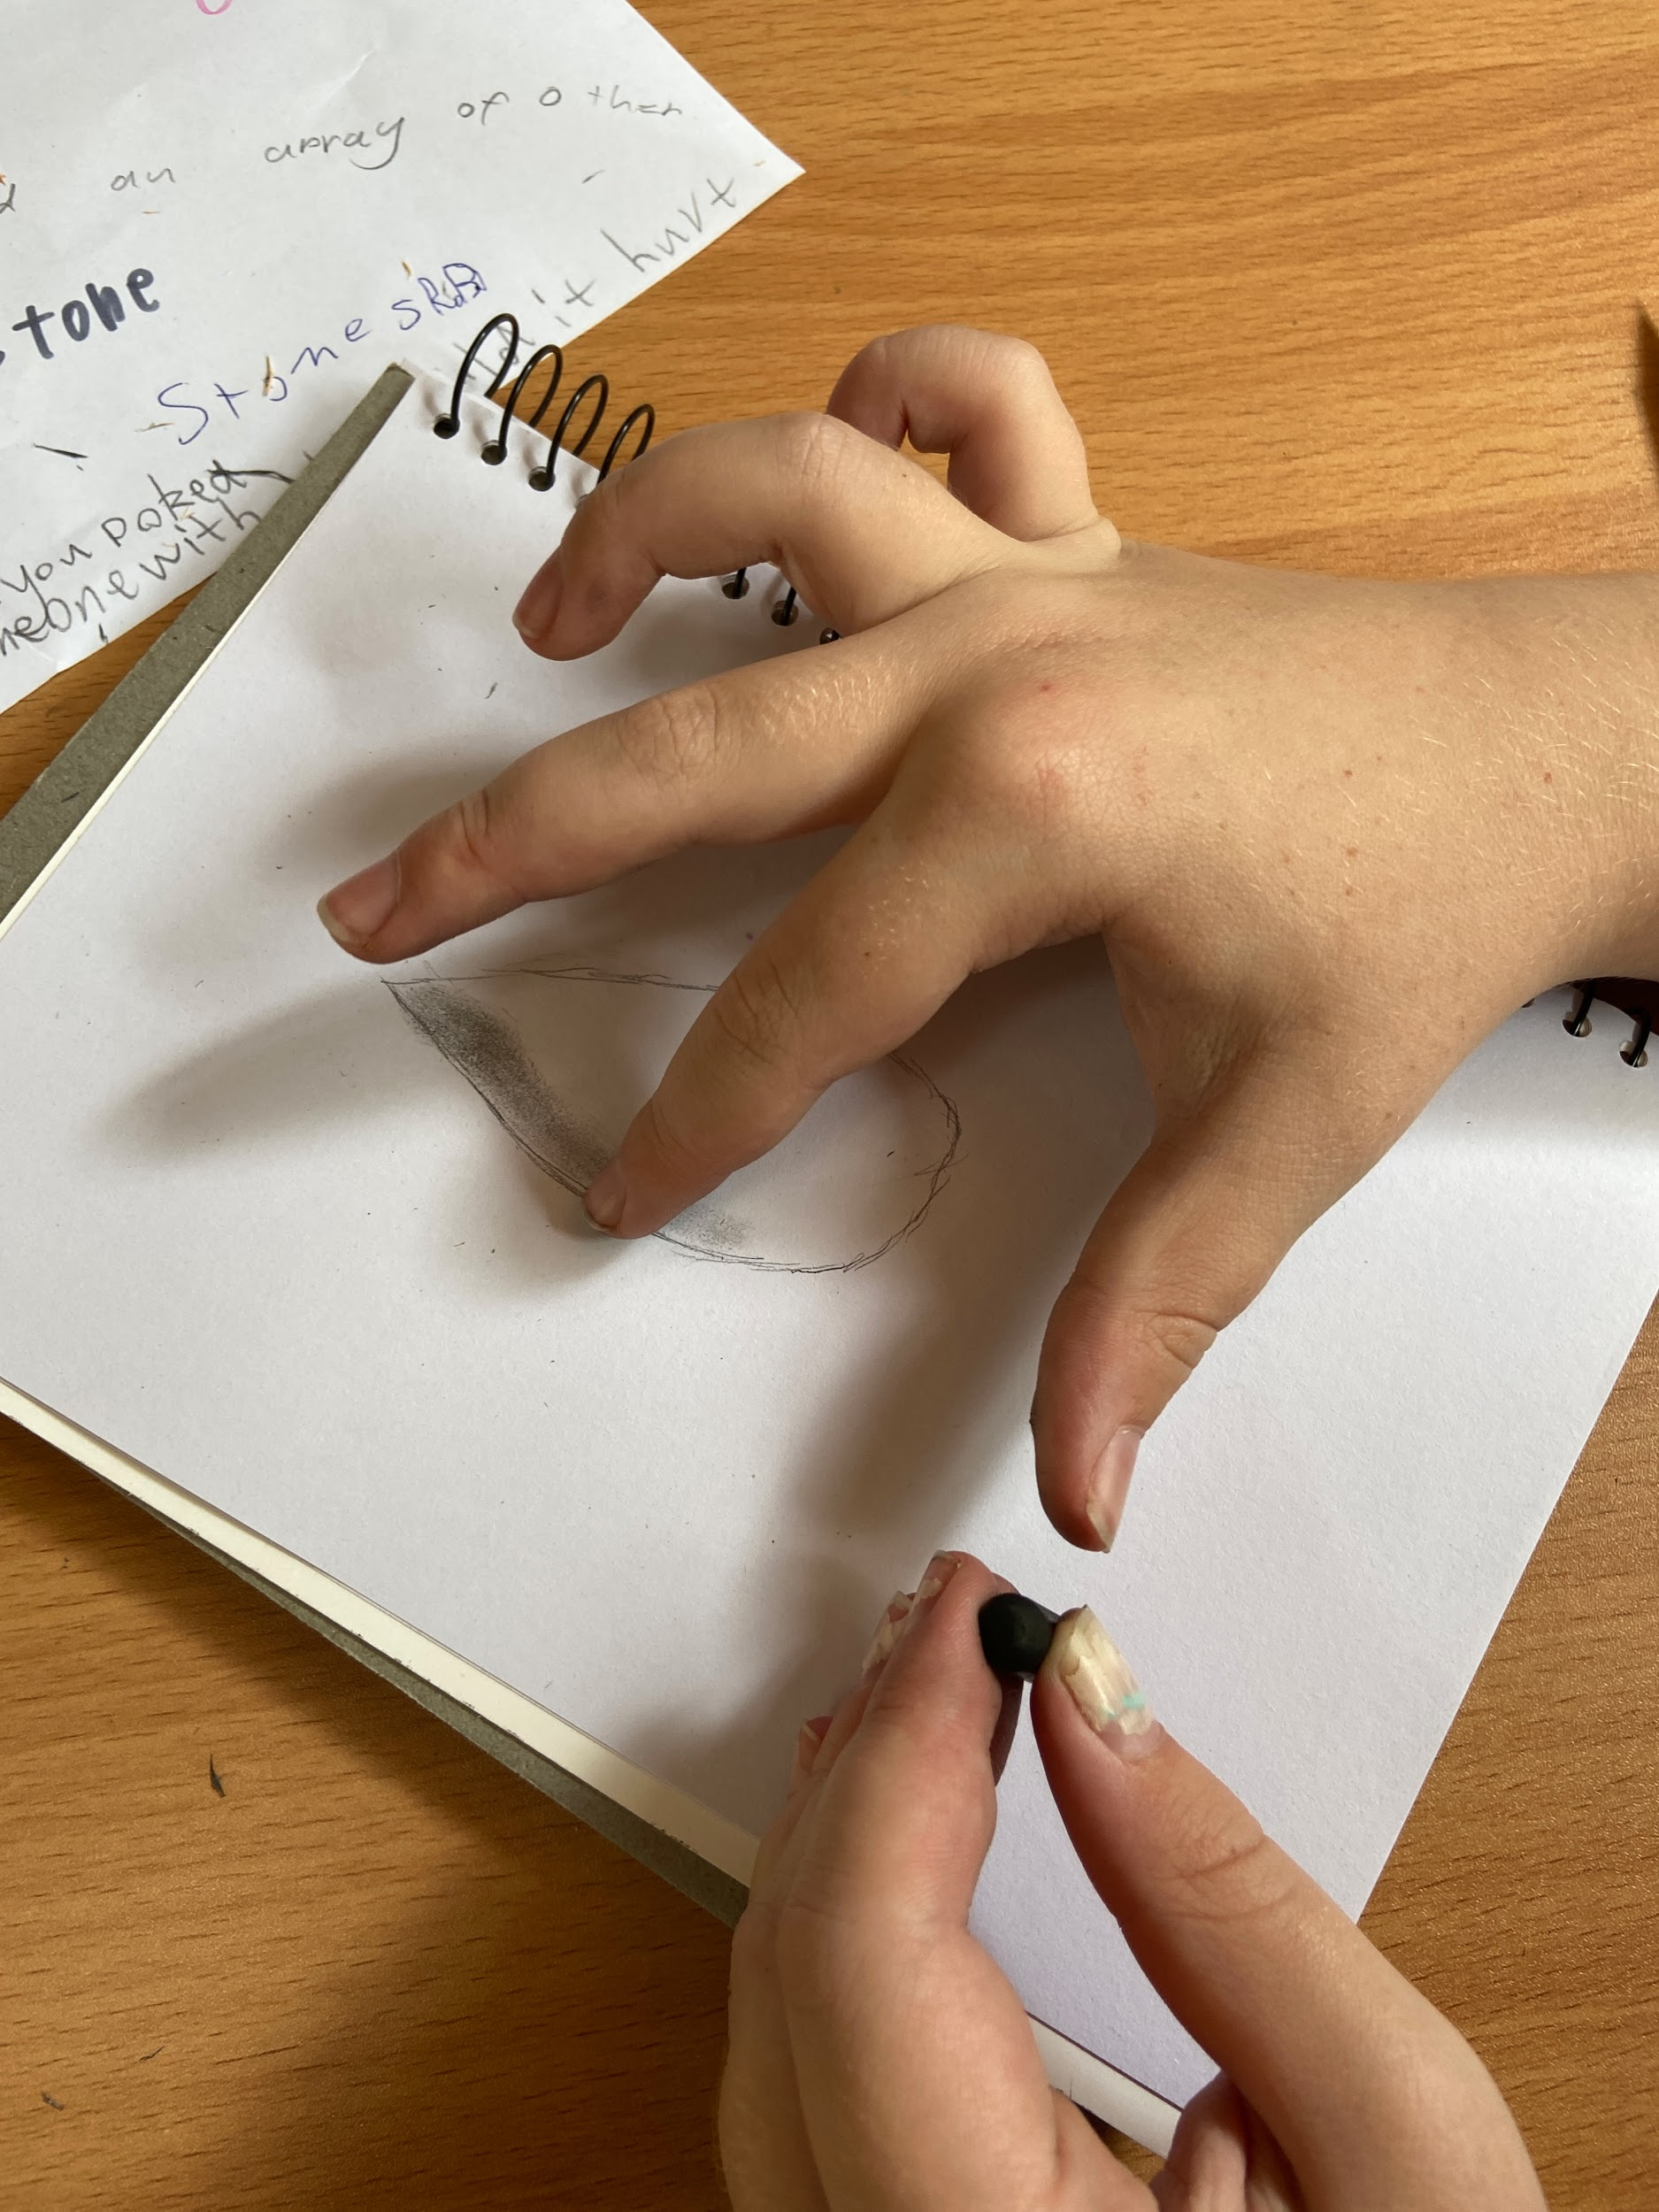
PYP: Unit of Inquiry - Personal Project
Independent Research Project:
Written - Focus Genre
Artifact - Tangible Piece
Presentation - Formal & Informal

Slide 11

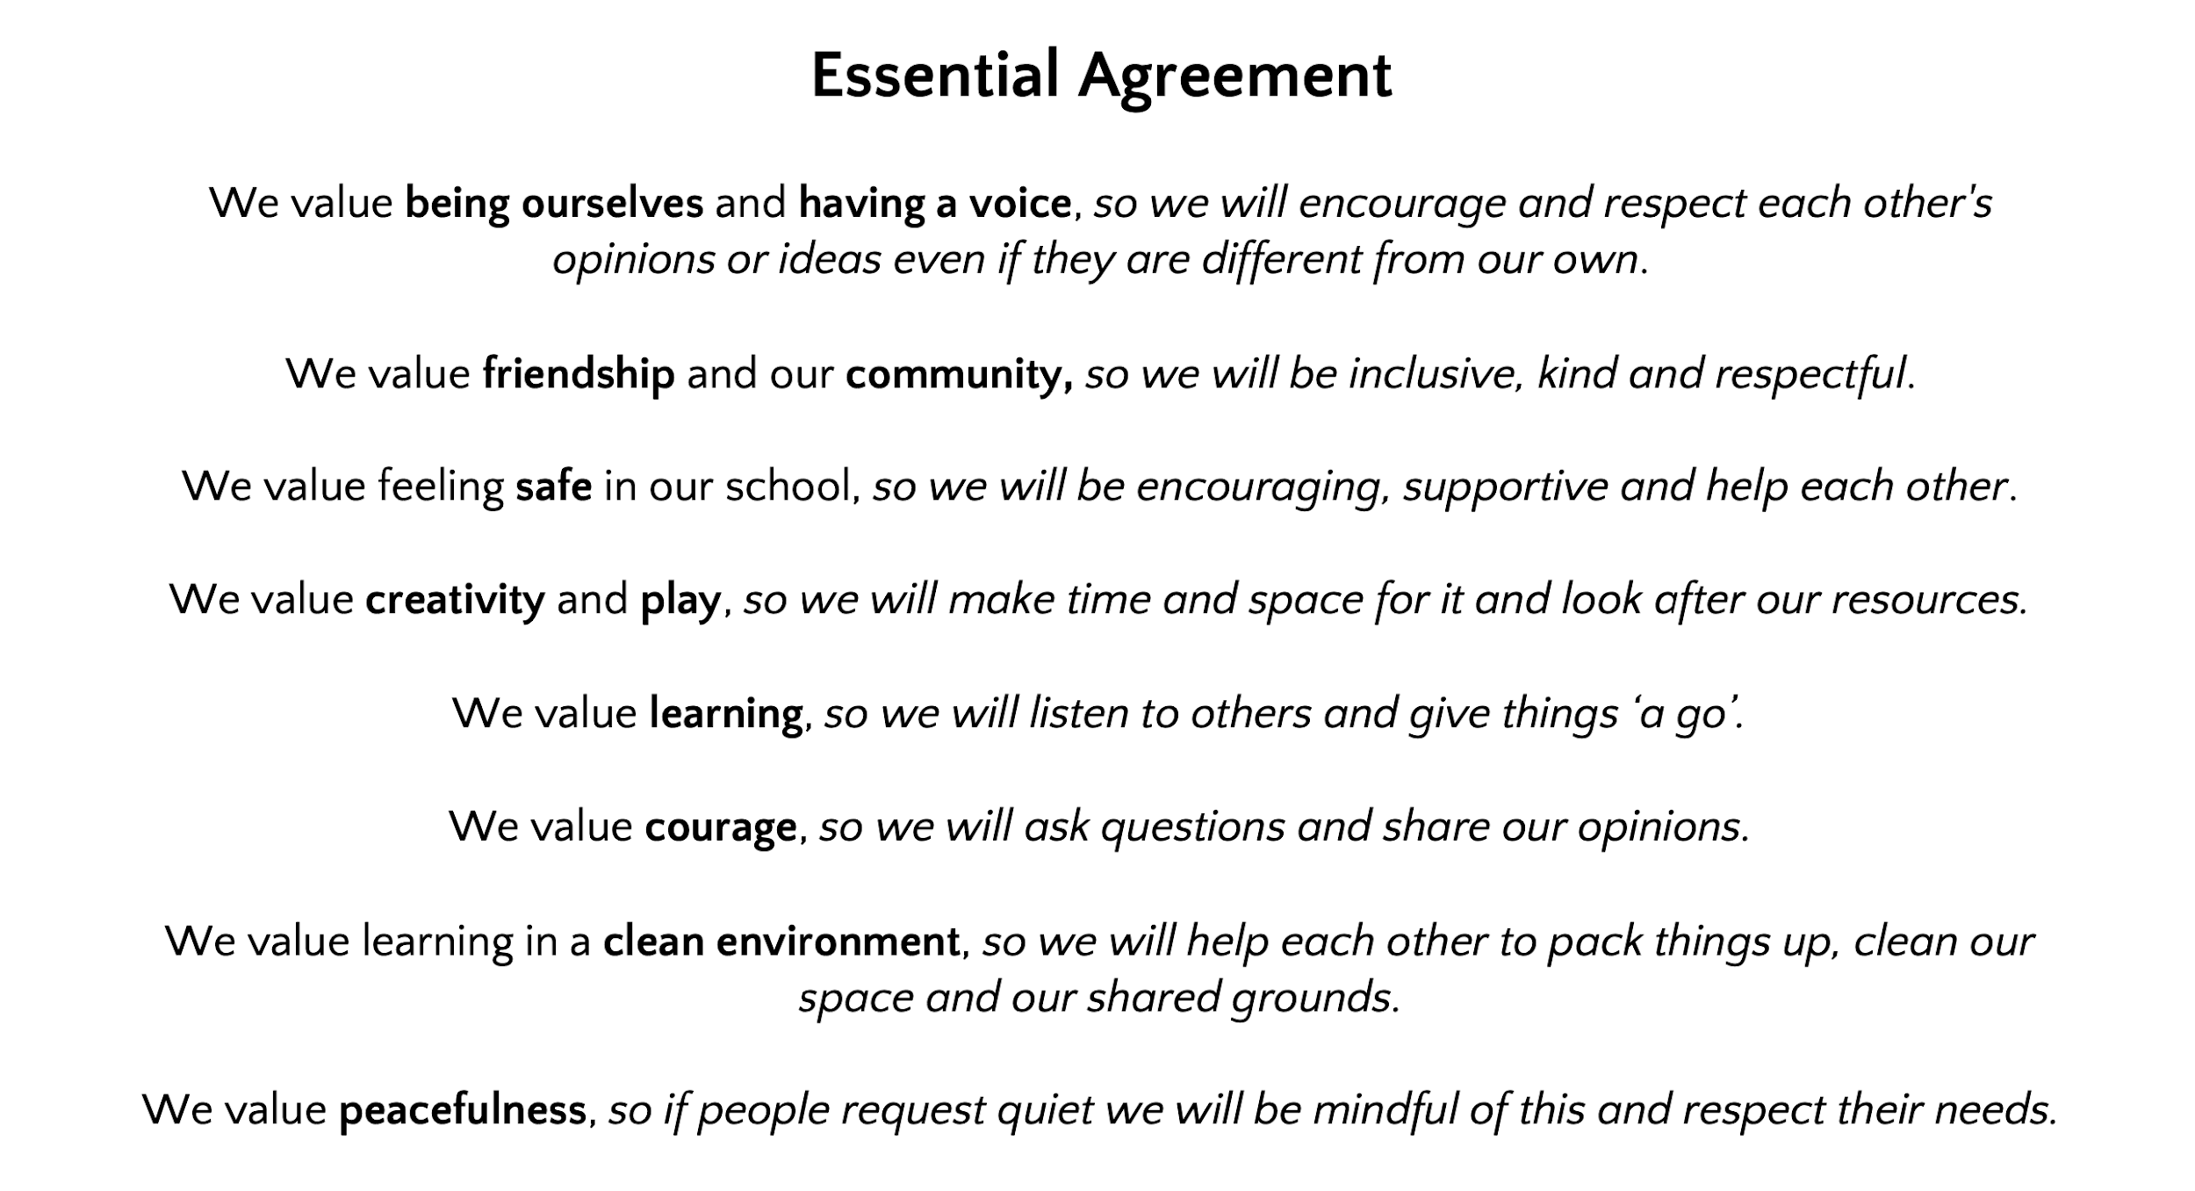
Essential Agreement
Courage
Custodianship
Consent

Slide 12

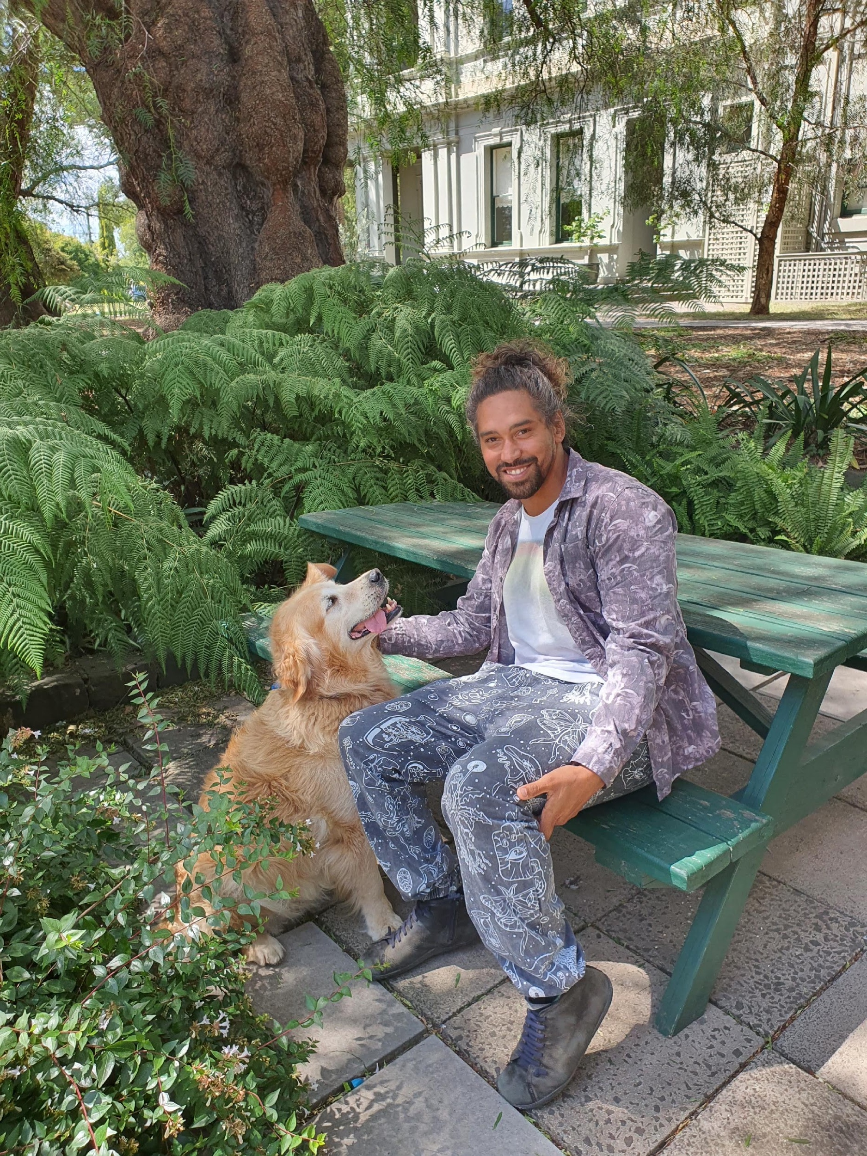
Wellbeing Coordinator: Amir Tatai & Charlie
B.Ed, M.Ed, G.Dip Psych, PhD – Lifelong learning for wellbeing (ongoing)
Hey all! If I haven’t met you yet, please feel free to say hi if you see me around.
Just so you’re aware, my role includes:
  Providing individual support to students
  Working with small groups, classes, or the whole school to address broader wellbeing issues
  Ongoing support to teachers to enhance classroom wellbeing
  Liaising with external professionals to support students at school
  Coordinating Individual Education Plan processes
  Attempting to make hilarious jokes
  If you have any wellbeing concerns or would like to chat about life in general –
  0475 036 146 or amir.tatai@preshil.vic.edu.au

Slide 13
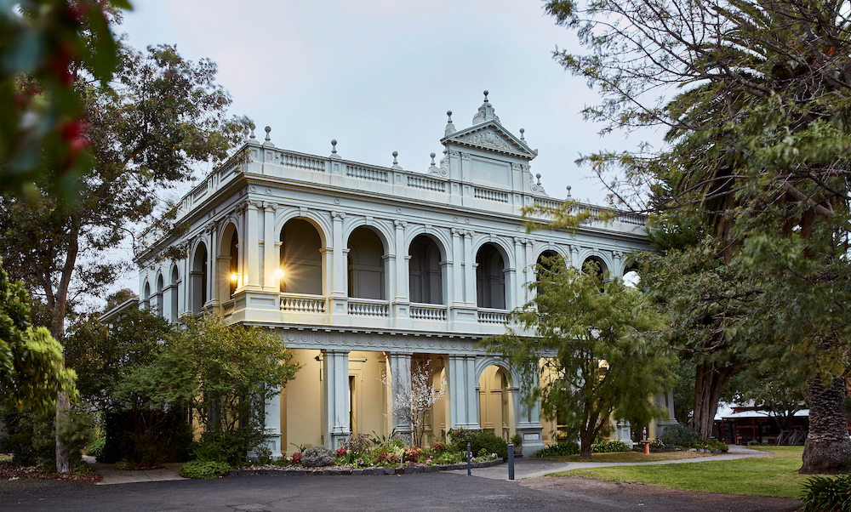
Transition to Blackhall Kalimna (BK)
Valedictory
Inquiry sessions
Exhibition Visits
Year 7 Co-ordinators and Head of Campus
Transition Day

Slide 14
Communication
Compass
Predominant communication mode for Arlington.
Uses: permissions, payment and medical forms for Camps and excursion/ incursions.
Teacher email – please include both of us in your communications unless it really does just pertain to one of us.
Parent Rep – Building community – a social event, Doo Dah, Any takers? Email Sophie, Michael or Cressida
Seesaw - Children upload work weekly

Slide 15
General admin
Name tags on personal items
Drop-off, pick-up
8.30 onwards. Pick up at 3:30
Co-curricular activities
Choir (Thursday Morning) & Chess (Thursday Afternoon)
Library (Friday until 4:30)
Swimming - 1st - 5th March
Camp - 3rd - 5th November - OEG Camp Marysville
Kelly Club - Please enrol in case you are late for pick up, Duty of care ends at 3.45 https://www.kellyclub.com.au/public/our-programs/preshil-school

Slide 16
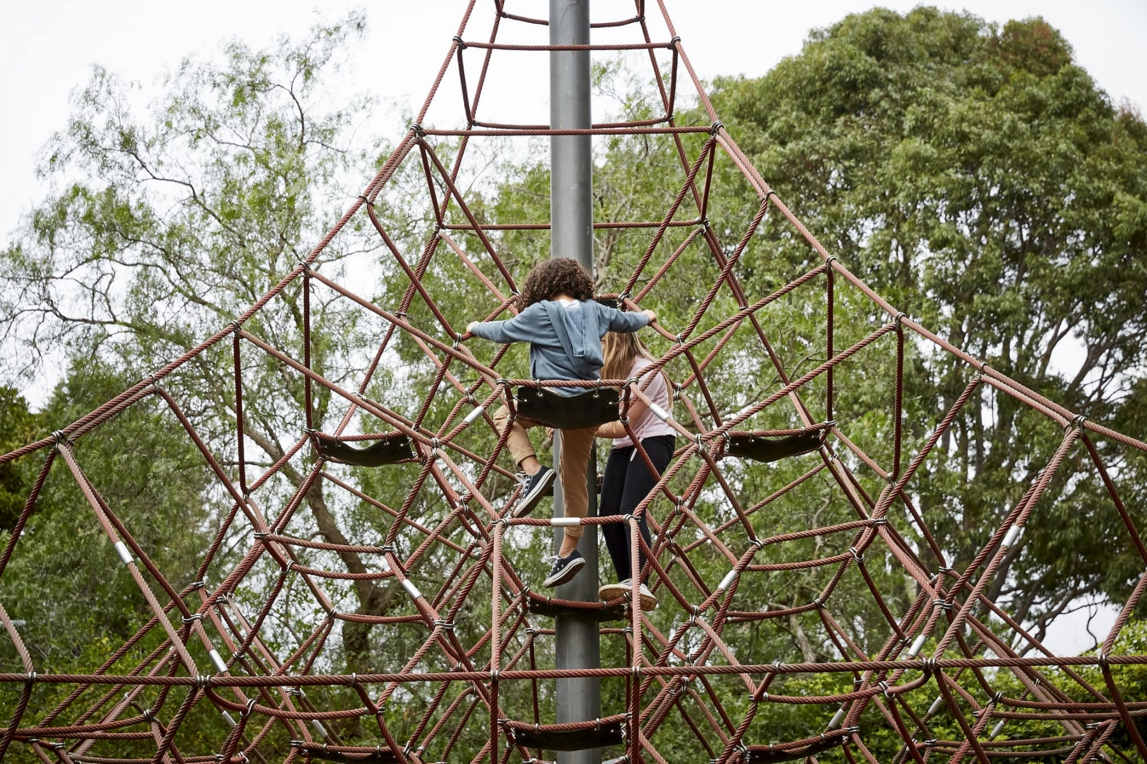
Questions

