Slide 1

Parent Information Session

Slide 2
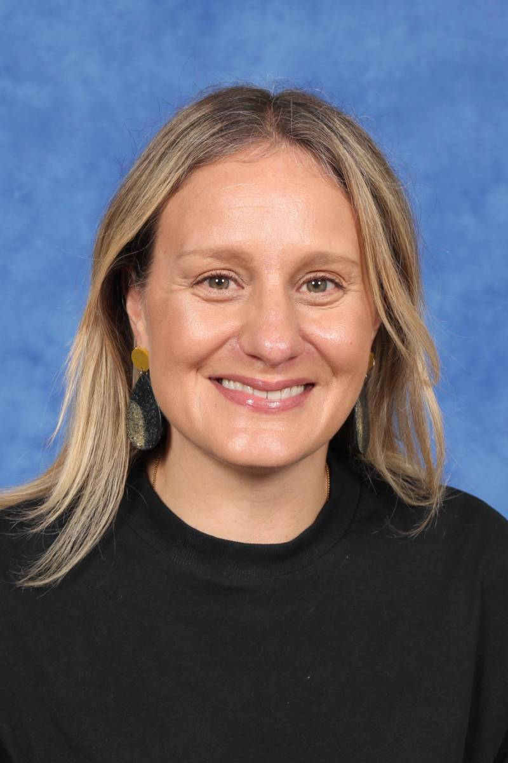
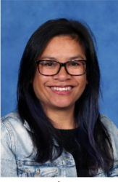
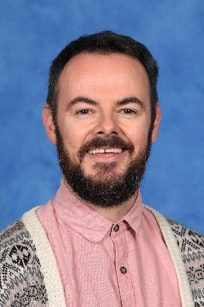
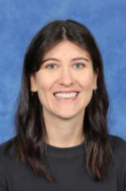
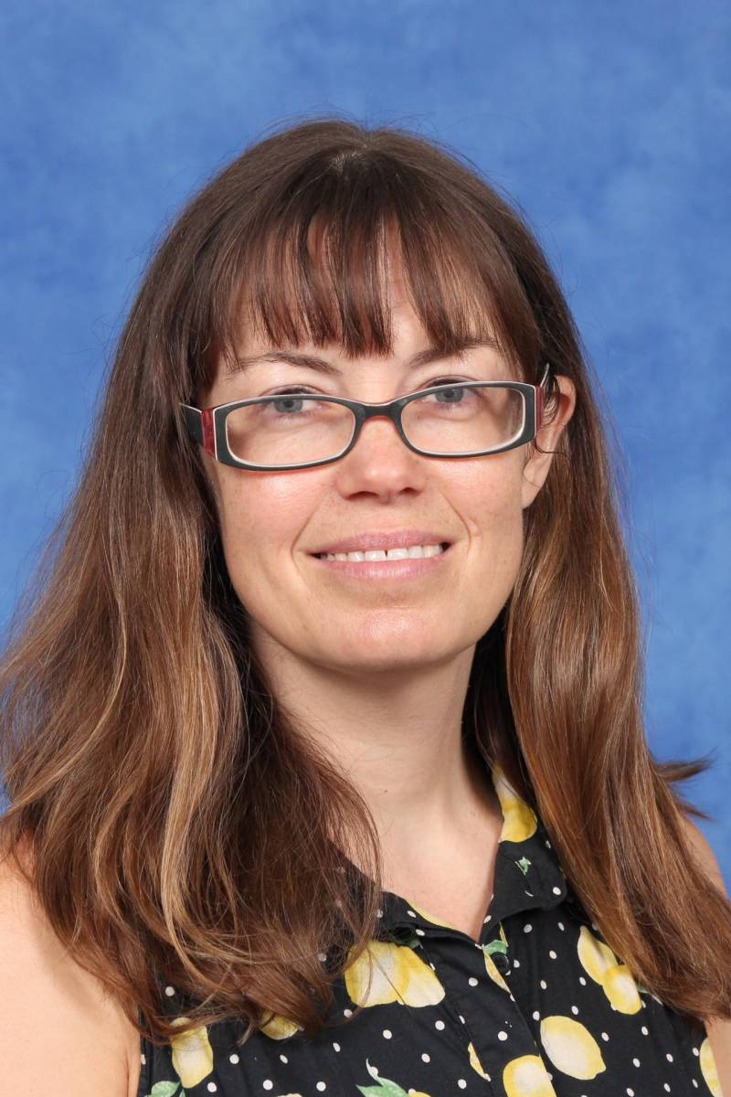
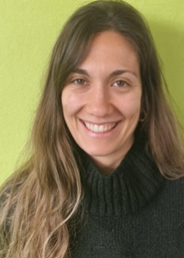
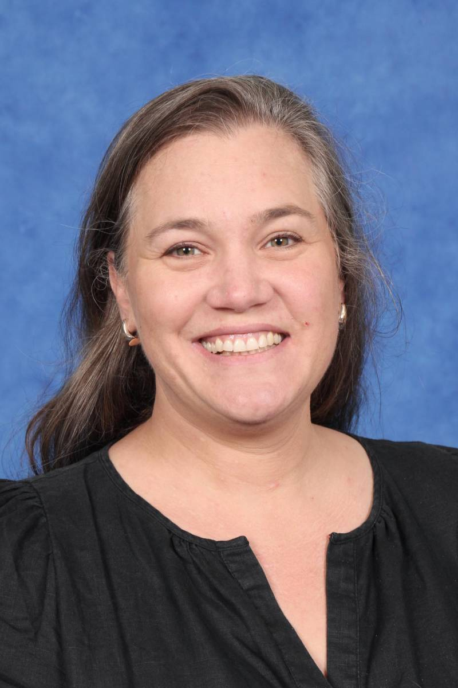
2025 1/2 Team
Learning Community Leader
Kylee Mason
Rob Cooney
Moira Peddie
Luisa Plata Herron
Team Leader
1/2B Classroom Teacher
1/2C Classroom Teacher
Paula Saba
Mel Tyson
Christine Shaver
1/2D Classroom Teacher
1/2E Classroom Teacher
1/2F Classroom Teacher

Slide 3
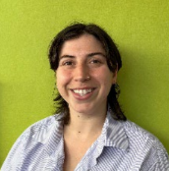
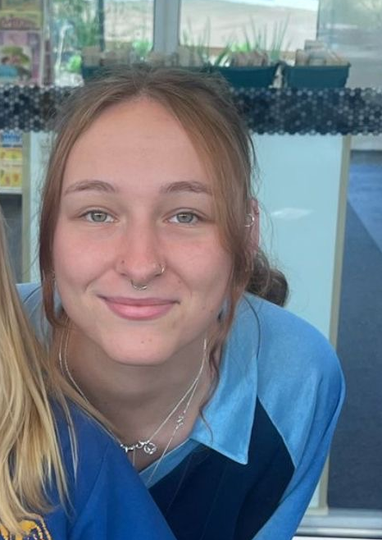
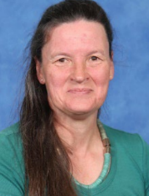
2025 1/2 Team- ES staff
Gaby
Elisa
Trish

Slide 4





The Learning Community Leader
Learning Community Leaders primary role is to Build Effective Professional Learning Teams that support and develop the teachers and students within their team.
Running morning
Writing/ Maths programs (with teachers)
Leading Newlands Planning Model in all subject areas
Visibility in cohort classrooms and supporting teachers with individual students when needed
Mentoring and coaching classroom teachers
Before & After school yard duty ensuring visibility to Parent Cohort Community
Notes:
Luisa
This year, we’re excited to introduce Learning Community Leaders who are now assigned to each cohort, making things even more connected and collaborative! In the past, we had subject-based leaders like the Literacy Leader or Numeracy Leader, but these roles sometimes felt a little disconnected from the classroom. With our new approach, the focus is all about building stronger relationships and creating a more hands-on impact in coaching, mentoring, and supporting both teachers and students. It’s all about teamwork and making learning even more exciting!
In 2025, our goal is all about tapping into the strengths of each team and individual teachers, facilitating planning sessions for greater impact, and really focusing on the unique needs of each cohort. Our Learning Community Leaders are at the heart of this mission, building strong teams, running our before school writing and math programs (along with other passionate teachers), and leading the Newlands Planning Model across all subjects.
They’ll be in the classrooms, supporting teachers, and working side-by-side with them through mentoring, coaching, and collaborative teaching. It’s all about making sure both teachers and students thrive and grow together!

Slide 5
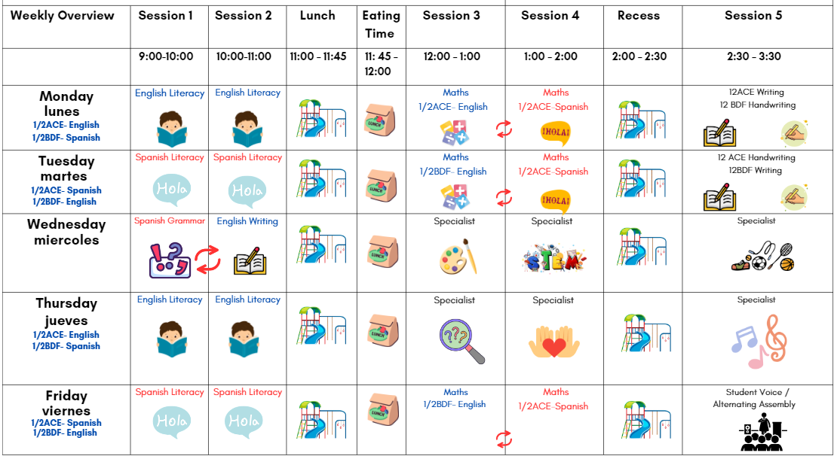
Weekly Timetable- Example
Notes:
Kylee
Our timetable can take some time for the students and teachers to get used to!
This is an example timetable from 1/2AB and is displayed on classroom display areas and provided at parent request. It also highlights the need for a routine to be established, and the students are helped by visual aids on doors or screens to assist them to go to the right place each day.
Most timetables are a simplified version of this one and can be subject to change as a result of special events such as incursions, curriculum days or public holidays.
Our Specialist timetable runs in cycles, which we inform students about the day before.
Our snack times in LW1 are at 10:00 and at 2:30pm, with lunch eating time commencing at 11:45am for 15 minutes. We try to ensure that there are no full lunchboxes at the end of the day but sometimes a couple slip through!
Mirror Classes

Slide 6

Communication Flowchart
Teachers
The teachers are the first point of contact.
Contact for day to day questions, updates or concerns.
Learning Community Leader
Contact Luisa when requiring further support.
This may include, setting up formal meetings, wellbeing, targeted support.
If the issue has not been resolved at the previous levels, or if it involves a school-wide concern (e.g., bullying, major academic challenges, safety), the Principal or Assistant Principal should be contacted.
Principals
Notes:
Luisa

Slide 7


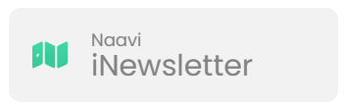

School / Parent Communication
  School Communication
  Payment and Permissions
  Absence Management
  Notifications and Notices
  Parent/Teacher Interview Booking.
  Access to School Calendar
  Semester Reports
  Published weekly (Friday)​
  Essential school-based communication​
  Upcoming events, classroom news, community news, school initiatives and ensures families stay up to date with essential and current happenings at Newlands.
Ensure urgent/timely communication via the office
  Payment and Permissions
  Absence Management
  Communicate medical/health care plans
  Visibility into learning experience to support and celebrate learning.
  Assessment posts/recording.
Notes:
Rob
School Communication: Send and receive messages from your child’s homeroom, specialist teachers, and LCL
Payment and Permissions: Provide permission and make payments for camps, excursions, and incursions.
Absence Management: Easily communicate and respond to unexplained absences, as well as submit future absence requests.
Notifications and Notices: Receive timely notifications for community events, absence alerts, and school notices sent directly to your device.
Parent/Teacher Interview Booking.
Access to School Calendar: View and sync the school calendar with your phone to keep track of important dates and events.
Semester Reports: Stay informed by viewing your child’s individual learning plans and end-of-semester reports.
If a msg is urgent then contact the office

Slide 8
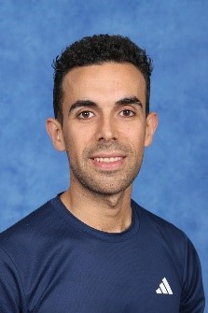
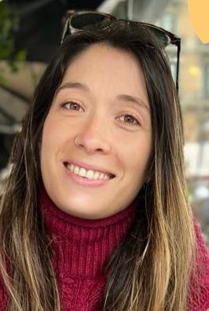
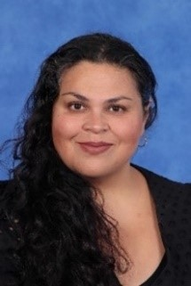
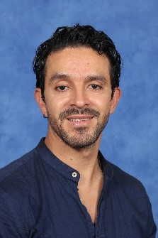
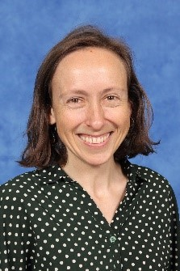
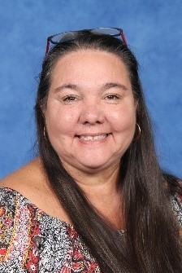
Specialist Team
Raul
Paula
Margaret
Physical Education
STEAM (F-2)
Visual Art
Felipe
Nerida
Karren
Performing Arts
Inquiry
Wellbeing
Notes:
Margaret

Slide 9






Specialist
Specialist teachers can be messaged on Sentral
Specialist Program: STEAM, HPE< Art, Music, Inquiry and Wellbeing
Pick up- Quadrangle
Whole school events
 | Wednesday |  |  | Thursday
 | 12pm | 1pm | 2:30pm | 12pm | 1pm | 2:30pm
Kylee | Art | STEAM | HPE | Inquiry | Wellbeing | Music
Rob | STEAM | Art | Music | Wellbeing | Inquiry | HPE
Moira | HPE | Music | Inquiry | Art | STEAM | Wellbeing
Paula S | Music | HPE | Wellbeing | STEAM | Art | Inquiry
Mel | Inquiry | Wellbeing | Art | PE | Music | STEAM
Cristine | Wellbeing | Inquiry | STEAM | Music | HPE | Art
Notes:
For 1/2s – the alternation of 12EF – Even weeks 1/2F will have Steam – Odd weeks 1/2E will have Steam. For Art 1/2E for even weeks and 1/2F on odd weeks
What is the purpose of each subject? What are the students doing?
STEAM
The science and digital and design technologies curriculums are covered.
Students:
engage in experiments
code using robots and online sites.
create solutions related to their learning
Art is weaved throughout all of this.
Art
The Art Program focuses on develop students' abilities as an artist:
- Exposed to a range these Visual Arts mediums; clay, drawing, collage, painting, sculpture and textiles.
They'll be learning about art elements, art movements and artists
Students artwork displayed throughout the school and there will be Biannual Art Show during October.
Inquiry
We are inquiring into biodiversity on Wurundjeri Country and how we can connect with, understand, and care for this land, focusing on our school grounds and developing our ethical capabilities to assist in our decision making.
Health and PE
The HPE program helps children stay active, learn about their bodies, and develop lifelong movement skills. Through fun games and sports, we promote teamwork, well-being, and healthy habits for a strong and active future.
Music
Music and dance as subjects
focuses on developing foundational music skills
F-2 qualities of the sound. Dynamics and contrasts (*loud/soft*, *high/low*).
explicit teaching, hands-on instrument practice, group collaboration, and reflective activities
incorporates cultural exploration and creative expression to enhance musical understanding and appreciation.
Wellbeing
This year, we’re diving into positive self-talk, resilience, and coping strategies to help us navigate challenges with confidence! 💪✨ Most of what we do is based on the Resilience Program, Berry Street, and Safe Schools, as well as what you need. Through fun activities, teamwork, and reflection, we’ll build skills to stay strong, support each other, and thrive. Get ready for an exciting journey of growth, kindness, and self-discovery! 🚀😊
Pickup – Quadrangle – every Wednesday and Thursday pick up at the end of the day will be at the Quadrangle
Mention whole school events related to our programs for the year. Term 1: Ride2School Day, Specialist Day Celebration. Term 2: Colour Run. Term 3: Athletics Carnival. Term 4: Art Show, swimming program (explain this year it is only for year 6s)

Slide 10
Cohort Specific Information
Our take-home reader program
Take-home reader program- Your child's current readers are aligned with last year's assessments. We will be assessing students as per our assessment schedule, which will be changed accordingly.
Wellbeing
If you have not received your Wellbeing handbook from our Wellbeing Day, let us know and we will arrange one for you.
Food items and water bottles
Lunchboxes and water bottles are stored inside in classroom tubs each day and are returned at the end of the day.
Adjusting to life in a Year 1/2 classroom.
We understand that new routines and changes are difficult for our students in year 1. We have a 'Friendly faces' buddy system and opportunities during Circle Time to discuss our day or week ahead.
Notes:
Take-home reader program- current readers are aligned with last year's assessments and we will be assessing students as per our assessment schedule. These will be changed accordingly.
Wellbeing- Friday 28th Wellbeing Day 3:30pm and Picnic. Complete an All About Me with your to assist us to get to know your children better. These are sometimes a precursor to the creation of a BSP if your child requires additional support.
Food items and water bottles- take home at the end of each day.
Classroom routines- lining up (roll order to support our Specialists) bags and lunchbox arrangements, end of the day pick ups on normal and Specialist Days, specific teaching team directives.
Toilet TPP program and expectations- Children will always be allowed to go to the toilet when we are asked. The toilet is in the building, so the students do not need to take a buddy. We use hand signals if the teacher is with another student. We also closely monitor the frequency of requests and time of requests because it may also alert us to a child feeling anxious about as a pattern emerges. We are eagle-eyed in spotting when a child needs to go, if they forget to ask us or leave it until it's nearly too late! The students know that if they let us know, we can provide spare clothes if an accident happens.
We have commenced sign-outs as part of a student-led initiative as a response to damage to our toilet areas in 2024.
Toys/Personal Items - A calming tool that is discussed with families is acceptable, excessive or personal items are to remain at home (distraction rather than calming and loss of a special toy might create more anxiety)
Home Learning Expectations - Nessy, EA, Raz Kids. We understand that many parents are reluctant to use ICT when students get to home. However, we strongly encourage you to use the resources recommended by us, as long as it is monitored. Individual teachers may discuss alternative arrangements as an 'at needs' basis. As our students are settling in this term, we understand that they are tired and need to reset for the next day.
Question Time
Toilets- Inside toilet spaces, hand signals, sign-outs as part of a student-led initiative, expectations during learning. 1 person at a time.

Slide 11
Cohort Specific Information
Classroom routines – lining up at the start and the end of the day
We line up in roll order outside our classroom doors and come into the space when a teacher is present. On Wednesdays and Thursdays, we are collected from the quadrangle after our Specialist Day timetable. If we attend after-school care, we are collected by staff in the shared space of 1/2AB.
Toilet expectations
There are two sets of toilets located in Learning World 1. Children are allowed to go to the toilet during class time and are encouraged to go at recess, lunch and during snack times. If there are any accidents, we encourage the students to ask for help, so we can arrange some alternative clothing from the office.
Toys/Personal Items
We strongly encourage students to keep special toys (soft toys, Lego, Pokemon cards) at home. If your child requires an exemption for this (fidget spinners, comfort toys or similar), please see your classroom teacher to discuss how we may best support your child through a BSP.
Notes:
Take-home reader program- current readers are aligned with last year's assessments and we will be assessing students as per our assessment schedule. These will be changed accordingly.
Wellbeing- Friday 28th Wellbeing Day 3:30pm and Picnic. Complete an All About Me with your to assist us to get to know your children better. These are sometimes a precursor to the creation of a BSP if your child requires additional support.
Food items and water bottles- take home at the end of each day.
Classroom routines- lining up (roll order to support our Specialists) bags and lunchbox arrangements, end of the day pick ups on normal and Specialist Days, specific teaching team directives.
Toilet TPP program and expectations- Children will always be allowed to go to the toilet when we are asked. The toilet is in the building, so the students do not need to take a buddy. We use hand signals if the teacher is with another student. We also closely monitor the frequency of requests and time of requests because it may also alert us to a child feeling anxious about as a pattern emerges. We are eagle-eyed in spotting when a child needs to go, if they forget to ask us or leave it until it's nearly too late! The students know that if they let us know, we can provide spare clothes if an accident happens.
We have commenced sign-outs as part of a student-led initiative as a response to damage to our toilet areas in 2024.
Toys/Personal Items - A calming tool that is discussed with families is acceptable, excessive or personal items are to remain at home (distraction rather than calming and loss of a special toy might create more anxiety)
Home Learning Expectations - Nessy, EA, Raz Kids. We understand that many parents are reluctant to use ICT when students get to home. However, we strongly encourage you to use the resources recommended by us, as long as it is monitored. Individual teachers may discuss alternative arrangements as an 'at needs' basis. As our students are settling in this term, we understand that they are tired and need to reset for the next day.
Question Time
Toilets- Inside toilet spaces, hand signals, sign-outs as part of a student-led initiative, expectations during learning. 1 person at a time.

Slide 12

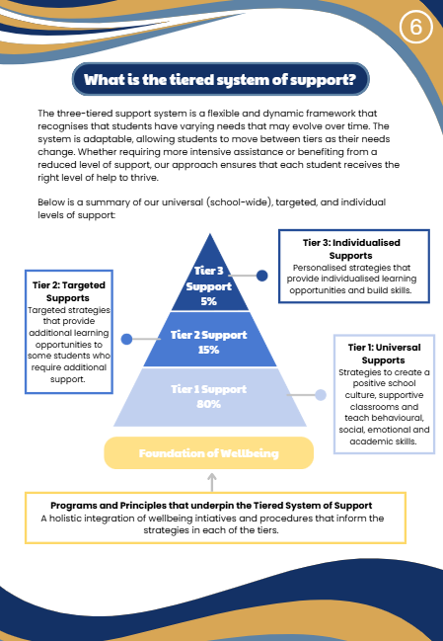
Supporting Your Child's Wellbeing at School
Notes:
Rob
Find out more about our Wellbeing Supports by coming to visit our spaces after school!

Slide 13
Attendance
Student Late Arrivals
Students that arrive at school later than 9:15 am, must sign in at the office. If a student arrives between 9:00 and 9:15am are to be marked as present by the classroom teacher.
All students who are late to school or are collected early are required to sign out at the office.
If your child is leaving early, we ask that it not between 3:00 - 3:30 or during playtime.
Notes:
Luisa

Slide 14
Soft Start
What is the routine?
After hanging up their bags, students bring in their lunch boxes and water bottles and enter Learning World 1 through their homeroom teacher's door.
What are the expectations for parents and carers?
From Term 2, we encourage parents to 'kiss and drop' at the door, unless a quick check-in is needed with the classroom teacher. For students requiring additional support to transition into the classroom, the teachers will create a behaviour support plan with the student and parents.
What kinds of activities will my child engage in?
Students get ready for learning by getting their workbooks out for the day, putting down chairs and then choose a book to read or complete a 'quiet' time activity until the bell goes at 9:00am. All students are encouraged to sit on the floor by 9:00am.
Notes:
Kylee
What is the routine?
8.50 – 9:00am The students enter the learning spaces.
This is also an opportunity to have informal conversations and quick check-ins with teachers.
9:00am: Attendance rolls, Daily schedules & Community Circle discussions happen here. Parent helpers assist us by reading from 9:00-10:00am.
What are the expectations for parents and carers?
From Term 2, we are encouraging parents and carers to farewell their children at the door where possible, which can assist us to deal most effectively with students that require further support. We do have additional staff that assist with students where possible. However we do encourage parents to arrange a meeting to put formal supports in place if this issue comtinues.
What kinds of activities will my child engage in?
Reading on a chair or floor space, mindful colouring and drawing and getting organised for the day (hats away, lunchboxes inside, toilet reminders, preparing for learning)

Slide 15
Home Learning
Take Home Literacy Program
We change our readers every Friday.
Students will take home 3 English readers and 2 Spanish readers
Expectations that students are reading 15 minutes each night
Students have access to Raz-Kids and Nessy online to support their reading and spelling
Homework
Notes:
Mel
We change our readers every Friday (3 English and 2 Spanish)- we are using current assessment data.
Students will take home English readers and Spanish readers to read one each night.
Expectations - nightly reading with your child and of course they can read books from home!
Online platforms- Nessy
Homework- reading is our priority in ½!

Slide 16

Parent Helper Program
Please come into the learning space during the soft start.
Listen to Spanish or English
Please stay for 1 hour during the Reading session.
Prompt page and checklist
Notes:
Mel

Slide 17
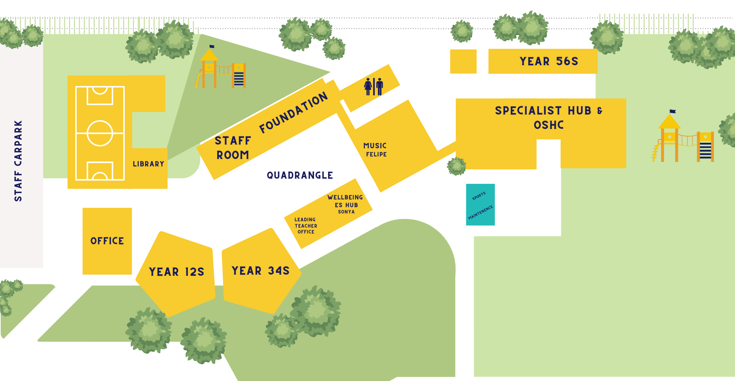
Play Areas
Out of Bounds
Notes:
Luisa

Slide 18
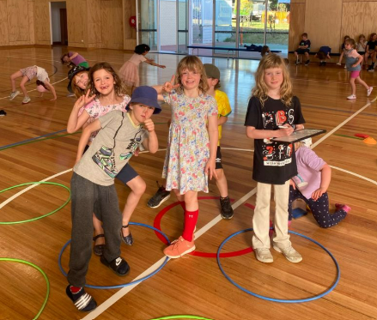
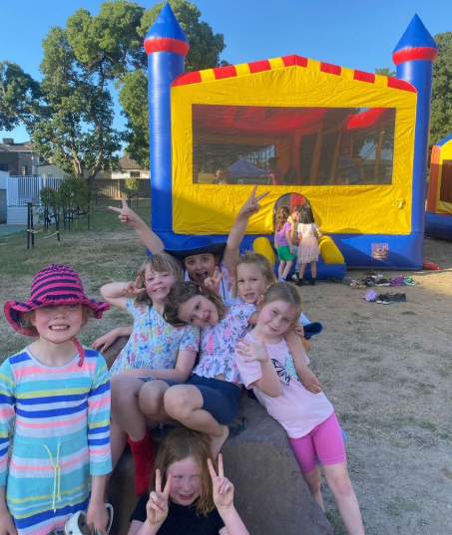
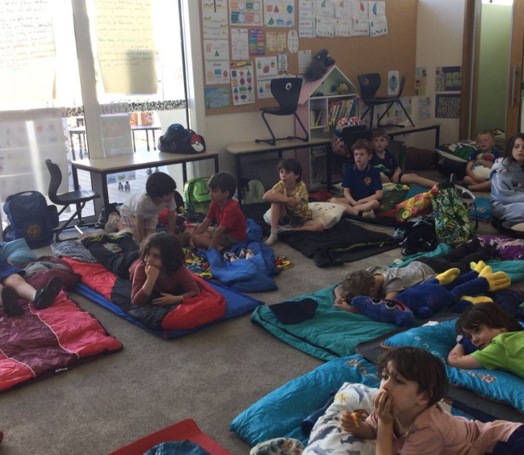
Camps, Excursions and Incursions
What is coming up this year for the 1/2 students?
We provide an incursion or excursion each term, which aligns with our Inquiry focus for the term.
Term 1 - Resilient Warrior incursion
( Tuesday 11th March, Week 7)
Term 2 - Indigenous Perspectives
Term 3 - TBC
Term 4 – Sleepover – Date TBC
Notes:
Kylee

Slide 19

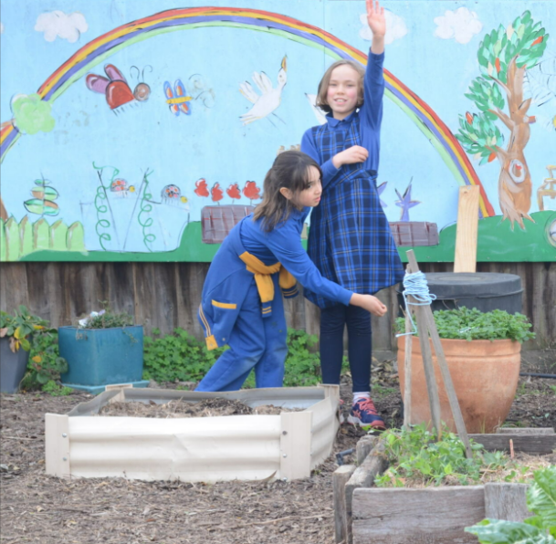
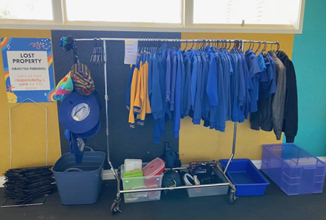
Uniform, Hats and
Lost Property
Lost Property
Located in C block outside the STEAM classroom.
Hats
Hats are compulsory to wear in t
Term 1 and 4.
We are setting up an inside Wellbeing hub where students can go if they don't have a hat.
Uniform
Ensure all uniform/ personal items are clearly labelled
Notes:
Rob

Slide 20


Reporting / Parent Teacher Interviews
Termly Parent Teacher Interviews
Reports published Semester 1 and Semester 2
Alternate between Spanish and English teacher
Term 1 with both teachers​
Term 2-4 with one teacher

Slide 21
Local Excursions / Photography
A Permission Slip has been published on Sentral to obtain consent for all local excursion and photography that may take place in 2025.​
If you do not want to give consent for local excursions, please indicate this on the Sentral Permission Slip. ​
Local excursions may include walking to local kindergartens, parks and community spaces. ​
Parents and Caregivers will be notified of any upcoming local excursion beforehand. ​
You may withdraw consent for local excursions at point in the year by calling the school on (03) 9354 2928 or emailing the school at newlands.ps@education.vic.gov.au.
Notes:
Kylee

Slide 22
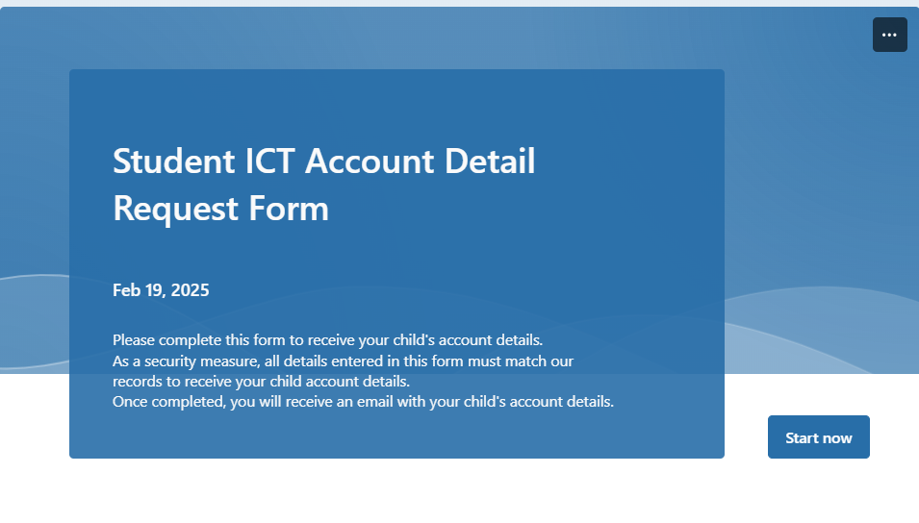
Student ICT Account Details
Student ICT account details are emailed at the start of each school year.
You can also request your child’s account details by completing the Student ICT Account Details Form on the school's website.
Please contact the classroom teacher if you are having trouble signing in to any platforms.
Notes:
Luisa

Slide 23
Community Events
NAPLAN week 7 and 8 (year 3 & year 5)
Parent teachers interview Friday 28th March
School photos March 31st
Cultural week assembly 4th April 1:30 –2:30
Bilingual Fiesta 4th April 3-6
Last day of the term 4th April School finishes at 2:30

Slide 24
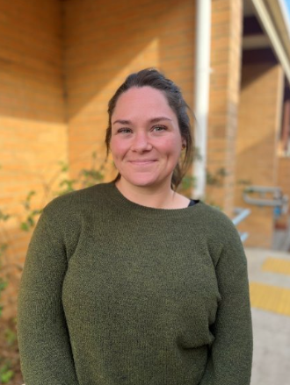
Outside of School Hours Care
Newlands Primary School offers a nationally accredited before and after school care program.
Care is provided from 7:00am until 8.50am each day, and until 6:00 pm after school from Monday to Friday.
OSHC Phone Number: 0491 273 710
You are able to book in advance for the whole term, or book in casually.
Registrations are be completed online. The link can be found on our website.
Most families are eligible for a fee reduction through the child care subsidy system.
Example Activities: Arts and craft, sport, cooking, relaxation and quiet corners.
Notes:
Rob
Enrollment on website. Some days are fully booked. Capacity 160 students. Book for a year unless otherwise stated. On days where available casual spots may. Clsim to through centralink, you get a CRM

Slide 25
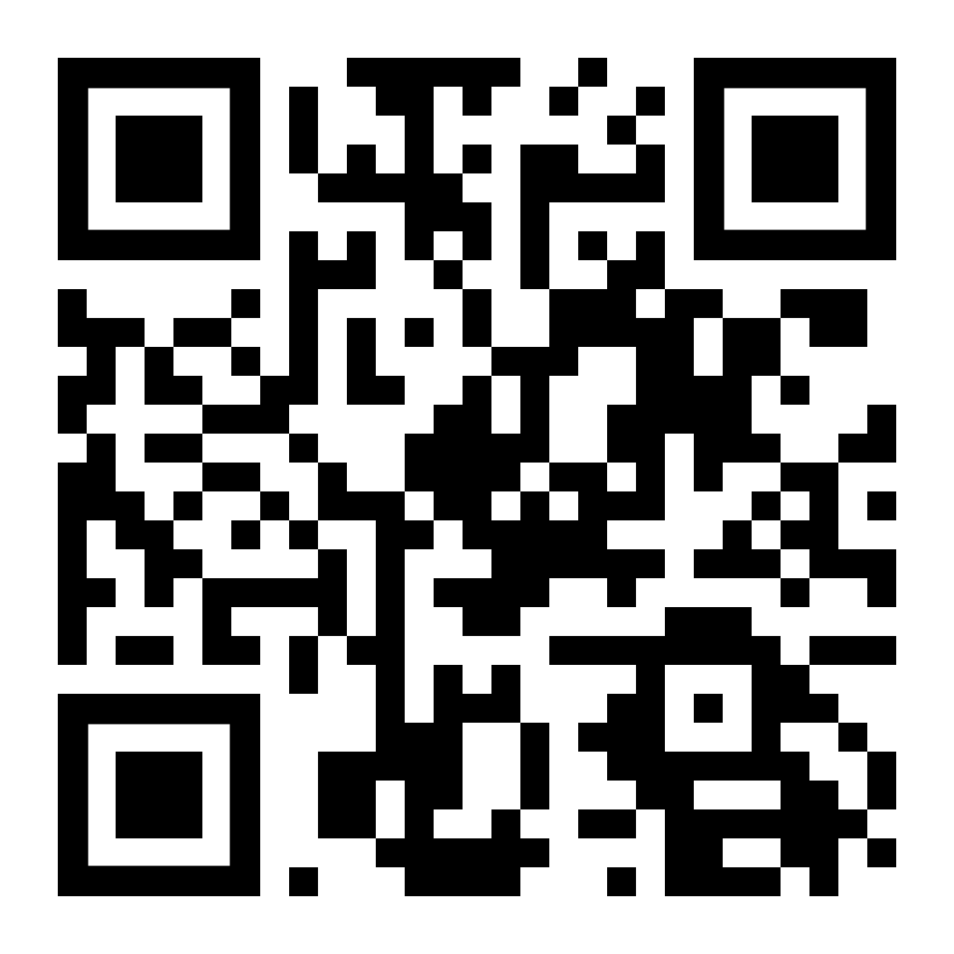
Parent Involvement
Sub-Committees
Parent & Friends Association - Community Events & Fundraising
Education Sub-Committee
Buildings and Grounds Sub-Committee
Finance Sub-Committee (School Council Members Only)
OSHC Sub-Committee
Reconciliation Action Plan Group (RAP)
Spanish Sub Committee
School Council
Notes:
Luisa

Slide 26

2026 Sibling Enrolments
If your child is currently in kindergarten and will be joining us next year, please complete the enrolment form on our school website, and send it to the school via email or directly to the office.

Slide 27
Want to Know more about Learning at NPS?
Who: Parents and families interested in knowing more about teaching and learning at Newlands are invited to a presentation.
What: A presentation from our Learning Community Leaders regarding:
Instructional Model
Assessments / Rubrics
Tiered Learning Model
When: Thursday, 20th of March
Where: Staffroom

Slide 28
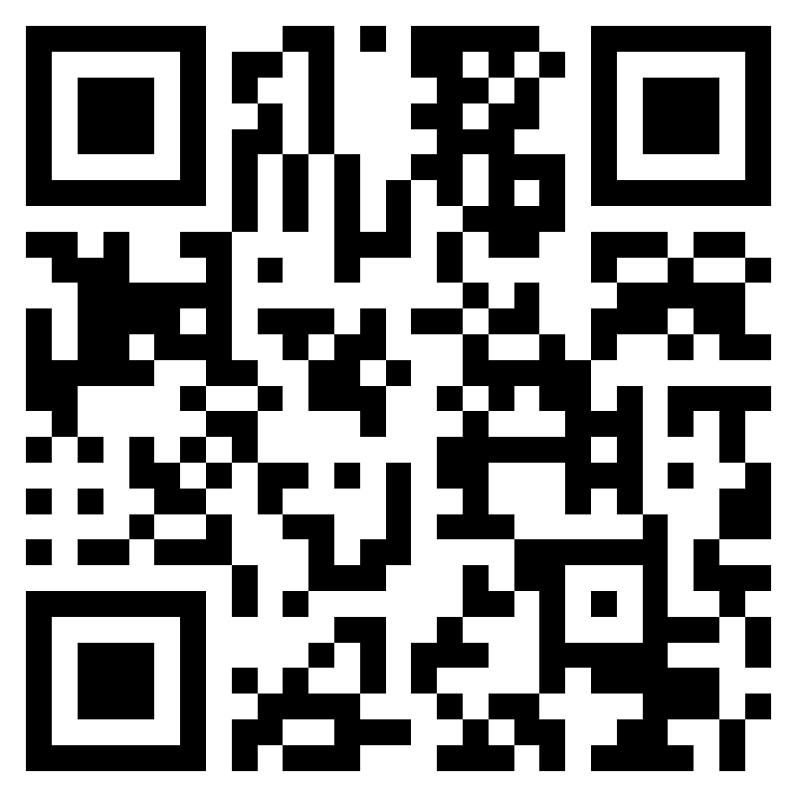
Further Questions
If you have a question that hasn't been addressed, please ask away in the QR code.
All responses will be published in next weeks newsletter.

