Slide 1



VCE – HEALTH AND HUMAN DEVELOPMENT
(2025-2029 Study Design)

Slide 2

Focus of Health and Human Development
Focus of HHD:
  EXPANDS HEALTH LITERACY
  IMPROVE YOUR OWN HEALTH & WELLBEING
  IMPROVE THE HEALTH & WELLBEING OF OTHERS
  EVALUATE AND INTERPRET INFORMATION
School Office
Gymnasium
Sports grounds

Slide 3
INTRO
UNIT 1 & 2
  UNIT 1: Understanding health and wellbeing
  UNIT 2: Managing health and development

Slide 4

Unit 1 - Understanding health and wellbeing
AREA OF STUDY 1
  Concepts of Health
TOPICS
    Dimensions of health and wellbeing
    Health status of Australia’s youth
    Indigenous health and wellbeing
    Factors influencing health outcomes
School Office
Gymnasium

Slide 5
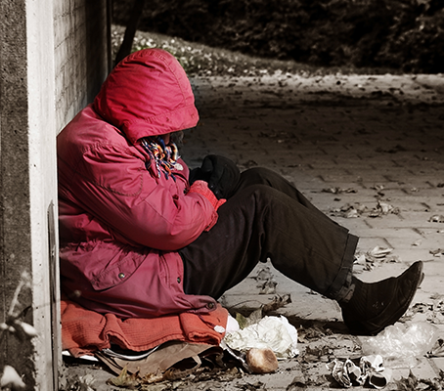
Unit 1 - Understanding health and wellbeing
AREA OF STUDY 2
  Youth health and wellbeing
WRITTEN-REPORT
  Students conduct independent research based on one area focus, that relates to a youth health problem or concern.
School Office
Gymnasium
Sports grounds outside Gym
Sports grounds

Slide 6

Unit 1 - Understanding health and wellbeing
AREA OF STUDY 3
  Health and Nutrition
TOPICS
    Macronutrients
    Micronutrients
    Nutritional imbalances
    Food selection models/tools
    Health promotion
    Food marketing tactics
    Food trends
    Factors influencing dietary behaviours
School Office
Sports grounds outside Gym
Sports grounds

Slide 7
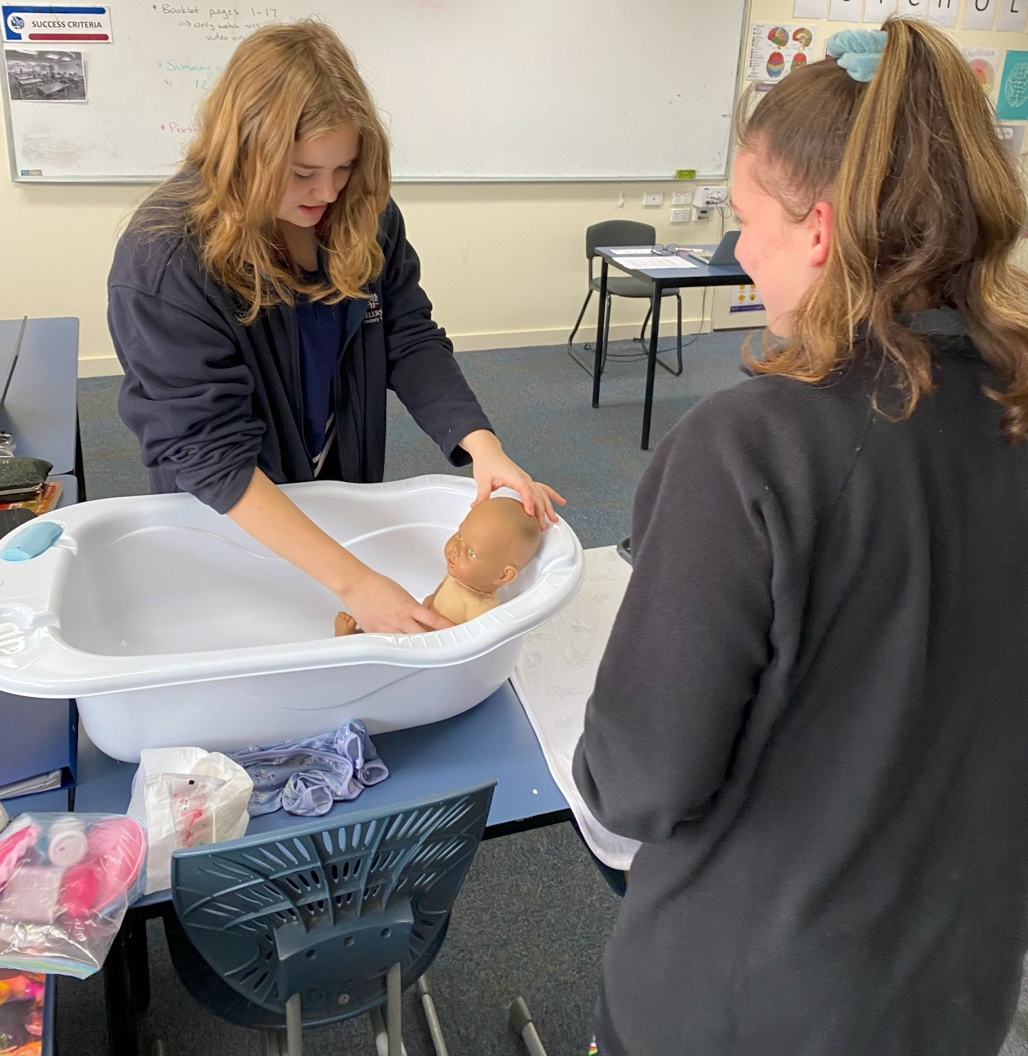
Unit 2 - Managing health and development
AREA OF STUDY 1
  Developmental transitions
TOPICS
    Developmental milestones across the human lifespan
    Fertilisation and prenatal development
    Factors influencing prenatal development
    Development in infancy and childhood
    Early life experiences
    Parent responsibilities, programs and services
    Healthy/unhealthy relationships
School Office
Gymnasium
Sports grounds

Slide 8

Unit 2 - Managing health and development
AREA OF STUDY 2
  Youth Health Literacy
TOPICS
  Medicare
  Pharmaceutical Benefits Scheme
  National Disability Insurance Scheme
  Private Health Insurance
  Factors influencing access to health services and information
  Privacy and confidentiality of health information/data
  Emerging health procedures and technologies
School Office
Gymnasium
Sports grounds

Slide 9
Unit 1 & 2 Assessment
Unit 1:
Assessment Task 1 – Structured Questions
Assessment Task 2 – Written Report
Assessment Task 3 – Case Study Analysis
Unit 1 Exam
Unit 2:
Assessment Task 1 – Structured Questions
Assessment Task 2 – Extended Response
Unit 2 Exam
School Office
Gymnasium
Sports grounds outside Gym
Sports grounds

Slide 10

Unit 3 - Australia’s health in a globalised world
AREA OF STUDY 1
  Understanding health and wellbeing
TOPICS
    Dimensions of health and wellbeing
    Health as a resource
    Factors influencing health outcomes
    Health status of vulnerable population groups within Australia
School Office
Gymnasium

Slide 11

Unit 3 - Australia’s health in a globalised world
AREA OF STUDY 2
  Promoting health in Australia
TOPICS
    Biomedical approach
    Public health approach
    Australia’s health system
    Health promotion initiatives
School Office
Gymnasium

Slide 12
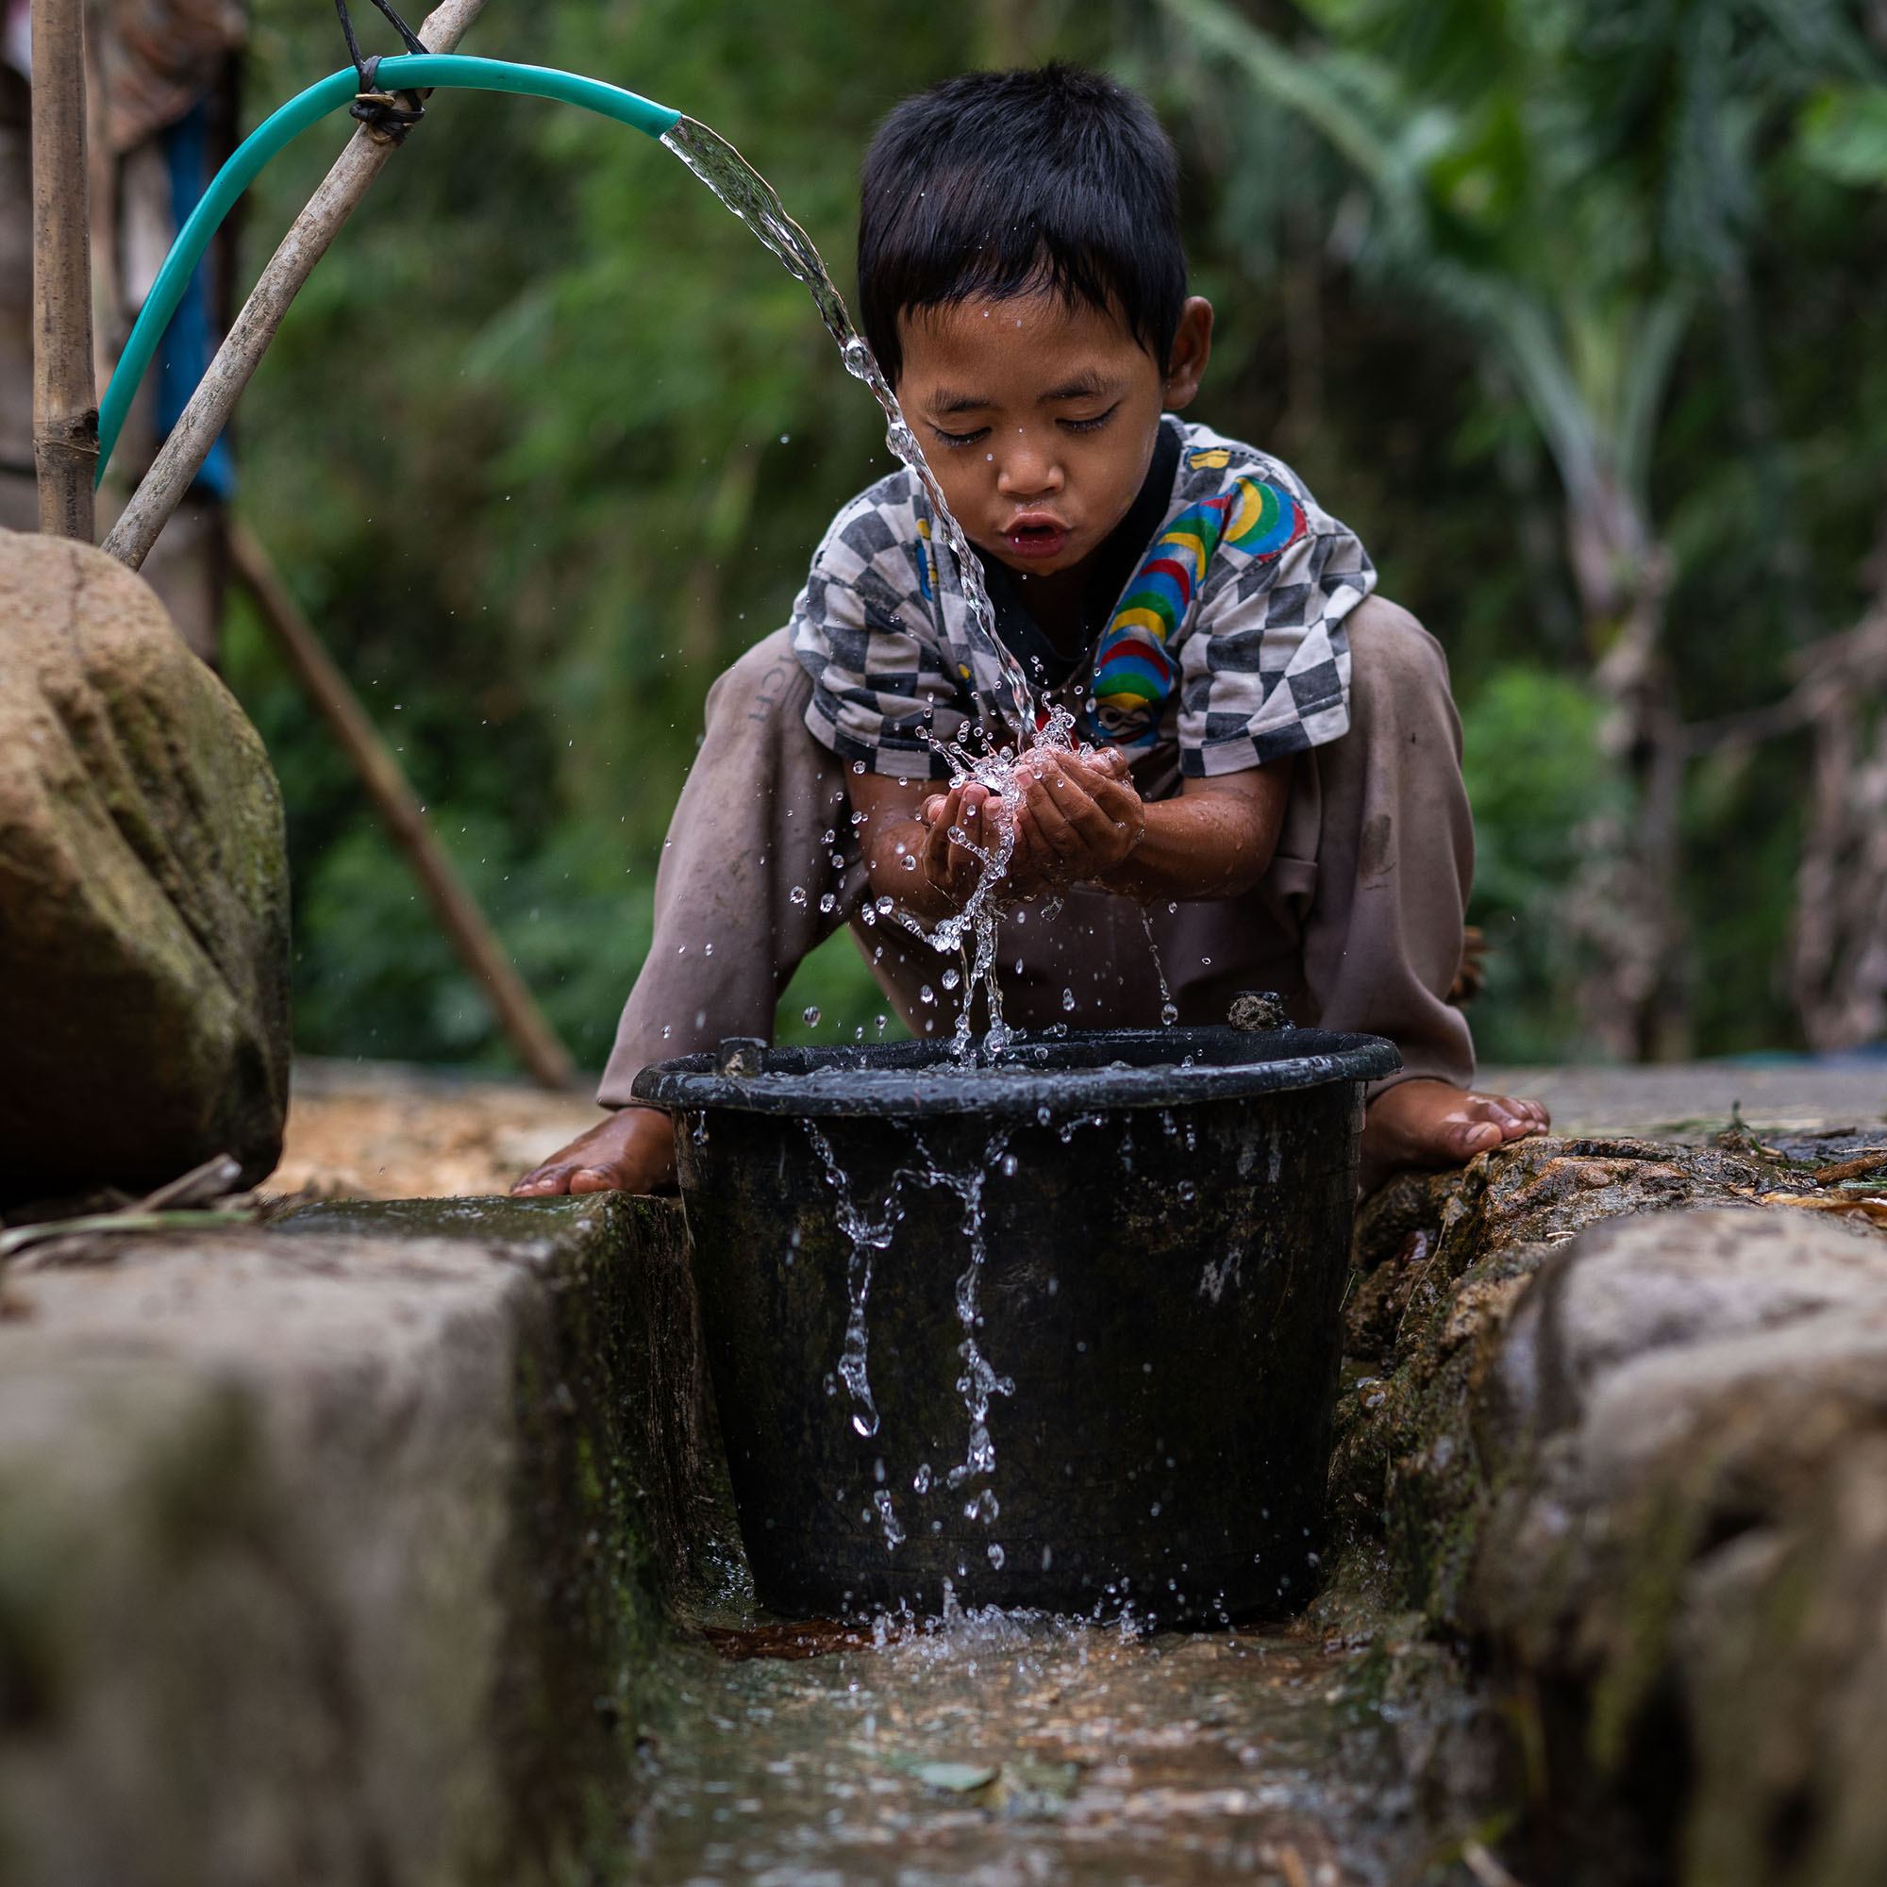
Unit 4 - Health and human development in a global context
AREA OF STUDY 1
  Health and human development in a global context
TOPICS
  Characteristics of high-, middle- and low-income countries
  Factors contributing to global health differences
  Global trends
  Human development
  Sustainability
School Office
Gymnasium
Sports grounds outside Gym
Sports grounds

Slide 13

Unit 4 - Health and human development in a global context
AREA OF STUDY 2
  Health and the Sustainable Development Goals
TOPICS
    Work of World Health Organisation (WHO)
    Types of aid
    Role of NGO’s (e.g. World Vision, Oxford, red Cross etc.)
    Australia’s aid program
    Features of effective aid programs
School Office
Gymnasium
Sports grounds outside Gym
Sports grounds

Slide 14
Unit 3 & 4 Assessment
Unit 3:
Assessment Task 1 – Structured Questions (Part A)
Assessment Task 2 – Structured Questions (Part B)
Assessment Task 3 – Written Report
Unit 4:
Assessment Task 1 – Structured Questions
Assessment Task 2 – Extended Response
Unit 3 & 4 Exam
School Office
Gymnasium
Sports grounds outside Gym
Sports grounds

Slide 15
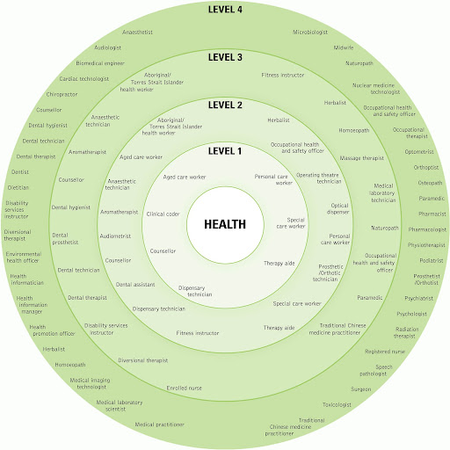
Leads to…
There are many job opportunities in the health industry.
Many healthcare professionals have moved towards a holistic health approach that takes all aspects of health and wellbeing into account.
School Office
Gymnasium
Sports grounds outside Gym
Sports grounds

Slide 16
CONTACT US…
For more information contact:
  Ms Mandarino Email: melissa.mandarino@education.vic.gov.au

