Slide 1

Struggling with sums?
No need for pretence,
Come get some help, from miss offer and pence
Drop-In Centre – TUESDAY AND FRIDAY 8.00-8.30am. (Years 7,8 & 9) C1

Slide 2
Got a test coming up?
There’s no need to pray, come along to the centre, there’s help there today.
Drop-In Centre – TUESDAY AND FRIDAY 8.00-8.30am. (Years 7,8 & 9) C1

Slide 3
Need some extra support?
Come along with a buddy,
Tuesday’s and Thursday’s,
8am study.
Drop-In Centre – TUESDAY AND FRIDAY 8.00-8.30am. (Years 7,8 & 9) C1

Slide 4
want to nail the test?
You need to improve?
The maths drop-in centre, is your next best move.
Drop-In Centre – TUESDAY AND FRIDAY 8.00-8.30am. (Years 7,8 & 9) C1

Slide 5
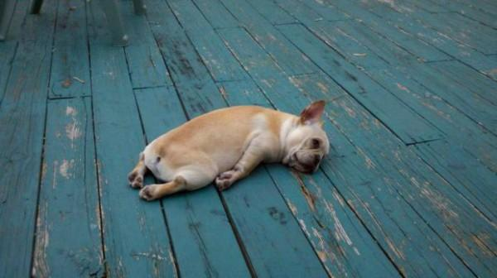
Me doing algebra
Drop-In Centre – TUESDAY AND FRIDAY 8.00-8.30am. (Years 7,8 & 9) C1

Slide 6

Me: just hide at the back of class, no one will notice other me: no, go to math’s drop-in centre
Drop-In Centre – TUESDAY AND FRIDAY 8.00-8.30am. (Years 7,8 & 9) C1

Slide 7

When you the only one in the room to see the solution
Drop-In Centre – TUESDAY AND FRIDAY 8.00-8.30am. (Years 7,8 & 9) C1

Slide 8

When you have a test coming up, but then you remember you’ve been coming to maths drop-in centre
Drop-In Centre – TUESDAY AND FRIDAY 8.00-8.30am. (Years 7,8 & 9) C1

Slide 9

What do you mean?
Maths drop-in?
Drop-In Centre – TUESDAY AND FRIDAY 8.00-8.30am. (Years 7,8 & 9) C1

Slide 10

Right, Who’s turn is it to answer the question?
Drop-In Centre – TUESDAY AND FRIDAY 8.00-8.30am. (Years 7,8 & 9) C1

