Slide 1
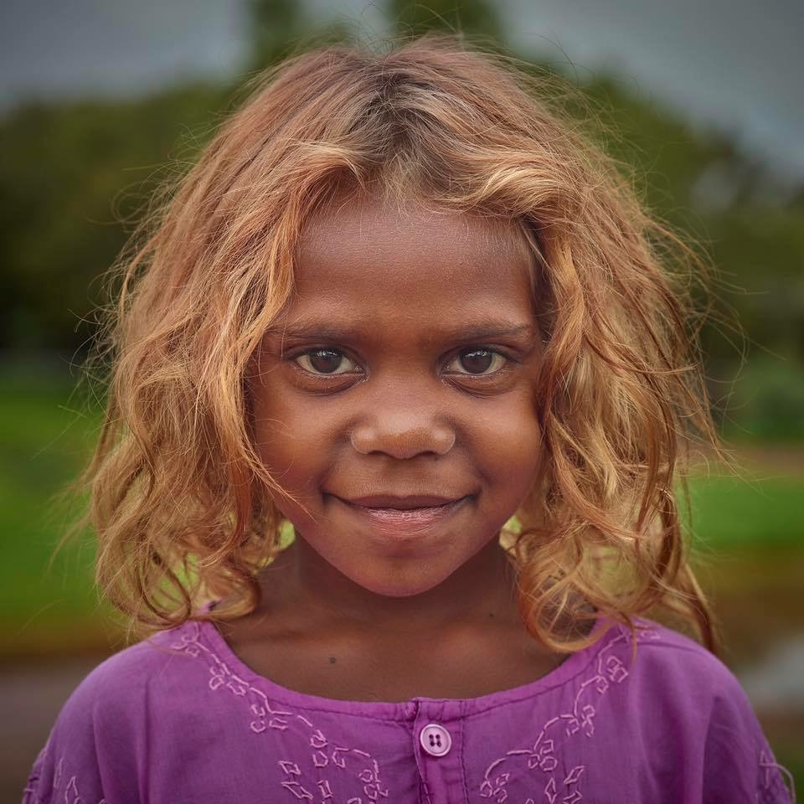
Charity
Proudly Sponsored By:
Fundraising Day
Friday 14th September 2018
putting smiles on the faces of kids in need

Slide 2
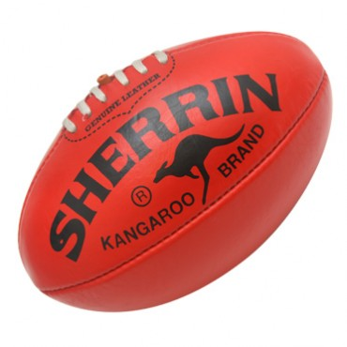
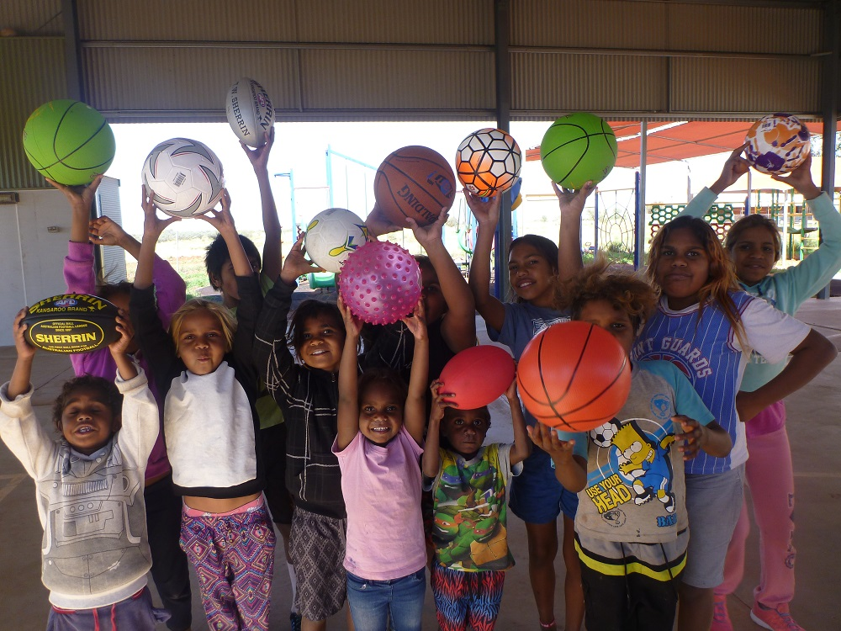
On Friday 14th September 2018, be part of a fantastic fundraising event day at your school for an exciting charity called the “Have a Ball Foundation”.
We would appreciate if all kids from St Bede’s College Mentone could please bring in:
A new ball OR a very good condition used ball OR a gold coin donation.
All balls can be of any type of sporting balls as pictured in this brochure.
All donated sporting balls will be collected and sent to kids in need in the very remote areas of Australia. Additionally, 100% of all gold coin donations raised as part of this event will be distributed to a number of remote schools and communities to assist with a number of projects related to the education, health and well-being of Indigenous kids.
We look forward to a successful day and appreciate your support in bringing smiles on the faces of many kids in remote outback schools and supporting the health and well being of indigenous Australians.
Have a Ball Foundation
The ‘Have a Ball Foundation’ was established to put smiles on the faces of young indigenous children by providing sporting balls to schools and communities in remote areas of outback Australia and to encourage a healthy, active, and fun sporting life as well as raise money to support their health and well-being.
The foundation seeks assistance from well-established schools to participate in holding a “bring a ball’ event day, where children can either donate a new or good condition ball or a gold coin.
putting smiles on the faces of kids in need

