Slide 1



VCE
History 2024
By Holly Jepson

Slide 2
What is History?
The study of VCE History assists students to understand themselves, others and the contemporary world. It broadens their perspectives by examining events, ideas, individuals, groups and movements. Students of VCE History develop, social, political, economic and cultural understanding of the conditions and features which have helped shape the present.
The study of VCE History equips student to:
enhance their critical thinking
Take an informed opinion on how the past informs the present and future
Contributes to them becoming informed and engaged citizens

Slide 3
Focus of VCE History
Year 11 History: Modern History
Year 12 History: Revolutions
Year 11 and 12 History Cover Different Topics and time in history. They are:

Slide 4
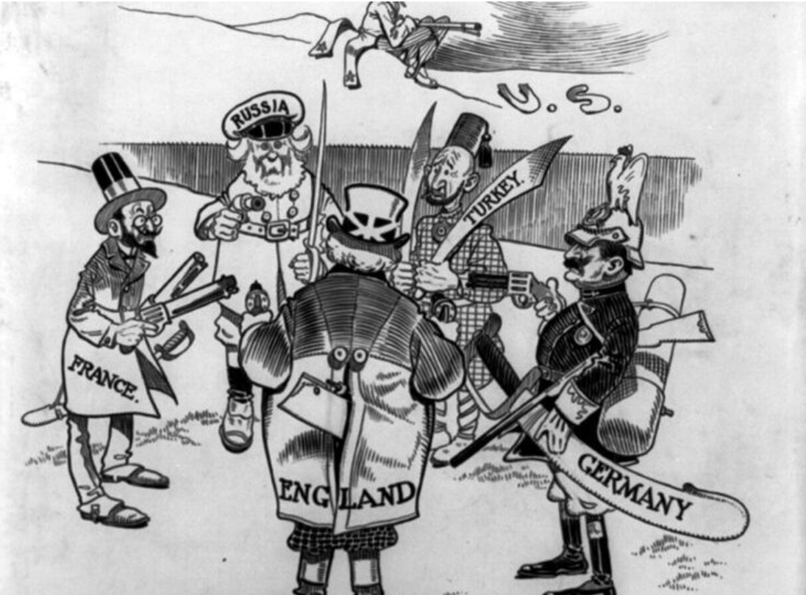
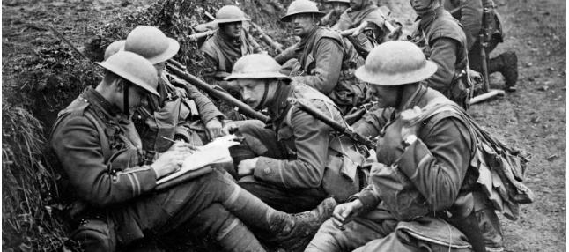
Modern history
Unit 1: Change and conflict
Area of study: Ideology and Conflict
How did significant events and ideas contribute to conflict and change?
How did individuals and movements challenge existing political and economic conditions?
What were the consequences of World War One?
How did ideology influence the emergence of new nation states?
To what extent did the events, ideologies, individuals, movements and new nations contribute to the causes of World War Two?

Slide 5
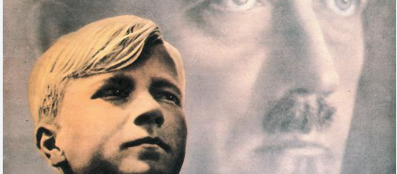
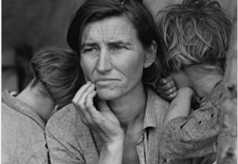
Modern history
Unit 1: Change and conflict
Area of study: Social and cultural change
How did society and culture change?
How did cultural life both reflect and challenge the prevailing political, economic and social conditions?
How did ideologies contribute to continuities and changes in society and culture?
What role did individuals, groups and movements play in social and cultural continuity and/or change?

Slide 6
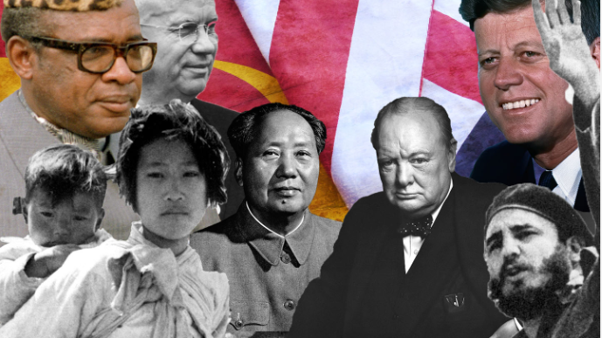
Modern history
Unit 2: The changing world order
Area of Study: Causes, course and consequences of the cold war
What were the causes of the Cold War?
How did Cold War ideology contribute to increased tensions and conflict?
What were the consequences of the Cold War on nations and peoples?
What caused the end of the Cold War?
How did the social, political, economic and cultural conditions influence and change the post-Cold War world?

Slide 7
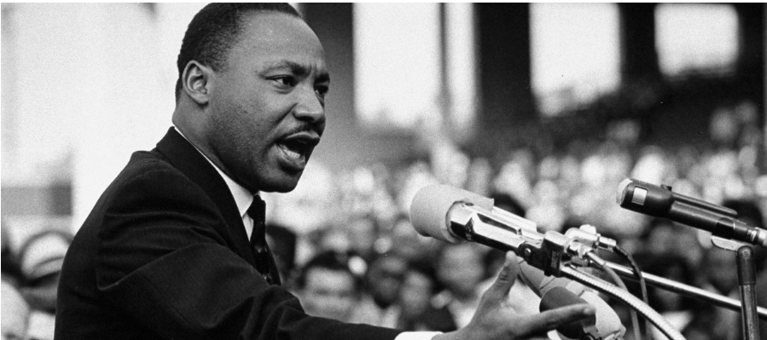
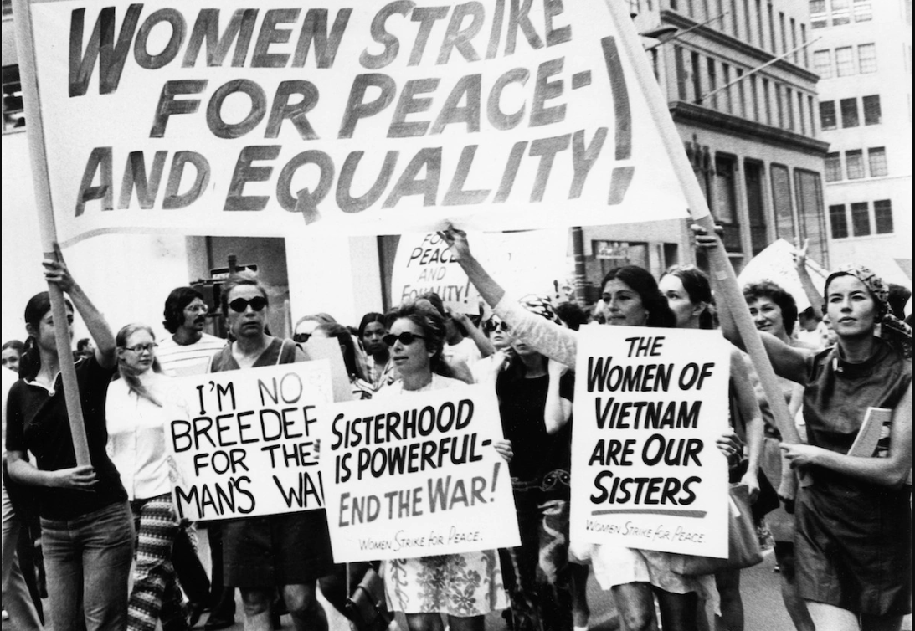
Modern history
UNIT 2: THE CHANGING WORLD ORDER
Area of study: Challenge and Change
What caused the challenges to existing political and/or social structures and conditions?
How did the actions and ideas of popular movements and individuals contribute to continuity and change?
To what extent did change occur?
What were the perspectives and experiences of those who demanded and/or resisted change?

Slide 8
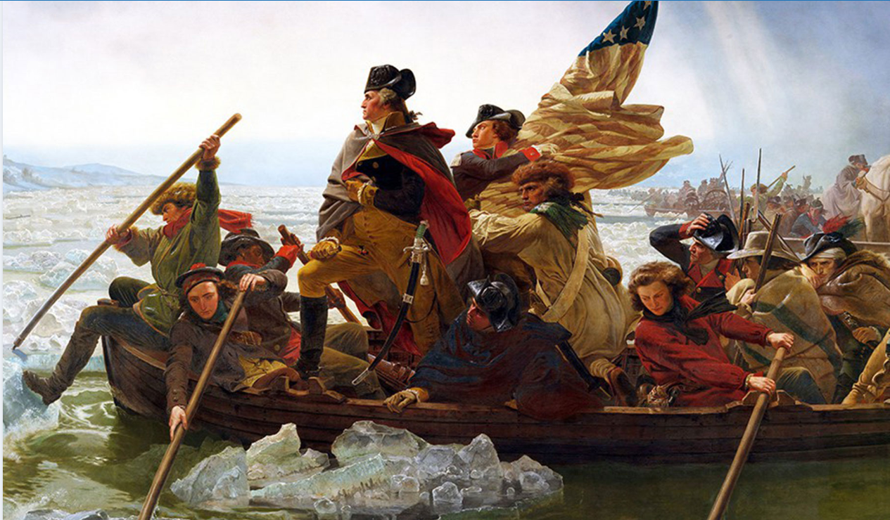
revolutions
Unit 3: the American revolution
Area of Study: Causes of the revolution
What were the significant causes of revolution?
How did the actions of popular movements and particular individuals contribute to triggering a revolution?
To what extent did social tensions and ideological conflicts contribute to the outbreak of revolution?
Area of Study: Consequences of the revolution
What were the consequences of revolution?
How did the new regime consolidate its power?
What were the experiences of those who lived through the revolution?
To what extent was society changed and revolutionary ideas achieved or compromised?

Slide 9
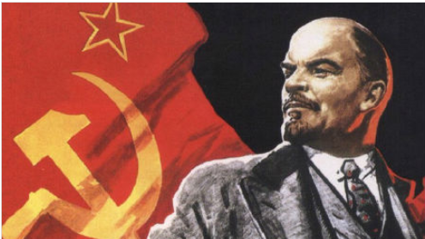
revolutions
Unit 4: The Russian revolution
Area of Study: Causes of the revolution
What were the significant causes of revolution?
How did the actions of popular movements and particular individuals contribute to triggering a revolution?
To what extent did social tensions and ideological conflicts contribute to the outbreak of revolution?
Area of Study: Consequences of the revolution
What were the consequences of revolution?
How did the new regime consolidate its power?
What were the experiences of those who lived through the revolution?
To what extent was society changed and revolutionary ideas achieved or compromised?

Slide 10
Assessment
Assessment tasks are selected from the following:
A historical enquiry​
An essay​
Evaluation of historical sources​
Short answer questions​
Extended responses​
Multimedia presentation

Slide 11

PRIOR KNOWLEDGE AND SKILLS
You do not need any pre-requisite subjects to undertake History units 1 - 4

Slide 12
Career Prospects
Career pathways associated with this subject are:
Academic researcher
Archivist
Heritage manger
Conservation officer
Museum educator officer
Museum/gallery curator
Museum/gallery exhibitions officer
Media
Education
Academic publishing
Politics
Archeologist
Cultural heritage

