Slide 1
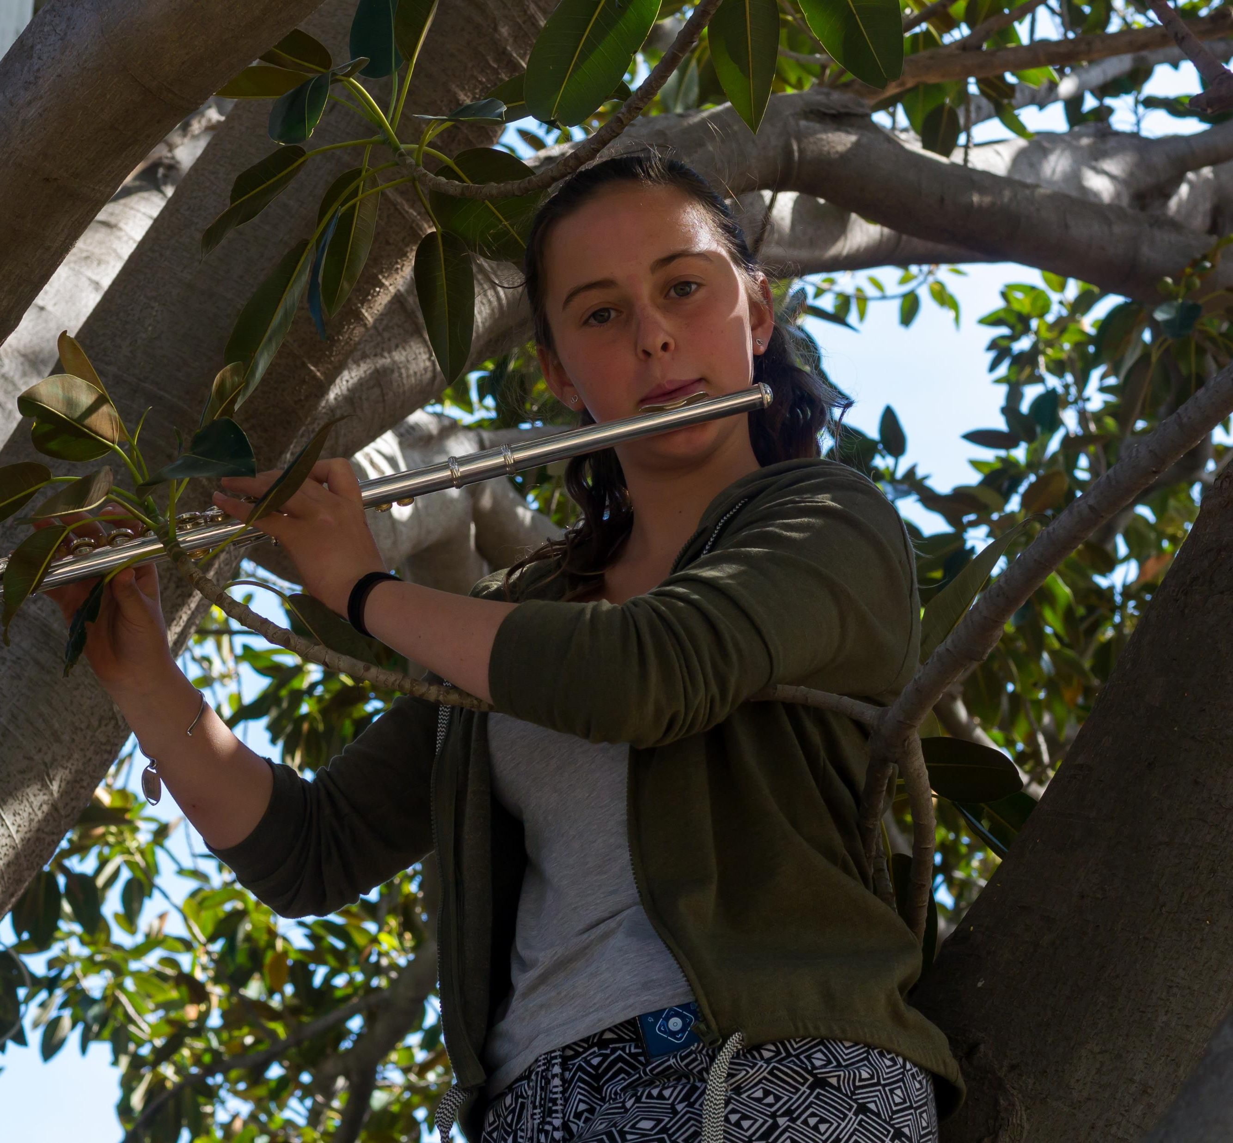
MUSIC CAMP SAVE THE DATE
Term 2, Week2
Friday 5th May (Period 4) till Sunday 7TH MAY (till noon)

