Slide 1











St Thomas More
PARENTS & FRIENDS

Slide 2
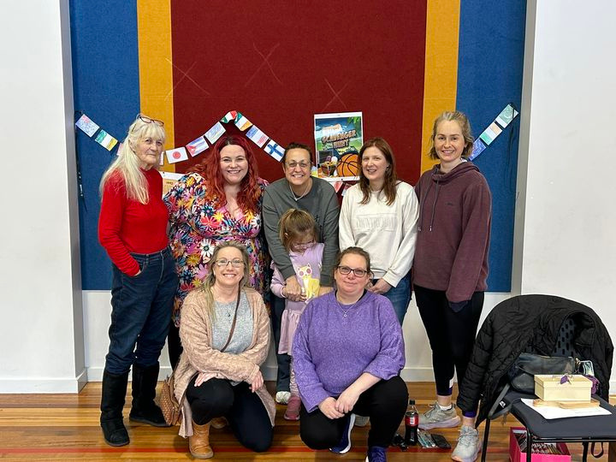
ABOUT US
The Parents and Friends is a group of parents and grandparents who work together to provide fun and engaging events for the school community to enjoy

Slide 3
TYPICAL EVENTS WE HOLD
STALLS
BIG EVENTS
Welcome Back morning tea
Coffee Catch Ups
Raffles
For Mothers day and Fathers day we hold a stall for all students to be able to come and purchase a gift for the significant carers in their life
We try and aim to have 1 or 2 big events through the year.
In 2024 this was a Bunnings BBQ and a Trivia Night

Slide 4
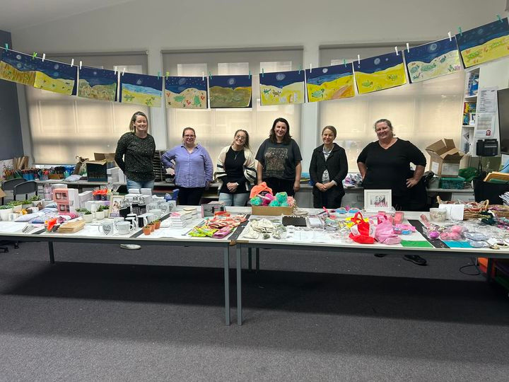
HOW CAN YOU HELP?
  Come to meetings and share ideas
  Help in person at events held by the P&F
  Help behind the scenes of events, emailing, requesting donations, assembling hampers

Slide 5
WE WOULD LOVE YOU TO JOIN US!
Join us for our AGM Monday November 18th, 7pm in the Staff Room

