Slide 1

Navigating Teenage Years
Paul Jeffery
A Clinical Psychologist’s Perspective

Slide 2


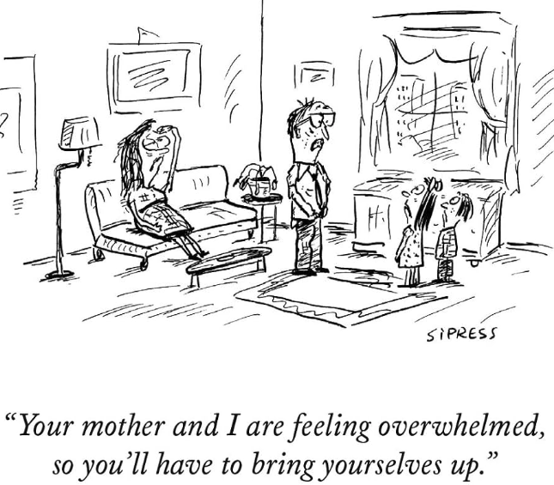
Focus for Today
Developmental perspective.
The important roles of fathers and mothers.
Some of the things that matter and that you can influence.

Slide 3
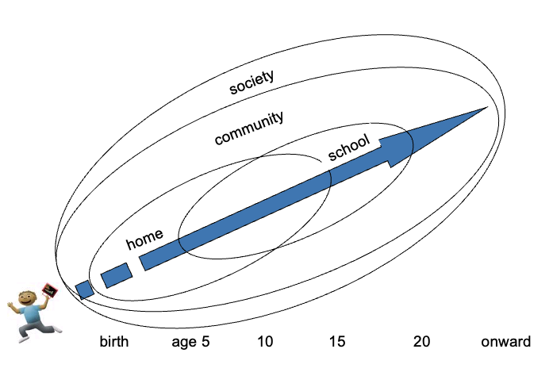
Developmental Trajectory
(Melissa Davis)

Slide 4
Stages of psychosocial development.
A series of conflicts or challenges to master.
Erikson
Industry vs. Inferiority (Primary School)
Finding something to be good at.
Identity vs. Confusion (High School)
Individuation and identity formation
Intimacy vs. Isolation (Young Adult)
Finding a partner
Spending more time with the people you really gel with.

Slide 5
Mums and Dads (earlier influence)
Both matter.
Gender roles / stereotypes have been rightfully challenged.
However Mums and Dads are not necessarily interchangeable. One example.
Earlier attachment crucial for helping build emotional awareness, emotional and behavioural regulation.
Impacts of different roles mediated by biological and social mechanisms. Co-regulation is hugely important.
  Mums – The sensitive, empathic nurturer. Kids learn to regulate emotions like fear, sadness and distress. Oxytocin systems activated in Mo and child
  Dads – The playful explorer. Kids learn to regulate things like excitement and aggression. Learn to explore and separate but also where to draw lines.
Notes:
I grew up in a household with stay at home Mum until age six. Then Mum threw herself into work and forged a very busy and successful career. Dad maintained work and took on lots of the cooking, cleaning, washing and shopping.
There is a pressure on Mums and Dads to be all things to their kids.
This is a reminder that our gender roles have rightfully broken down, however we still strong evidence that Mums and Dads also make some unique contributions.
One example -

Slide 6



Mums and Dads (later)
Metaphors of being more like a Light House or a Shepherd.
  Keeping an overview (create room for individuation and exploration but still aware of what’s going on).
  Kids know where to find you when needed (the Port in the storm)
  Blend of warmth and willingness to set limits and maintain expectations where needed. Embodying values.
  You don't get to design your children!
Notes:
Widely acknowledged that we have to try to take a step back and yet still be present in the teen years.
I'm going to show a brief video by Russell BArkley, a US Psychiatrist and prominant researcher in the ADHD field.
He's going to make a strong case for why it is unhelpful to try to engineer our kids. This is not to say we don't have an important influence. But that helicoptering and snow ploughing is not the answer.

Slide 7
What do I reckon?
What are the skills and capacities we most want to help our kids to develop and where might our influence lie?
Emotional Regulation
Communication
Something to be good at
Social connection (being accepted)

Slide 8
Emotional Regulation
Its not a technique or a strategy
Its how you are in those moments over time (remember co-regulation)
Strong routines and predictability across the day and week.
Rupture and repair – rupture is inevitable, repair is crucial.
Be willing to self reflect and share / own your mistakes

Slide 9
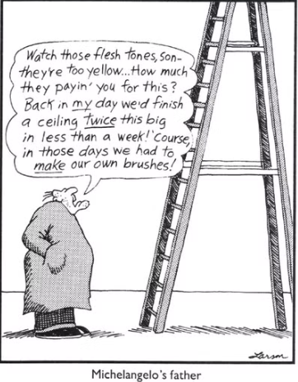
Communication
Be open for business at (nearly) all hours
Create spaces and take an interest (rituals and routines again can help).
Prompting with questions rather than advice
Problem Solving conversations go a long way.
  Understand the issues from their point of view
  Encourage your teen to think of solutions you can all agree on

Slide 10
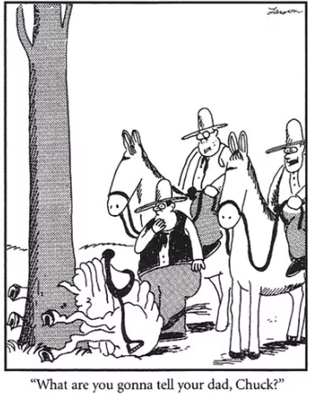
Being Good at Something
NOT hot housing and snowplowing.
  But its also not set and forget.
Promoting competence is about Mastery not Control
  Mastery requires exposure to problems, failure, and learning.
  Mastery can occur in multiple domains
Have to be able to fail and try again.

Slide 11
Social Connection
Making room for individuation and the transfer of energy away from you.
It takes a village to raise a child
Some parents can find it hard to “let go”.
Reflective listening to help navigate social ups and downs.
Modelling of respectful communication and partnership at home.
Letting Go is Healthy

Slide 12
Thank you!
….fatherhood is where you spend your life teaching those that you can’t live without, to live without you
z

