Slide 1
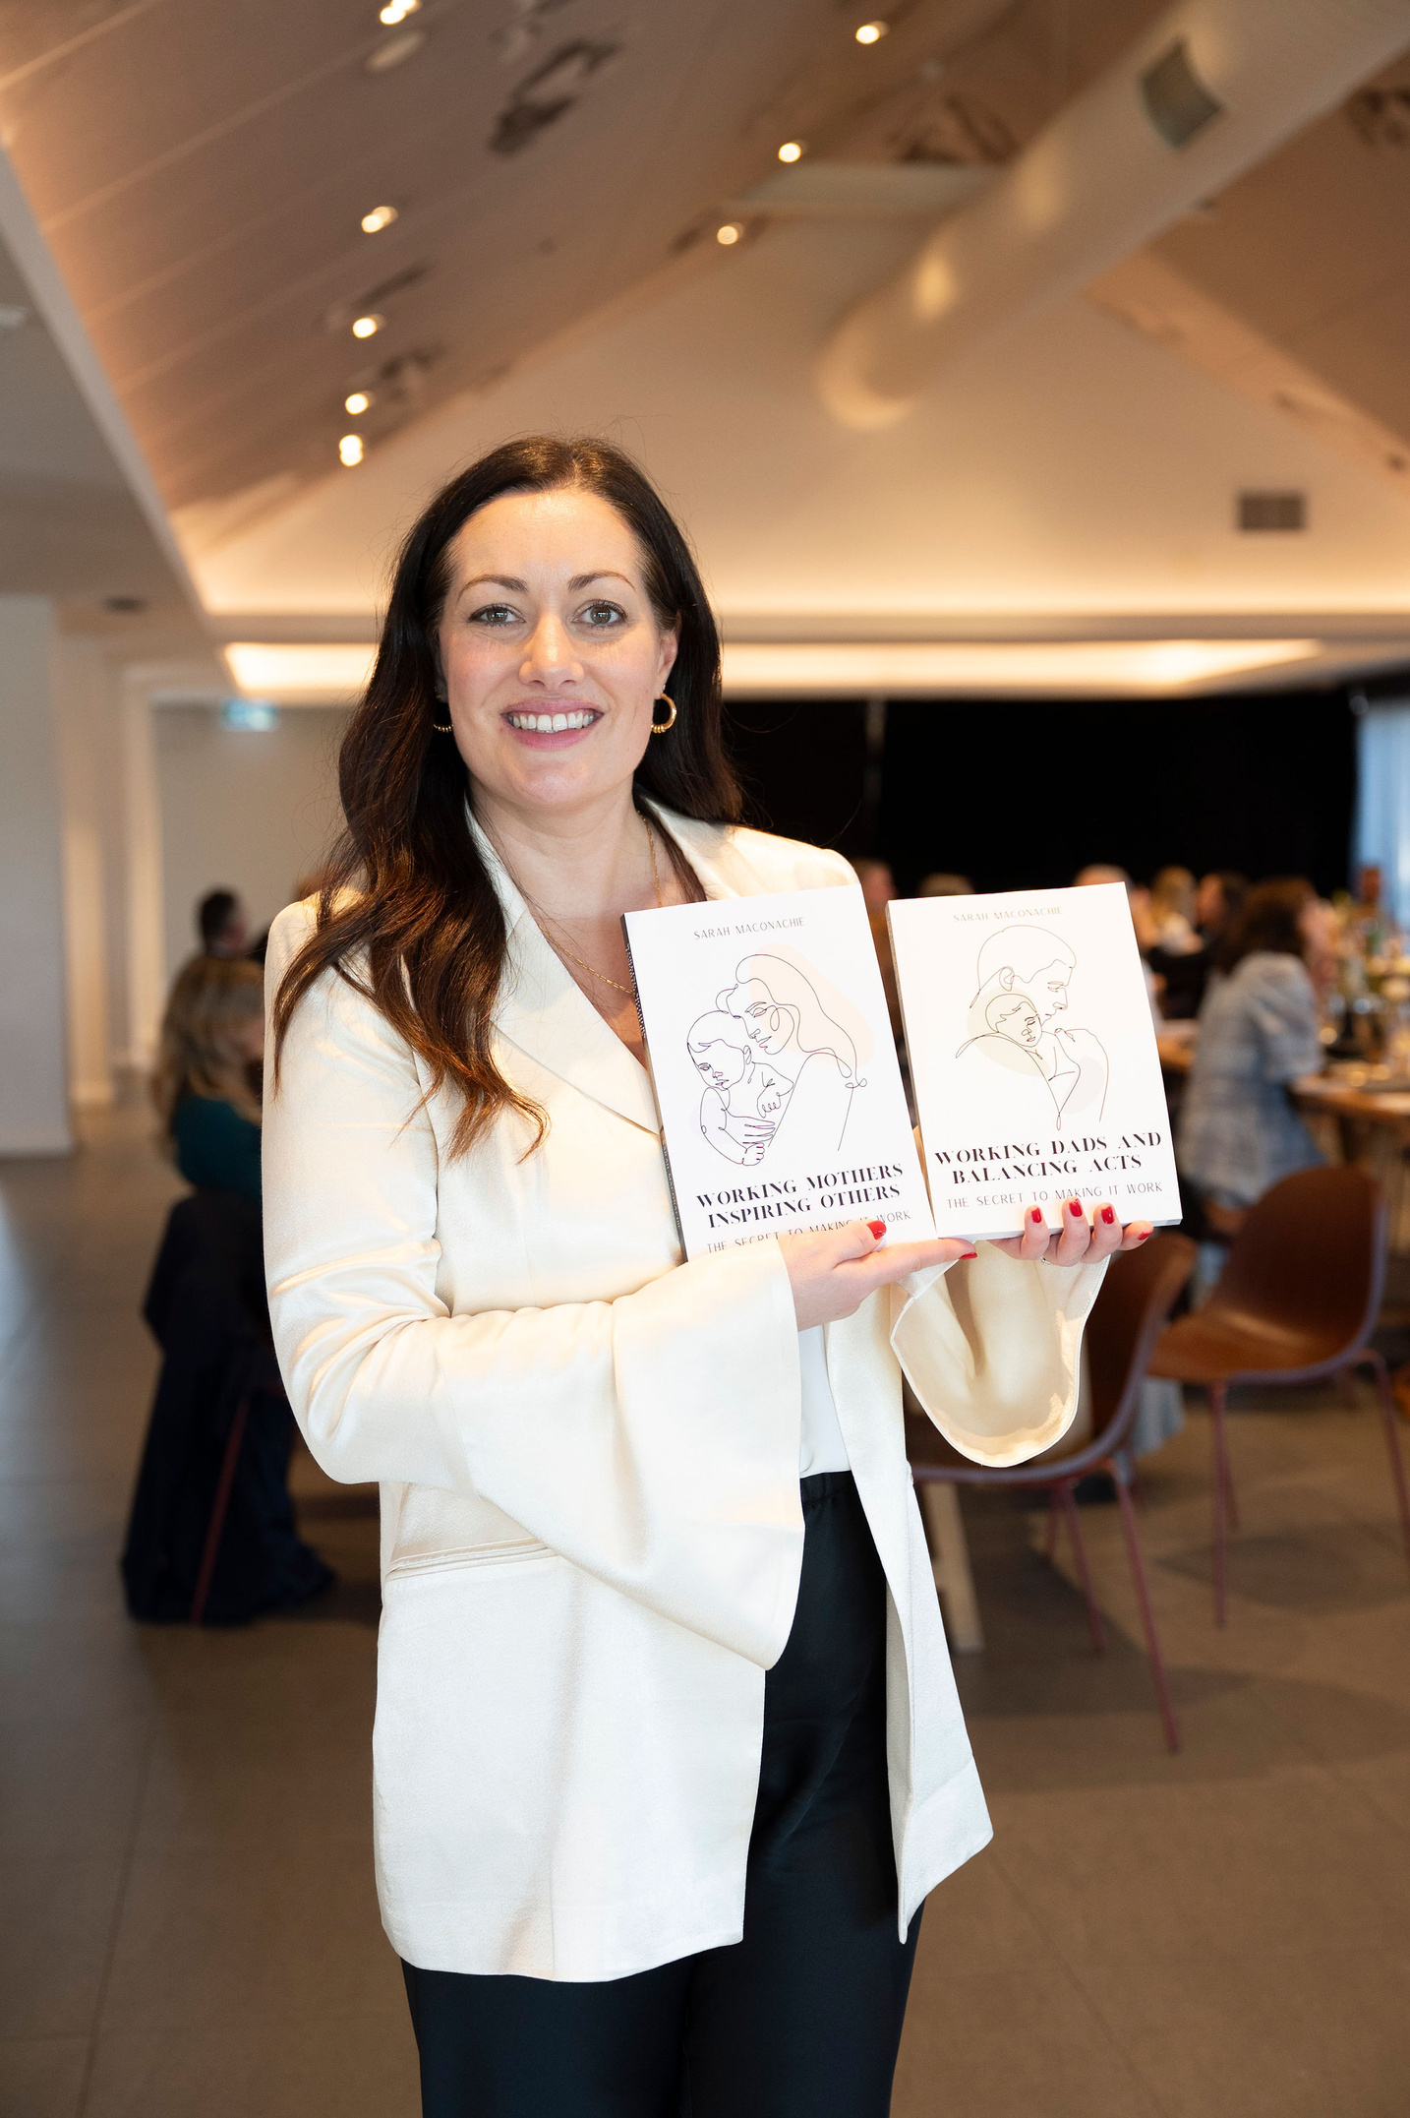
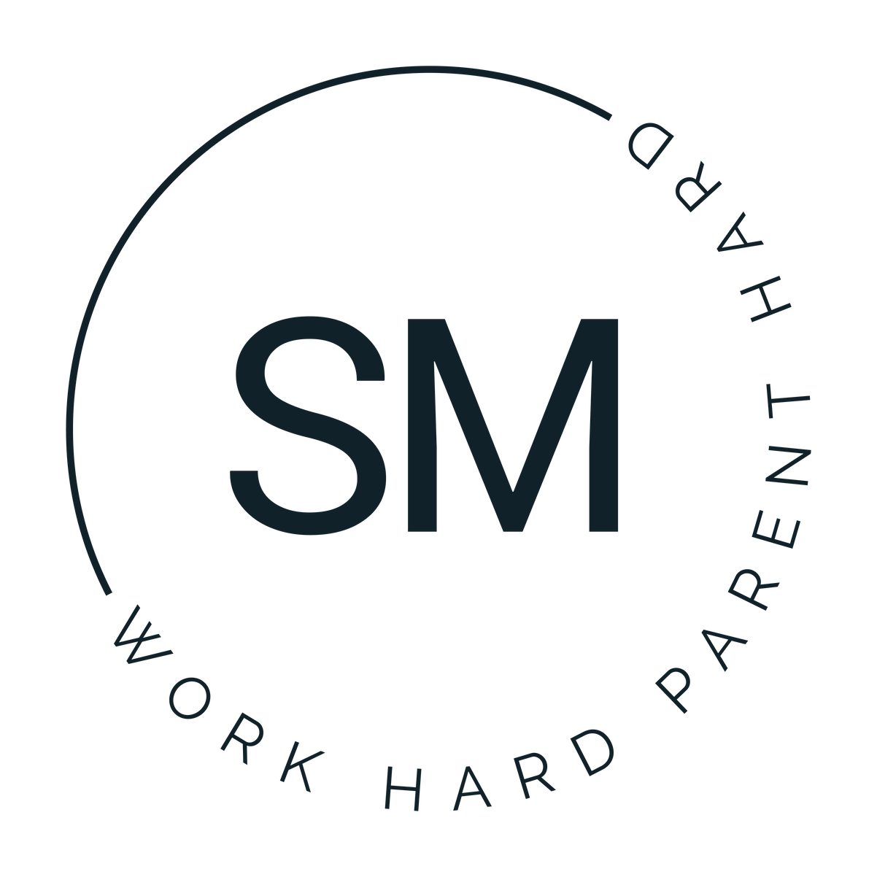



Work Hard Parent Hard
From Playground to Prom
... and the importance of developing a positive mindset!
With
Sarah Maconachie
Our Website
Our Social Media
Our Contact
www.workhardparenthard.com.au
@rworkhardparenthard
0488241154

Slide 2

By the time your child turns 7,
Most of their foundational beliefs about the world, and themselves, and what’s possible for them are already formed.

Slide 3

Children from birth to age 7-8 operate mostly in a theta brainwave state. It’s like hypnosis—they absorb everything around them as truth.
Our subconscious mind accepts whatever we imprint on it, and up until the age of 7 everything that a child sees, hears or feels is accepted into their subconscious as truth.
This becomes the internal operating system they run on into adulthood: beliefs about love, self worth, work, identity, gender roles, money… the list goes on.
Our minds are made up of a conscious mind and a subconscious mind.
Children don’t develop critical thinking skills until age 7-8

Slide 4

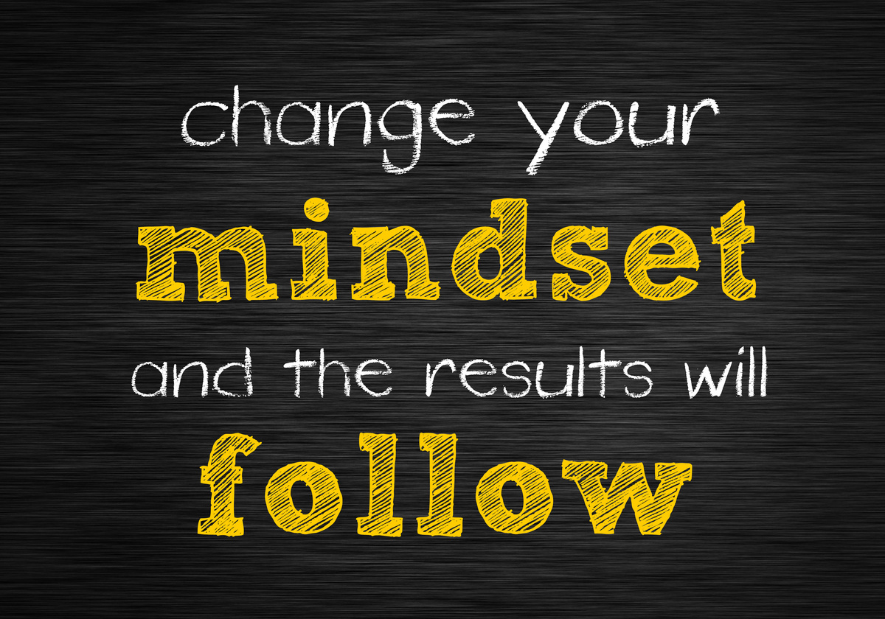

We can override subconscious patterns with repetition, awareness, and conscious modelling of new behaviours.

Slide 5
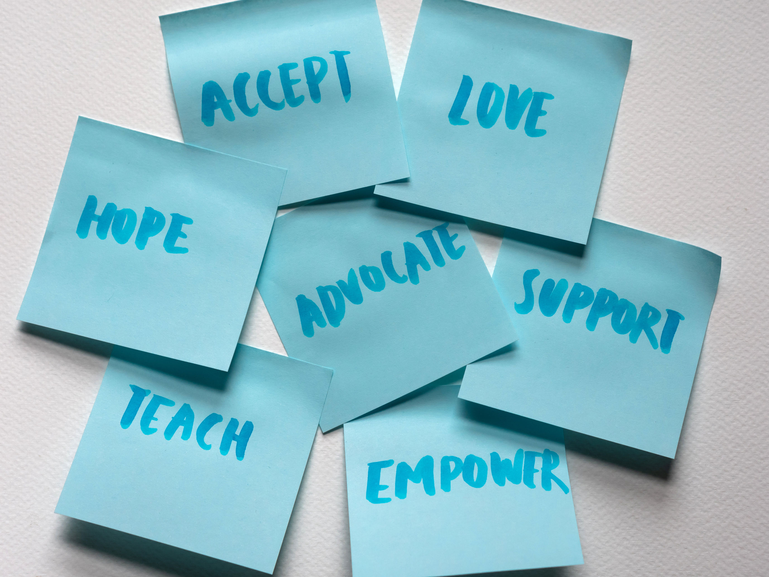
  By age 7, a child has formed 80% of their core beliefs about themselves and the world around them.
  Children model over 70% of their behaviours directly from their primary caregivers.
  Fathers who are actively engaged in conscious parenting raise children with higher emotional intelligence, greater confidence, and more progressive gender perspectives.

Slide 6
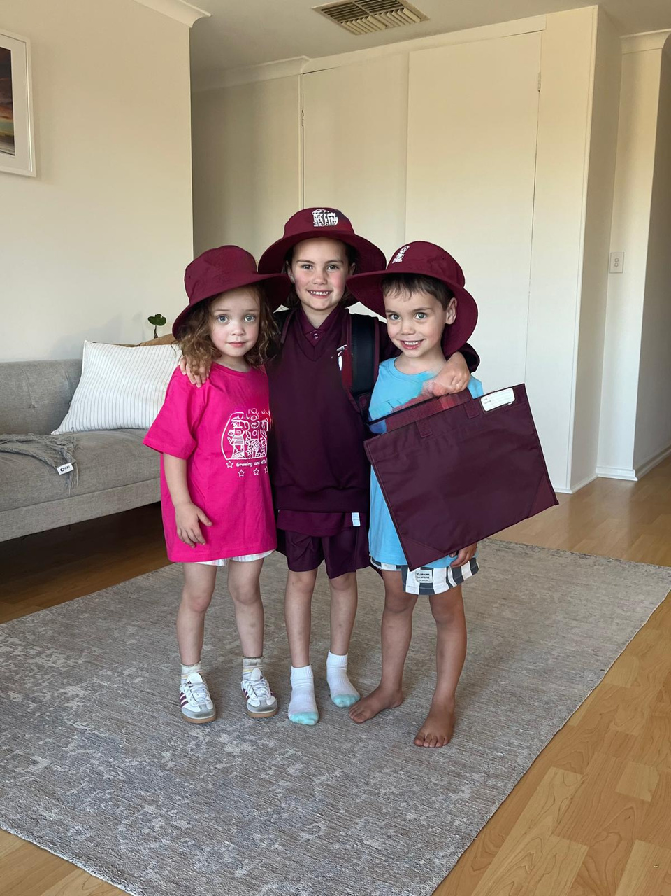

Slide 7
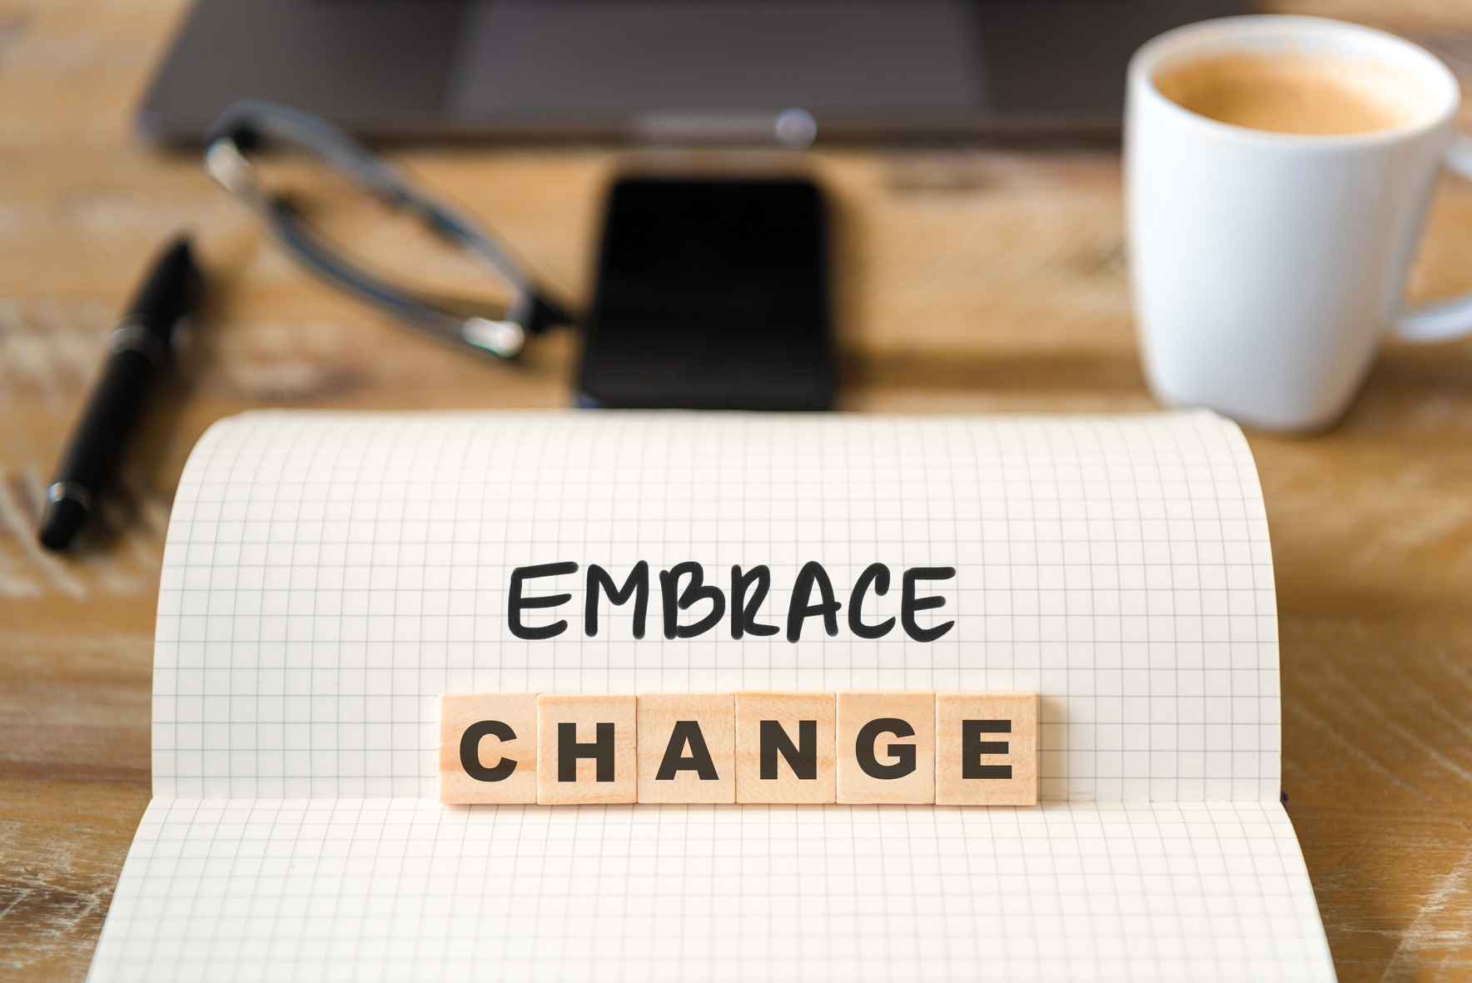
Why does this matter?
We are in an ever evolving world, and if we want to create change we need to make a conscious decision to change the way we think and behave.
As parents we are also wired in a certain way based on our own upbringing and environment so it’s up to us to make a change.
When we have more awareness of it, we can call out outdated stereotypes and biases.

Slide 8

So what can you do today?
Be conscious of your own mindset.
Model what you want to see.
Do the inner work.
  Rewrite the beliefs you inherited that no longer serve you… so you don’t unconsciously pass them on.
You can’t pour from an empty cup—or teach from a broken rulebook.
  Show them what emotional regulation, self-worth, and equality look like.

Slide 9
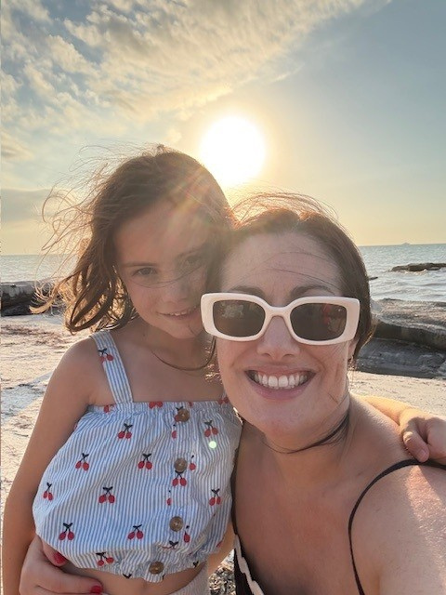
Work Hard Parent Hard
Thank You
Sarah Maconachie
Our Website
Our Social Media
Our Contact
www.workhardparenthard.com.au
@rworkhardparenthard
0488241154

