Slide 1



Slide 2

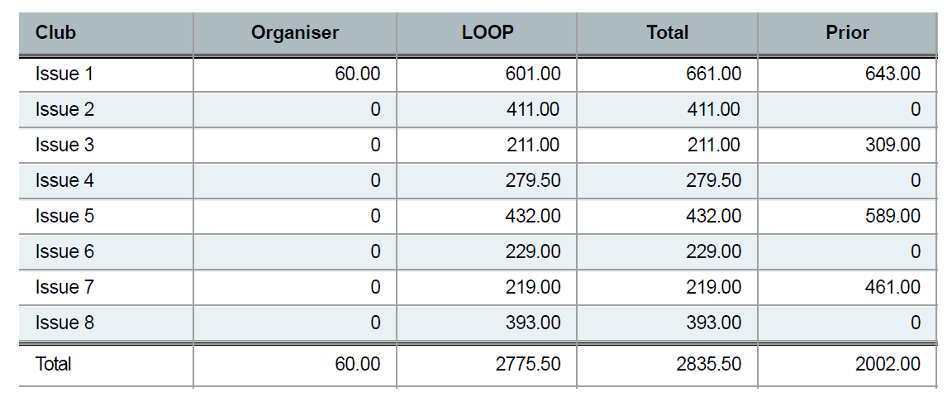
Book Club Summary 2025

Slide 3
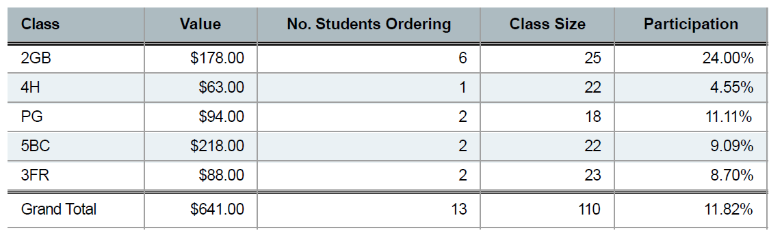
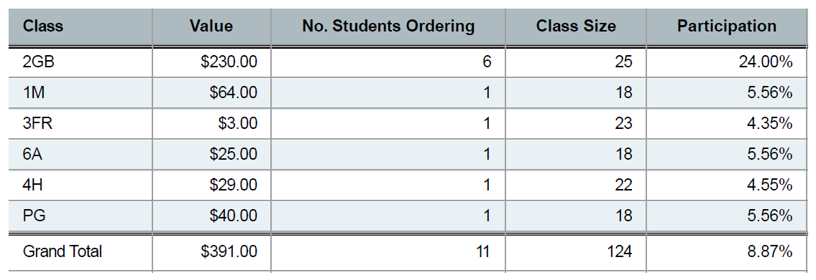
Participation by Class Issue 1 & 2

Slide 4
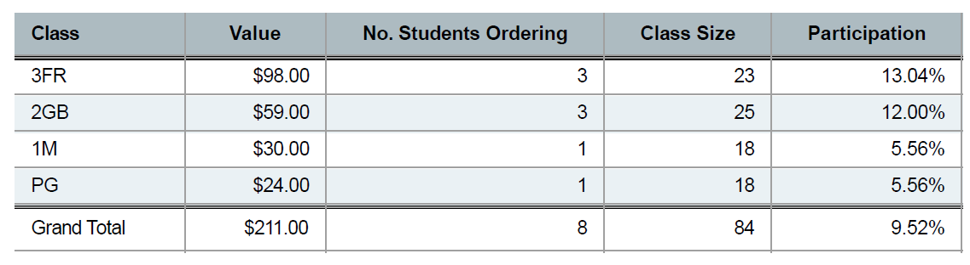
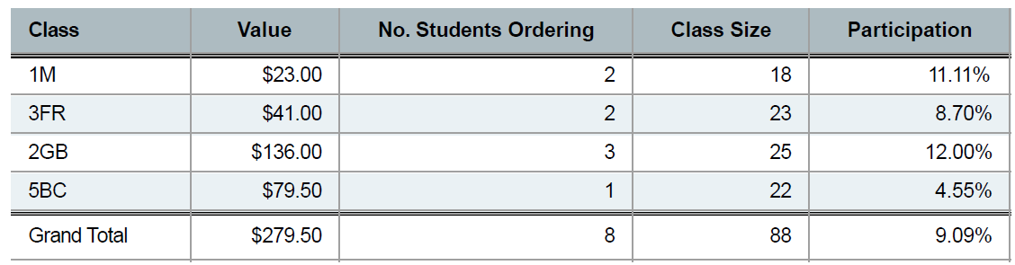
Participation by Class Issue 3 & 4

Slide 5
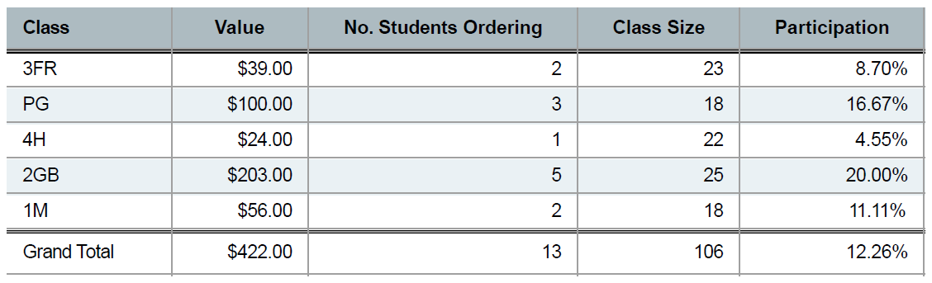
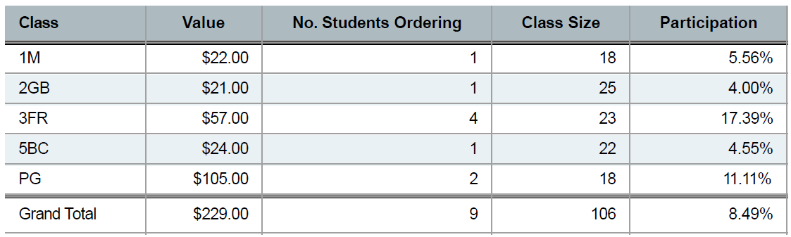
Participation by Class Issue 5 & 6

Slide 6
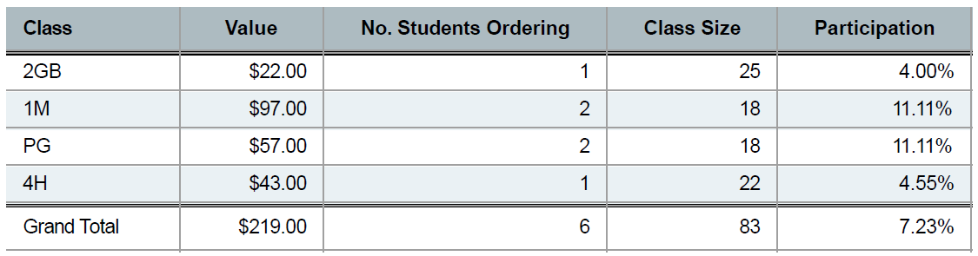
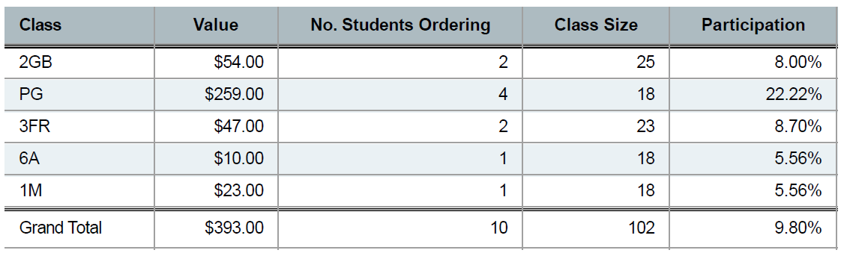
Participation by Class Issue 7 & 8

Slide 7


$425.30
St Roch’s PPS Rewards Earned in 2025

Slide 8



