Slide 1
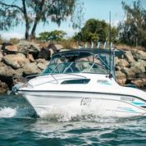
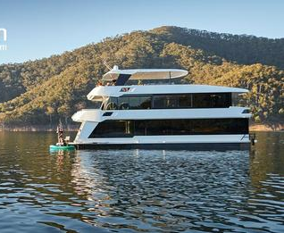
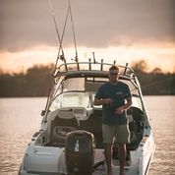
CAREER OPPORTUNITIES IN THE
MARINE INDUSTRY
INDUSTRY IMMERSION DAY
STUDENTS, TEACHERS AND CAREER ADVISORS
MADE, SERVICED AND ENJOYED IN VIC
Victorian Snippets
200,000 registered boats 420,000 Marine Licences $4.5b per annum impact 17,000 jobs Growing demand for boats and boating lifestyle Victoria a manufacturing
strong-hold
TUESDAY 13 SEPTEMBER
9.30am-2.30pm
ROYAL YACHT CLUB of VICTORIA
AND SURROUNDING MARITIME PRECINCT
120 Nelson Place
WILLIAMSTOWN
Next Door to Police Station
Club House Room
Onsite Parking
Victoria is a hotspot for boat building, all of the associated support services, boat sales, marine technologies, marina management, and boating and fishing related careers.
Career opportunities and apprenticeships abound.
Come along and join a host of industry professionals as they display their wares, and welcome you to the waterfront world of the marine industry.
Flexible visit options.
The Boating Industry Association of Victoria invites you.
Please enquire or book via mary@biavic.com.au by Thursday 1 September
GREAT 3 MIN VIDEO
CAREERS GUIDE
Right click to view links

