Slide 1
Medical Imaging
By Shea

Slide 2
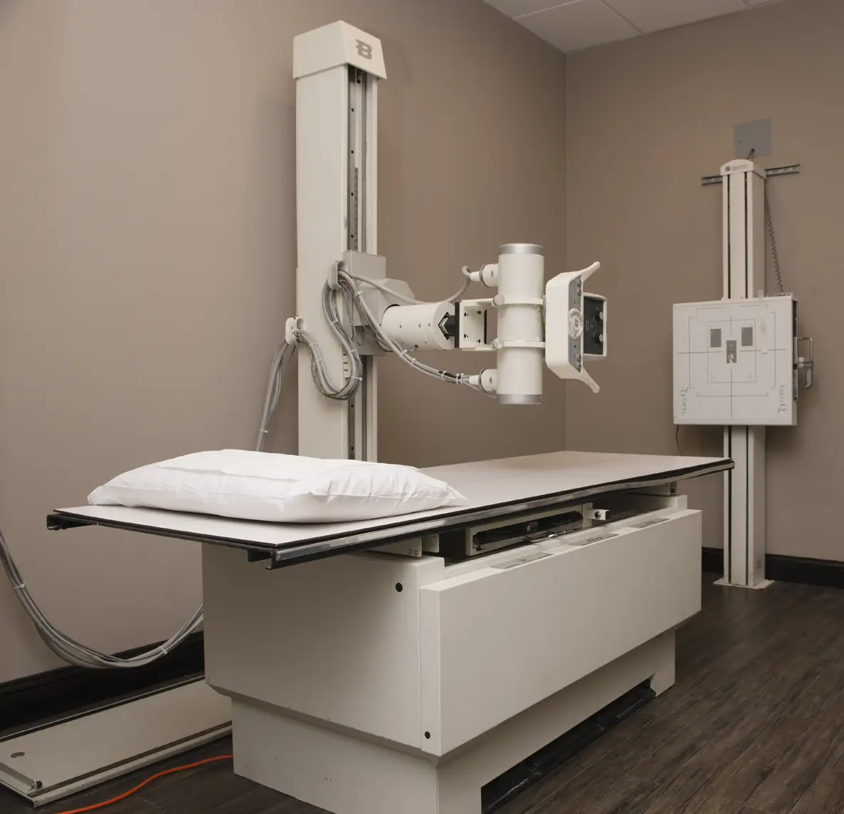
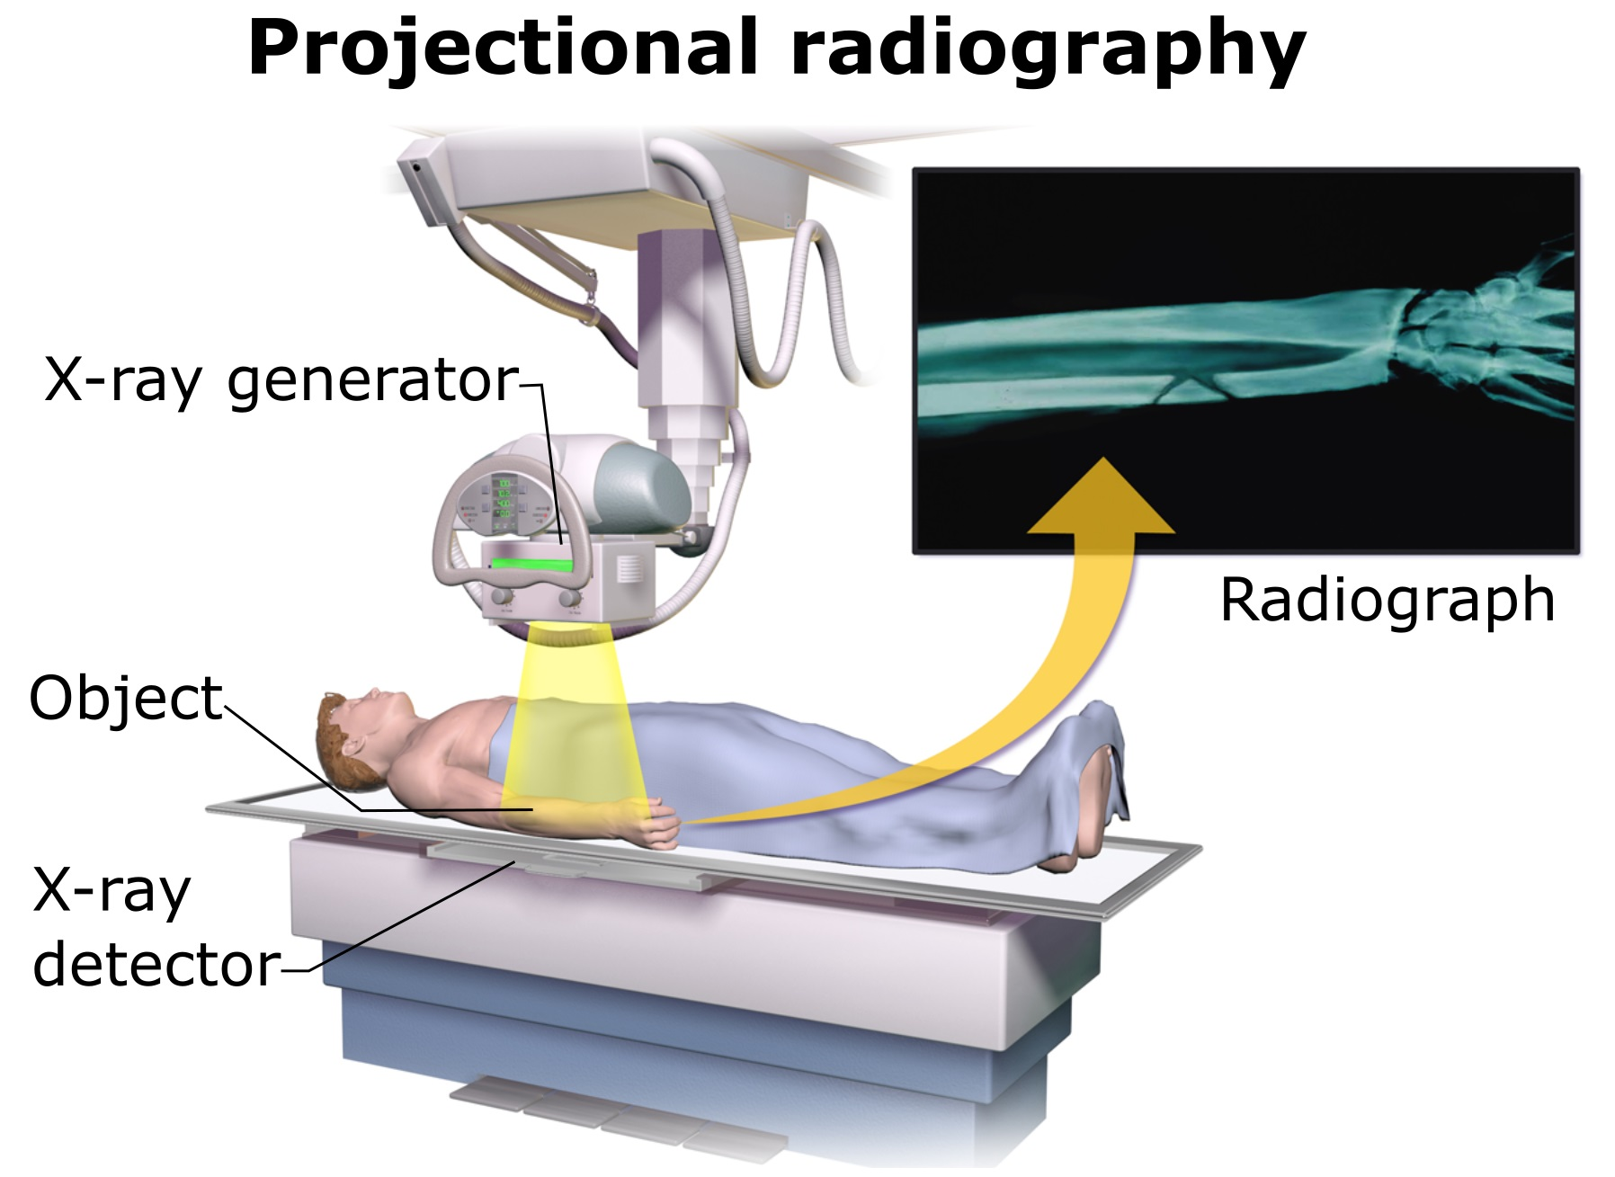
Process of x rays
a negatively charged electrode is heated by electricity and electrons are released
high velocity energy is directed towards a metal plate and collides with the atoms
a cassette holds the film that is exposed by the x-ray
radiation goes through the body
soft tissues cannot absorb the radiation
radiation goes straight through the air in lungs
bones absorb most of the radiation
final x-ray image is called a radiograph

Slide 3
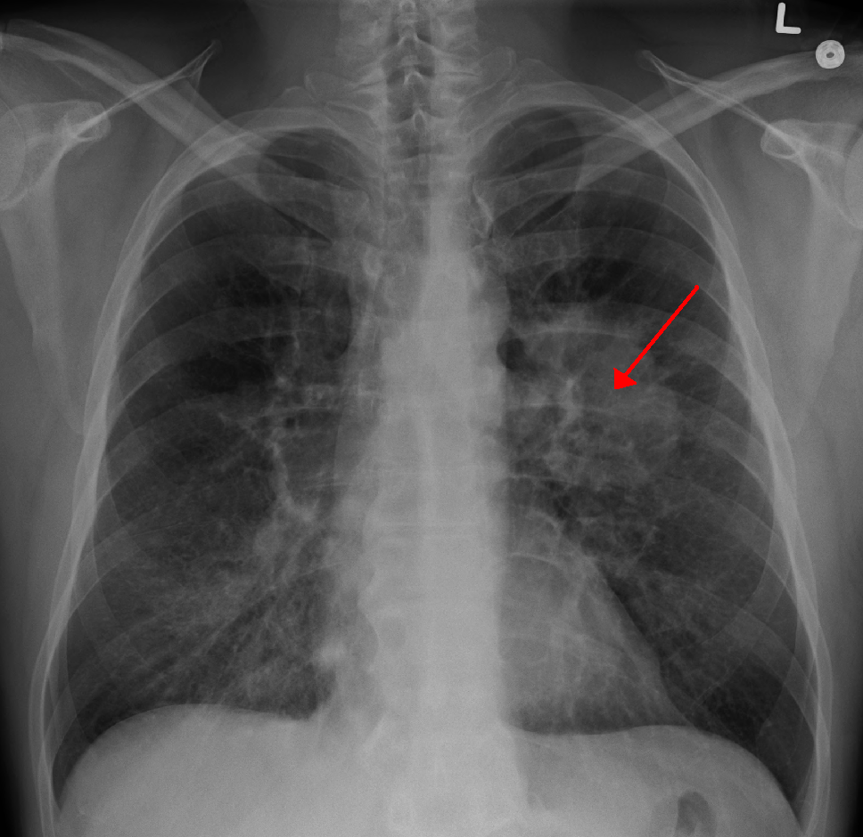
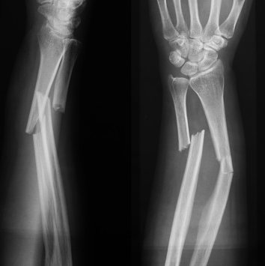
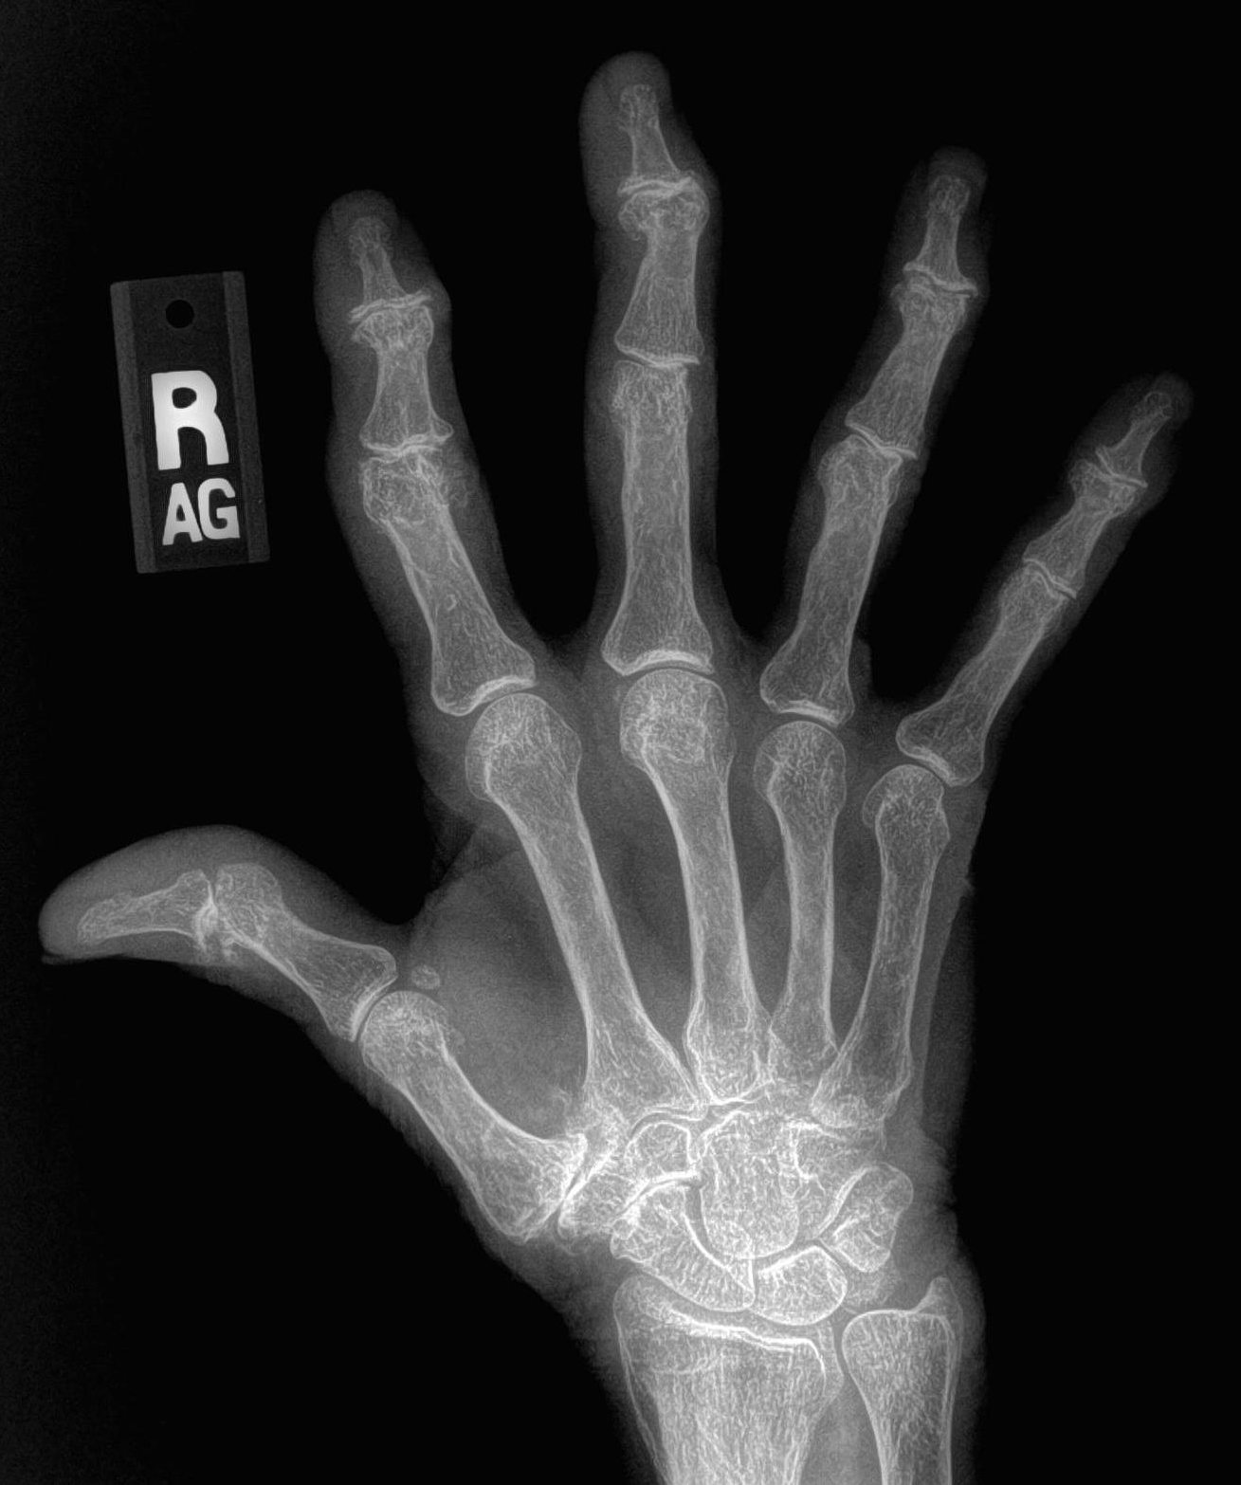
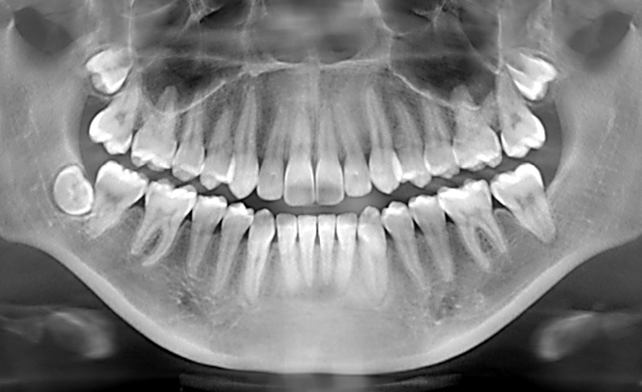
Images x rays capture
Lung cancer
Bones (fracture, break, dislocated joint)
Osteoporosis
Arthritis
Cancers and tumors
Tooth decay
Foreign objects swallowed or lodged in the body
Pneumonia
Fluid and infections in the lungs
Osteoarthritis

Slide 4
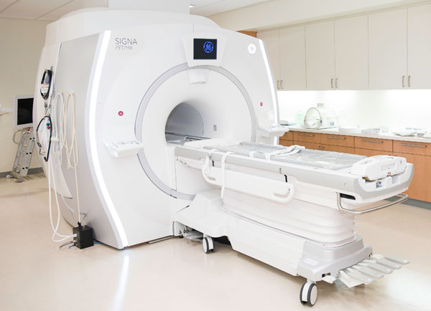
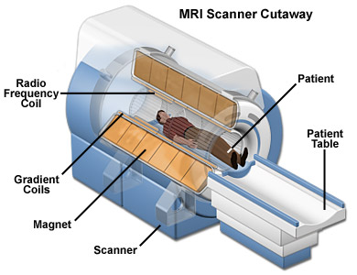
Process of MRIs
magnets create a very strong magnetic field
magnetic field temporarily rearranges the water molecules in the body
magnetic field acts on the protons found in water
computer generated radio waves are directed into the body
radio waves cause the magnetised protons to send out an echo
which a computer organises into images

Slide 5
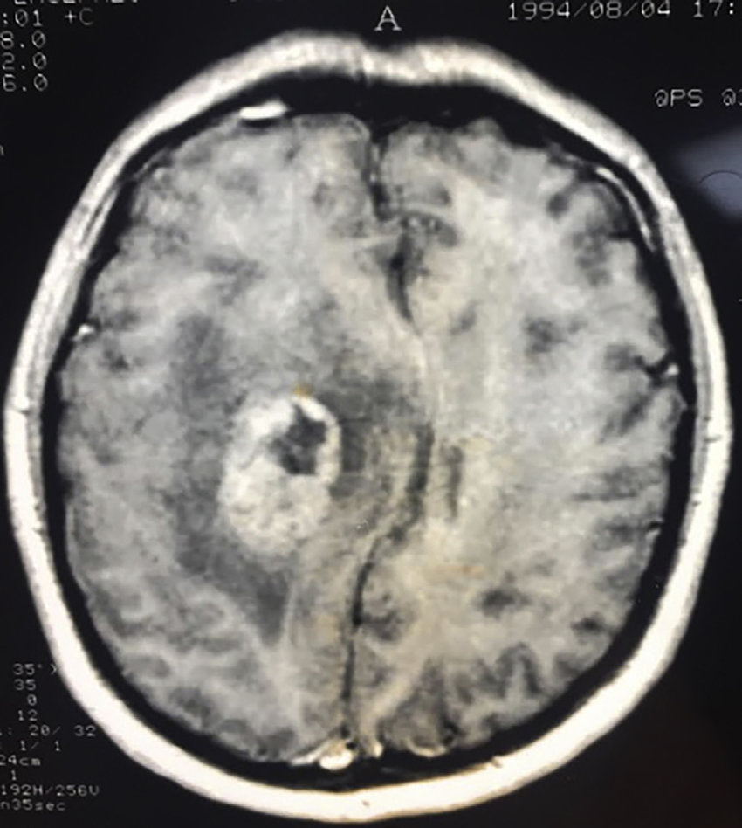
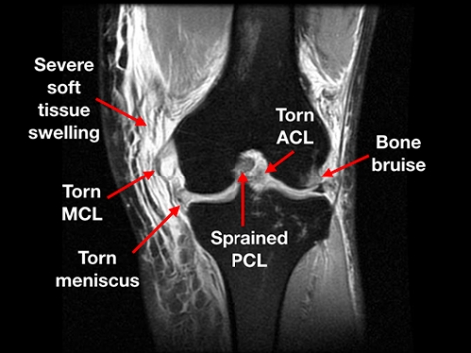
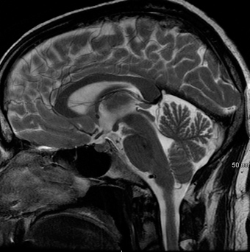
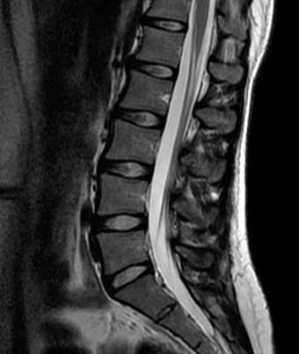
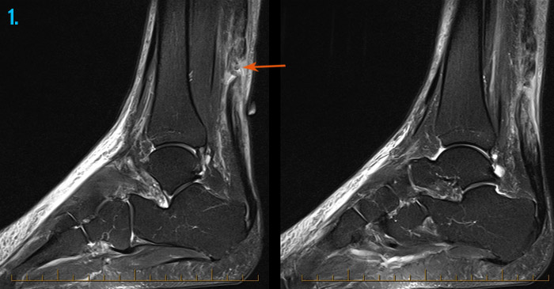
Images MRIs capture
Brain tumor
Soft tissues
Tumours
Damaged ligaments
Joint injury or disease
Spinal injury or disease
Injury or diseases of internal organs
full thickness tear of the Achilles tendon (arrow)
Lumbar spine

Slide 6
Medical Radioisotopes

Slide 7
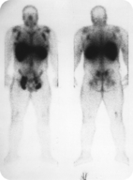
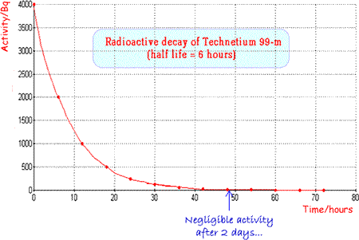
Technetium-99m
radioisotope tracer
taken orally, injected or inhaled into the body
it then circulates through the body or is taken up by certain tissues
distribution can be tracked by the radiation it emits
captured by imaging techniques such as SPECT and PET scans
decays to Tc-99 and a gamma emission (low intensity)
half-life is about six hours
it will stay in the body for some time but not long enough to do damage
***the “m” stands for metastable
Radioisotope scan to detect tumors.

