Slide 1





UNIT 1 & 2 Theatre Studies
Wheelers Hill Secondary College
Visual Communication Design
Visual Communication Design

Slide 2
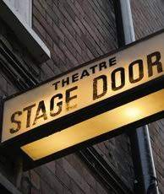

VCE
Theatre Studies
2025 Success Awaits You……..

Slide 3
Why study Theatre Studies?
An opportunity to work collaboratively in planning, developing and presenting theatre pieces
It involves creative production roles…….not just acting
Experience and perform a variety of Performance Styles
Experience professional theatre for inspiration and analysis

Slide 4
Area of Studies
Unit 1 Pre- Modern Theatre Styles and Conventions
Unit 2 Modern Theatre Styles and Conventions
The production roles are:
• actor
• director
• designer – any one or more of costume, make-up, props, set, lighting, sound.

Slide 5
Outcome 1 - Written Task or Oral Presentation. You need to understand the styles of theatre that we cover (3 per Unit). History, Conventions, Key writers and practitioners, Stagecraft.
Outcome 2 - Design OR Performance. For EACH theatre styles (3 per unit) you will need to create at least One Design and Perform at least once. ONE performance per semester will be to an audience.
Outcome 3 – An analysis of a Professional Performance

Slide 6
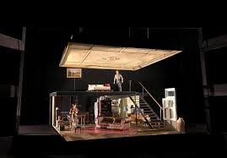
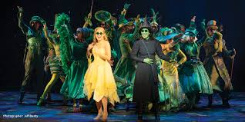
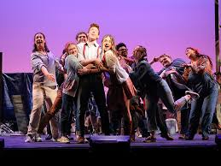
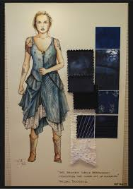
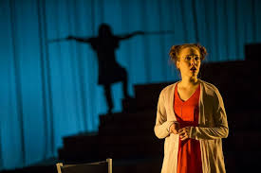
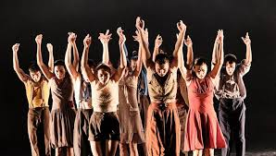
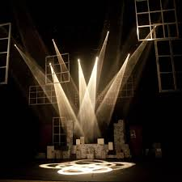
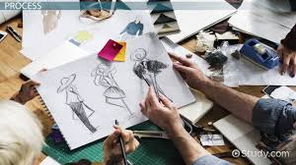
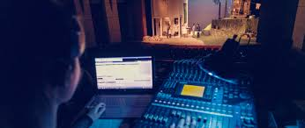
.

Slide 7
Career Pathways
Production: Creative &Technical
Direction Production Management
Staging Designer- Set, Costume, Lighting, Sound
Acting Event Management
Advertising Exhibition curator
Promotions Artist
Producer

Slide 8
Engagement…………
Passionate about costumes, sets, lighting sound & direction
At least once per Unit you will present work at an evening to be
scheduled from our theatre
Opportunities to work collaboratively- acting, directing, stagecraft –
for Theatre Studies projects
Subject expenses - performance excursions.

Slide 9
VCE Theatre Studies
"Join us where anything is possible to create, perform
and enjoy”
“Give yourself permission to shine.”
"There's a million things I haven't done, but just you wait."
More Information: Miss Wilson
Mr Razaai

