Slide 1
Year 7 Challenge Champions
2021

Slide 2
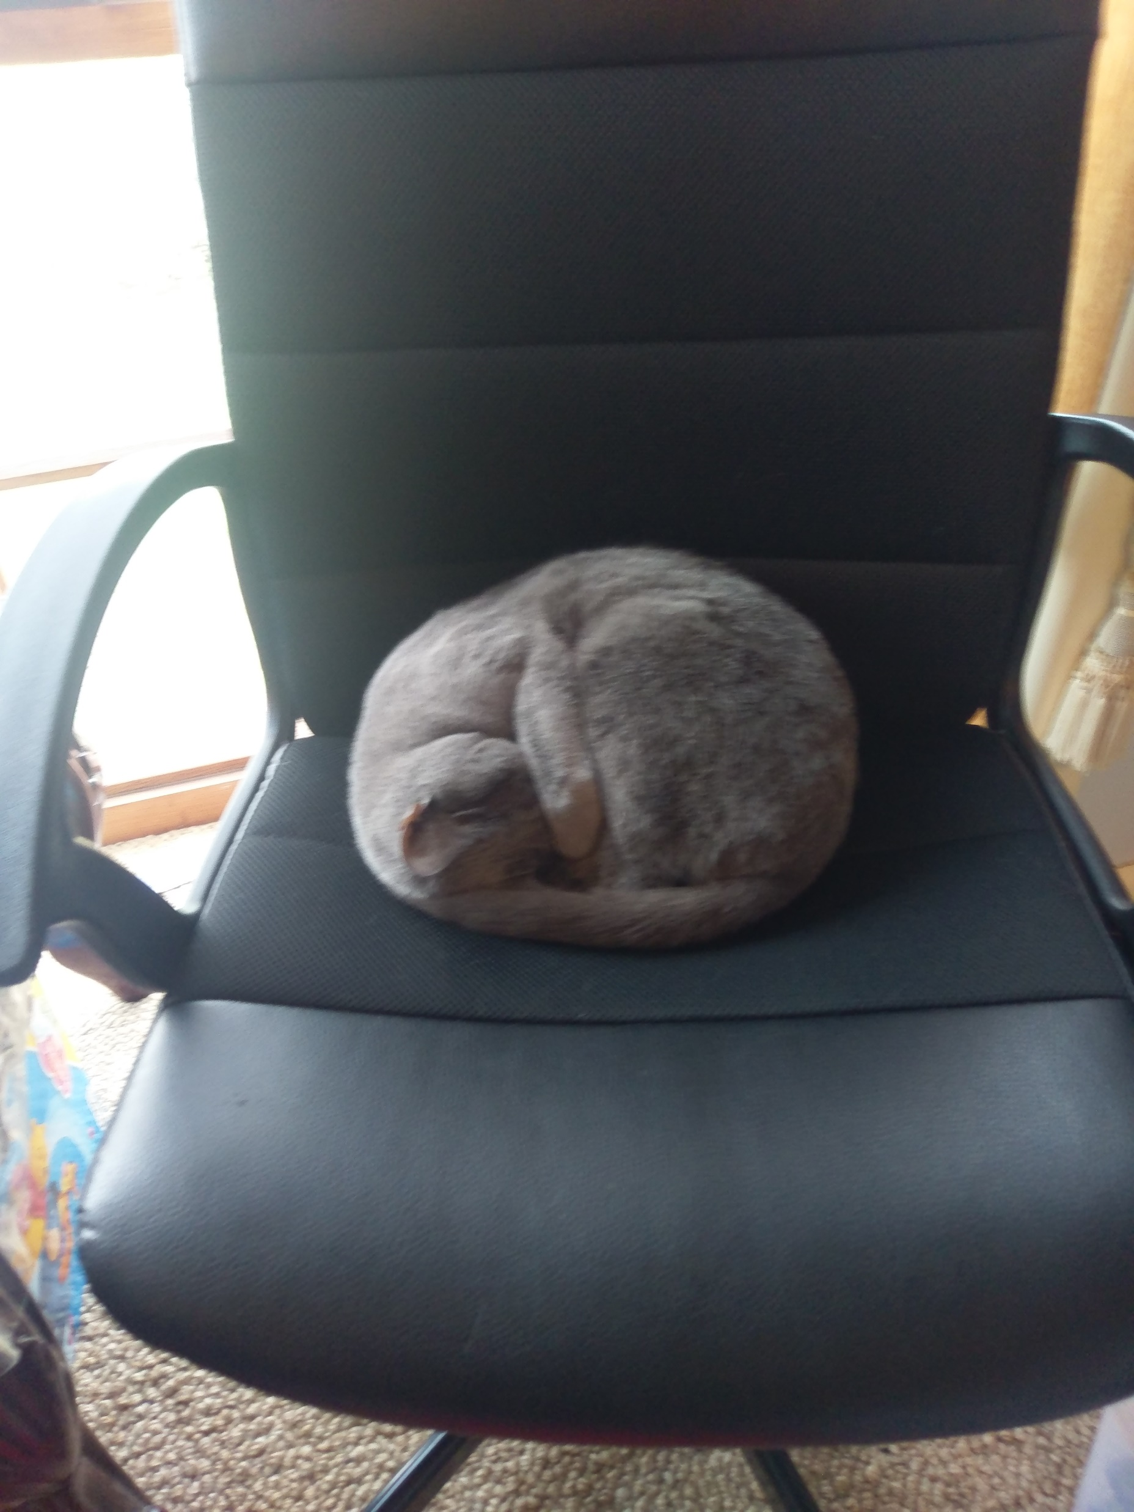
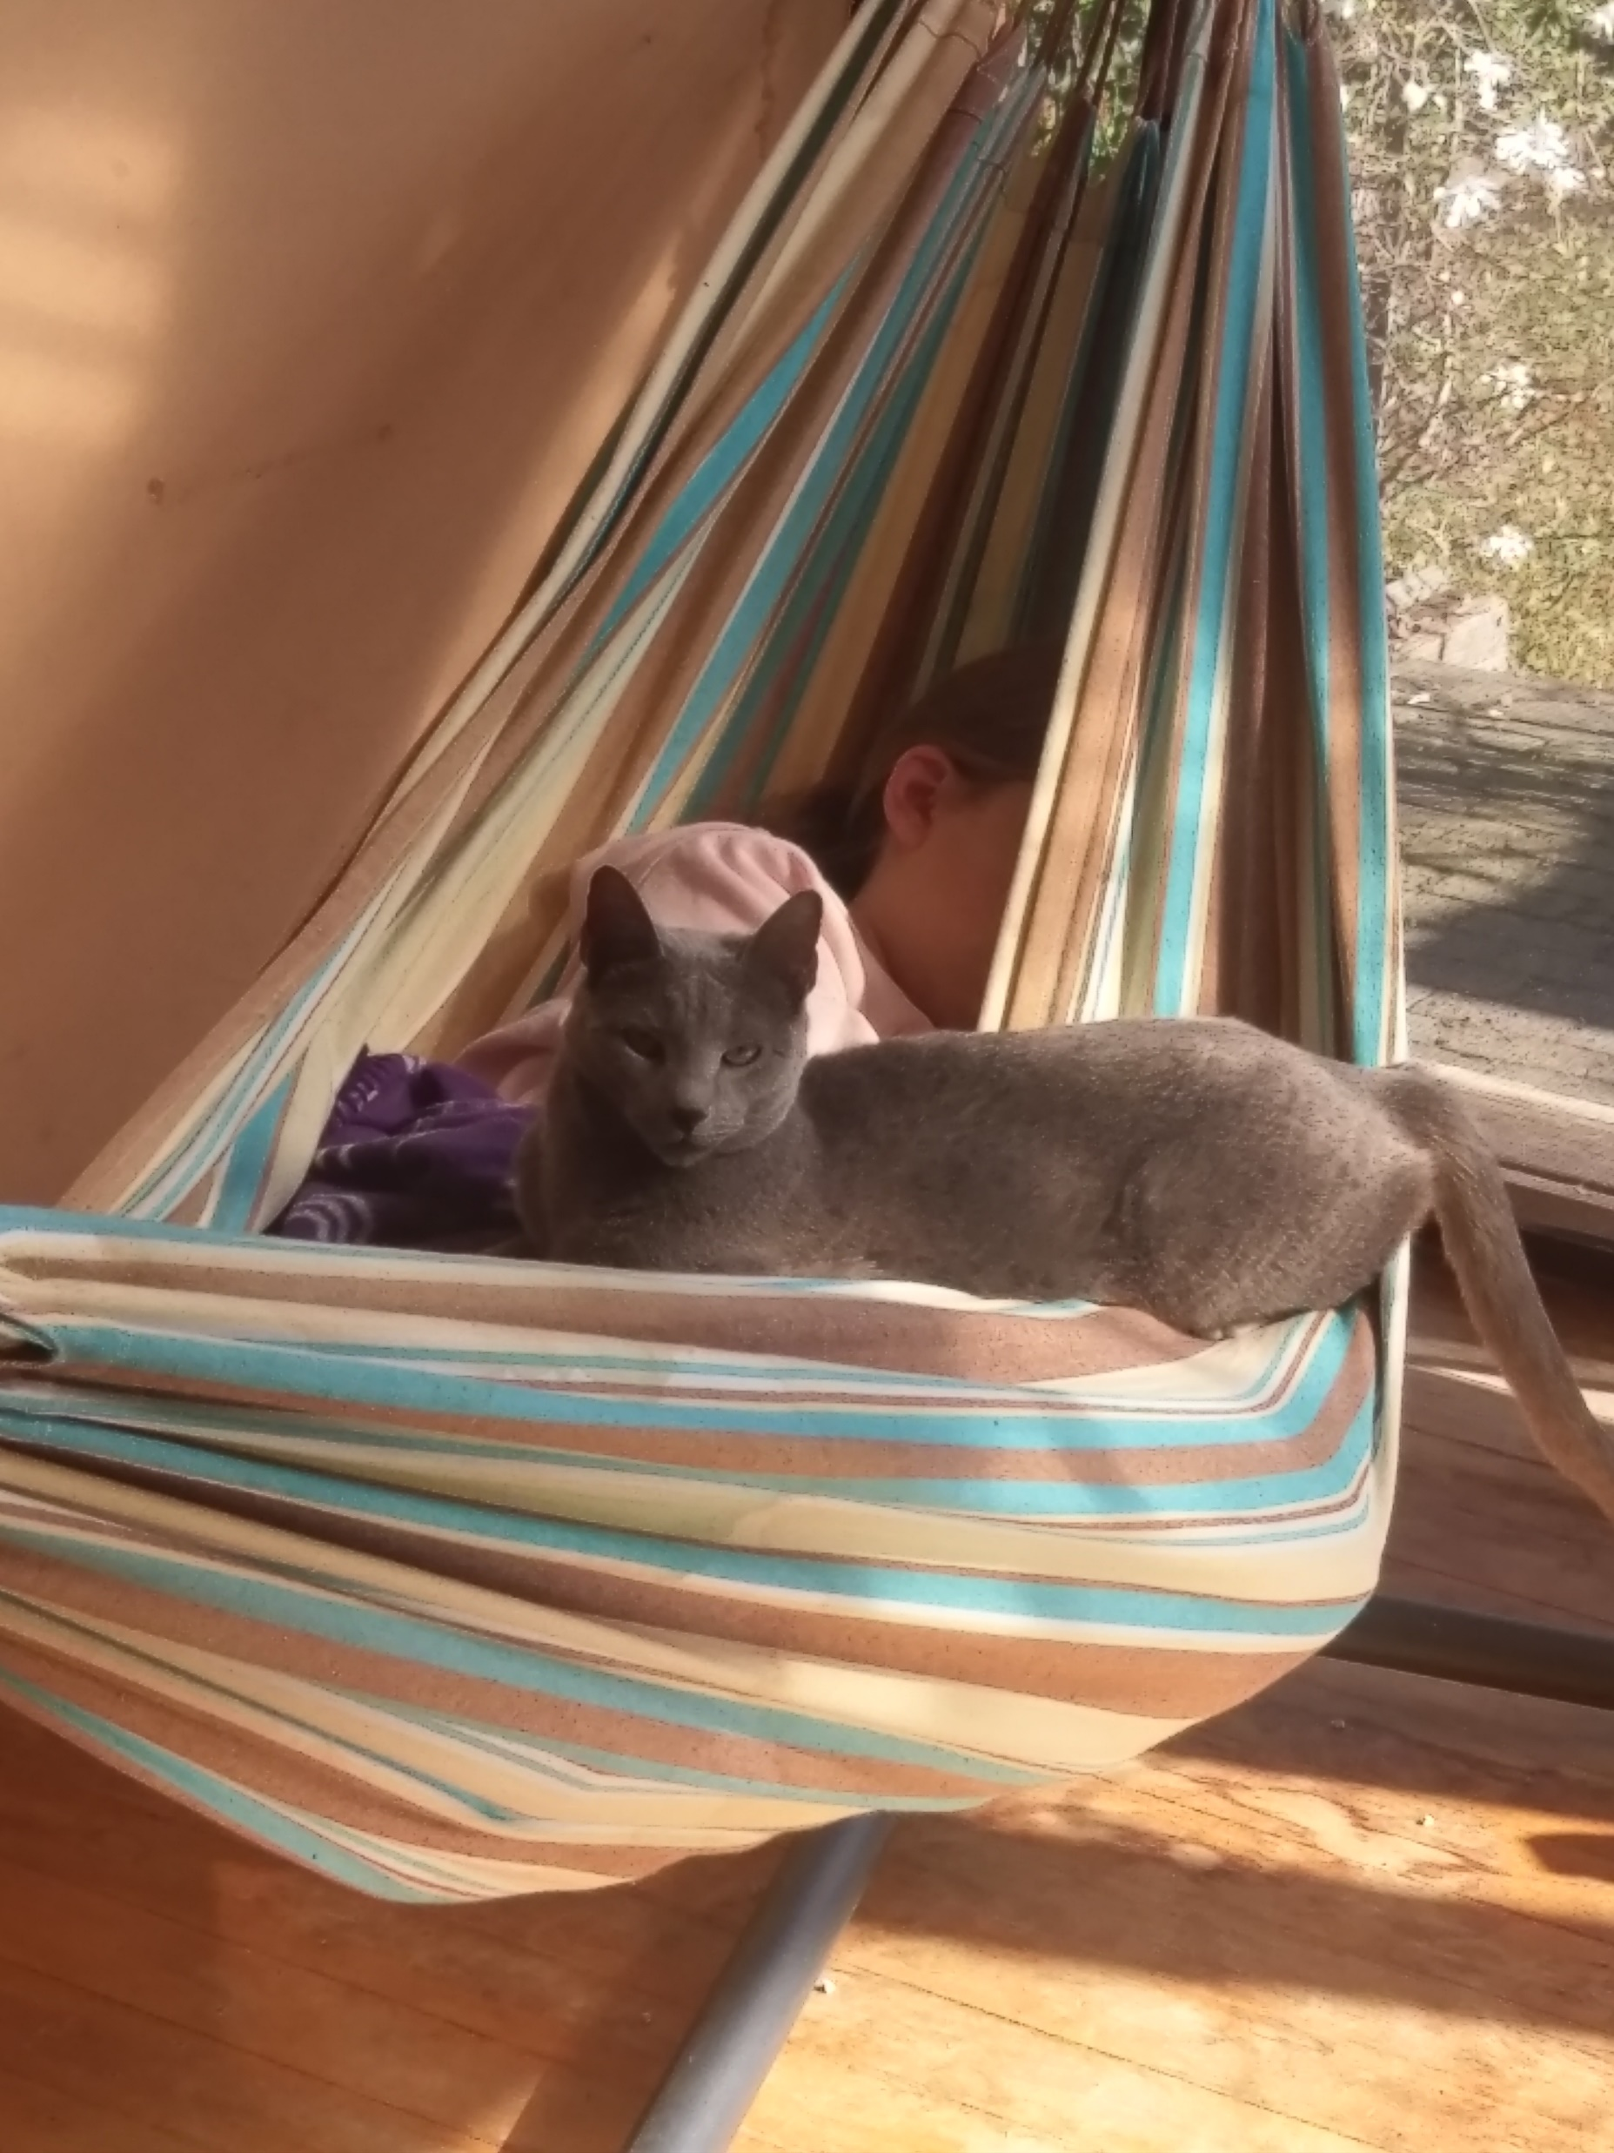
CHALLENGE #1
CUTEST PET
Is your pet sooooo cute?
Take a photo of your pet
(you must be in the photo too – to prevent “internet images”)
It could be your cat, dog, bird, lizard &/or rock.
Upload your photo of your pet BY THURSDAY 4PM to the “Year 7 Assembly” team (or email it to schwarz.kim@eastdonsc.vic.edu.au ) for your chance to WIN!

Slide 3
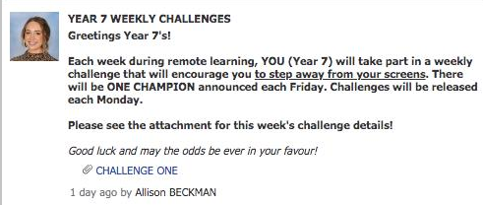

Slide 4
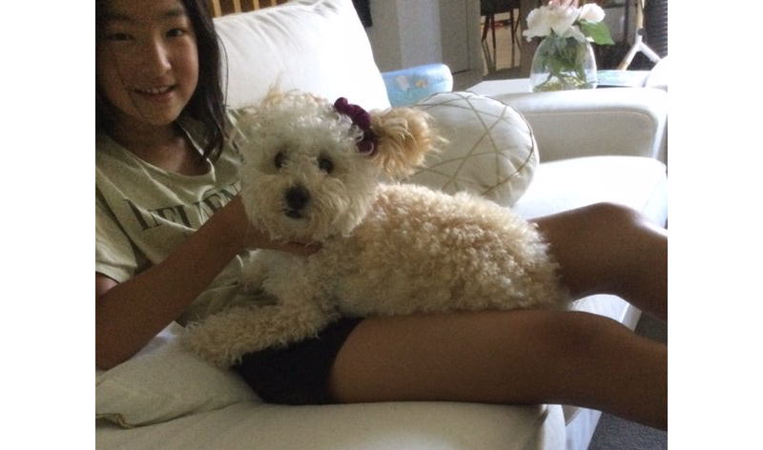
Rusty & Amanda H

Slide 5
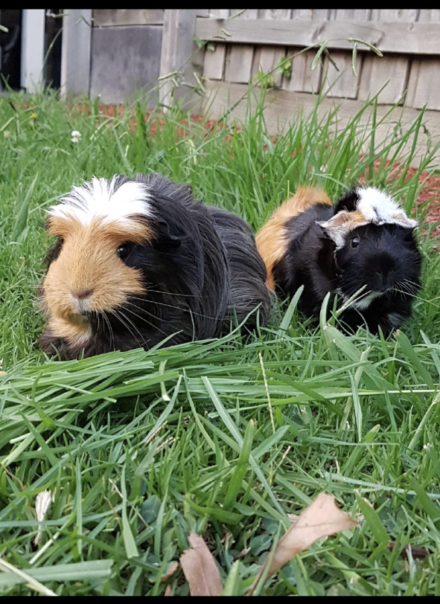
Sienna K

Slide 6
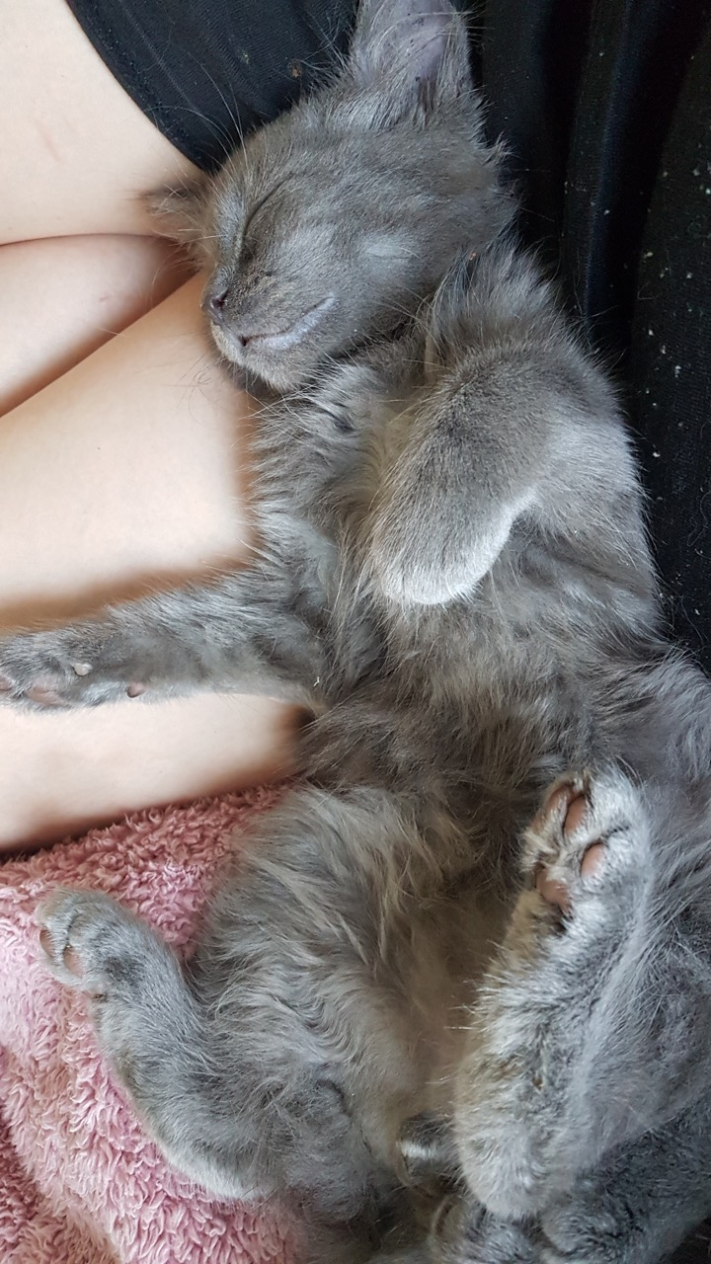
Mr Bond
Lucky

Slide 7
Mohamed A

Slide 8
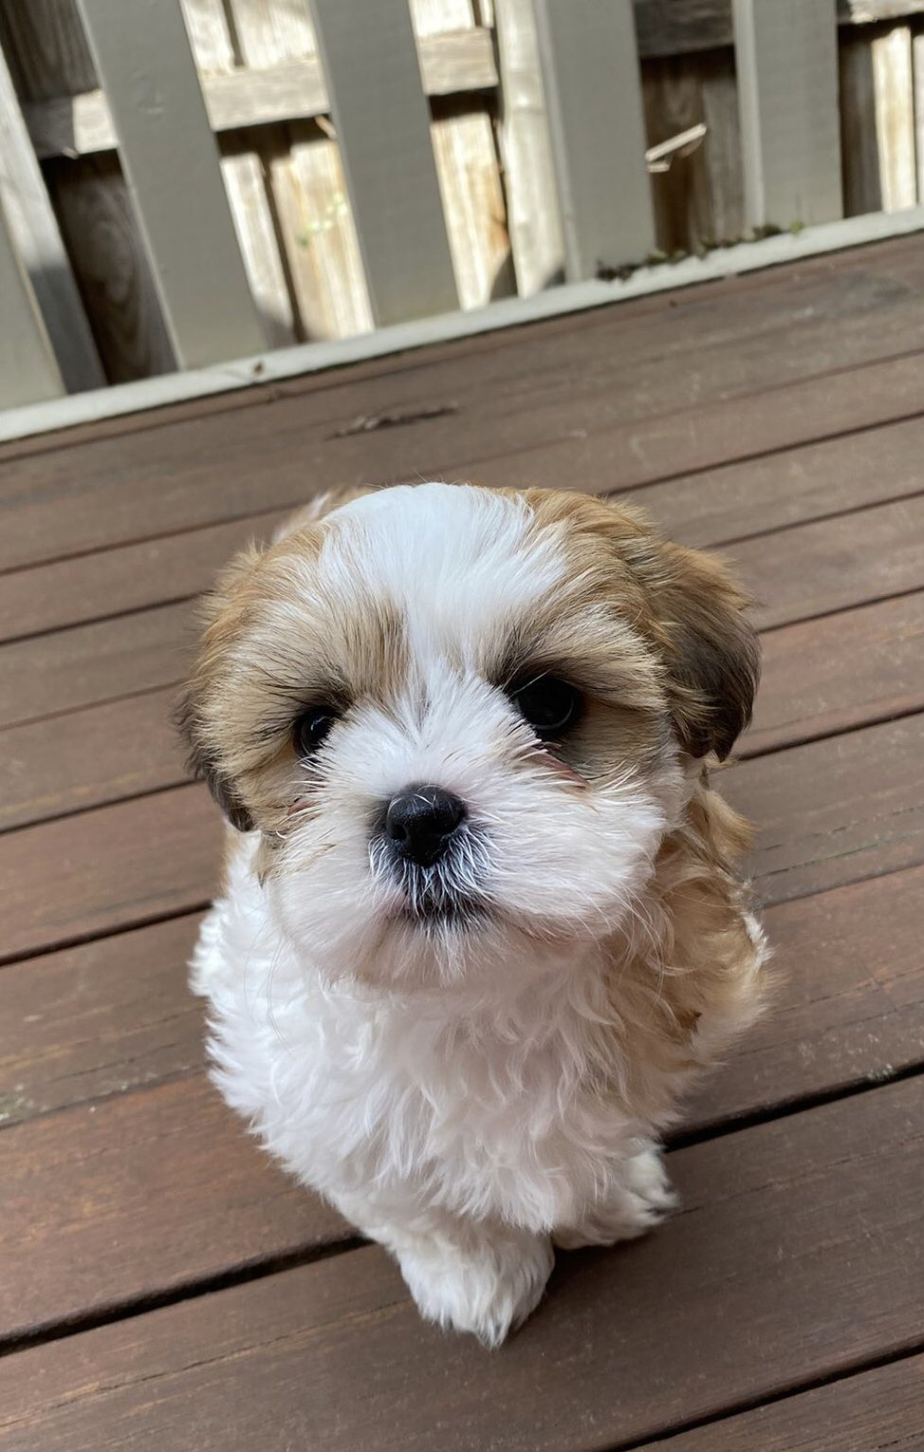
Xin (Charley) C
Jackson

Slide 9
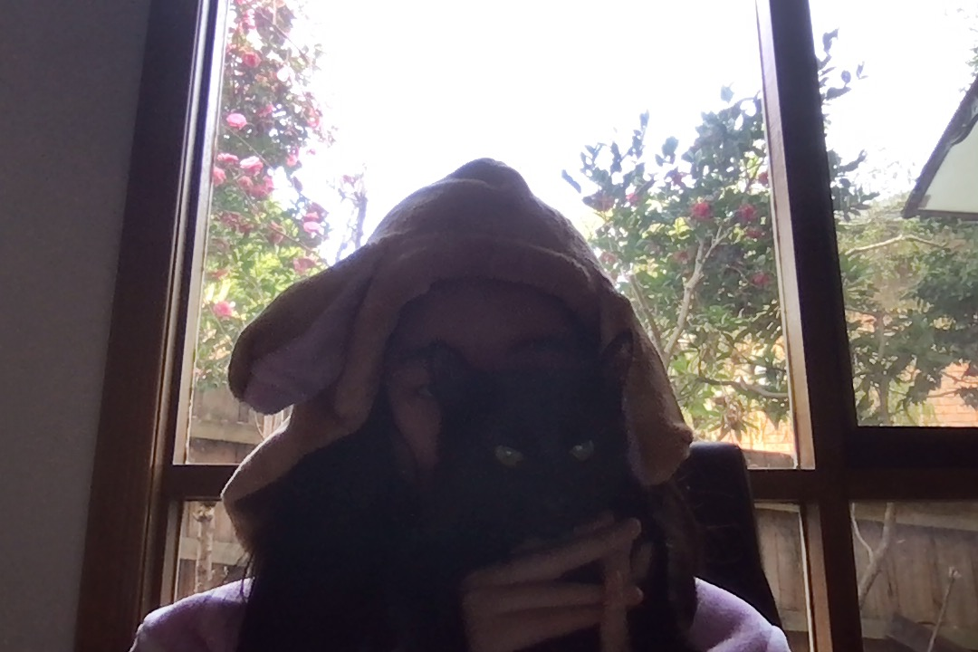
Emily L
Ocean

Slide 10
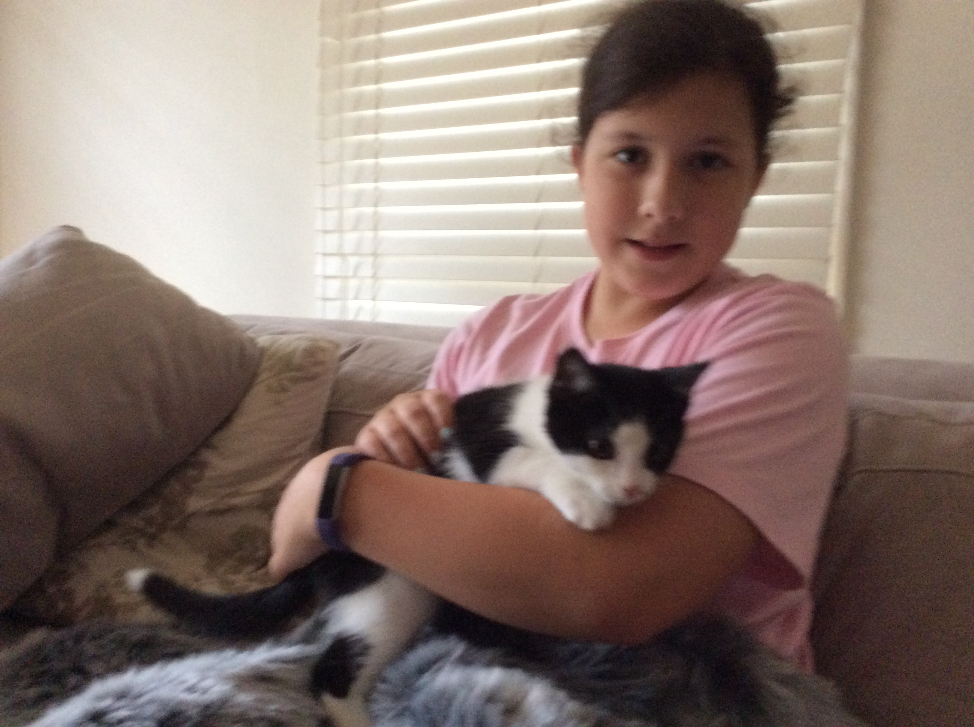
Lola R & Marlow

Slide 11
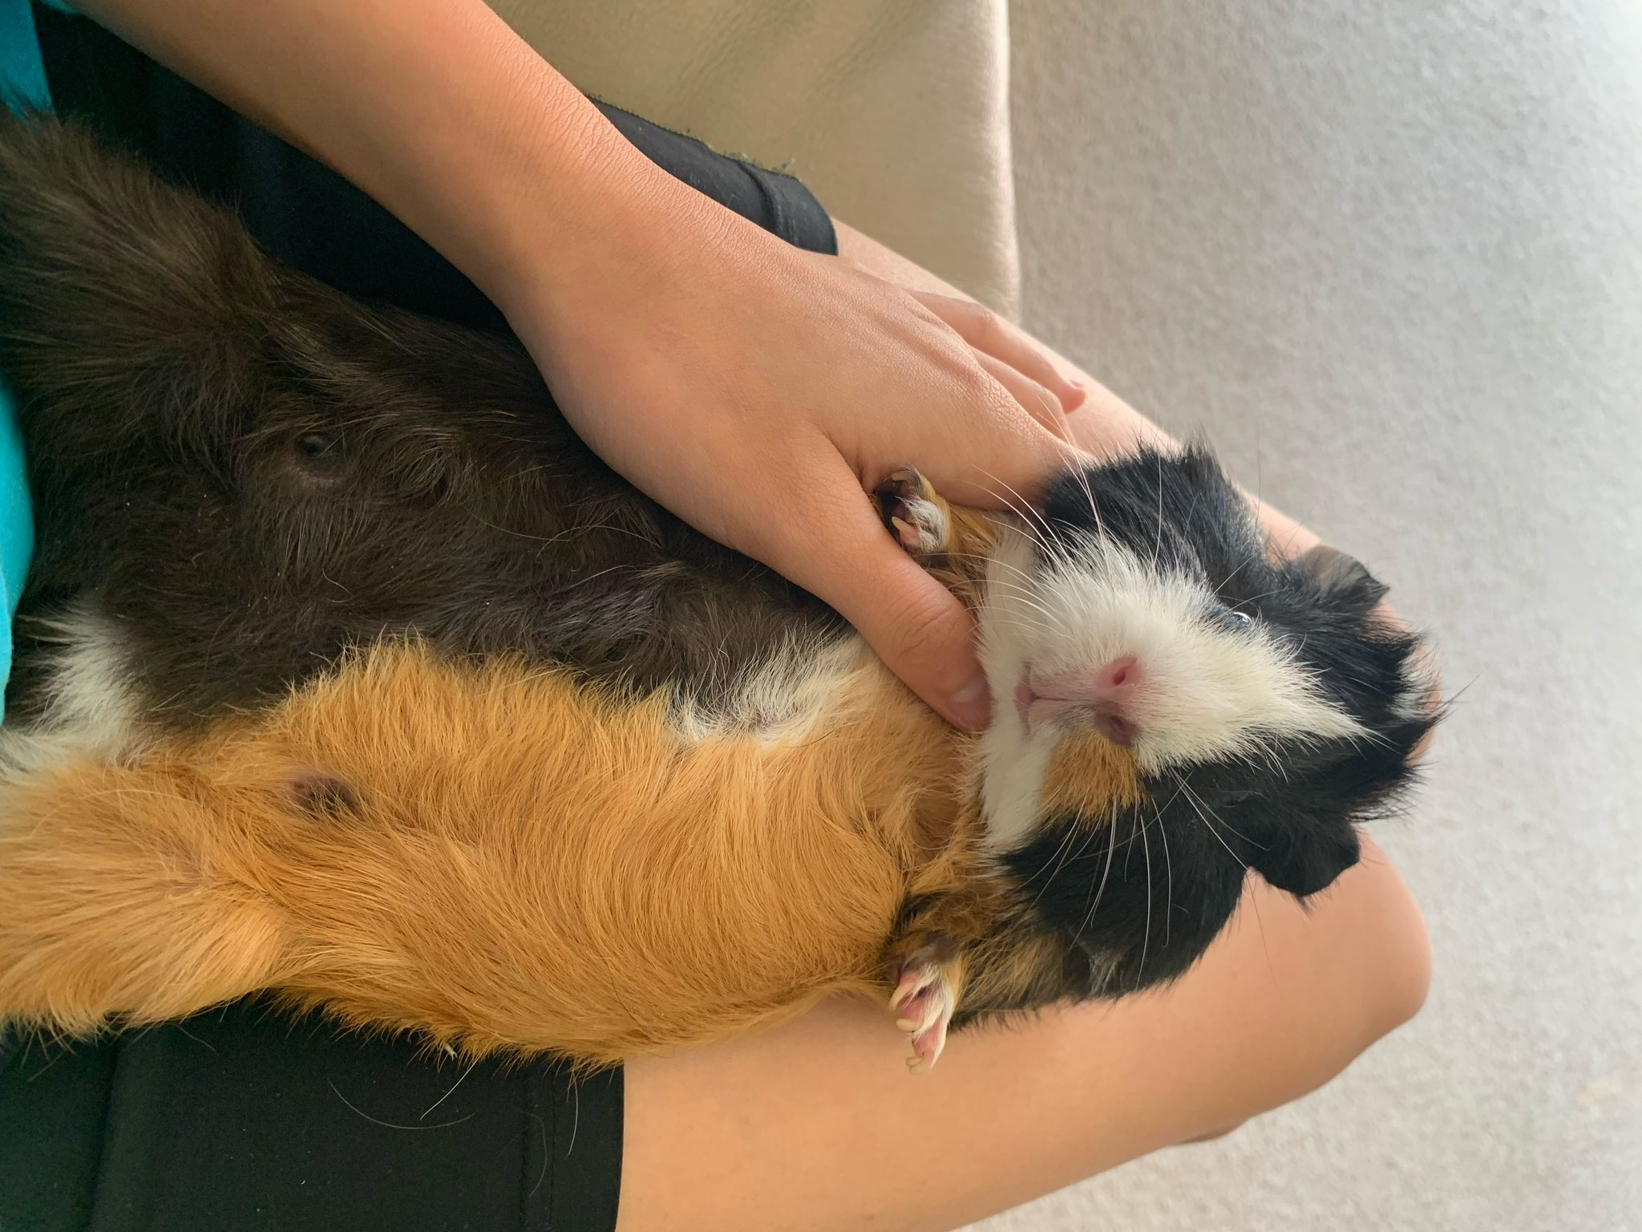
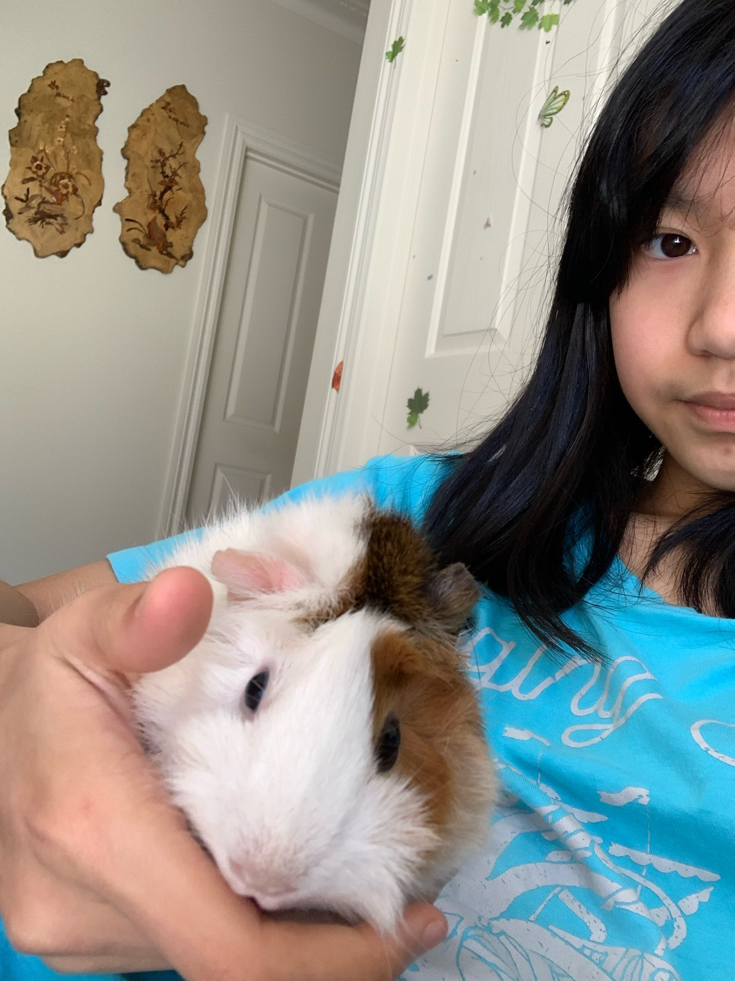
Chelsea T Milko Toffee & Coffee

Slide 12
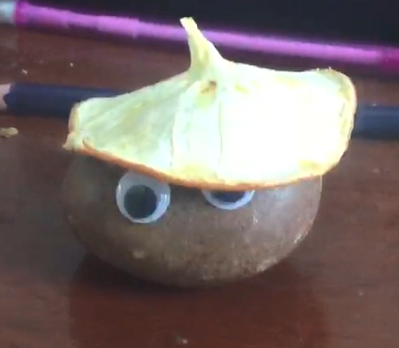
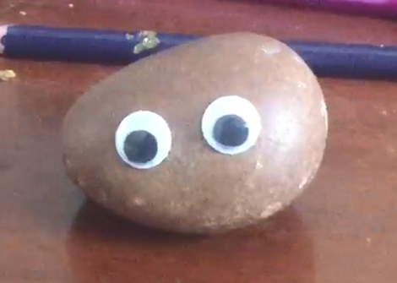
Wei Duo Y & Min

Slide 13
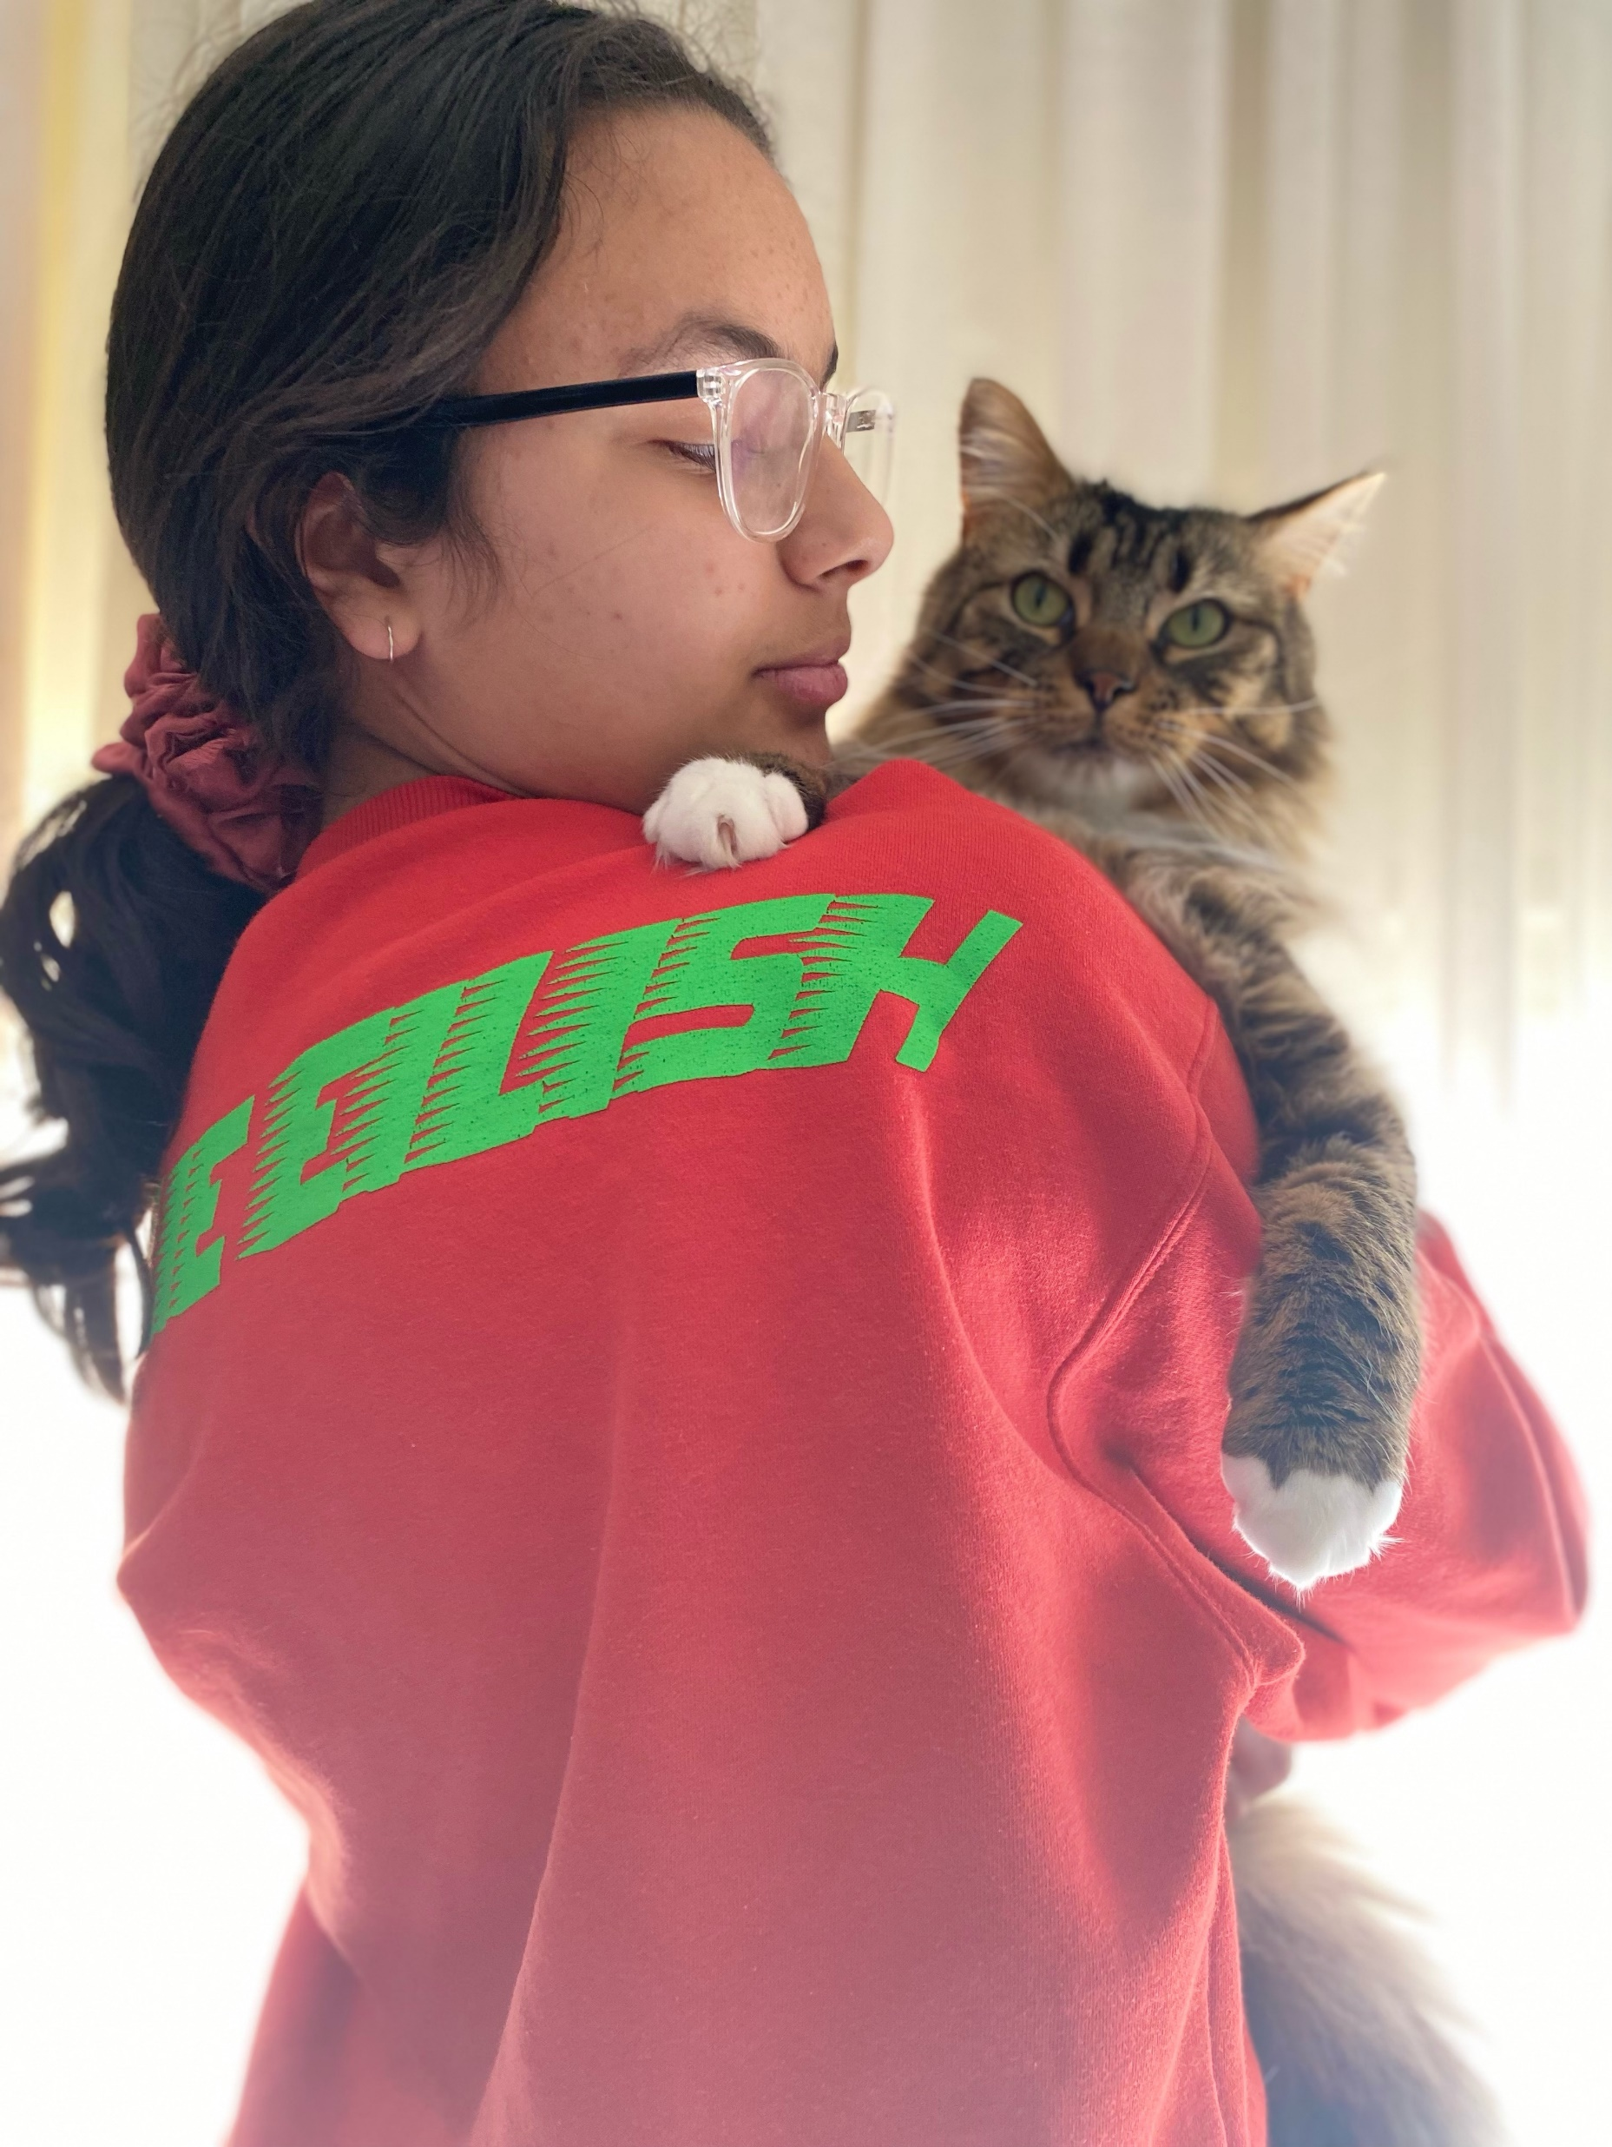
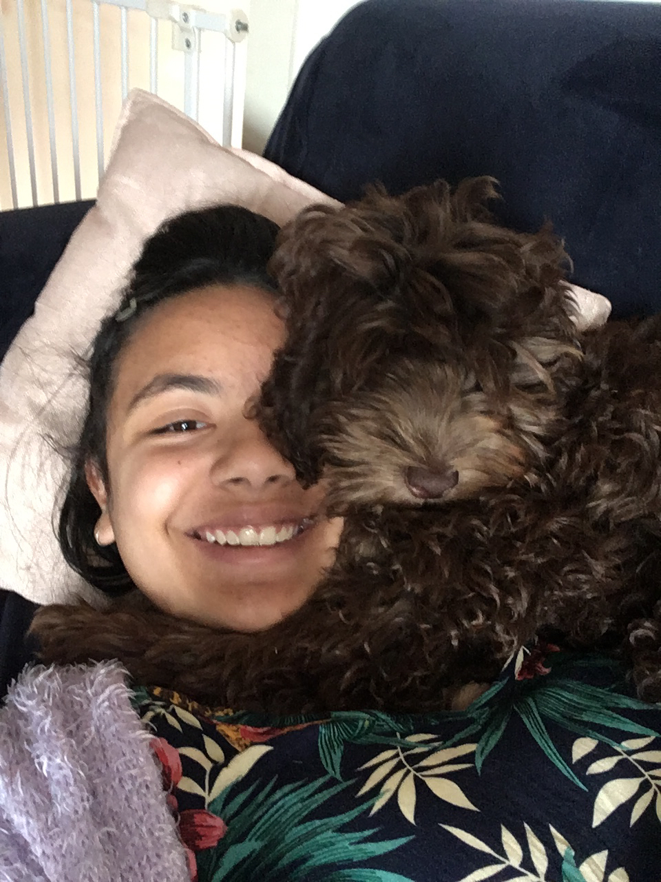
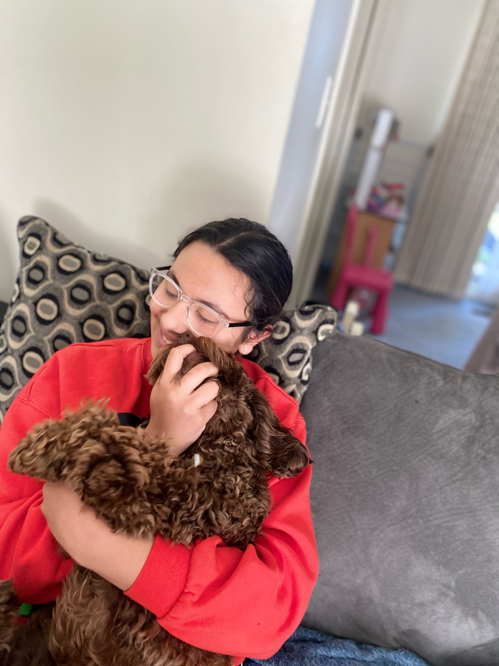
Jordan N Simba (cat) Coco (dog)

Slide 14
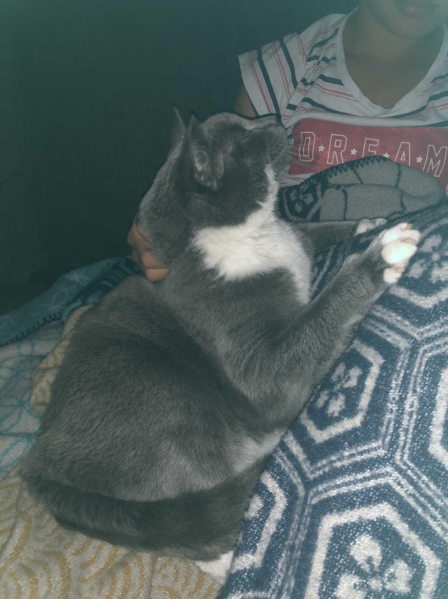
Ayesha H
Bambi

Slide 15
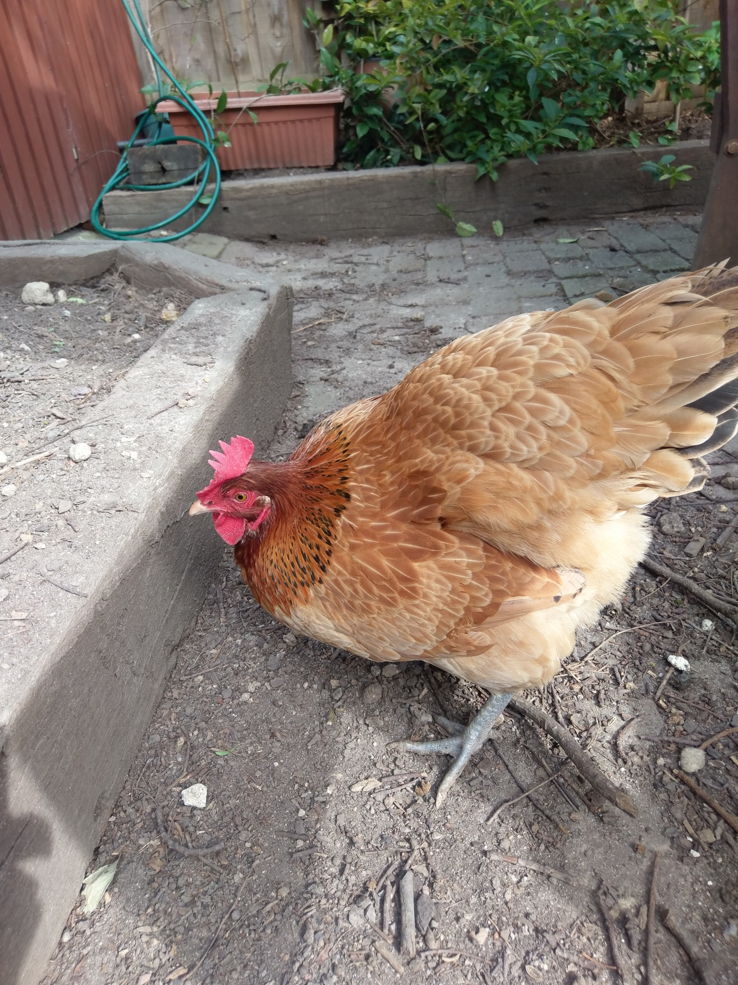
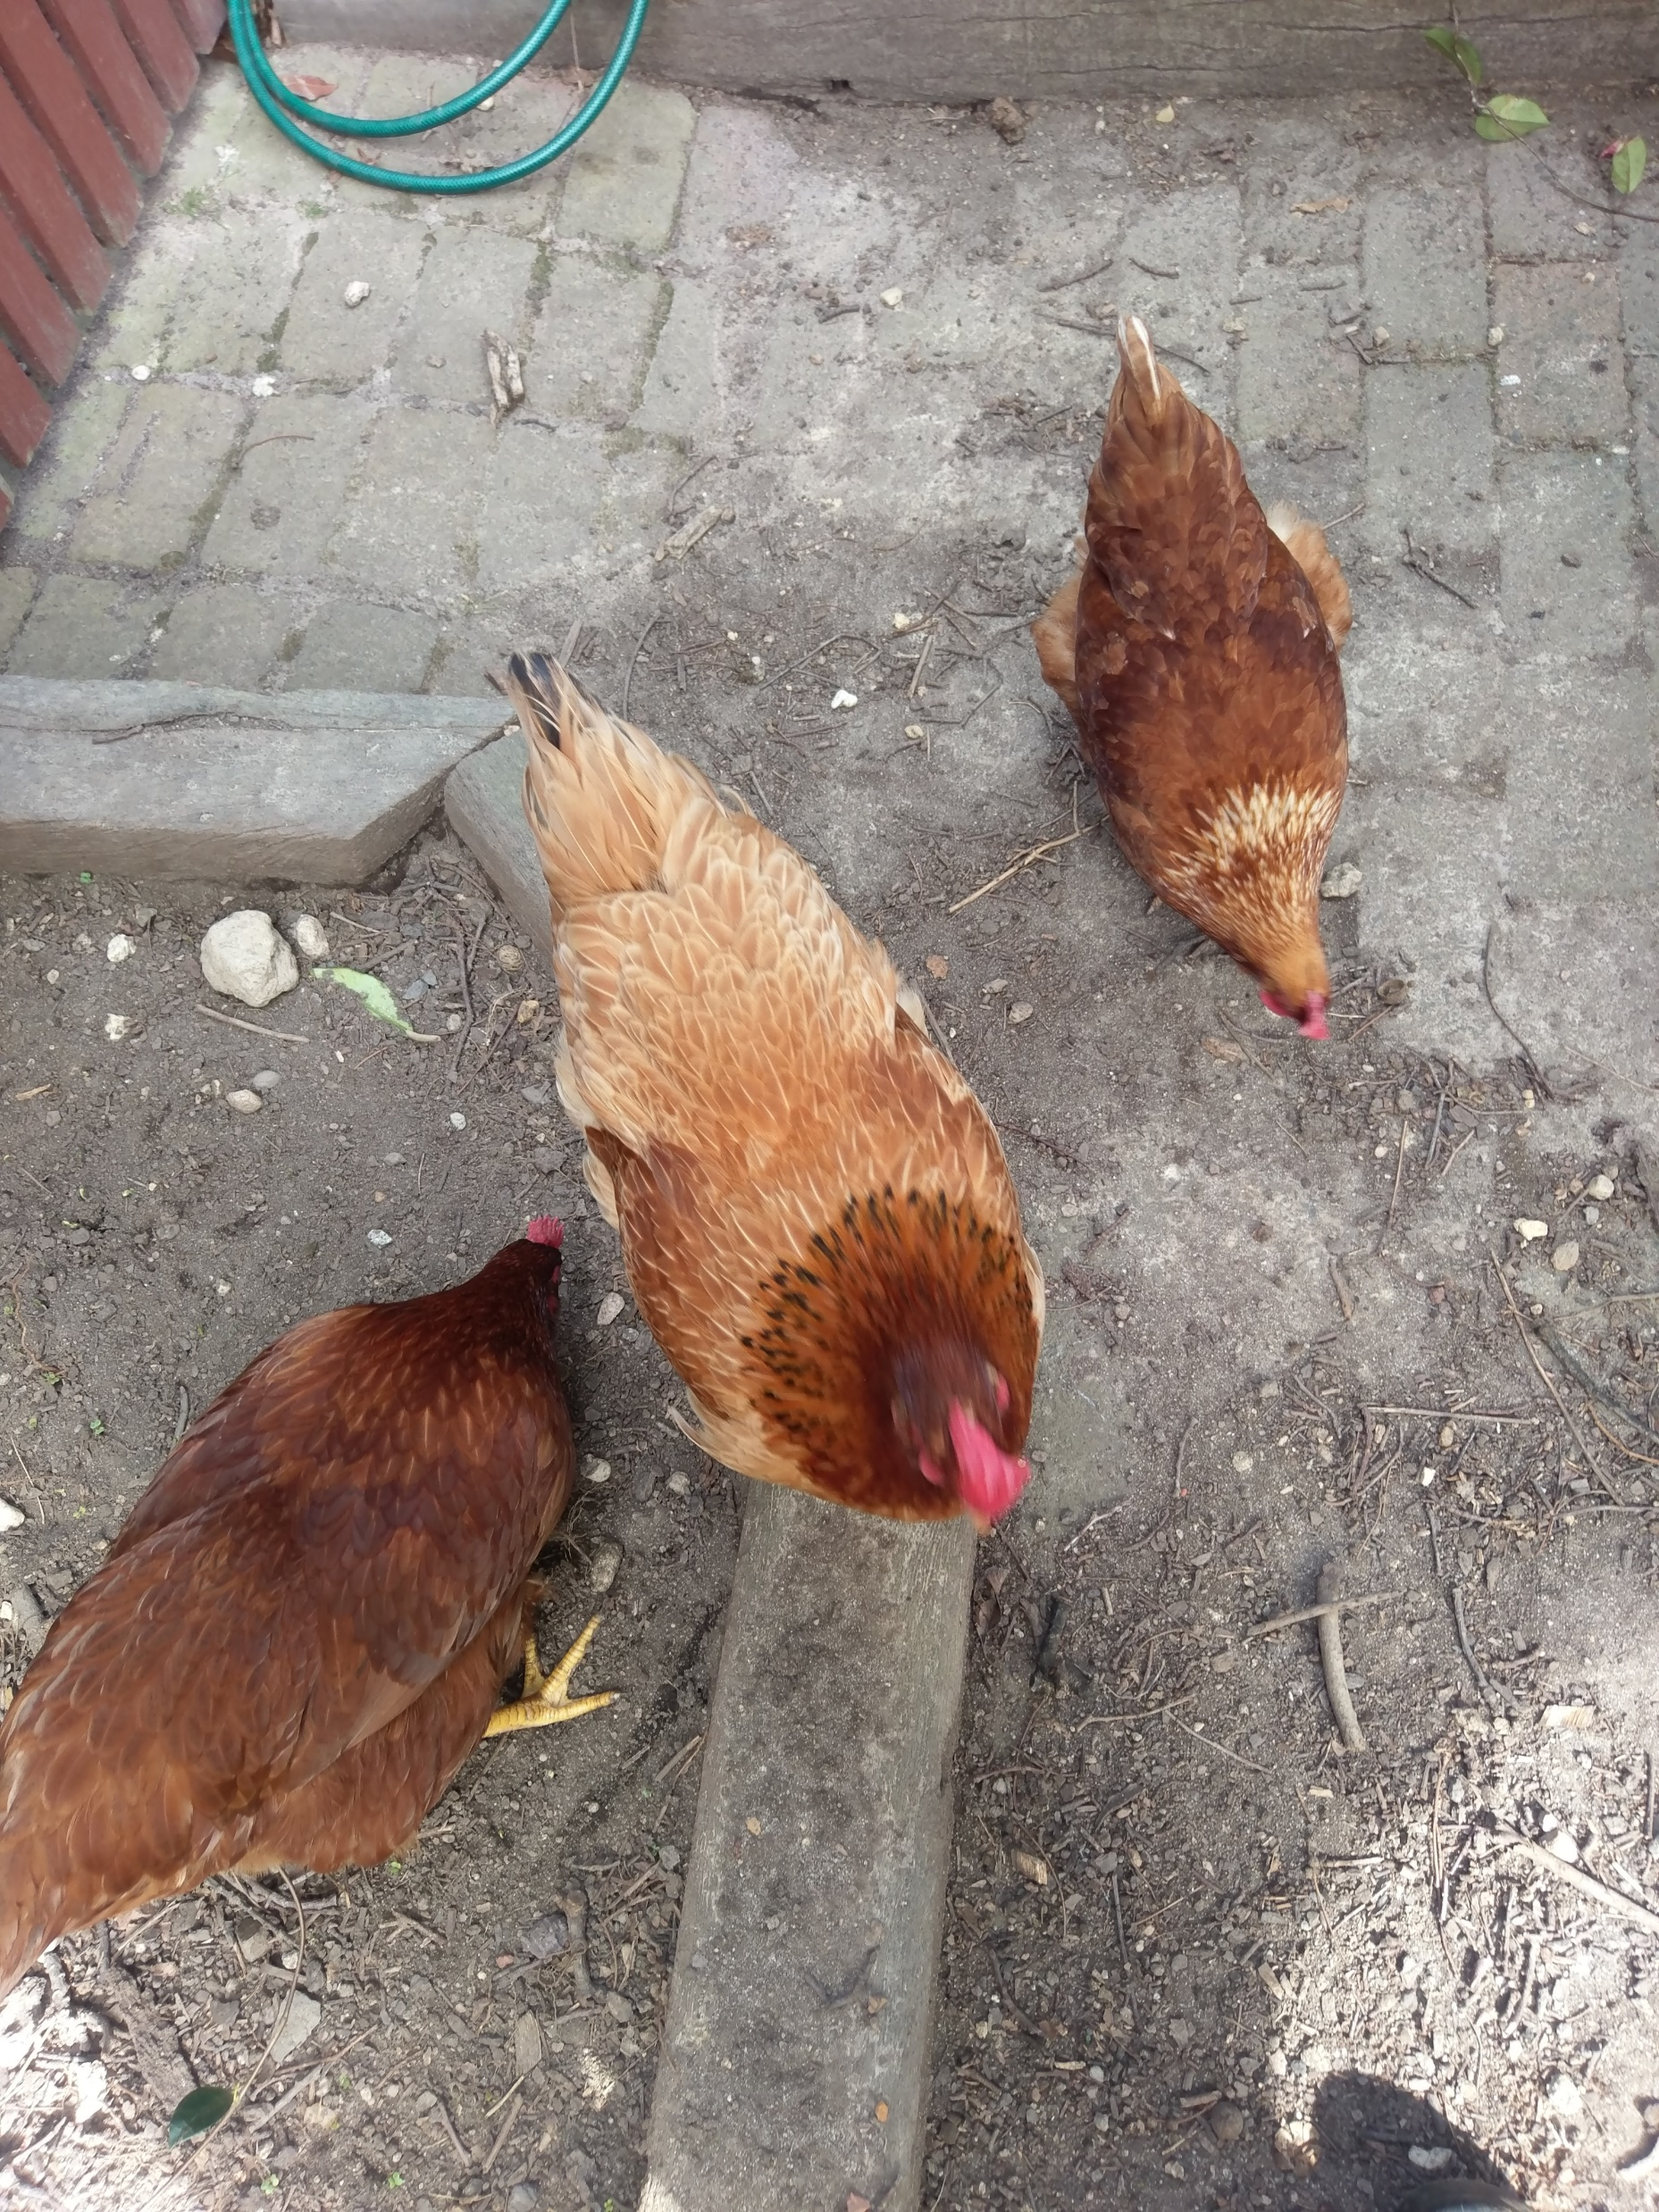
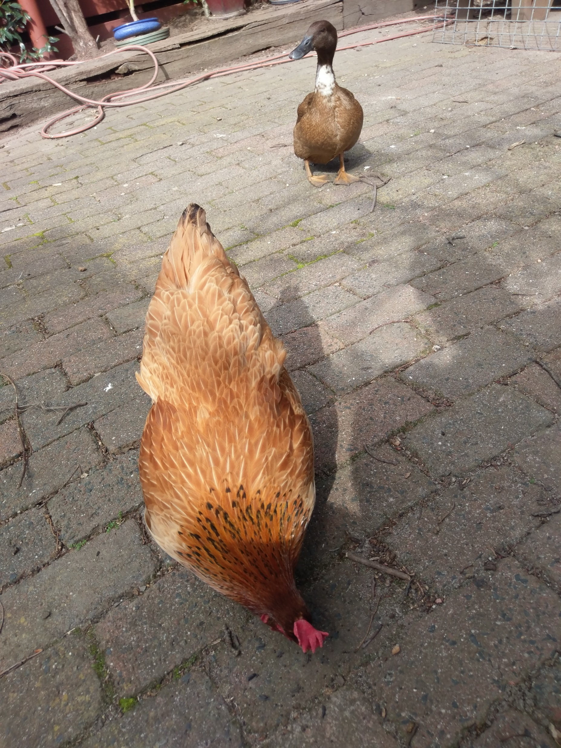
Penny & Pecky Ducks
Dotty, Sunflower & Claire Chooks

Slide 16
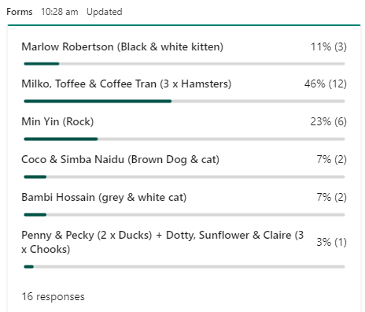
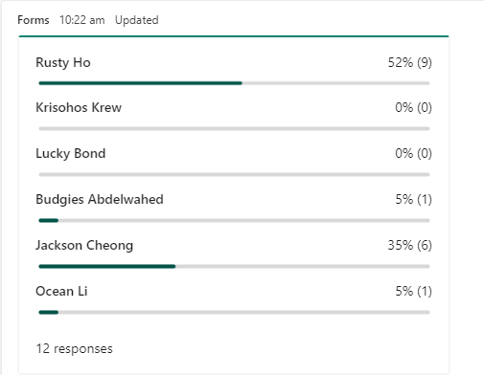
Winner: Milko, Toffee & Coffee Runner Up: Rusty Bronze medals: Jackson & Min

