Slide 1
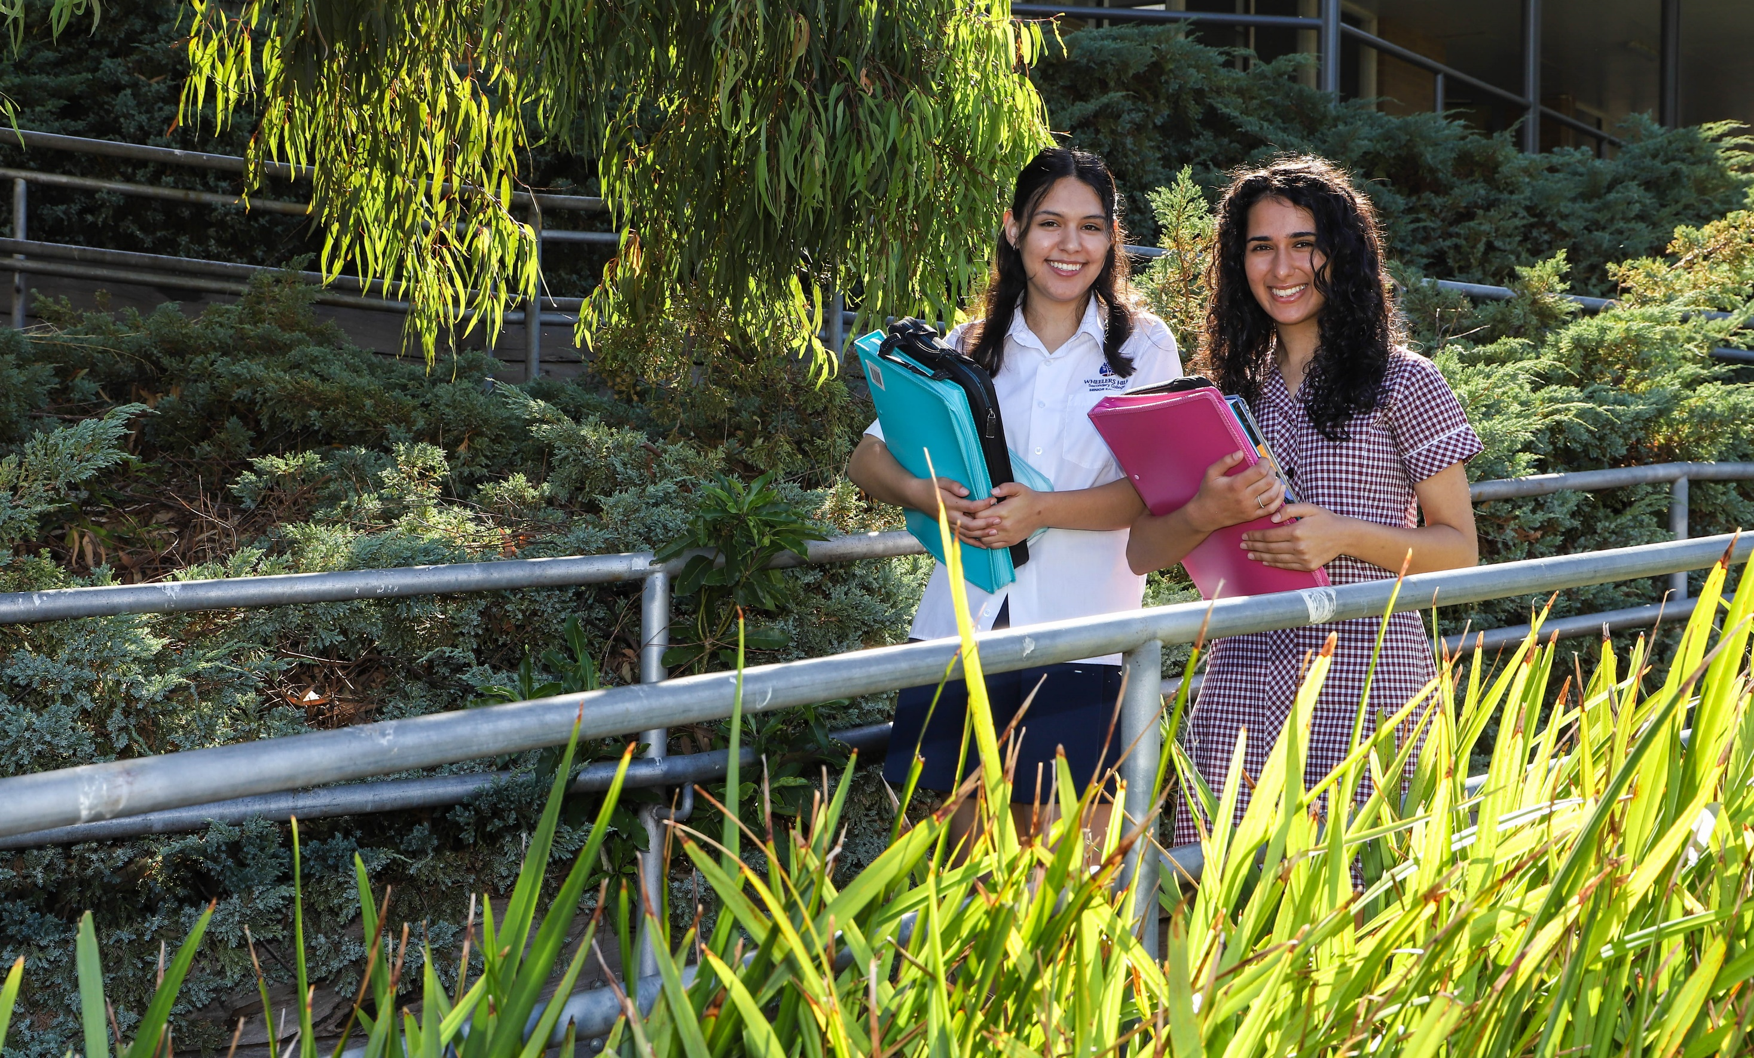

VCE Biology

Slide 2

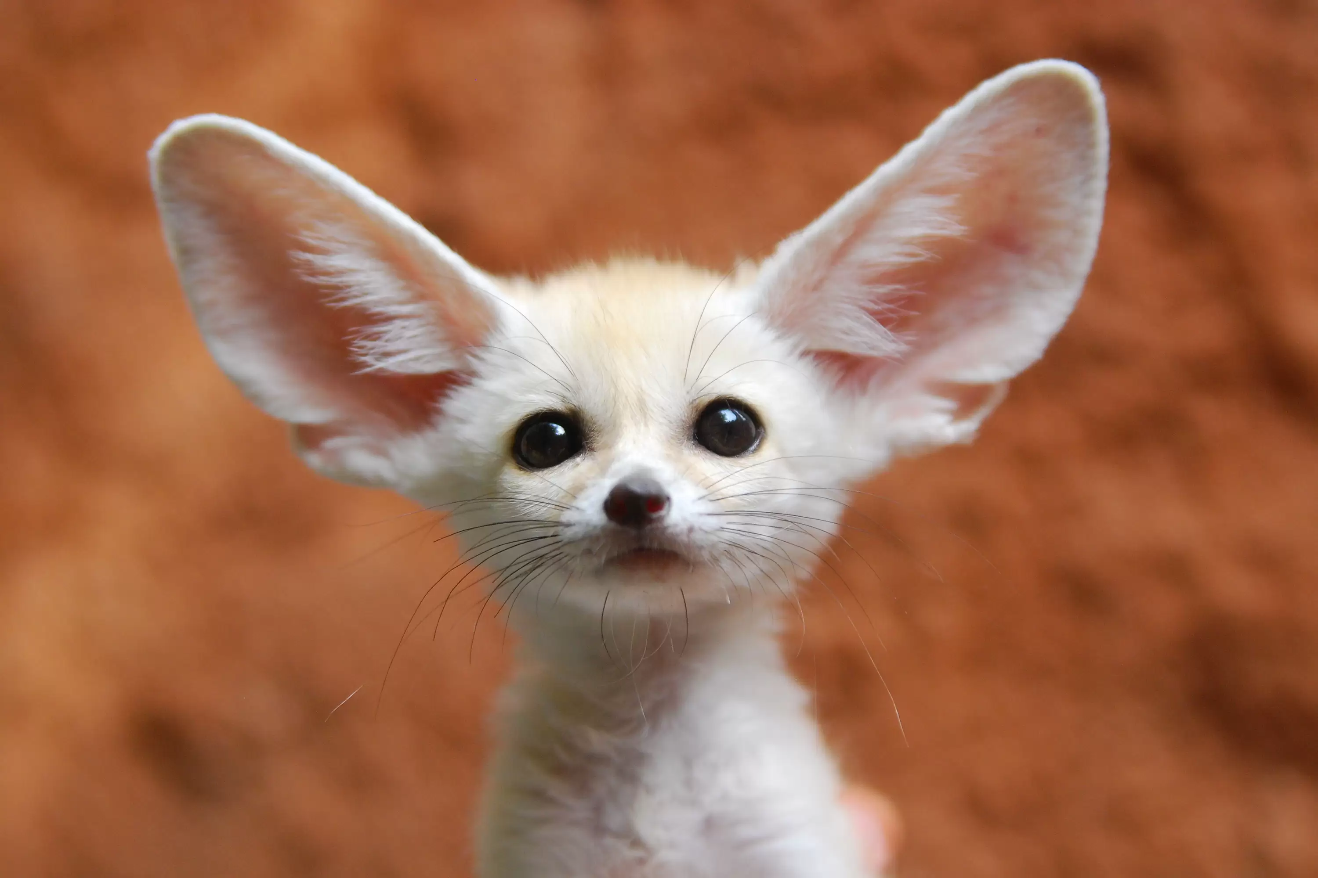
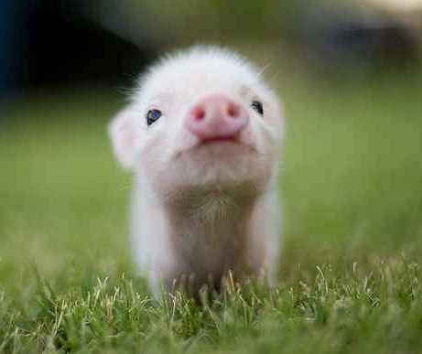
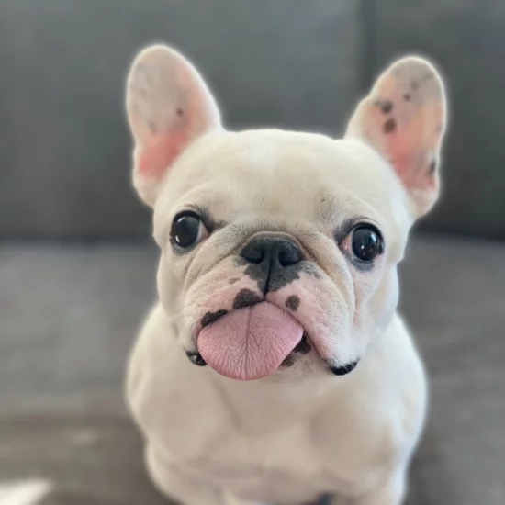
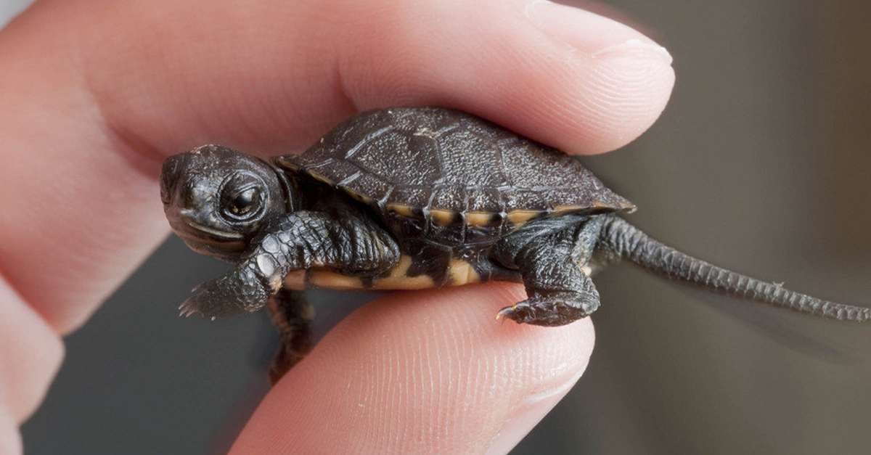
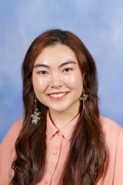
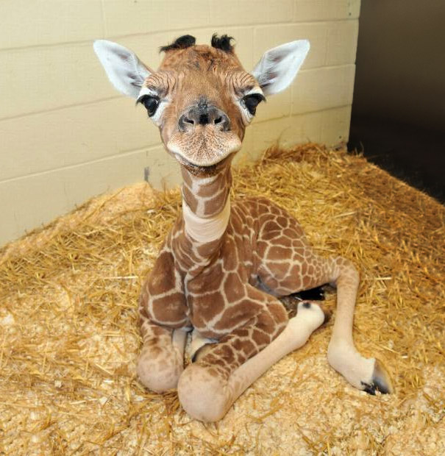
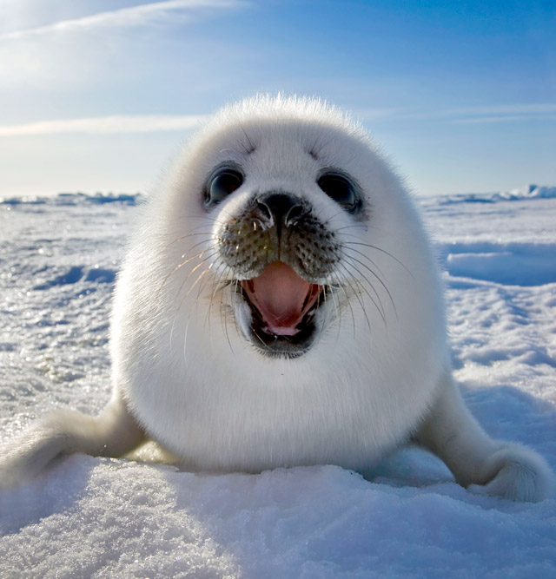
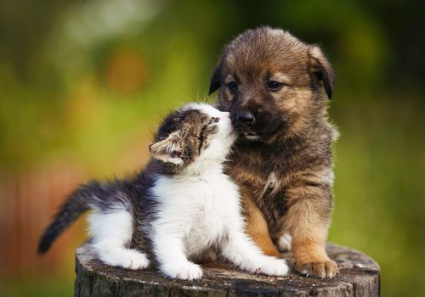
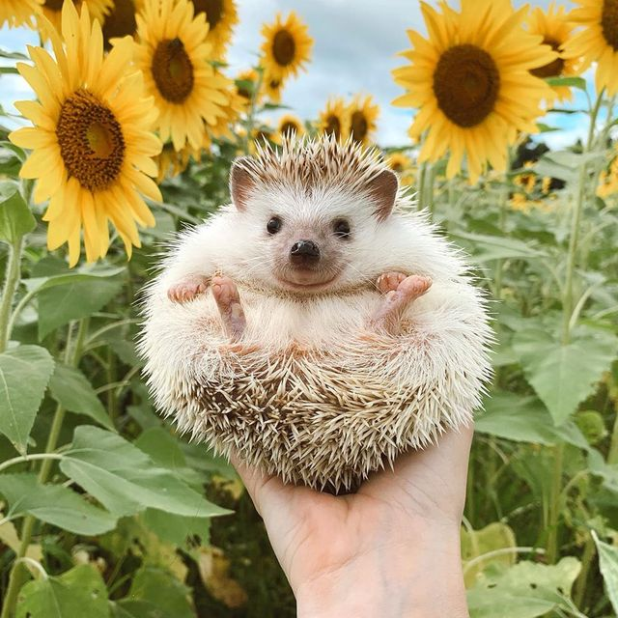
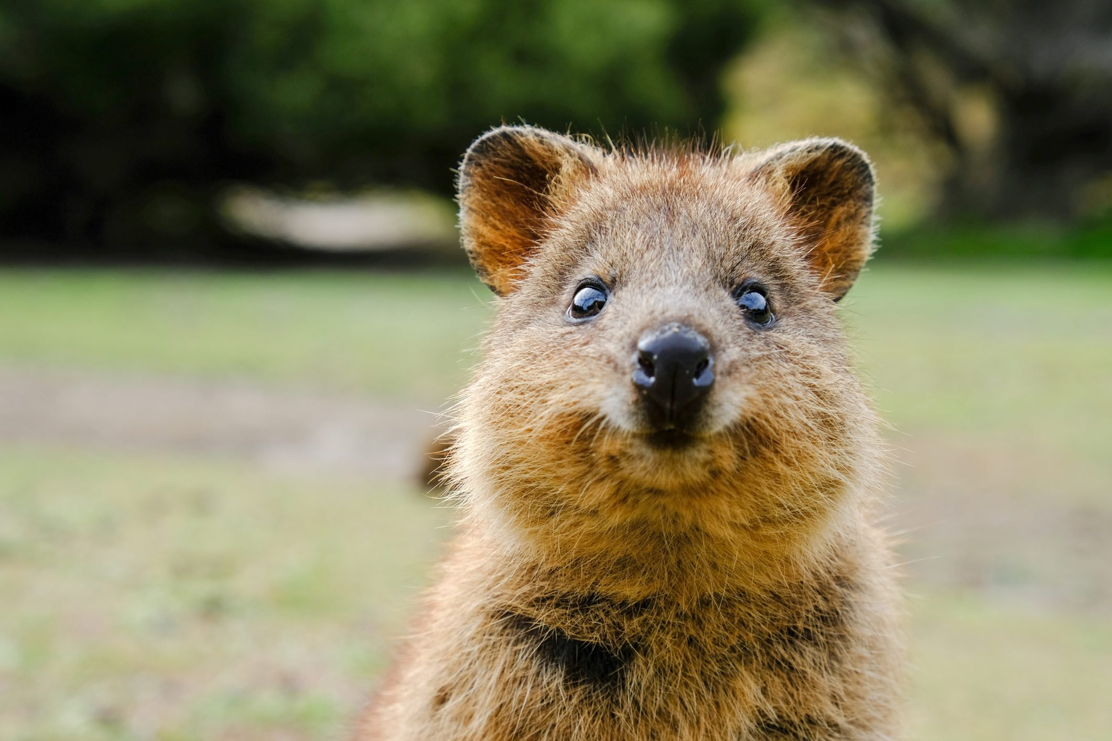
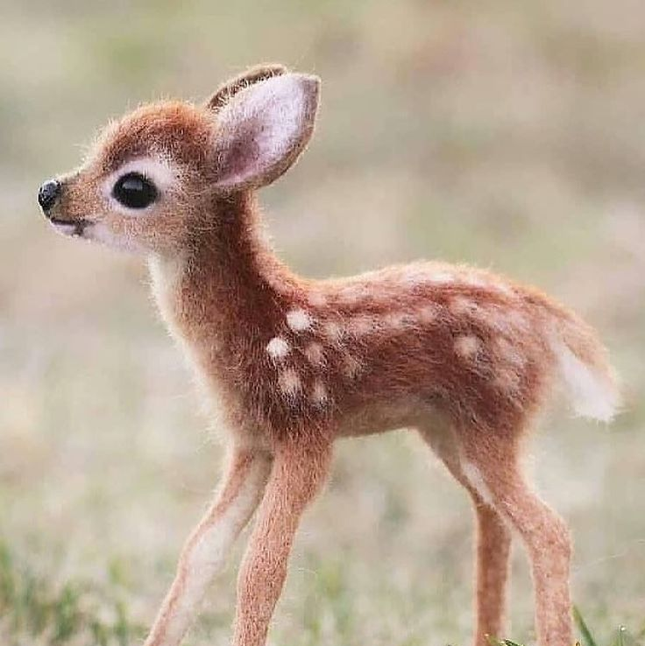

INTRO
Presenter
VCE Biology
2022 - 2026
Donia Yao
Notes:
I will be giving a quick overview of what you will learn in the VCE subject of Biology

Slide 3
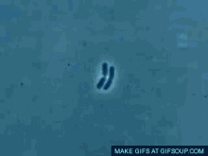
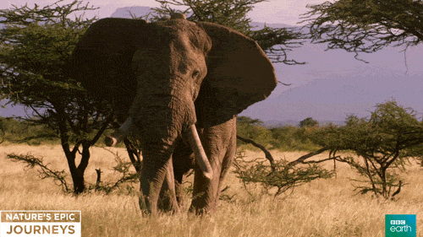
WHAT IS BIOLOGY?
The study of life.
From here:
To here:
School Office
Gymnasium
Sports grounds
Notes:
Biology is the study of life: from a single cell into an entire organism

Slide 4
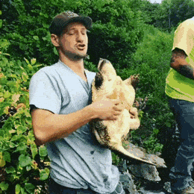
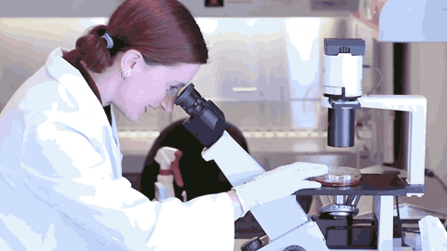
What do Biologists do?
Modern Biologists find answers within a variety of specialised fields of science such as biochemistry, neuroscience, genetics, evolutionary biology, and molecular biology
Make connections across all other areas of science and beyond
Sports grounds outside Gym
Sports grounds

Slide 5
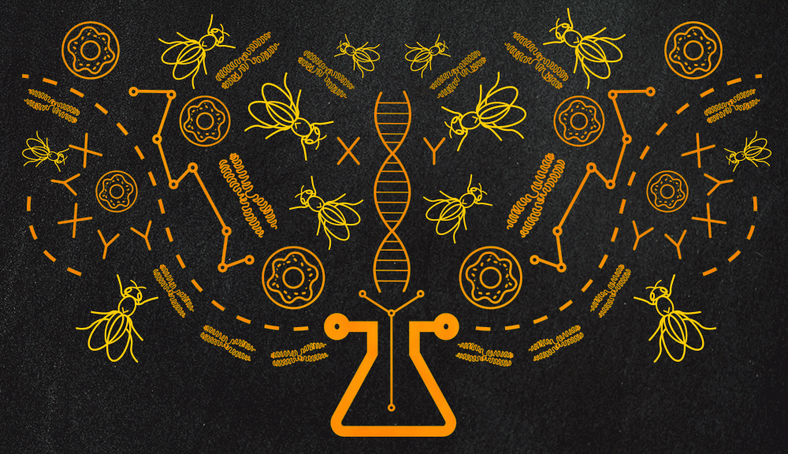
VCE Biology Course Outline: Unit 1 to 4
Unit 1: How do organisms regulate their functions?
Unit 2: How does inheritance impact on diversity?
Unit 3: How do cells maintain life?
Unit 4: How does life change and respond to challenges?
Sports grounds outside Gym
Sports grounds

Slide 6
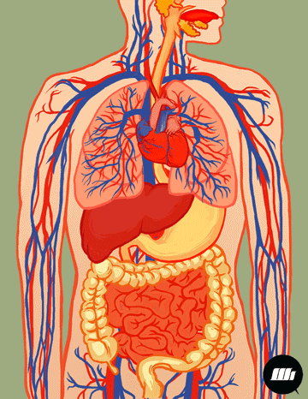
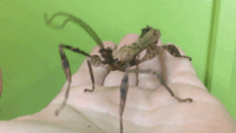
Unit 1 – How do organisms regulate their functions?
Area of Study 1 - How do cells function?
Area of Study 2 – How do plant and animal systems function?
Area of Study 3 – How do scientific investigations develop understanding of how organisms regulate their functions?

Slide 7

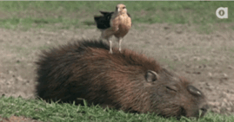
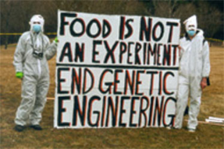
Unit 2 – How does inheritance impact on diversity?
Area of Study 1 – How is inheritance explained?
Area of Study 2 – How do inherited adaptations impact on diversity?
Area of Study 3 – How do humans use science to explore and communicate contemporary bioethical issues?

Slide 8

Unit 1 & 2 Assessment
Analysis of case studies and media articles
Data analysis of generated data from experiments
Laboratory report
Modelling and simulation exercises
Student- adapted and designed research investigation and scientific poster
End of Semester Exam
Notes:
The assessments that you will come across during your unit 1 and 2 coursework are the…

Slide 9
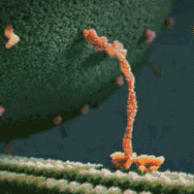
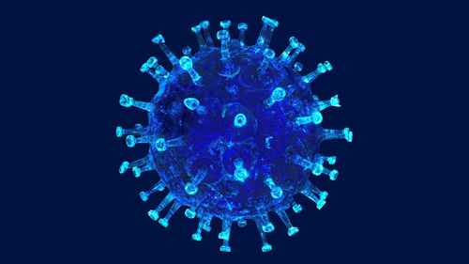
Unit 3 – How do cells maintain life?
Area of Study 1 - What is the role of nucleic acids and proteins in maintaining life?
Area of Study 2 – How are biochemical pathways regulated?

Slide 10
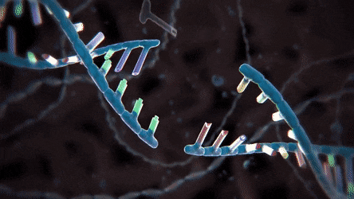
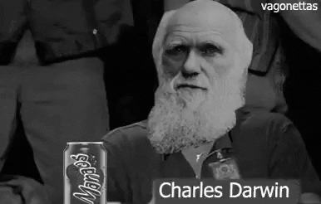
Unit 4 - How does life change and respond to challenges?
Area of Study 1 – How do organisms respond to pathogens?
Area of Study 2 – How are species related over time?
Area of Study 3 – How is scientific inquiry used to investigate cellular processes and/or biological change?

Slide 11
Unit 3 & 4 Assessment
Assessment is based upon
  A series of SACs including the Extended Experimental Investigation
  A formal exam
The SACs in Unit 3 & 4 account for 50% of the total Study Score
There is one formal exam covering Unit 3 & 4. This accounts for 50% of the Study Score and occurs during November Exams
Notes:
The units 3 + 4 assessments are based upon a series of SACs and a formal exam.

Slide 12
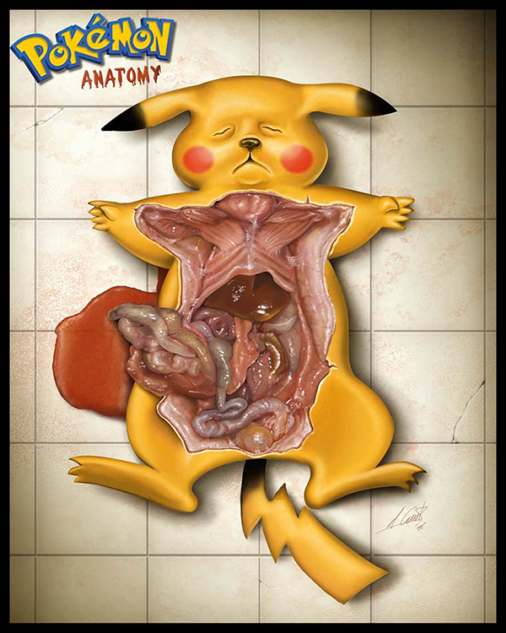
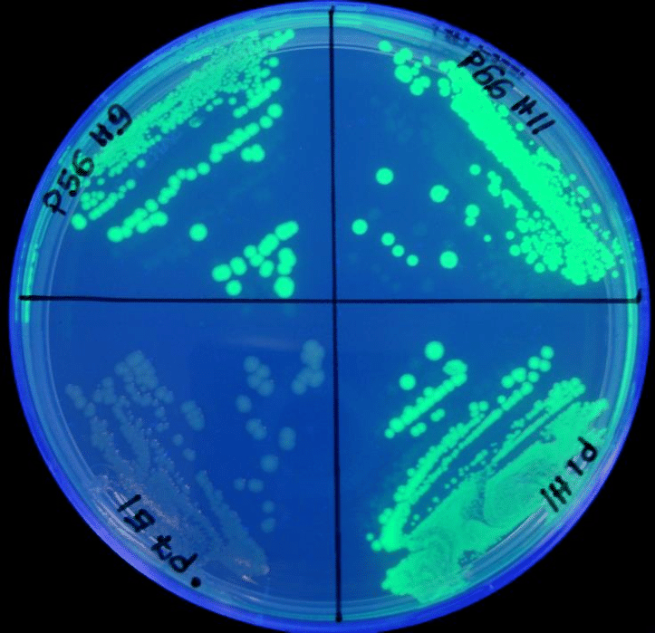
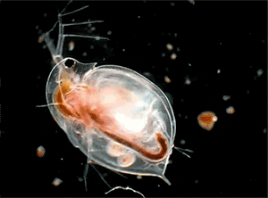
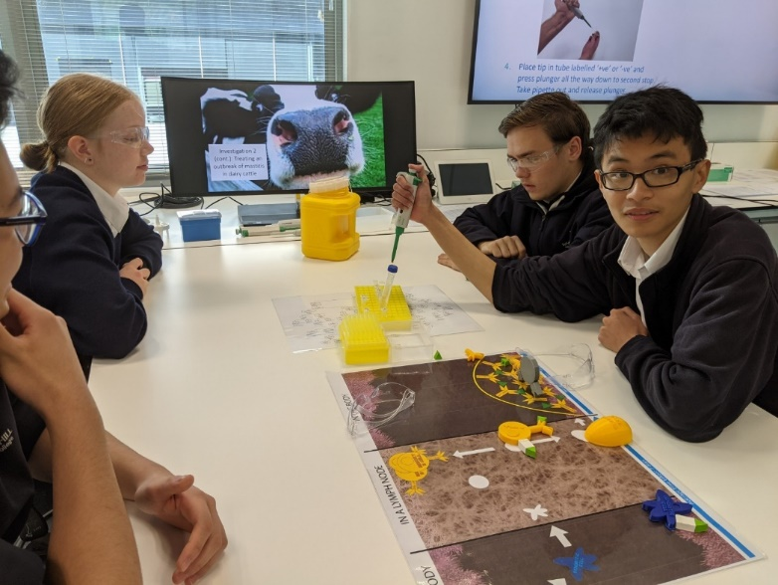
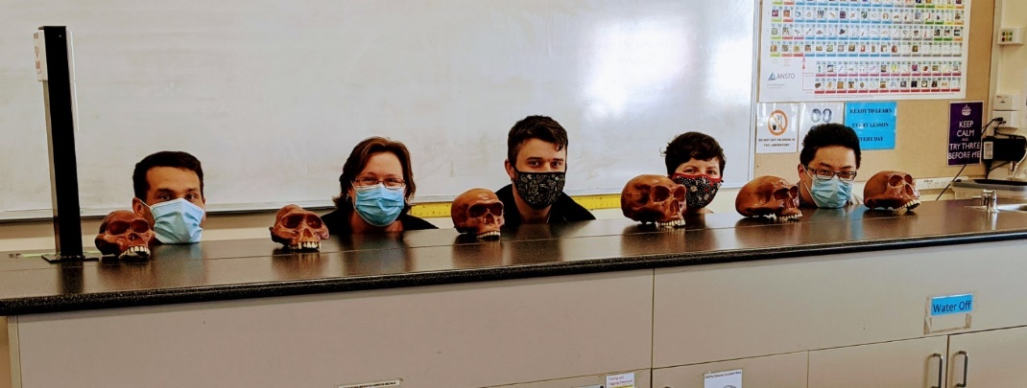
What to expect in Biology…
Notes:
Throughout the four units of study, you can expect to complete some practical investigations, dissections, modelling and data collation

Slide 13
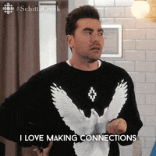
Connecting VCE subjects
Chemistry
Psychology
Physical Education
Food Technology
Health and Human Development
Notes:
The coursework studied in Biology also makes connections to the content studied in other VCE subjects, some of these include…

Slide 14
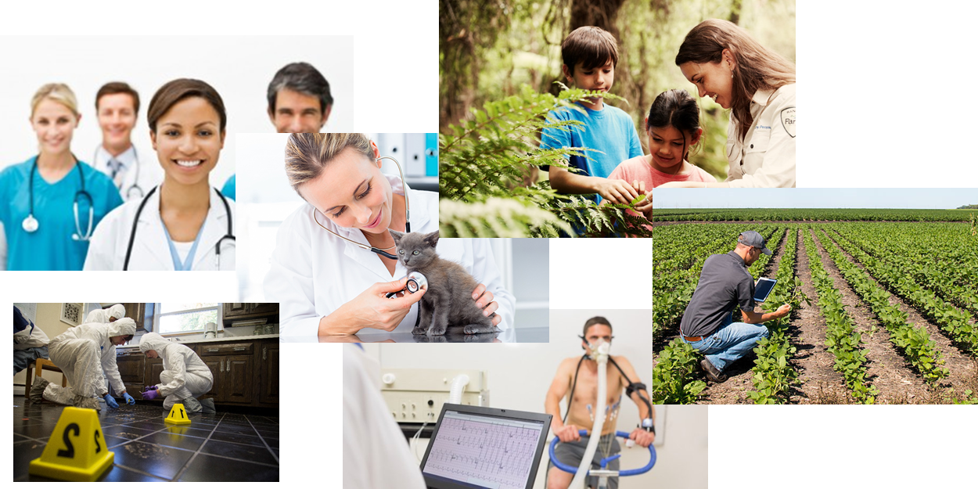
Career Prospects
Notes:
Medicine, forensic science, biochemistry, physiotherapy, agriculture, environmental science

