Slide 1
Parent Information Session
Primary School
Presented by Sue Pain

Slide 2
About Real Life Education
In school programs
Adult/child family evenings
Parent/carer information sessions & workshops
Education for individuals with special needs

Slide 3
Your sex ed?
Did you have an adult you felt comfortable talking to?
Did they seem comfortable talking to you?
Did they answer your questions? Truthfully?
How did they prepare you for puberty?
What was positive…why?
What was not helpful…why?
What overall message did you get from adults about sex?
Has your experience affected how you currently talk to your children?

Slide 4
Sexuality education…
Informs children with factual information about their bodies and how they work
Empowers children with correct language and protective behaviours
Introduces sex as a choice which involves respect, love and responsibility.
Counteracts negative media messages and prepares them for external influences

Slide 5
Sexuality education in schools
Is a part of a broader curriculum aimed at maximising children’s health & wellbeing.
Ensures information is consistent, accurate and age appropriate.
Reinforces a person’s body autonomy.
Ideally supports parents/carers as the primary sex and relationship educators of their children.

Slide 6
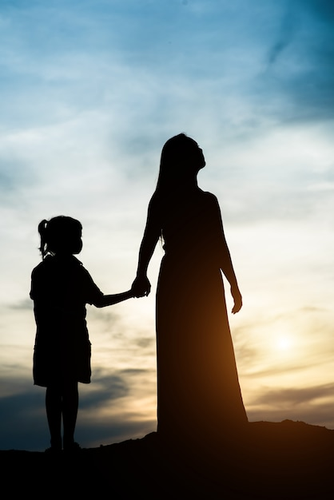
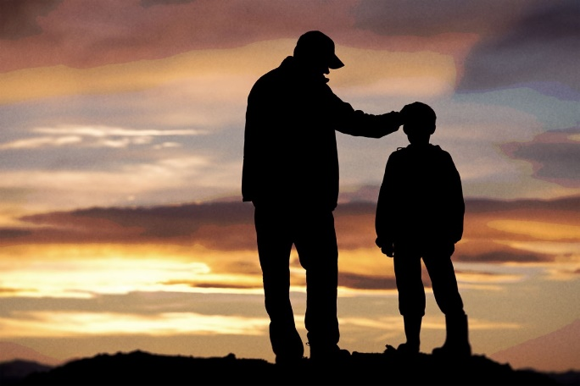
Years 3 & 4 family
Family & Friends
How we’re similar & different
Feelings
Bodies
Private body parts
Body safety
Babies
- Foetal development & birth

Slide 7
Years 5 & 6 family
Bodies
- reproductive anatomy
Puberty Changes
- physical
emotional / social
Reproduction
Privacy & Safety

Slide 8
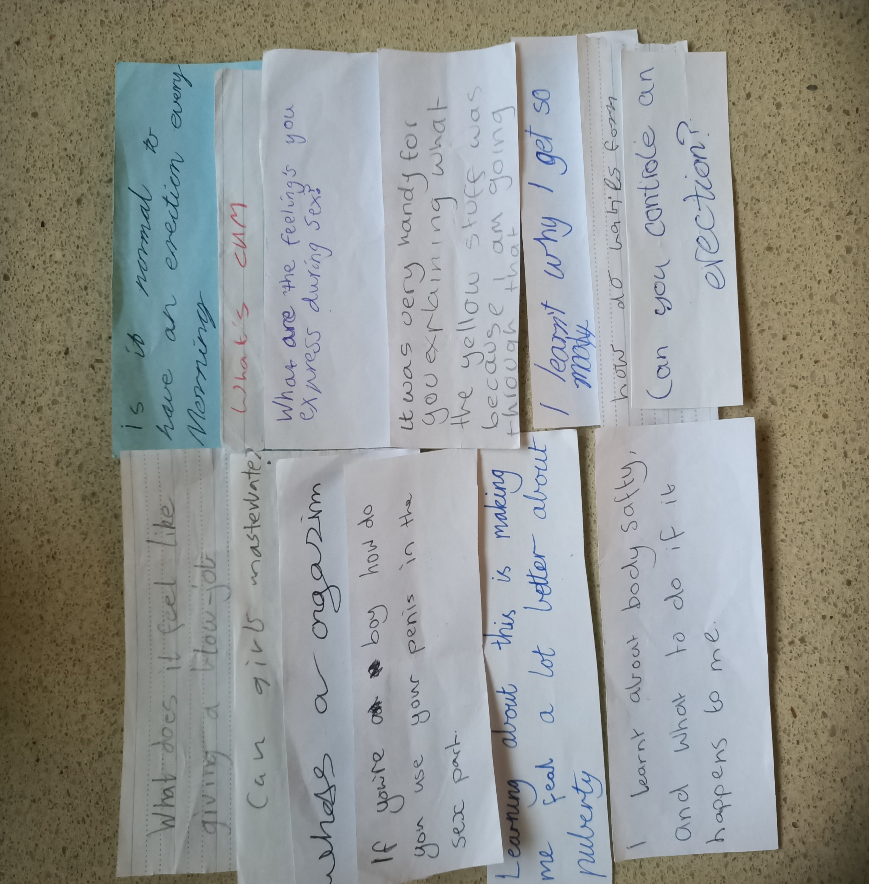

Slide 9
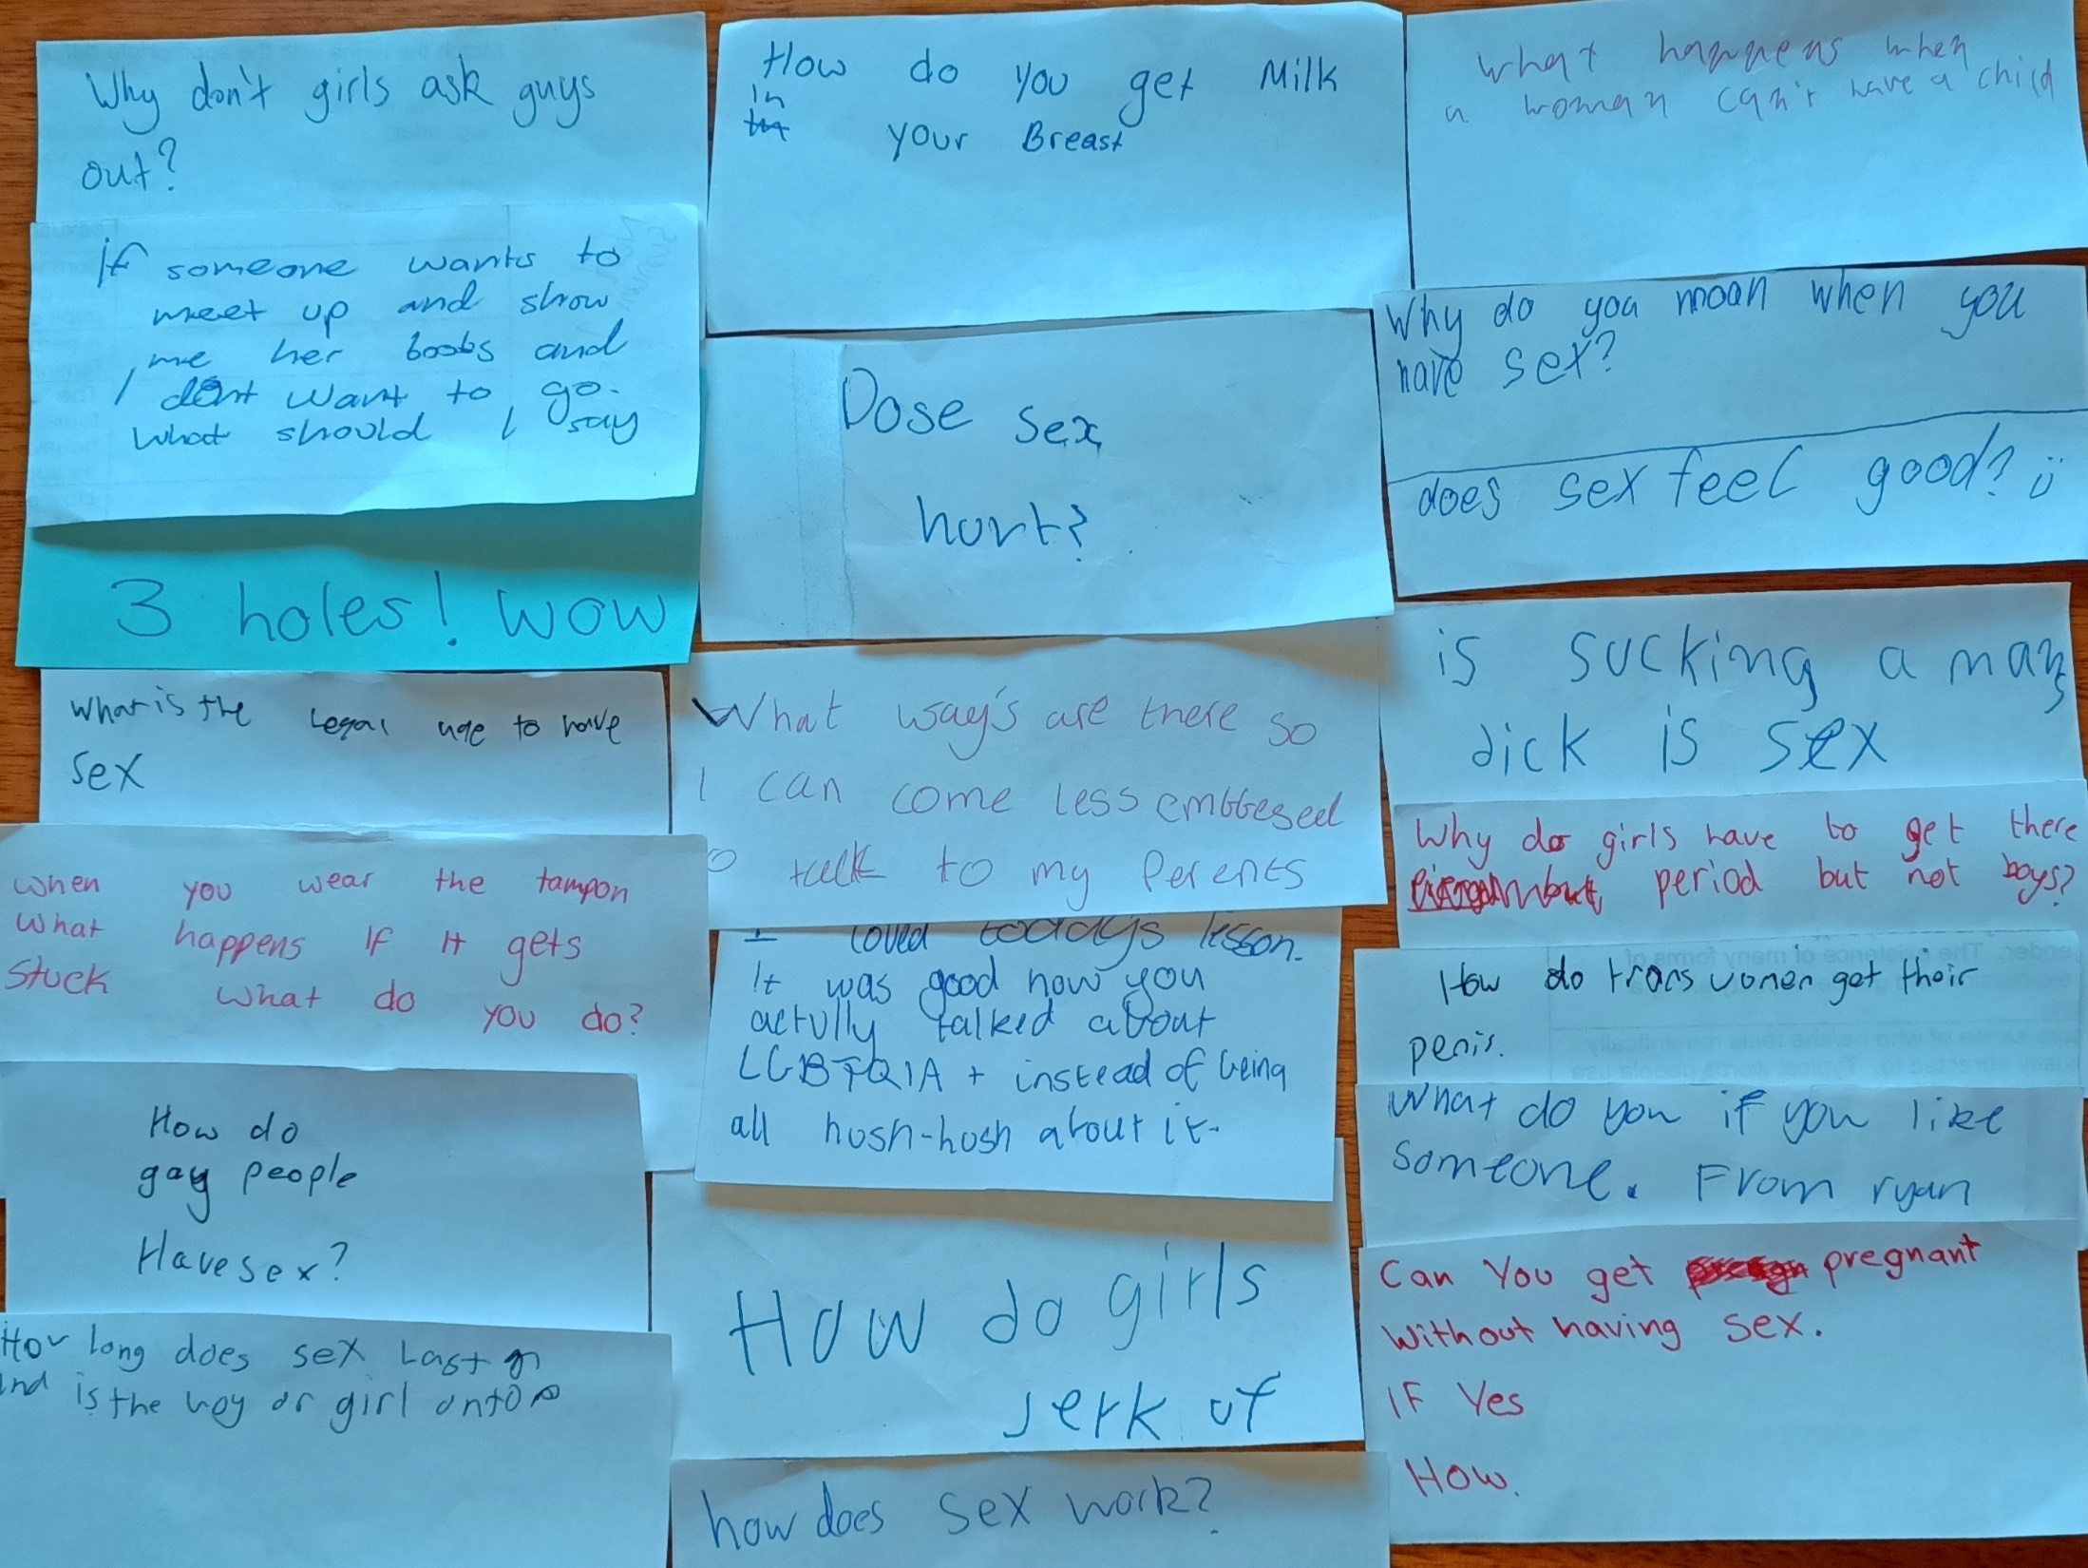

Slide 10
Sexuality & Safety
All young people need to learn to –
Identify what a respectful relationship looks and feels like
Understand what consent is and isn’t
Apply critical thinking to sexualised images & content
Develop the confidence to make choices according to their own values, especially in the face of external pressures;
Learn knowledge and skills to assist wellbeing;
Realise the benefits of ongoing conversations with trusted adults

Slide 11
For parents & carers
Students are strongly encouraged to share class information and activities with their adults.
Be reassured that programs are sensitive to and respectful of the values and beliefs of carers and families.
Sessions are a great trigger for family discussion about human sexuality and respectful relationships.

Slide 12
Family Conversations
How are males/females alike/different? How do we show our appreciation or lack of for differences?
How are males/females supposed to act? Why?
Are there things males can do that females shouldn’t? And vice versa?
What is attractive? Do you have to look young to be attractive?
Does the way we dress affect the way people see us? How?
What is a good relationship?
How are our relationships different between family, friends, partners?
Is conflict a bad thing? How should people manage conflict?
What does family mean? What are some of our family values?
What rights and responsibilities does each family member have?
Why do some people laugh or feel awkward talking about private body parts?
(And for older children - sex?)
How do we feel about gender diversity and same sex relationships?

Slide 13
More Information
www.betterhealth.vic.gov.au
www.kidshealth.org
www.raisingchildren.net.au
www.butterflyfoundation.org.au
www.esafety.gov.au
www.itstimewetalked.com
www.planetpuberty.org.au

Slide 14
Thank you

