Slide 1
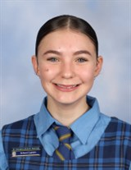
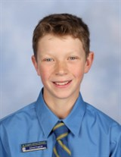
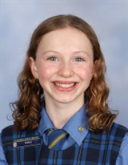
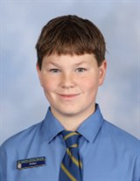
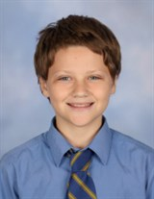
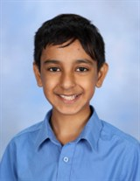
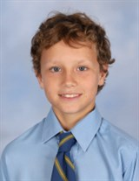
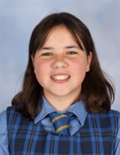
In 2024 we farewell our Year 6 Students
St Joseph’s Primary
Graduation Mass
Friday 13th December, 2024
An Irish Blessing
May the road rise up to meet you. May the wind always be at your back. May the sun shine warm upon your face, and rains fall soft upon your fields. And until we meet again, May God hold you in the palm of His hand

Slide 2
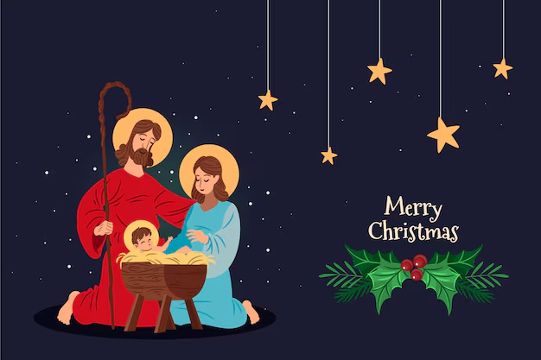
As we come to the end of our 2024 school year, we welcome you to our very special Graduation Mass and Farewell to Year 6 .
Processional Hymn - Come Together
First Reading - Alex Davis
A reading from the book of the prophet Isaiah.
I will tell all the kind deeds that the Lord has done, because they deserve praise. The Lord has shown mercy to the people of Israel. He has been loving and kind.
The word of the Lord
ALL - Thanks be to God.
Responsorial Psalm - Rosie
The Response is - Blessed be the name of the Lord for ever
Alleluia Verse
Come and listen, and I will tell what great things God has done for me.
Gospel
A reading from the holy gospel according to Matthew
All - Glory to you O Lord
Jesus told the people this story:
“The kingdom of heaven is like what happens when a farmer plants a mustard seed in a field. Although it is the smallest of all seeds, it grows larger than any garden plant and becomes a tree. Birds even come and nest on its branches”
The gospel of the Lord.
All - Praise to you Lord Jesus Christ
Homily
Prayers of the Faithful
Dani Cortis
Ricky Hird
Phoebe Farrant-Wills
Braxton Hand
Billie Peach
Offertory - Bailey Garden, Jorja Jamieson & Shivansh Madan
Liturgy of the Eucharist
Communion Reflection Hymn - Hosea
Blessing and Presentation for the Year 6 Students
Concluding Rites
Recessional Hymn - My Lighthouse
The staff of St Joseph’s School wish you and your loved ones a
blessed Christmas.
May the closeness of friends, the comfort of home and the love of God renew your spirit this festive season.

