Slide 1
IMPORTANCE OF THE GAT

Slide 2
SECTION A (morning exam) &
SECTION B (afternoon exam)
The GAT is used to check your SAC results
Your GAT along with your exam results are used together to adjust your SAC scores. They are used to even out the differences in marking standards that may occur from school to school.
2) The GAT is used to check your SAT results
The GAT is used to check SAT results in Art Creative Practice, Design and Technology, Food and Technology, Media, Systems Engineering, and Visual Communication and Design.

Slide 3
3) The GAT is used to check your exam results
If a student’s examination score is significantly different from the mark predicted by the GAT the paper will be assessed again. Scores may go up or stay the same, but will not go down as a result of this final check.
4) The GAT is used to calculate a DES
If a student becomes ill or experiences an accident or personal trauma at the time of their VCE examinations, they may apply for a Derived Exam score.

Slide 4
What is a DES?
You can apply for a DES if you sat the exam under duress (you were sick or some other circumstances occurred and you believe you underperformed). In this case the GAT is used to calculate your score.
If you miss an exam completely the GAT is used to calculate your score.

Slide 5
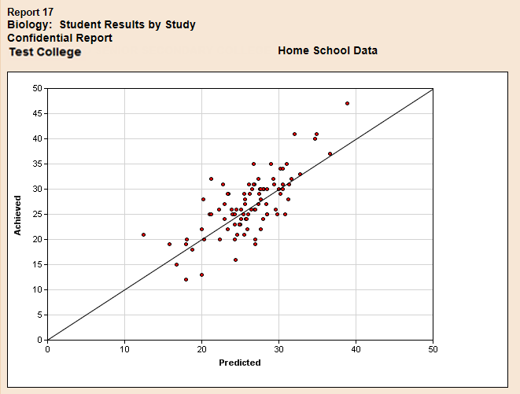


Slide 7

Students performed lower than predicted

Slide 8
Students performed lower than predicted

Slide 9
Students performed higher than predicted
Students performed lower than predicted

Slide 10
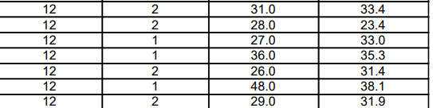

GAT predicted
study score
Actual study score
If a student was sick and did not complete the exam they would have got a 38

Slide 11



Achieved study score
GAT predicted
study score
Student obtained a 31
GAT check scaled it up to 33

