Slide 1
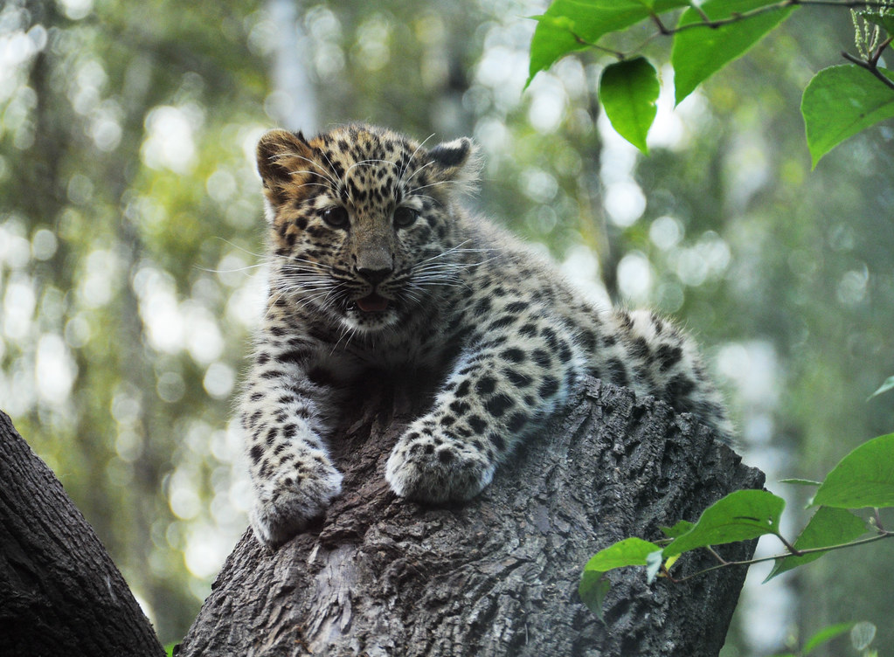
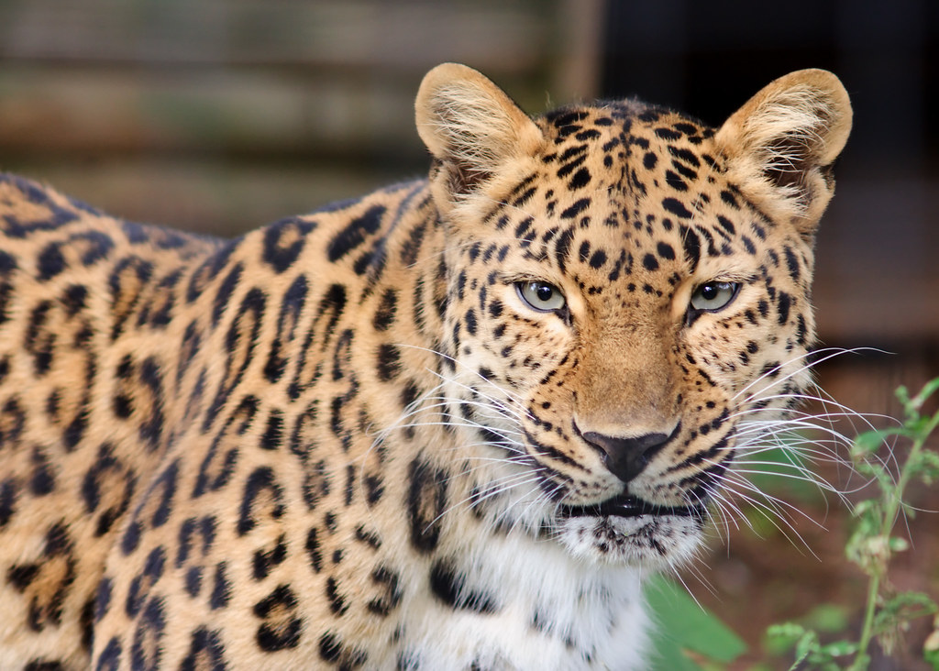
Amur Leopard
Amur leopard
HI
By Ebony
Cullen 3A

Slide 2
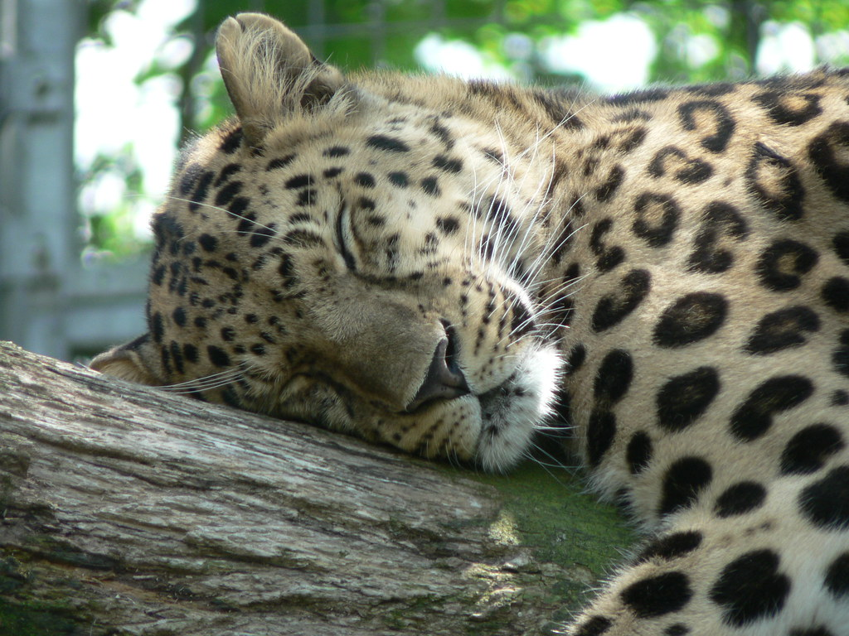
What does it look like
The Amur leopard is white, yellow and brown
They have spots, sharp teeth and claws

Slide 3
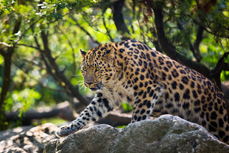

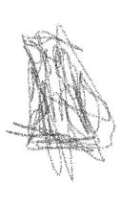

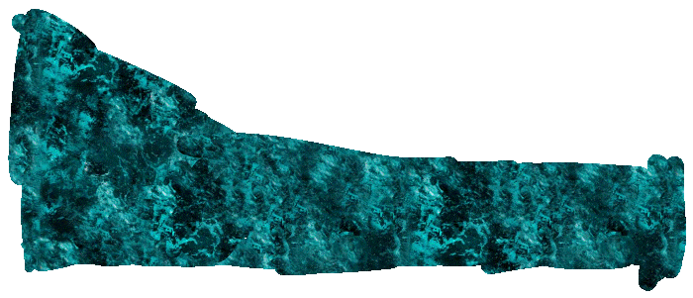



Habitat
It lives in Spain and far east Russia
It needs trees, food and water

Slide 4
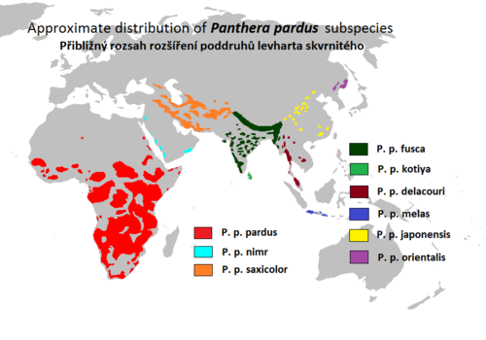
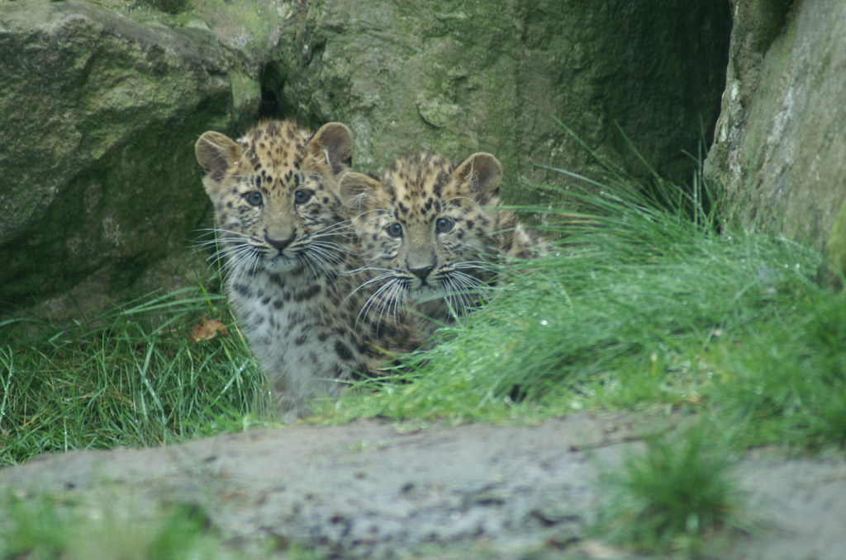
Map

Slide 5
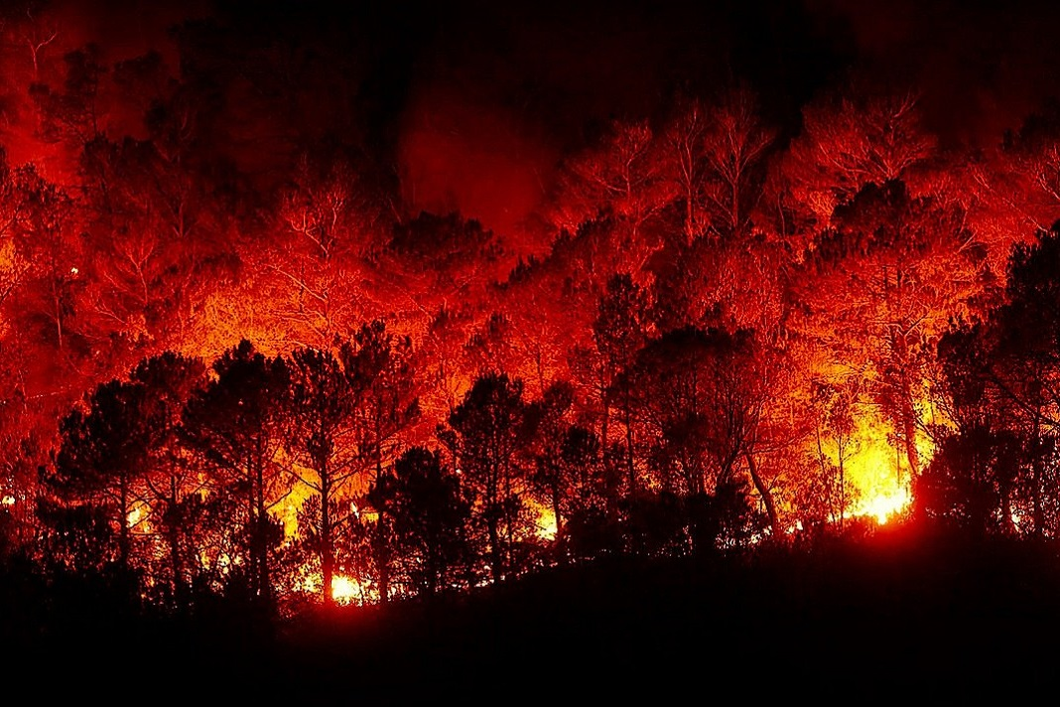
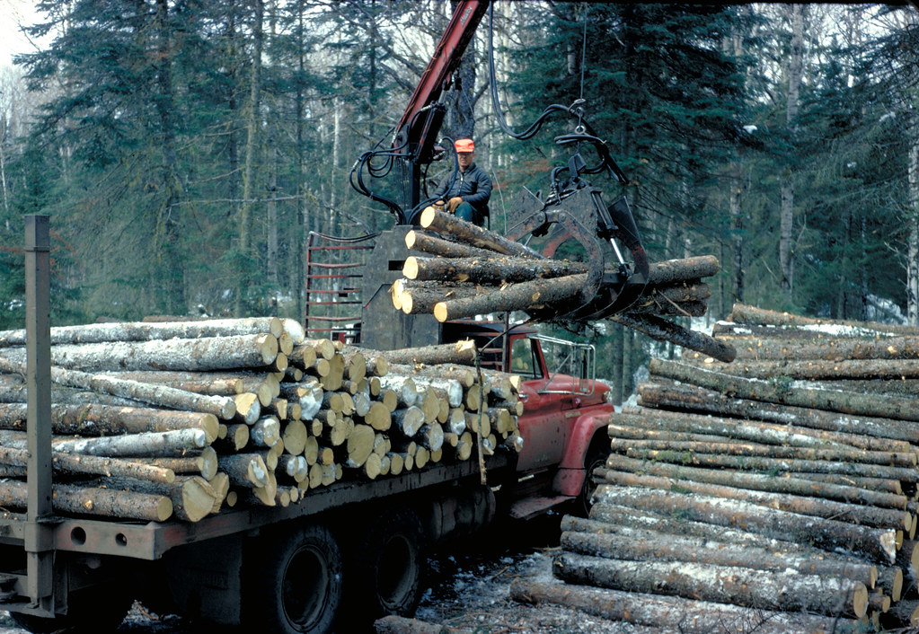
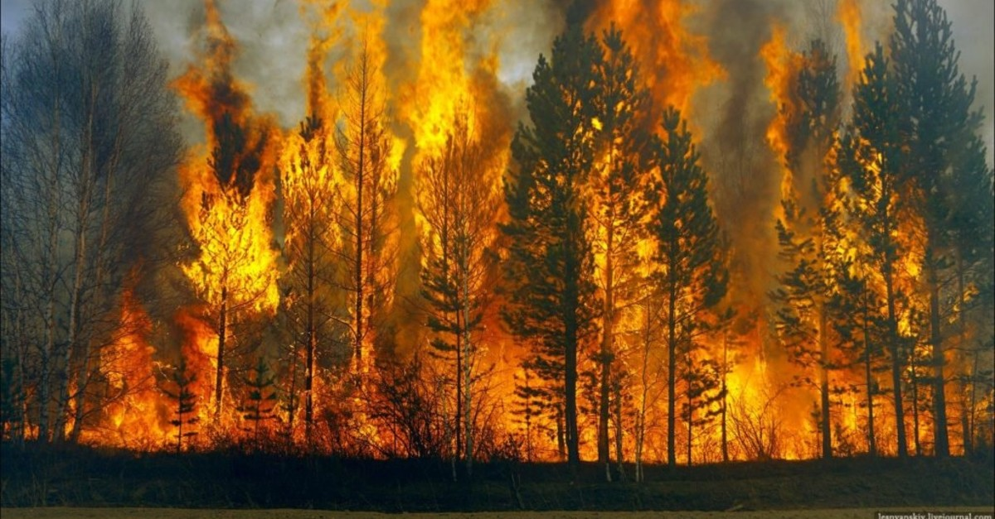
Threats
Amur leopards threats logging, forest fire and farming

Slide 6
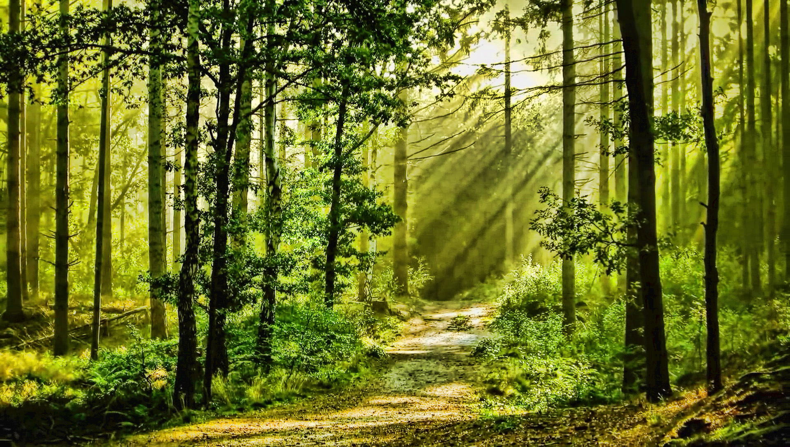
How we can help
We can help by not logging and to not heart the planet

Slide 7
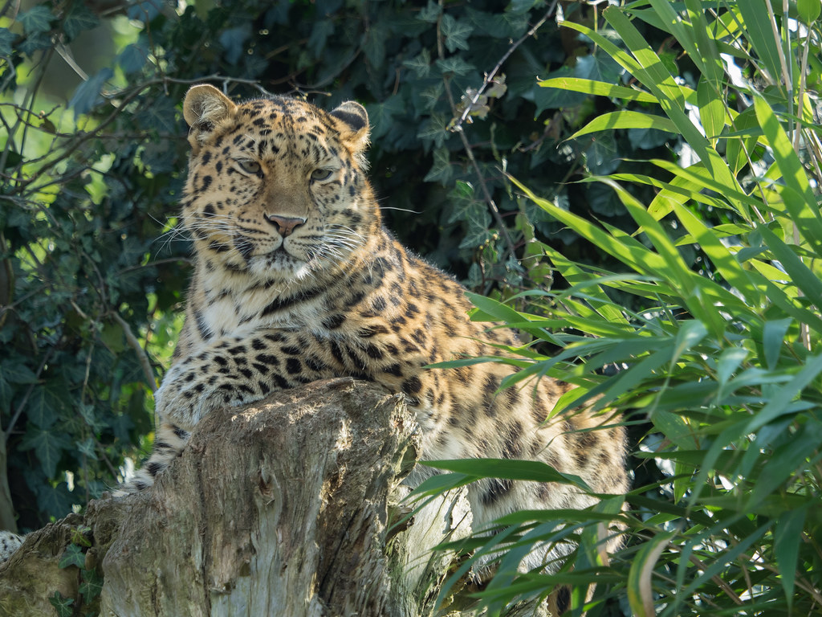
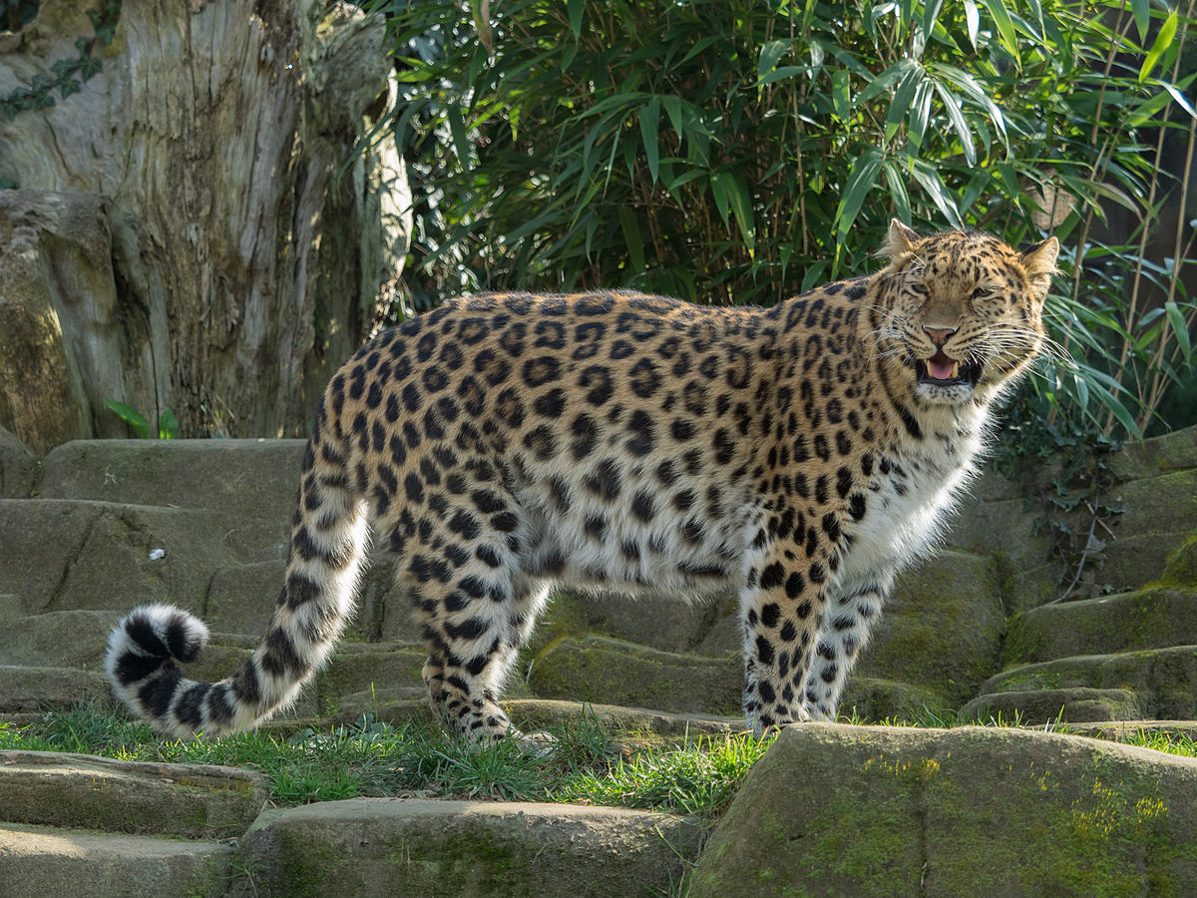
Fun facts
Baby amur leopard are born blind
Amur leopards are the only cold climate leopard
They live for 10-15 years and in captivity up to 20 years
They are critically endangered

Slide 8
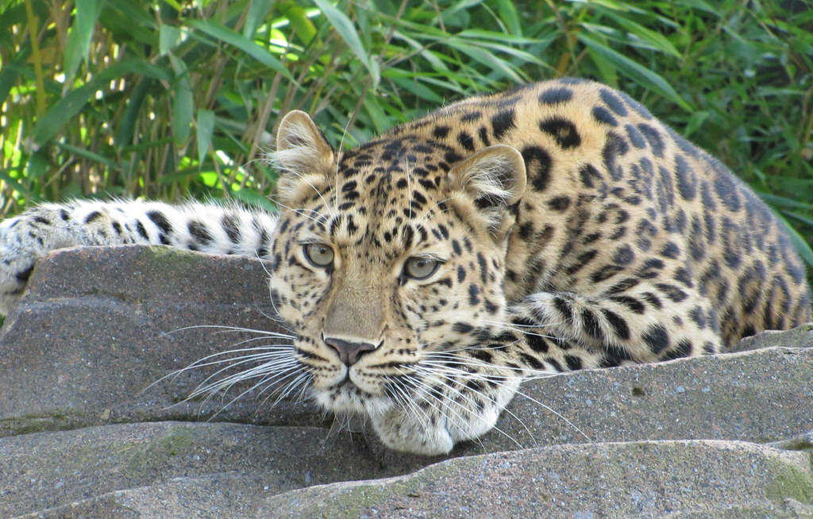
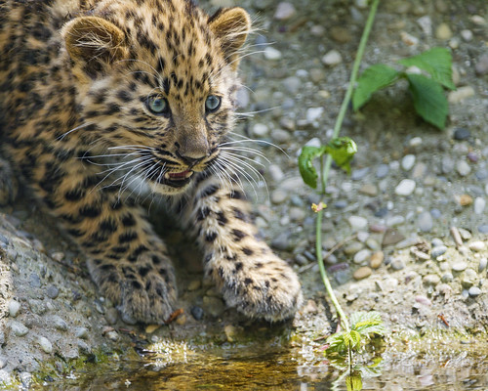
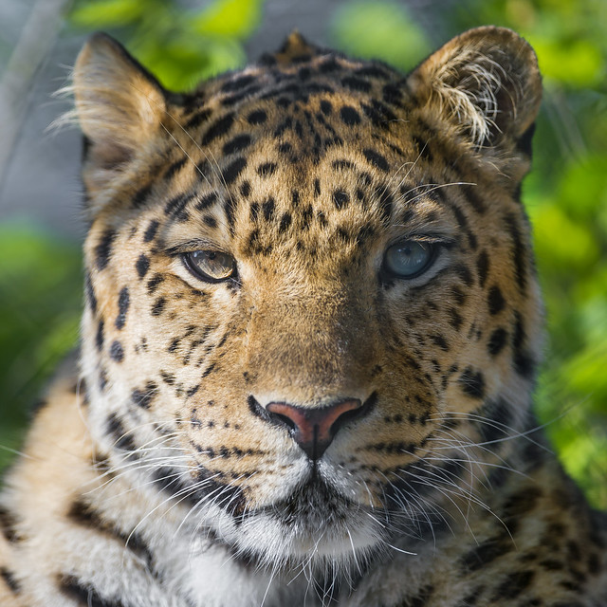

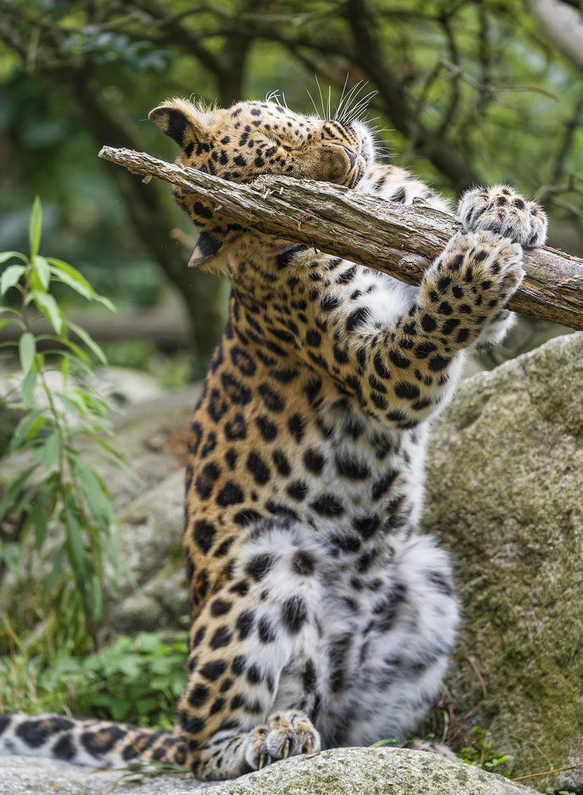
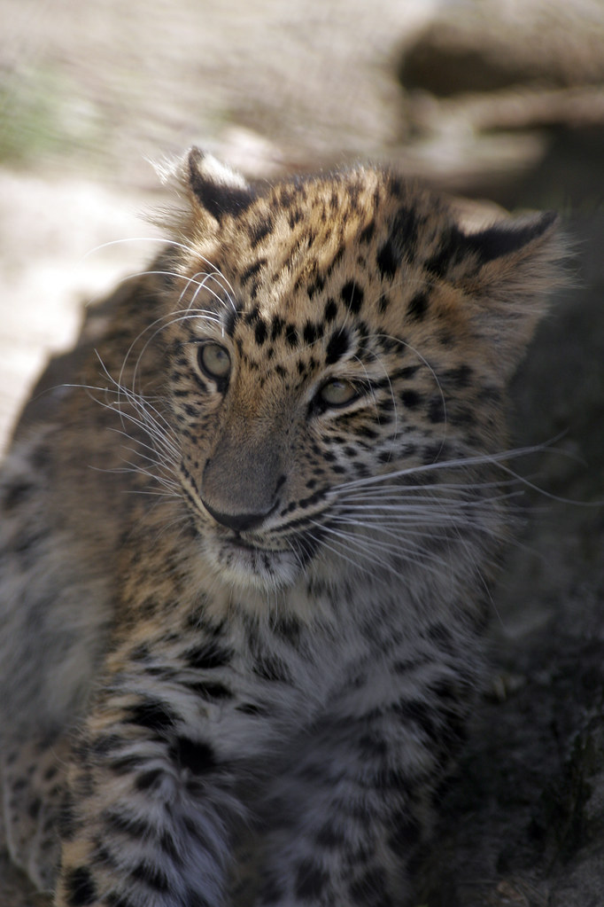
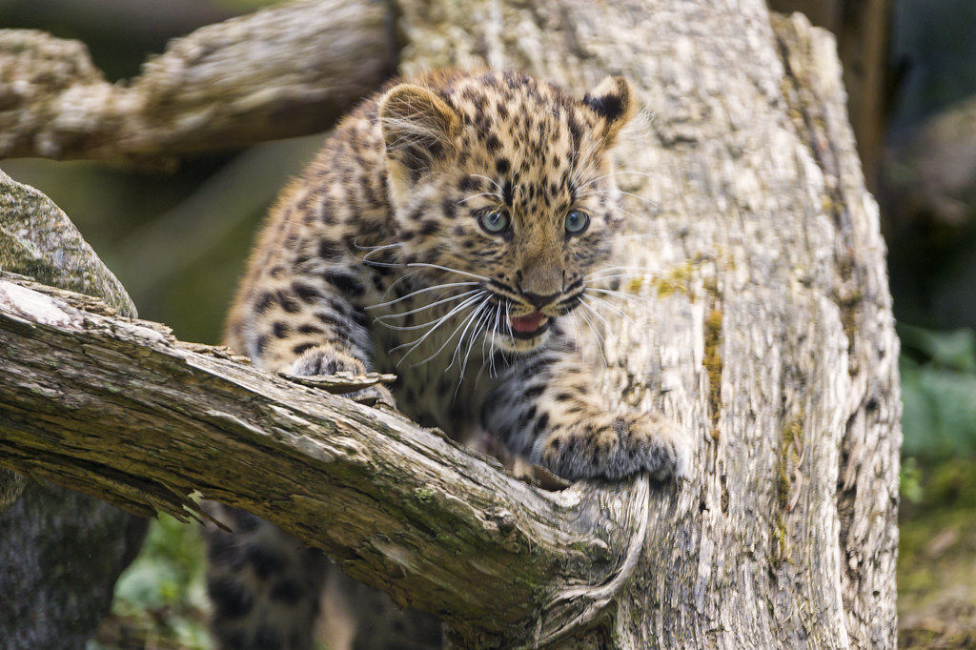
thank you

Slide 9
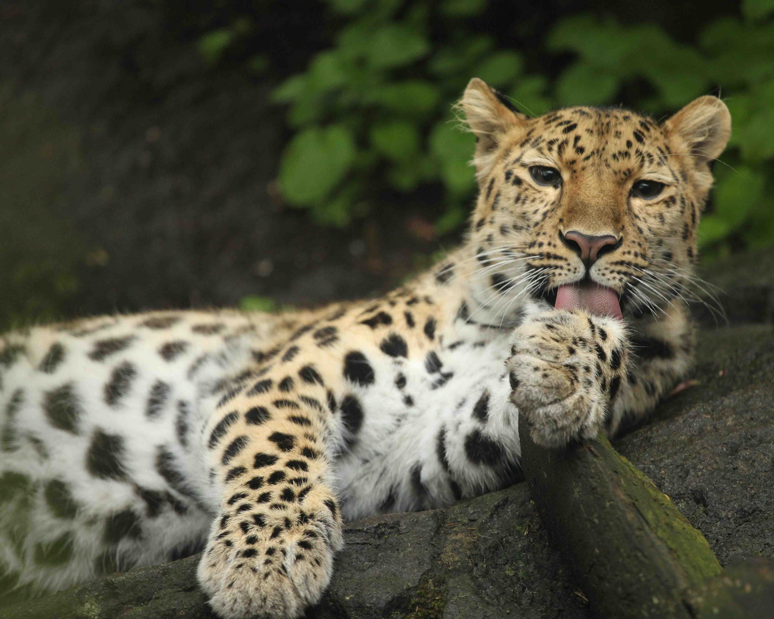
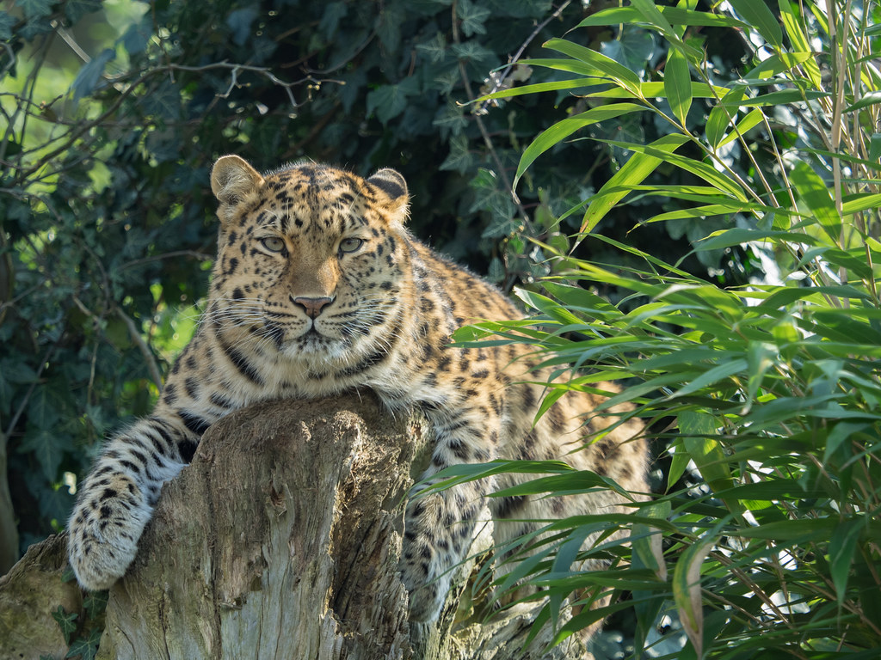
References
https://www.worldwildlife.org/species/amur-leopard#:~:text=Protecting%20Amur%20leopard%20habitat,committed%20to%20responsible%20forestry%20practices. https://www.worldwildlife.org/species/amur-leopard#:~:text=Protecting%20Amur%20leopard%20habitat,committed%20to%20responsible%20forestry%20practices.
https://www.wwf.org.uk/learn/wildlife/amur-leopards#:~:text=The%20Amur%20leopard%2C%20however%2C%20still,%2C%20and%20sadly%2C%20critically%20endangered

