Slide 1
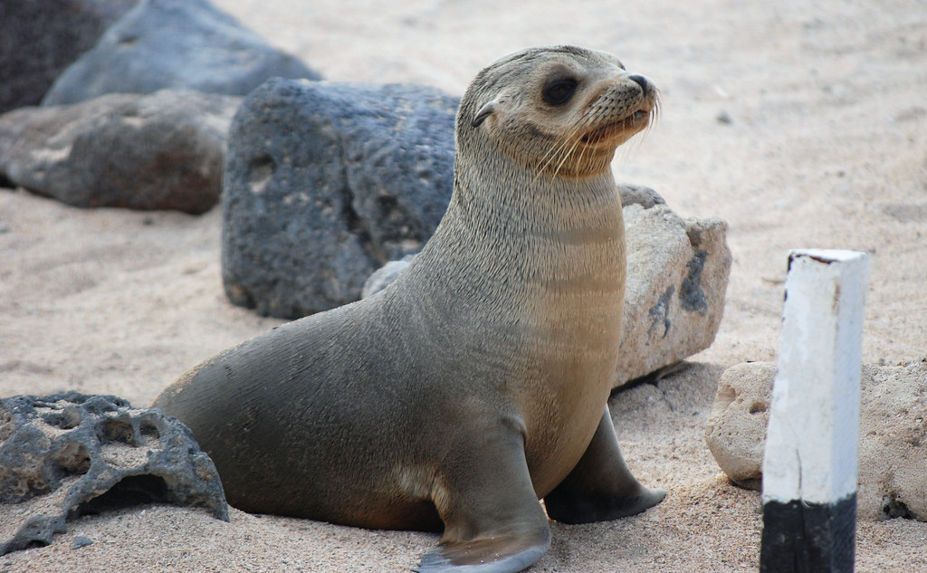
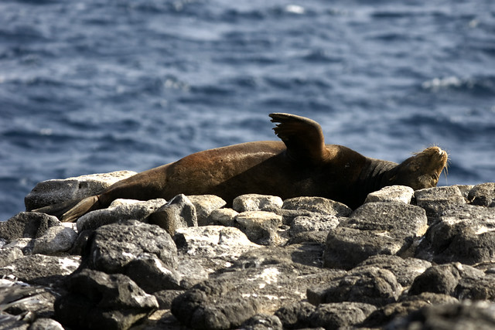
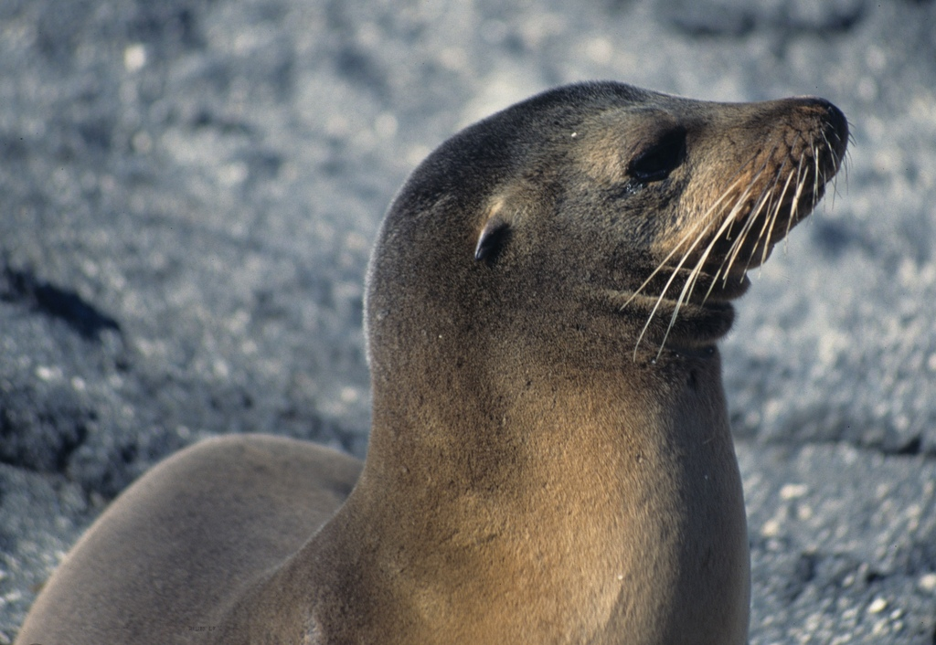
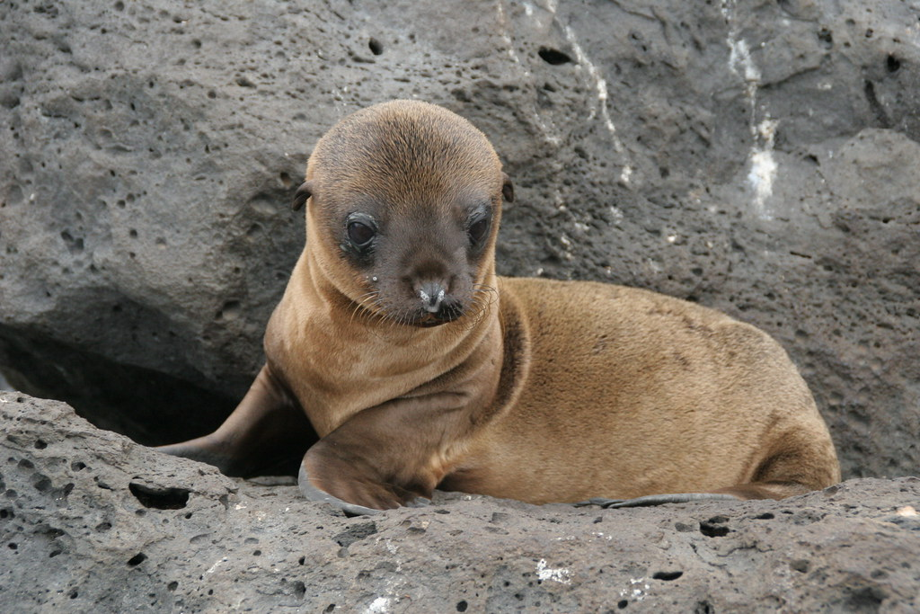
GALAPAGOS SEA LION
This Photo by Unknown Author is licensed under CC BY-NC
By Isla
This Photo by Unknown Author is licensed under CC BY-SA-NC
This Photo by Unknown Author is licensed under CC BY
This Photo by Unknown Author is licensed under CC BY

Slide 2
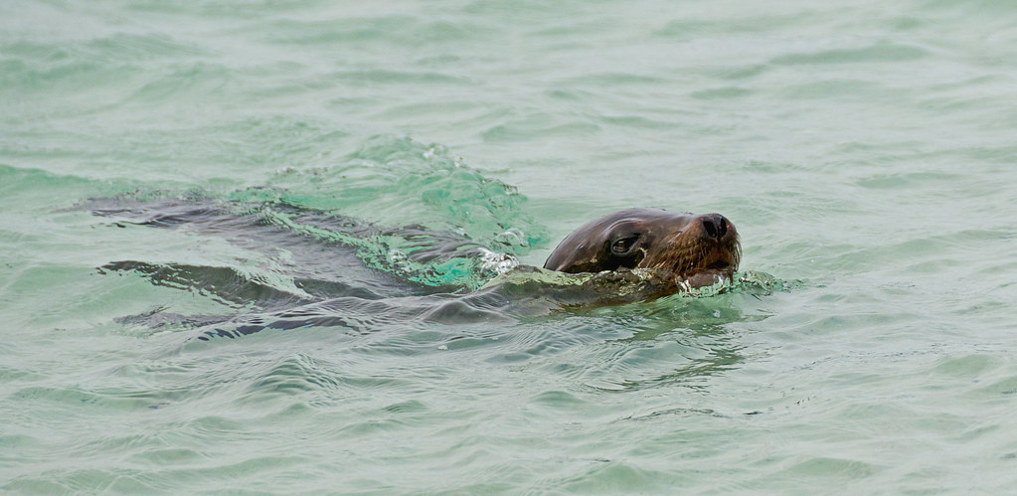
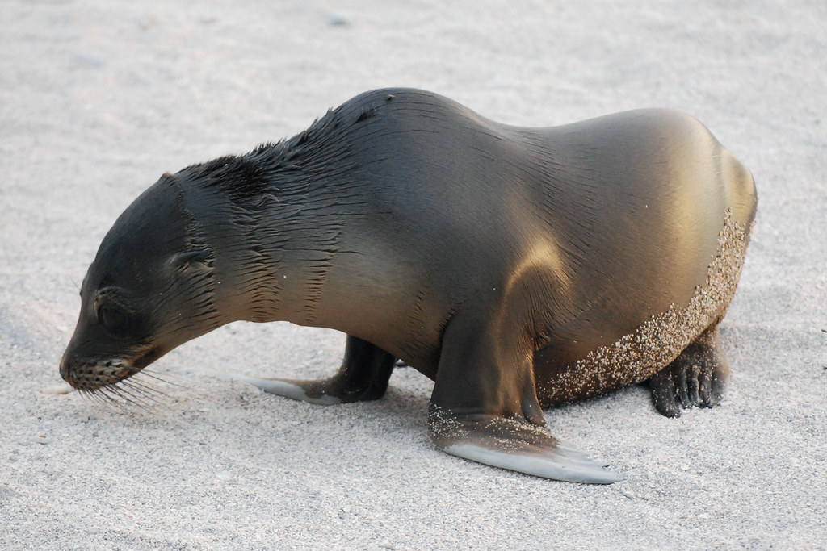
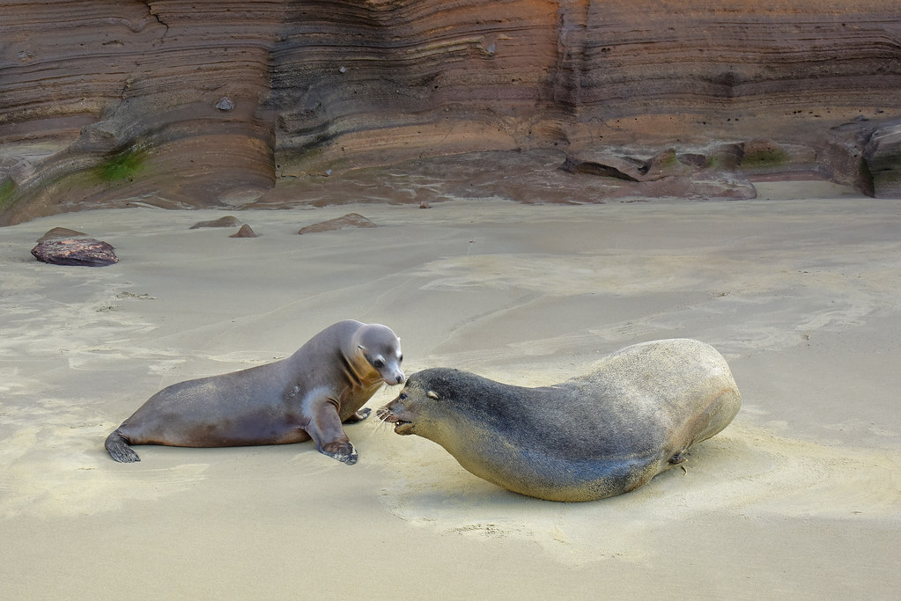
Detailed Description
The Galapagos sea lion is 1.50m to 2.50m and can weigh up to 250kg. The adult males have a pronounced bump on their forehead. Adult females are light brown or tan a have a smaller forehead. All sea lion pups are dark brown when born. The scientific name is Zalophus Wollebaeki .
This Photo by Unknown Author is licensed under CC BY-NC-ND
This Photo by Unknown Author is licensed under CC BY-SA-NC
This Photo by Unknown Author is licensed under CC BY-SA-NC

Slide 3
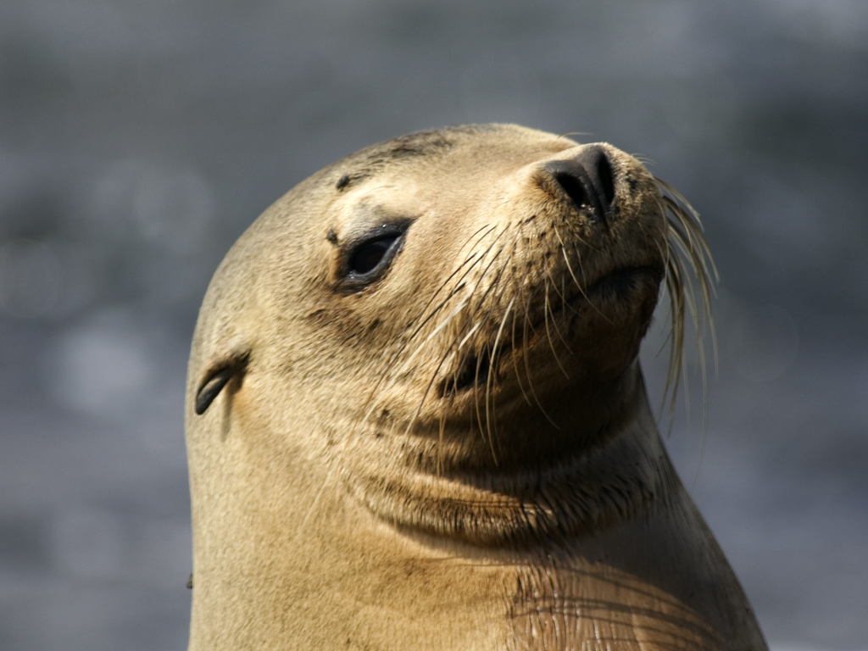
Conservation Status
ENDANGERED
This Photo by Unknown Author is licensed under CC BY-NC

Slide 4
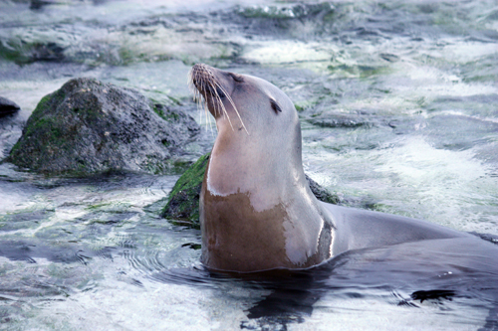
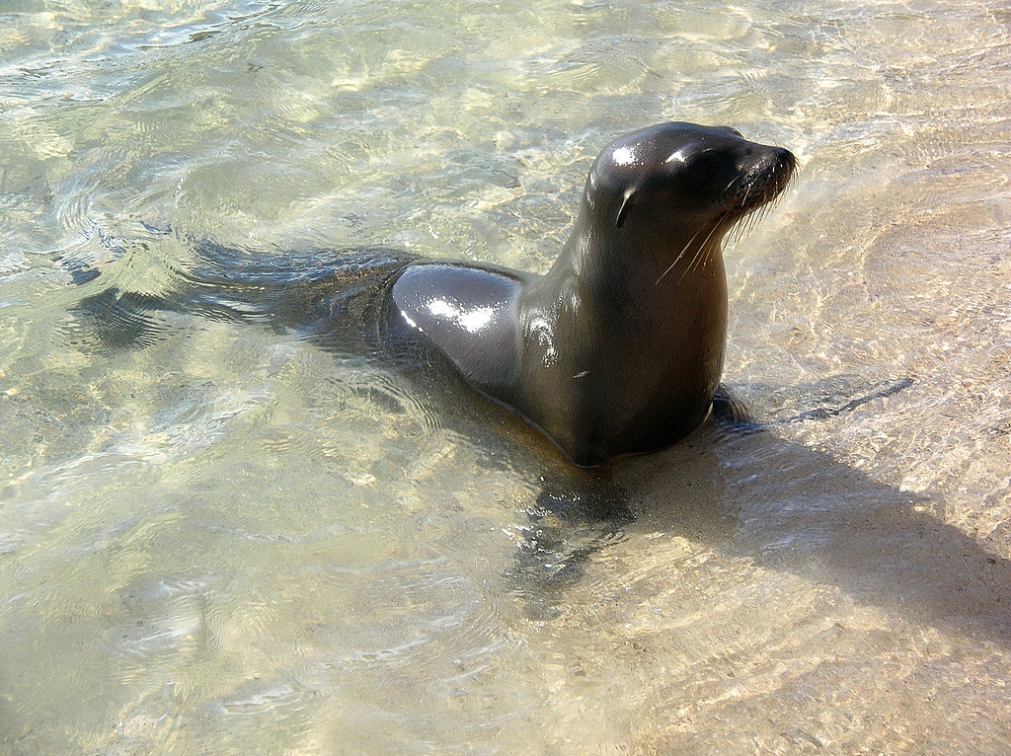
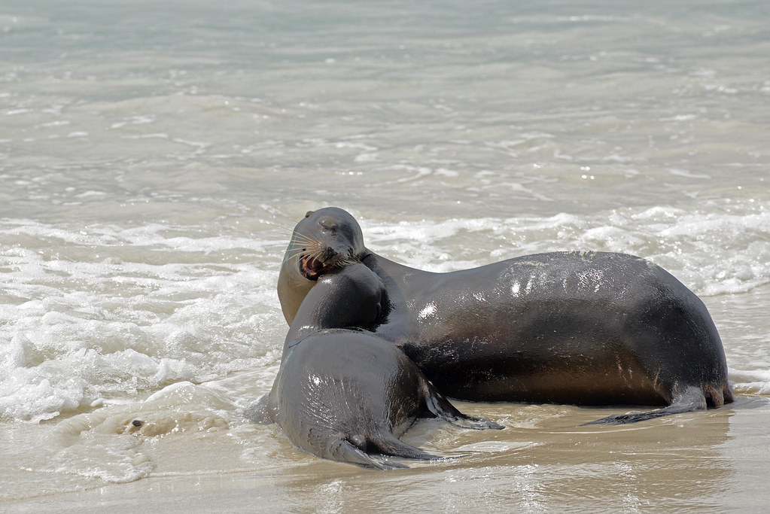
HABITAT
Galapagos sea lions are carnivores and mostly feed on sardines and also eat fish , squid octopus and crustaceams.
Galapagos sea lion live in South Plaza Island.
Galapagos sea lion live in the sea
This Photo by Unknown Author is licensed under CC BY-NC-ND
This Photo by Unknown Author is licensed under CC BY-SA-NC
This Photo by Unknown Author is licensed under CC BY

Slide 5
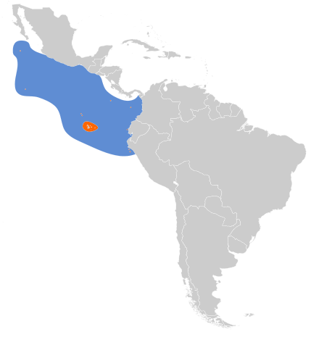
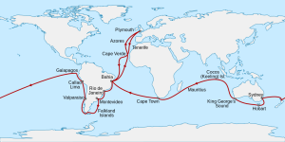
MAP OF WHERE GALAPAGOS SEA LION LIVE
This Photo by Unknown Author is licensed under CC BY-ND
This Photo by Unknown Author is licensed under CC BY-SA

Slide 6
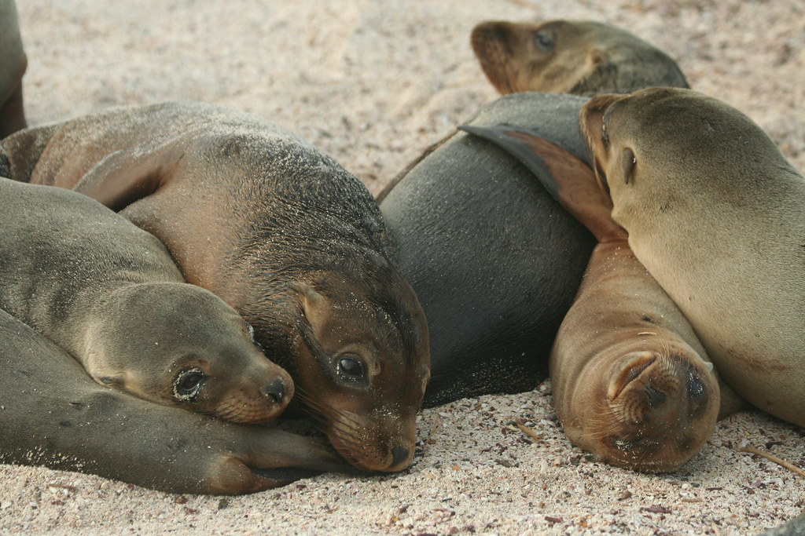
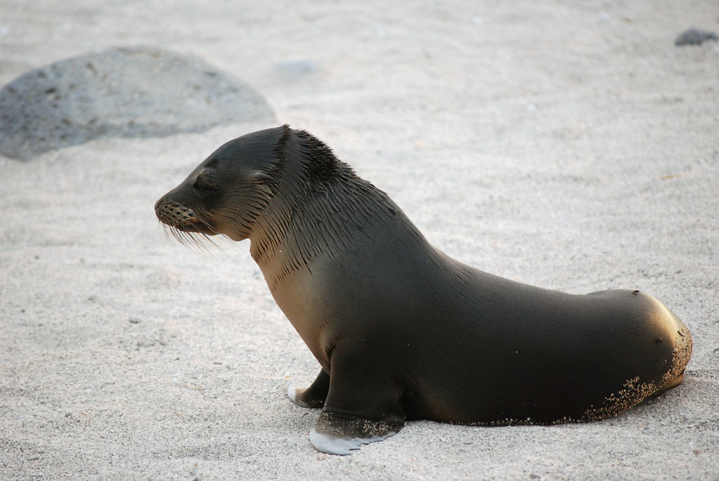
THREATS
Their natural predators of the sea lions are sharks and killer whales.
The main threat to the sea lion is climate change which causes the sea to warm and kills the marine life upon which the sea lion feed.
Sea lions also eat plastics which are polluting the sea. This makes them sick.
This Photo by Unknown Author is licensed under CC BY-SA-NC
This Photo by Unknown Author is licensed under CC BY-NC

Slide 7
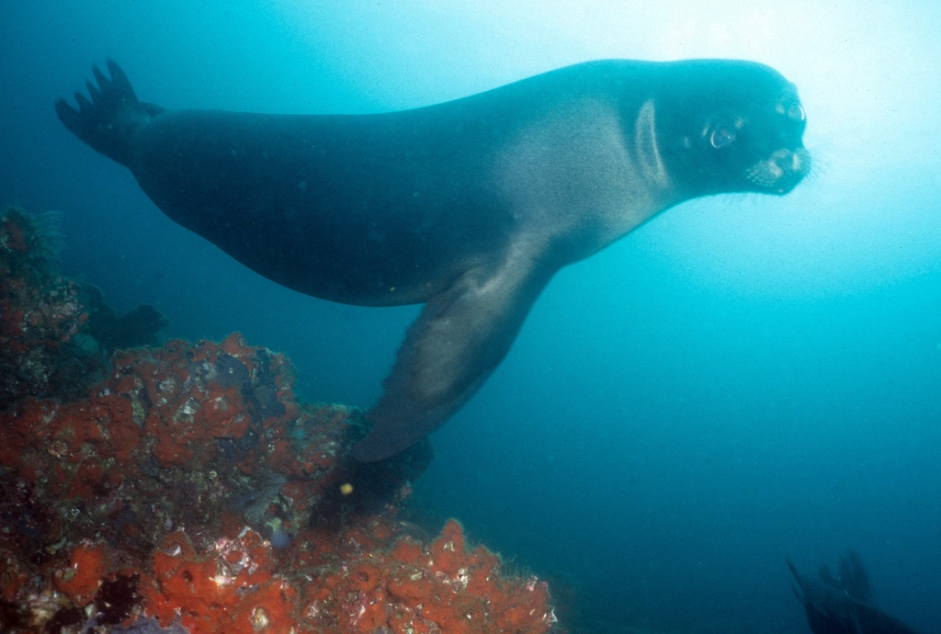
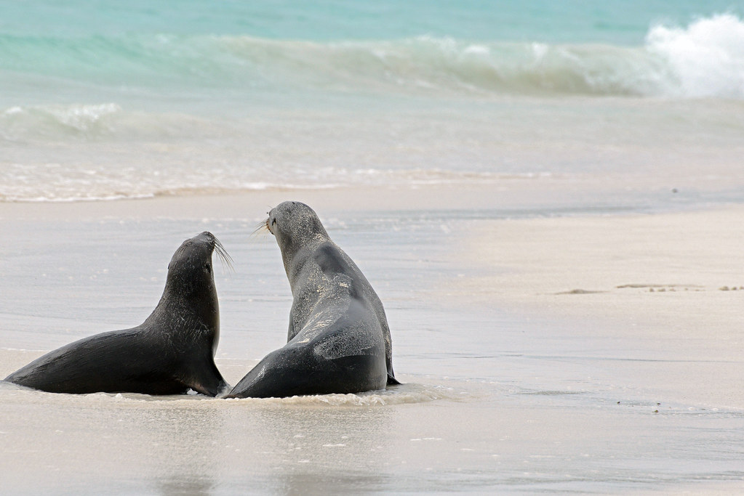
HOW WE CAN HELP THE GALAPAGOS SEA LION
Help them to protect the Galapagos sea lion today by donating to the plastic pollution free Galapagos programme.
This Photo by Unknown Author is licensed under CC BY-SA-NC
This Photo by Unknown Author is licensed under CC BY

Slide 8
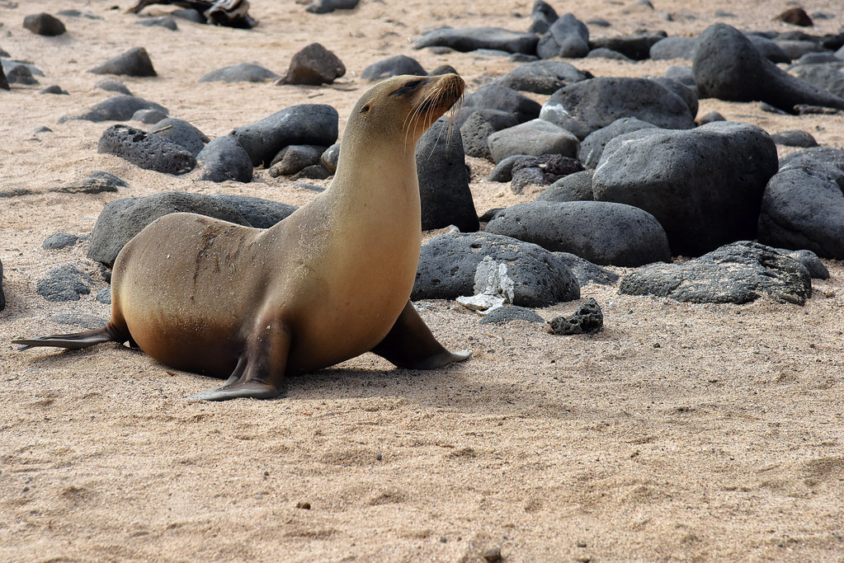
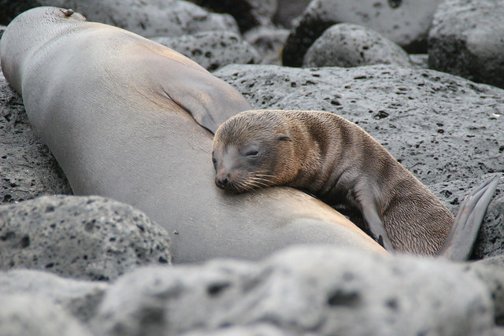
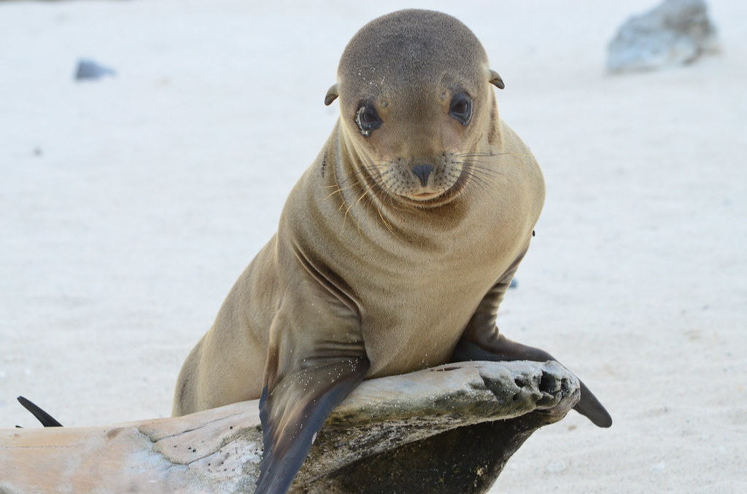
FUN FACTS
There are 50,000 sea lion in the Galapagos Islands.
The male sea lion can be aggressive they have chased swimming out of the water.
The females and pups are playful, and they will often have fun swimming with snorkelers.
There are seven different species of sea lion.
This Photo by Unknown Author is licensed under CC BY-SA-NC
This Photo by Unknown Author is licensed under CC BY
This Photo by Unknown Author is licensed under CC BY

Slide 9
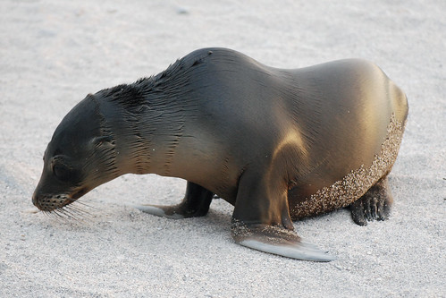


DIAGRAM
eyes
Brownwet fur
ear
Long whiskers
Big flipis
This Photo by Unknown Author is licensed under CC BY-SA-NC

Slide 10
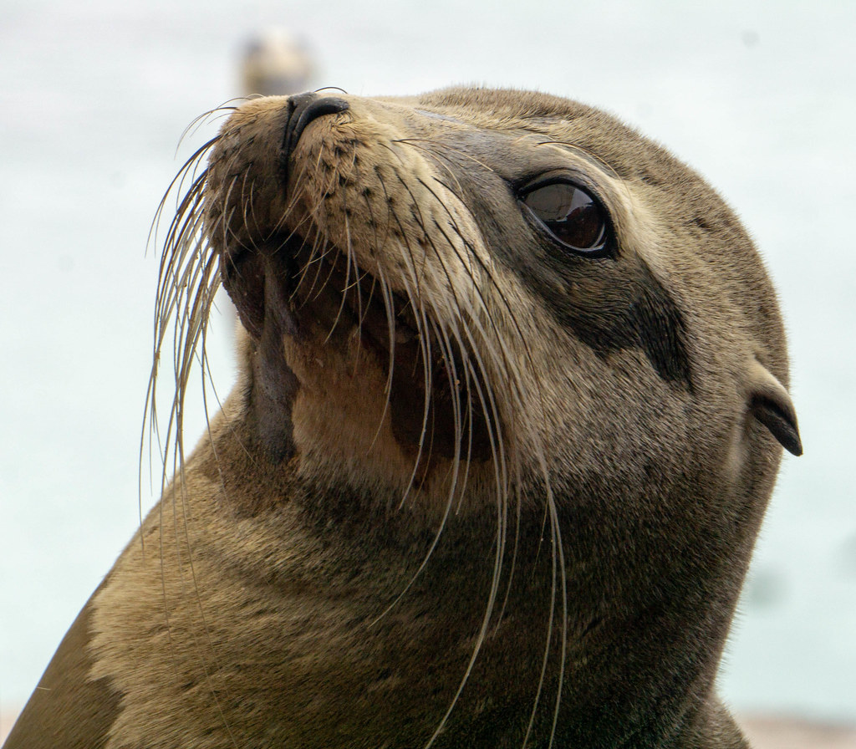
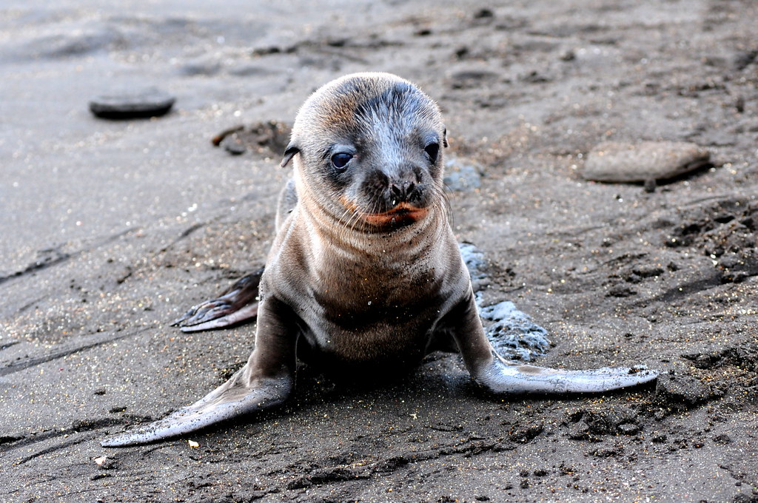
BIBLIOGRAPHY
https://www.google.com/search?q=fun+facts+about+galapagos+sea+lion+for+kids&rlz=1C1GCEA_enAU1025AU1025&oq=&aqs=chrome.0.69i59i450l8.1389982966j0j15&sourceid=chrome&ie=UTF-8
https://www.google.com/search?q=fun+facts+about+galapagos+sea+lion+for+kids&rlz=1C1GCEA_enAU1025AU1025&oq=&aqs=chrome.0.69i59i450l8.1389982966j0j15&sourceid=chrome&ie=UTF-8
This Photo by Unknown Author is licensed under CC BY-ND
This Photo by Unknown Author is licensed under CC BY-NC-ND

